Slide 1
Highlights of the April 2012 California GIS Council Meeting
Presented at the San Diego Regional GIS Council Meeting April 18, 2012
Notes:
I’m going to report back some of the highlights I can remember from the California GIS Council Meeting. This meeting was held last week at the CalGIS Conference in Sacramento.

Slide 2
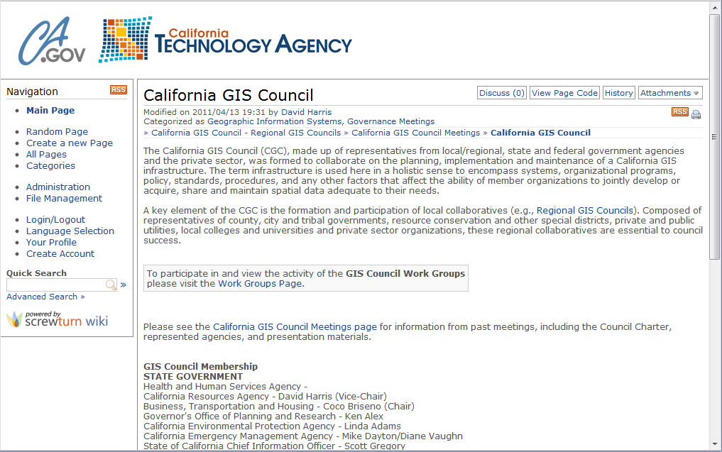
California GIS Council
Representatives from local/regional, state, federal, academic and private sectors
Meets infrequently (3x per year)
http://www.cio.ca.gov/wiki/CAGISCouncil.ashx
Notes:
Just a reminder in case some of you aren’t aware of the California GIS Council – it was formed to allow local/regional/state/federal agencies to collaborate on California GIS infrastructure and initiatives. They have a sporadic meeting schedule. They have a Web portal that needs updating.
At this portal you can find information about statewide initiatives, council meetings, list of regional councils throughout the state. Representing SD RGC was me.

Slide 3
California GIS Council Meeting Work Group Reports
Homeland Security
Homeland Security Infrastructure Protection (HSIP) Gold 2012
Released April 6
~500 Layers
HSIP Freedom 2012
~260 Layers
Only includes layers from Gold that are license-free and distributable
Notes:
So during the meeting we had reports from the various work groups. I’ll start with Homeland Security Work Group.
They reported that the Homeland Security Infrastructure Protection (or HSIP) datasets were recently release. The HSIP Gold consists of roughly 500 layers and is only available for select users involved with homeland security or public safety. The HSIP freedom dataset contains layers from Gold that are license-free and distributable.
Who here uses HSIP?

Slide 4
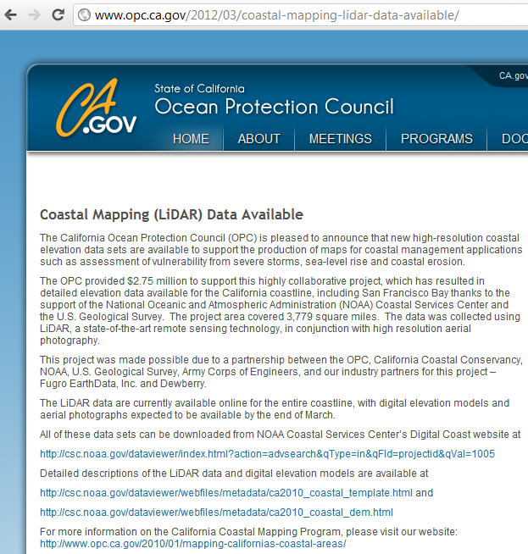
California GIS Council Meeting Work Group Reports
Coastal and Marine
Coastal LiDAR Data
Entire CA Coast
Download from NOAA Digital Coast site
Notes:
The Coastal and Marine Work Group reported that Coastal Mapping (LiDAR) Data are available. They include the entire CA Coast and can be downloaded from NOAA’s Digital Coast site.

Slide 5
California GIS Council Meeting Work Group Reports
Digital Land Records Information (DLRI)
Statewide Parcel Layer Working Group
Discuss strategies of maintaining statewide parcel layer merged from county/regional agencies
Land Use Codes Working Group
Develop standard land-use codes
Develop cross-reference to local agency land-use codes
Both meetings on May 1st in Sacramento
WebEx conferencing will be available
Contact Karen Beardsley (kbeardsley@ucdavis.edu)
Notes:
The Digital Land Records Information (DLRI) Work group reported two upcoming meetings. The first is the statewide parcel layer working group. DLRI lead and effort to gather parcel data and develop strategies for data sharing. For this statewide layer they would like to implement a standard schema and develop cross-referencing with county standards.
The second ties in with the parcel effort in that they want to develop a standard land-use codes and cross-reference them to local codes as well.

Slide 6
California GIS Council Meeting Work Group Reports
Ortho/Imagery
NAIP collection this summer for 1 meter
Caltrans
Improving the quality of Census TIGER 2009
Conflating function class
KML Web Service
Caltrans Earth (earth.dot.ca.gov)
Includes WMS
Notes:
The Ortho/Imagery work group reported that there will be a NAIP collection this summer for 1 meter imagery.
The Caltrans work group reported that they are working on their own version of Census 2009 TIGER lines. There are conflating roadway functional class to TIGER lines and generally improving the quality.
Caltrans also mentioned the KML Web app called Caltrans Earth (earth.dot.ca.gov). I allows you to view various Caltrans’ layers on Google Earth map. It also includes a Web Mapping Service that you can bring into ArcMap or any other GIS software that can be a WMS client.

Slide 7
CGIA Meeting at CalGIS
CGIA 2nd Annual Geospatial Summit at UC Merced
Friday, April 27th
Theme “Using GIS to Improve our Communities”
Free
http://communityresearch.ucmerced.edu/
CalGIS 2013 will be presented by SoCal URISA
Notes:
I did attend the California Geographic Information Association (or CGIA) meeting last week. They mentioned that there will be an annual summit held at UC Merced for free next week. So if you happen to be in Merced you can stop by for a free conference. The theme is “using gis to improve our communities”. See link above.
It was reported that next year’s CalGIS meeting will be presented by SoCal URISA although a location has not been determined.

