Slide 1
Estimate Building Square Footage
Using LiDAR and Building Footprints
Grace Chung
Ed Schafer

Slide 2
Why?
  There is missing data on building square footage.
What PECAS needs?
  Ideally, PECAS needs building square footage for all residential and non-residential buildings in the region by parcel.
  For non-residential buildings, PECAS needs to match square footage to number of employees.

Slide 3
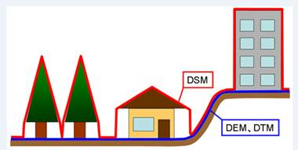

Slide 4
Building top (from LiDAR DSM)
Building Height
Ground Elevation (from LiDAR DEM)

Slide 5
LIDAR Data Collection
City of San Diego, 2005
City of Chula Vista, 2005, partial
North County Consortium, 2009
Oceanside
Vista
Carlsbad
San Marcos
Escondido
Encinitas
Solana Beach
Poway
Del Mar
Santee
San Diego
El Cajon
La Mesa
Lemon Grove
National City
Coronado
Chula Vista
Imperial Beach

Slide 6
Building Footprints Collection
Oceanside
Vista
Carlsbad
San Marcos
Escondido
Encinitas
Solana Beach
Poway
Del Mar
Santee
San Diego
El Cajon
La Mesa
Lemon Grove
National City
Coronado
Chula Vista
Imperial Beach

Slide 7
Building Height Extraction
Oceanside
Vista
Carlsbad
San Marcos
Escondido
Encinitas
Solana Beach
Poway
Del Mar
Santee
San Diego
El Cajon
La Mesa
Lemon Grove
National City
Coronado
Chula Vista
Imperial Beach

Slide 8
.LAS
Multipoint
DSM/ Surface (.grd)
2’ contour lines
DEM/ Ground Surface (.grd)

Slide 9
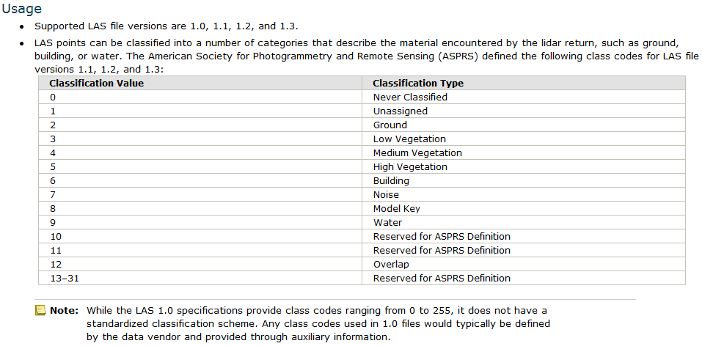

Slide 10
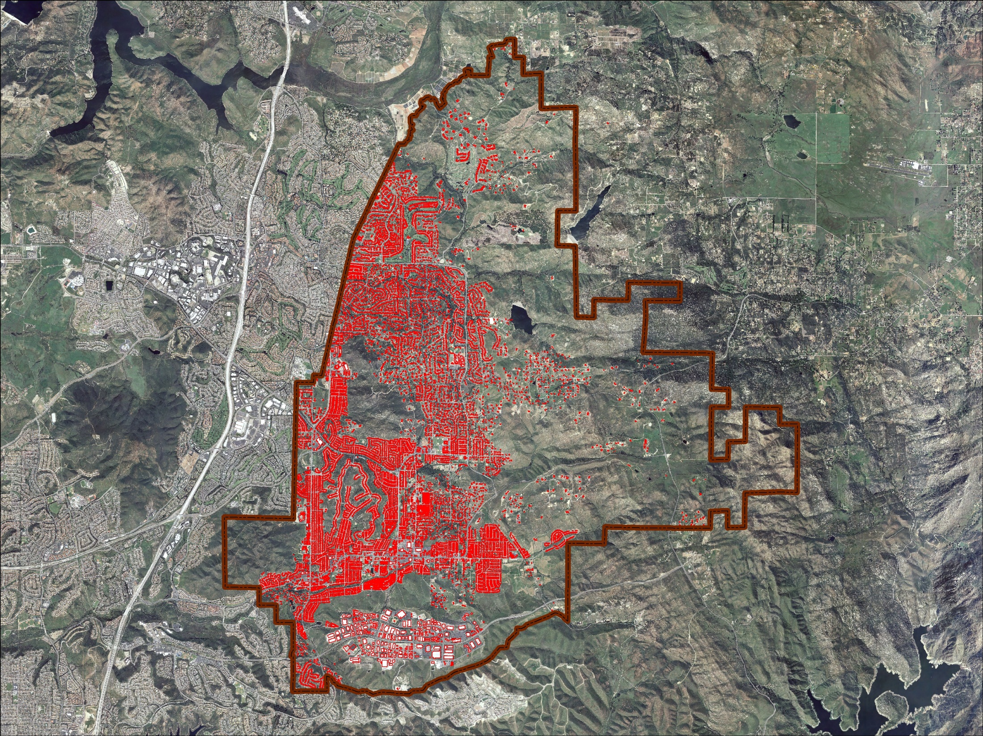
City of Poway

Slide 11
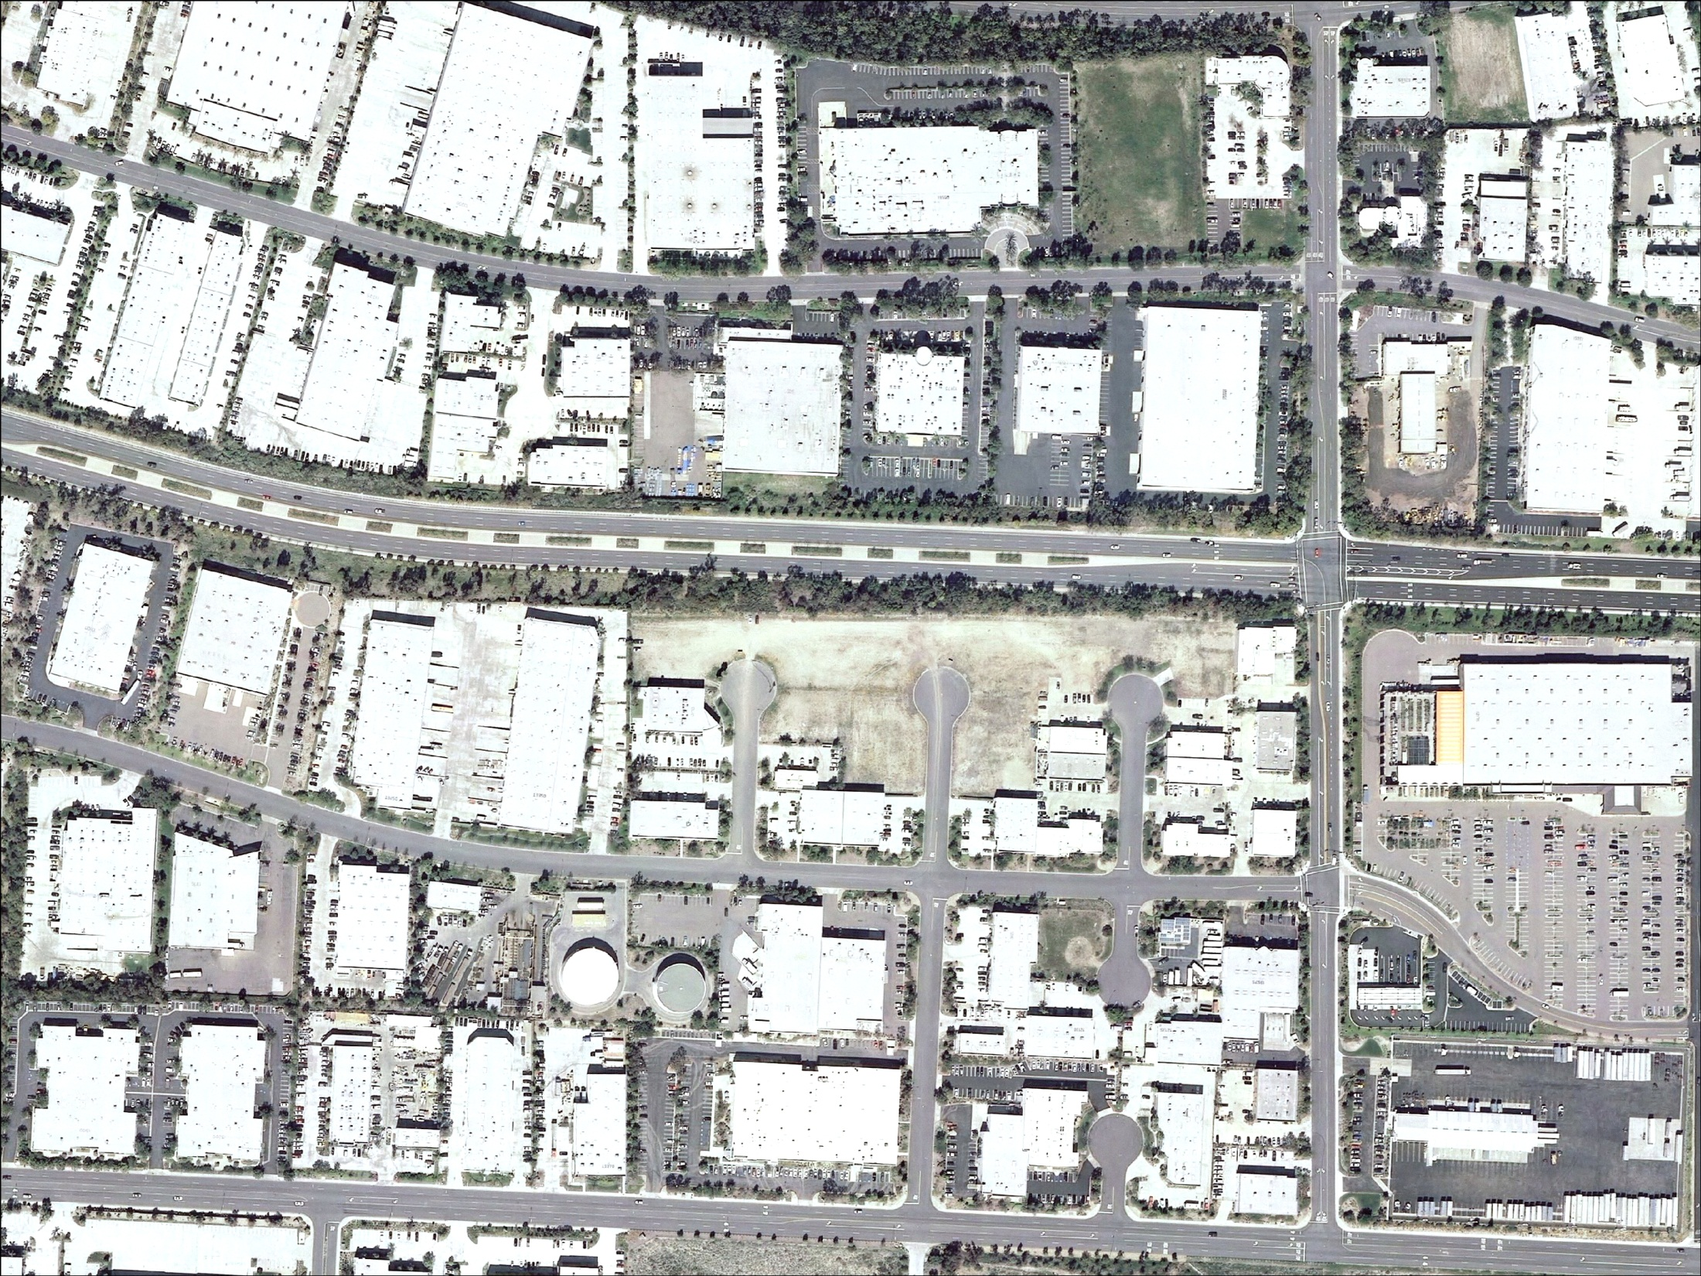
Scripps Poway Pkwy

Slide 12
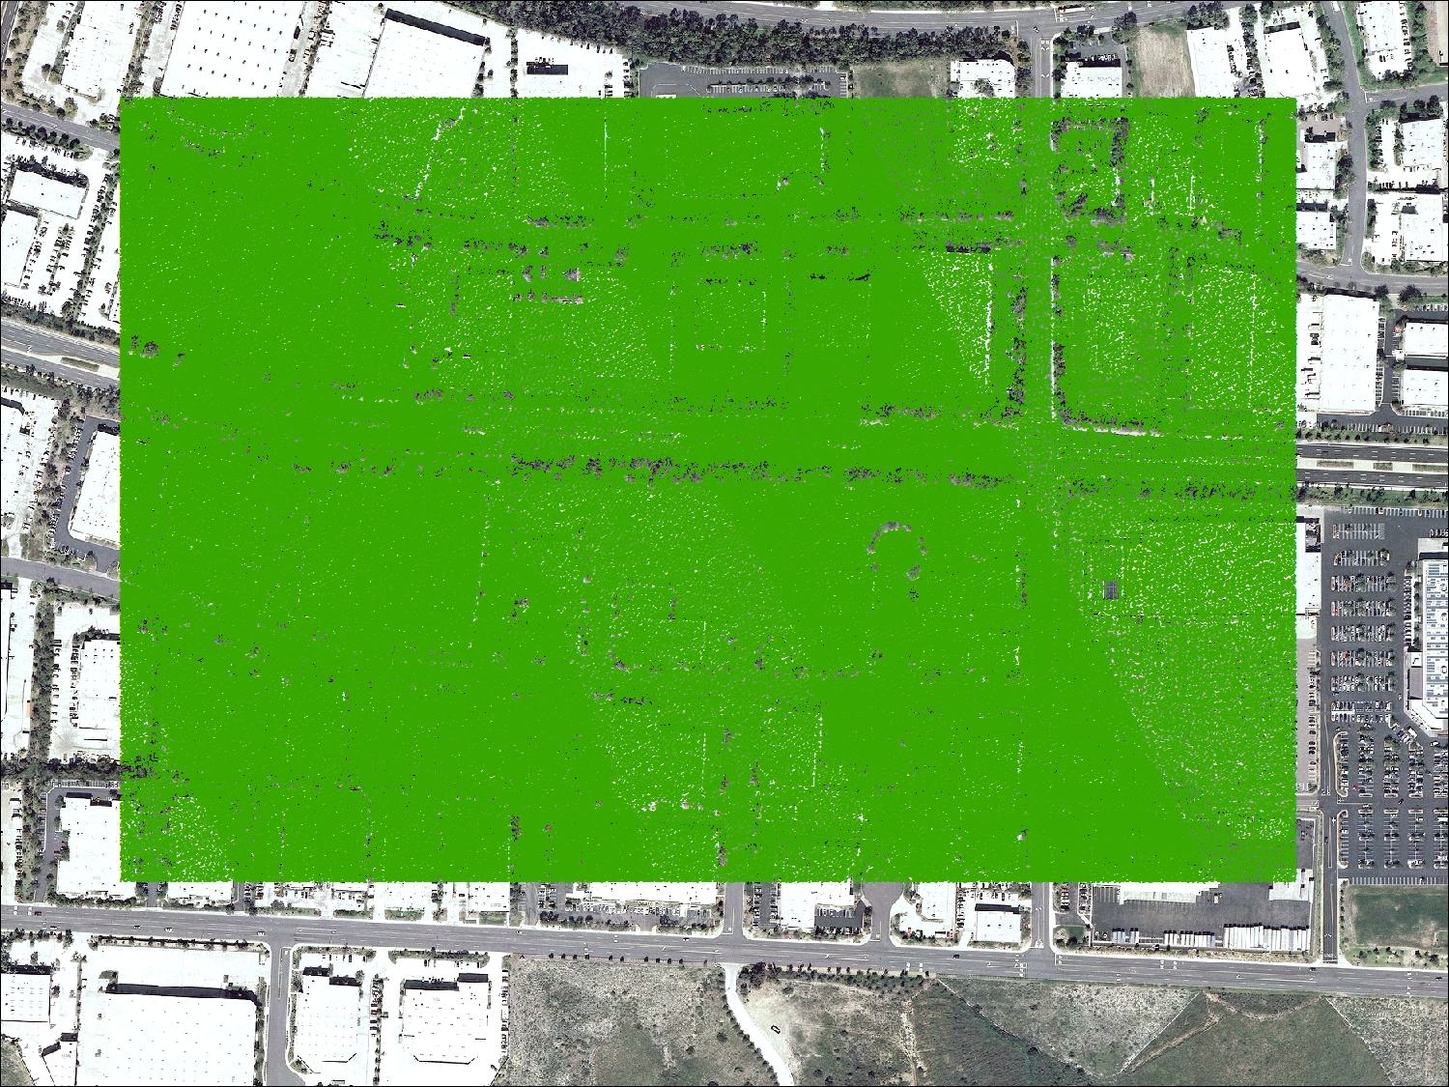

Slide 13
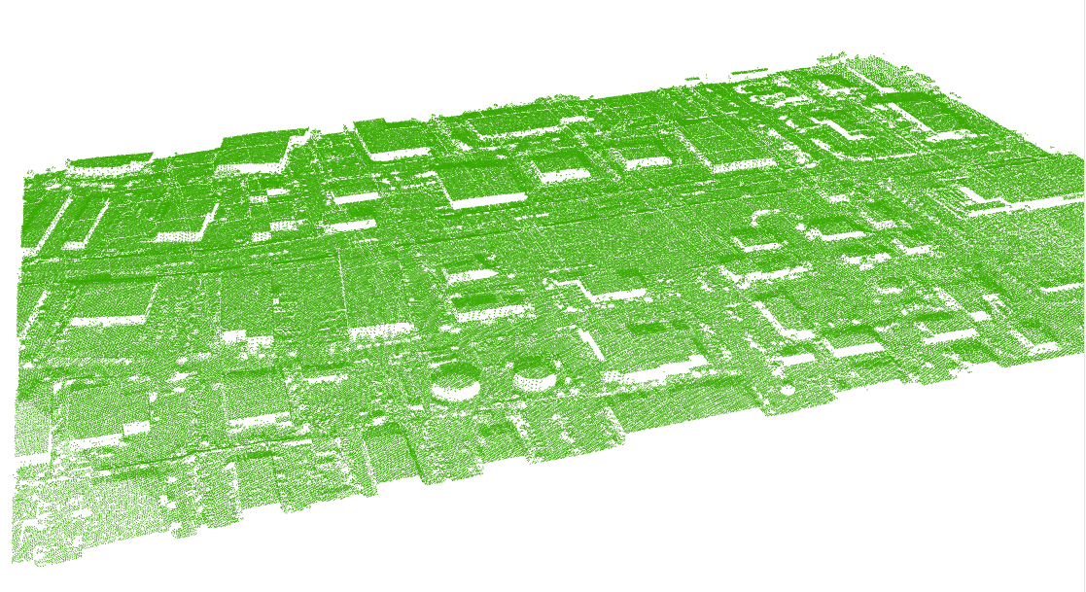

Slide 14
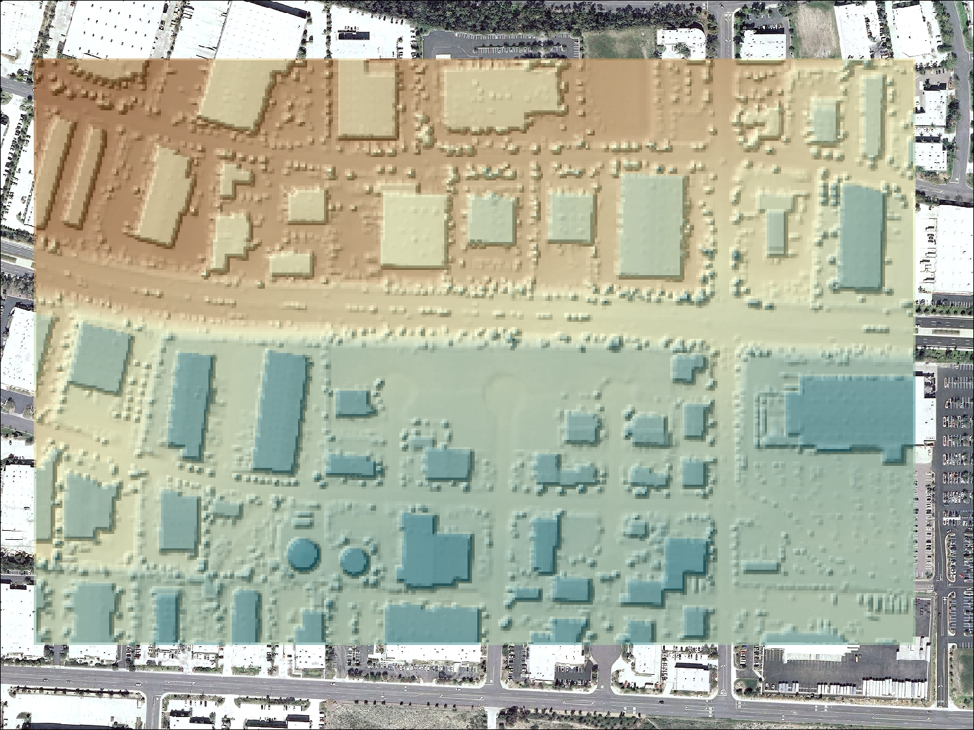
DSM

Slide 15
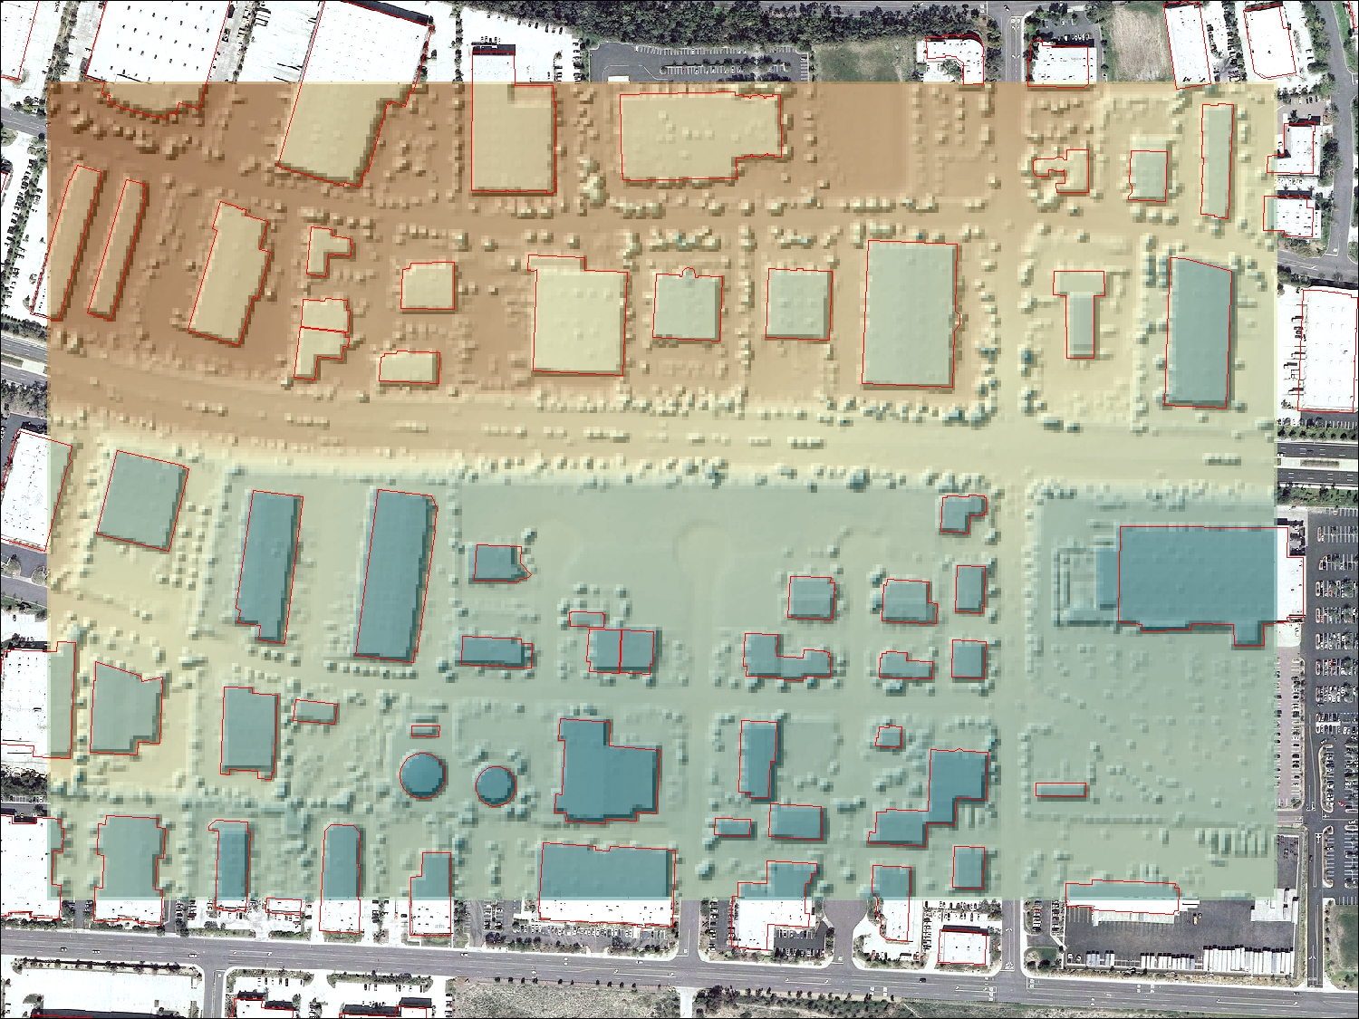
DSM
Max Bldg Top Height
Min Bldg Top Height
Avg Bldg Top Height

Slide 16
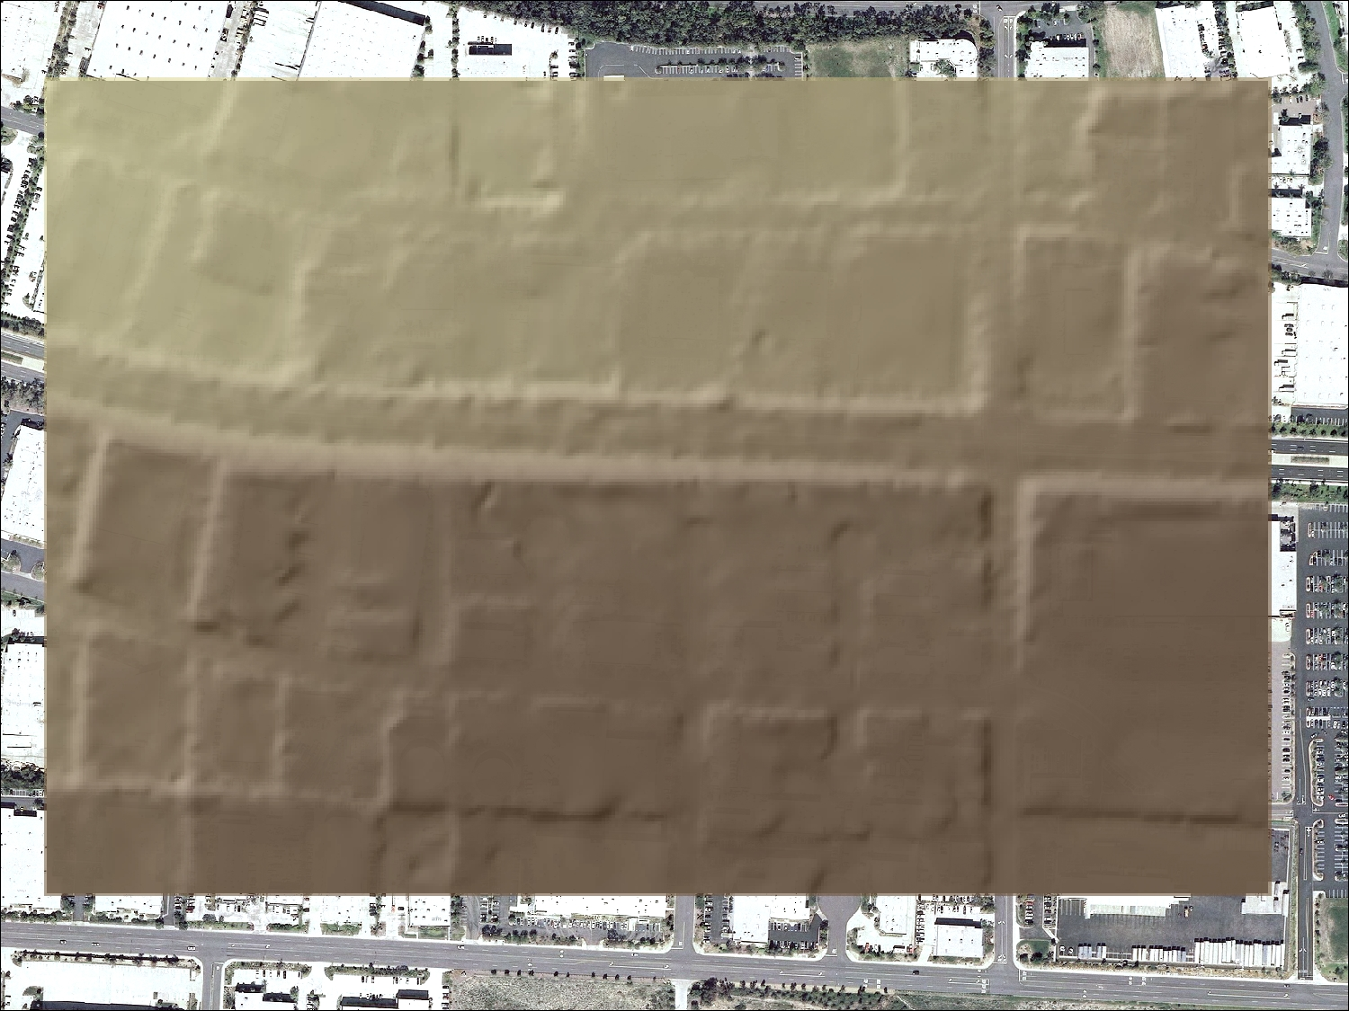
DEM

Slide 17
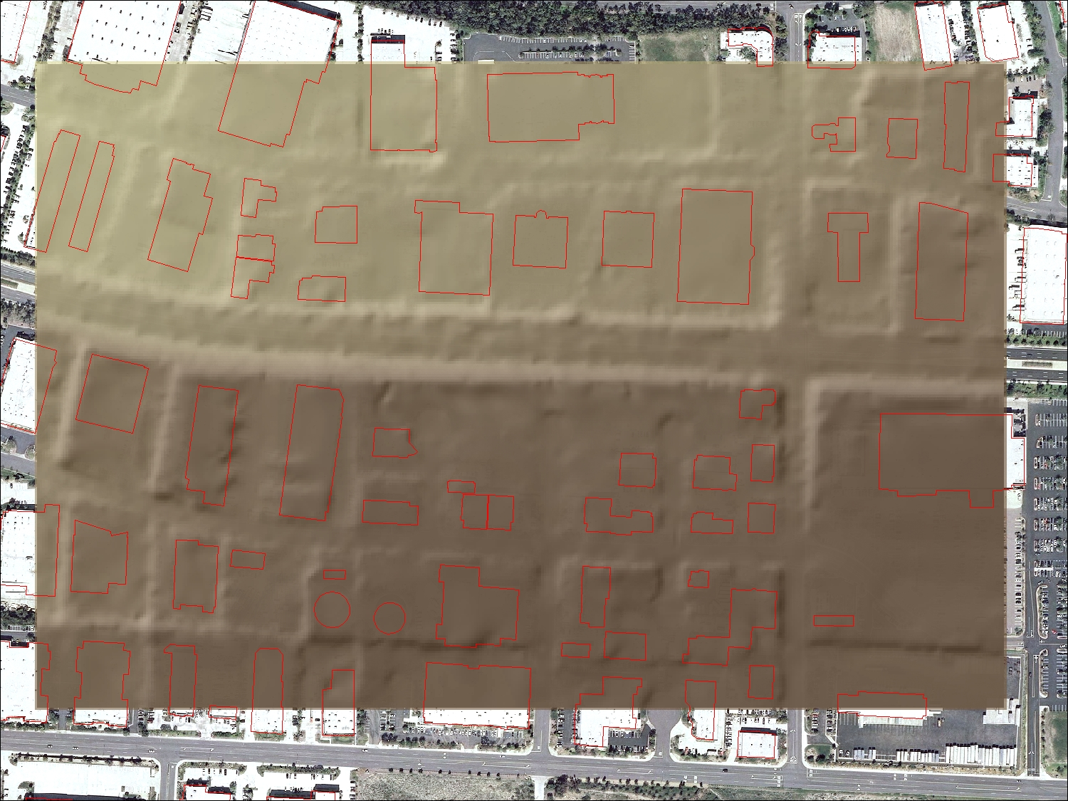
DEM
Max Ground Elevation
Min Ground Elevation
Avg Ground Elevation

Slide 18
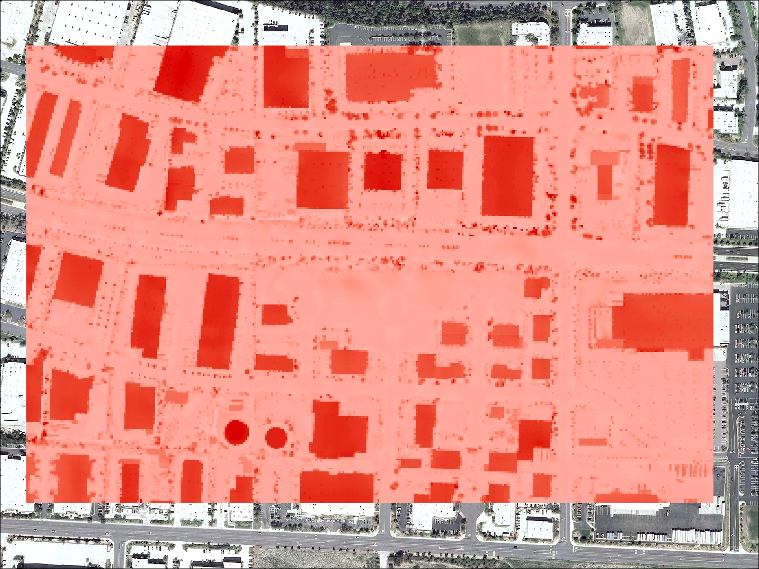
Max Bldg Height
Min Bldg Height
Avg Bldg Height

Slide 19
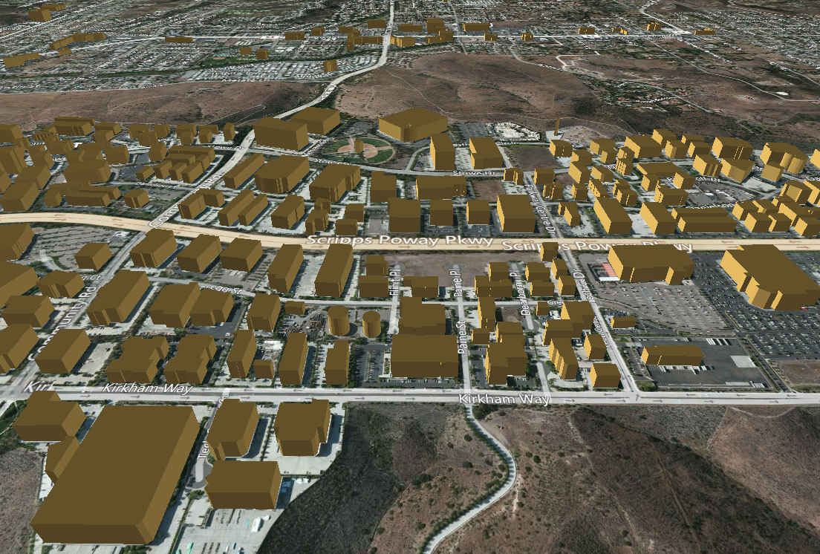

Slide 20
Estimating Floor Area
How do we go from footprint and height to floor area?
Most buildings at linear
  Rectangular footprint
  Regular (or semi-regular) height
  Uncertainty lies with the interior layout
Use multiple linear regression Est(FA) = B1*FP + B2*H
  Where EST(FA) is estimated floor space
  FP is footprint in square feet
  H is height in feet
  B1 is coefficient relating footprint to floor area
  B2 is coefficient relating height to floor space
No need for an intercept

Slide 21
Regression Results
Poway / Industrial
First model
  LU = 2101 (industrial park)
  N = 51
  AdjR-square = .972 p = .000
  B1 = 1.232 p = .000
  B2 = -62.758 p = .489
Second model
  LU = 2101 (industrial park)
  N = 51
  AdjR-square = .972 p = .000
  B1 = 1.208 p = .000

Slide 22
Regression Results
Poway / Retail
First model
  LU = 5003, 5004, 5007
  N = 74
  AdjR-square = .845 p = .000
  B1 = 1.022 p = .000
  B2 = 96.142 p = .193
Second model
  LU = 5003, 5004, 5007
  N = 74
  AdjR-square = .843 p = .000
  B1 = 1.062 p = .000

