Slide 1
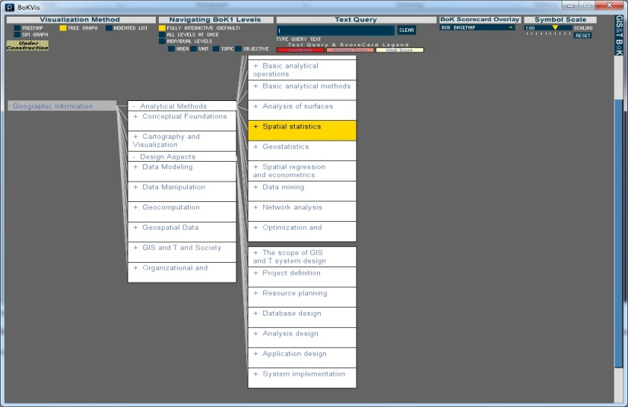
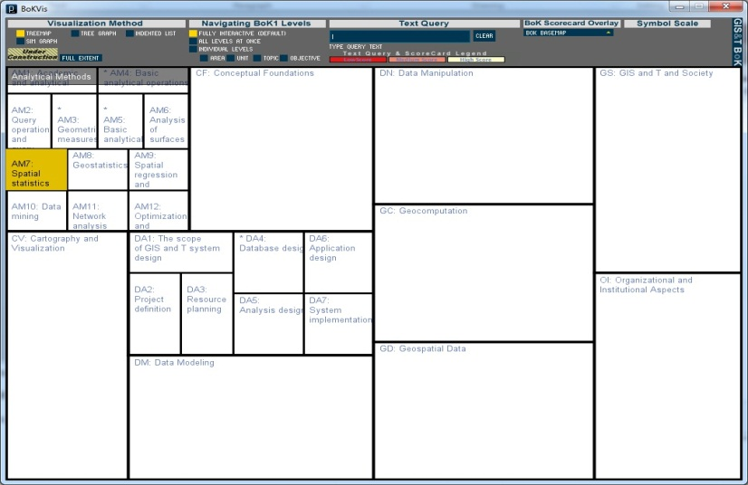
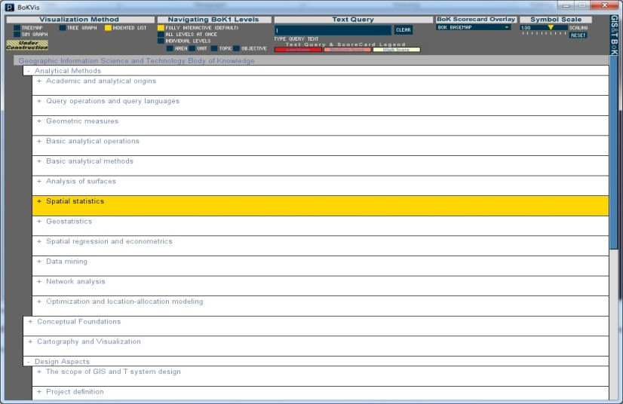
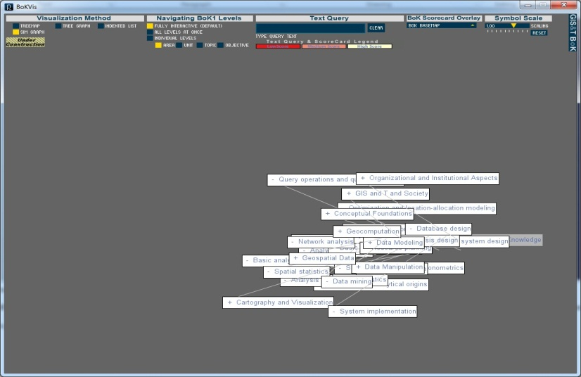
Examining a Knowledge Domain: Interactive Visualization of the Geographic Information Science and Technology Body of Knowledge 1
Project Overview by Marilyn Stowell, Masters Student, SDSU Geography
Notes:
My name is Marilyn Stowell, and I am a masters student at San Diego State University
I will be presenting my thesis research titled “Examining a Knowledge Domain: Interactive Visualization of the Geographic Information Science and Technology Body of Knowledge 1”, for which I am currently preparing the proposal.
This presentation will cover the key ideas, reasoning, technical approach, and current status of this project.

Slide 2
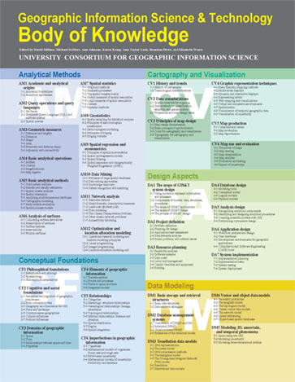
GIS&T Body of Knowledge
Content designed by experts in the field (UCGIS)
Intended for academic and professional use (course planning, professional certifications, human resources)
Published by the Association of American Geographers
Notes:
First, I would like to introduce the Body of Knowledge itself, which is the data driving these visualizations. Published in 2006, the Geographic Information Science and Technology Body of Knowledge (GIS&T BoK) has become one of the most influential documents in the area of GIS&T education, both in the United States and internationally.
This document was developed in a top-down manner by a group of experts in the field, the University Consortium for Geographic Information Science (UCGIS)

Slide 3
GIS&T Body of Knowledge
Body of Knowledge
Knowledge Areas
Knowledge Units
Knowledge Topics
Learning Objectives
Notes:
The BoK has been primarily distributed as a printed document, though it actually consists of a four-level tree structure, or hierarchy, of 10 knowledge areas, 73 units, 329 topics, and over 1,600 formal educational objectives. For this research, this document represents the knowledge domain of GIS&T.

Slide 4
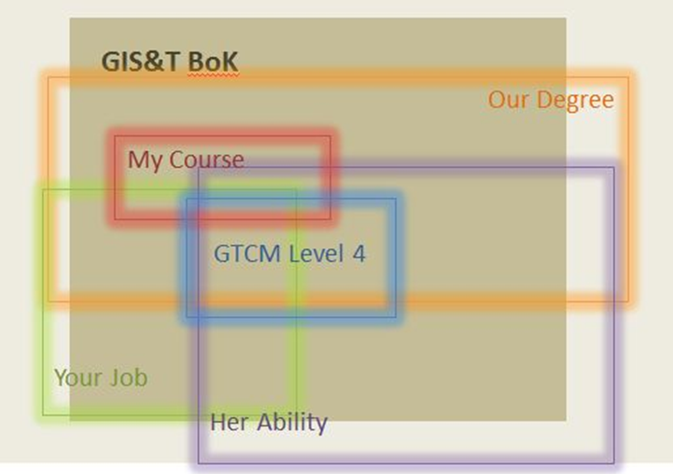
GIS&T Body of Knowledge
Notes:
One way to look at a knowledge domain is as a coordinate system for the knowledge “space” we inhabit. Because the notion of “knowledge space” is a difficult to conceptualize, visualization in an important tool for accessing and understanding the shape, structure, and interrelatedness of BoK elements.
In knowledge space, one is able to engage in activities (such as research, and education) and produce knowledge artifacts (such as articles and curricula), yet to this point there hasn’t been a means in which to situate these activities within a knowledge domain. However, by applying geographic concepts to abstract space, the knowledge domain becomes a reference system or base map onto which such knowledge artifacts can be overlaid.
This is done with an outside application that allows for input of weights or scores assigned to specific BoK elements, and the resulting input can be mapped directly onto the BoK basemap.

Slide 5
BoK Visualization (BoKVis)
Objectives:
Create interactive visualizations which will improve accessibility and understanding of BoK1:
Layout the hierarchical (tree) structure
Break up the tree structure and layout the BoK based on its content
Compare Spatial Layouts, User Testing
Utilize these visualizations as base maps for which other knowledge artifacts can be overlaid. (i.e. curricula, proficiencies, resumes)
Notes:
The research presented here aims to create interactive visualizations of the GIS&T BoK and will test the different spatial layouts in order to compare them in terms of effectiveness and performance.
The primary objectives are to improve accessibility and understanding of the structure and content of the GIS&T BoK through visualizations that layout the top-down hierarchy as well as exploit the content of BoK elements in a bottom-up manner.
This research is significant because the interactive functions developed in our visualization component will leverage the emerging domain ontology and be useful in a range of applications in academia and in the professional realm.

Slide 6
BoK Visualization (BoKVis)
Notes:
This is a simple model of the four spatial layouts that are currently being developed. All of these layouts are displaying the same Body of Knowledge, but utilize various layout algorithms.
All the layouts EXCEPT the similarity graph use only the given hierarchy of the BoK to determine each element’s placement and geometry. The Similarity Graph, however, calculates their position based on the similarity of the textual content of each BoK element.

Slide 7
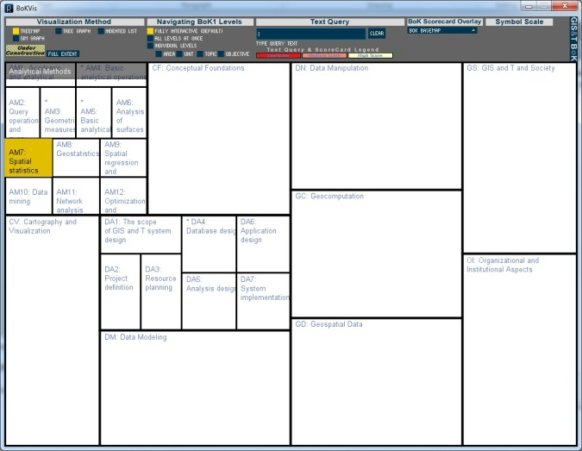
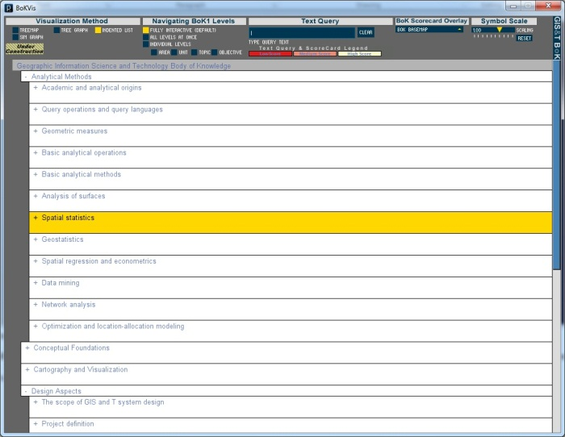
Structure-based Visualization of BoK1:
Tree Graph
Tree Map
XML
Indented List
Notes:
The structure-based visualizations (TreeMap, TreeGraph and Indented List) were created by transforming the printed document into an XML file, which preserves the hierarchical structure.
The XML was then imported and parsed into Processing to create the interactive interfaces. Processing is a free, open source programming language and environment that allows the user to easily see visual results of their coding. It is useful for all projects with visual outputs, and is capable of creating images, animations and interactive displays.
There are many benefits of using this environment for the BoK visualization including being easy to learn, java-based language, exportable applications or web applets, multi-server compatibility and accessibility to libraries (Fry 2008).

Slide 8
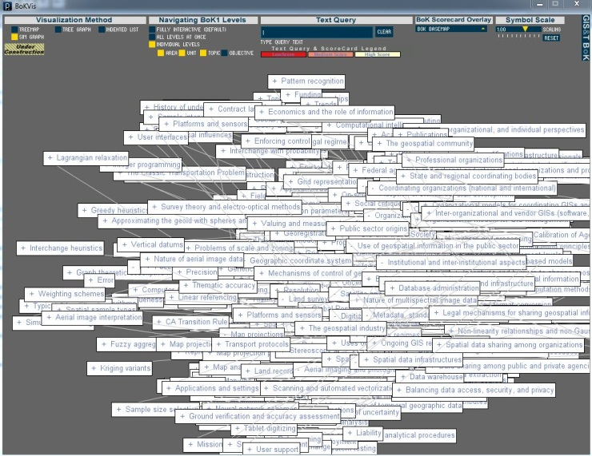
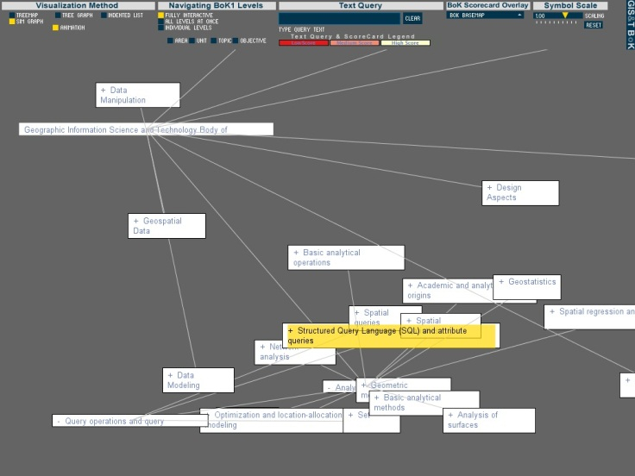
Content-based Visualization of BoK1:
Dimensionality Reduction
(MDS/SOM)
Export Similarity Matrix
XML
XML
Similarity Graph
Notes:
Creating the similarity graph based on the textual content of the BoK was done in four parts: calculating and exporting the similarity matrix from Processing, reducing the dimensionality of the data, reading the new coordinates back into Processing, and finally creating the visualization. We are currently experimenting with various dimensionality reduction techniques such as Multi dimensional scaling, Self Organizing Map, and Latent Dirichlet Allocation.

Slide 9
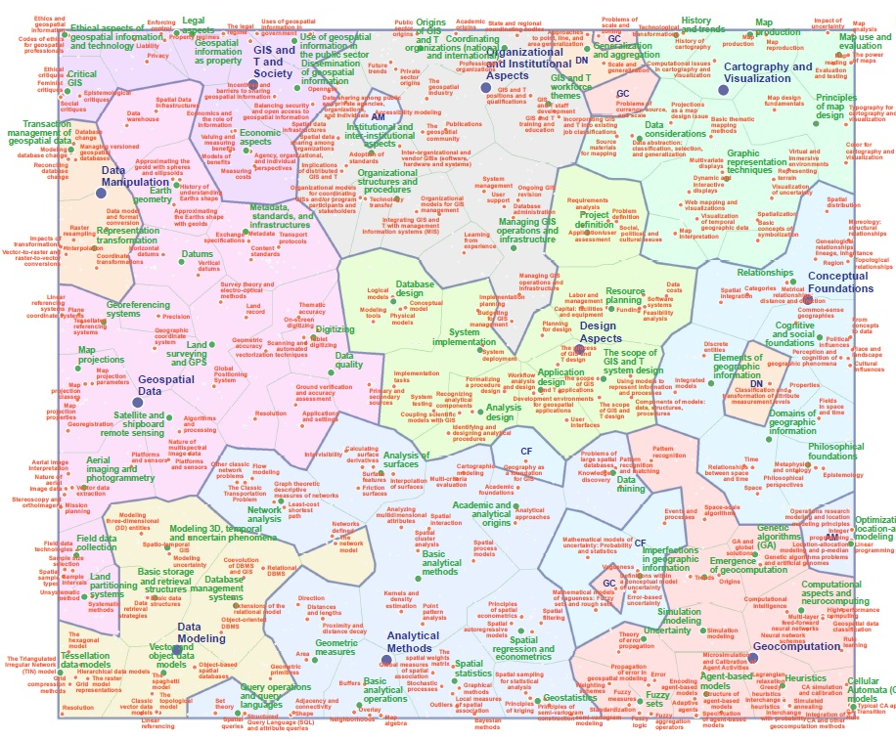
Notes:
This is a visual of the BoK, based on its textual content. This was created by:
- Preprocessing: natural language processing
- Initial dimensionality reduction: latent Dirichlet allocation (inferences to locate hidden dimensions, 3-level bayesian model)
- Final dimensionality reduction: self-organizing map
-Geometric transformation and symbolization: GIS
This visual gives a 2-dimensional view of the entire GIS&T BoK, and is essentially a MAP of the domain.
The coordinates derived from this SOM were then extracted and utilized in the processing visualization.

Slide 10
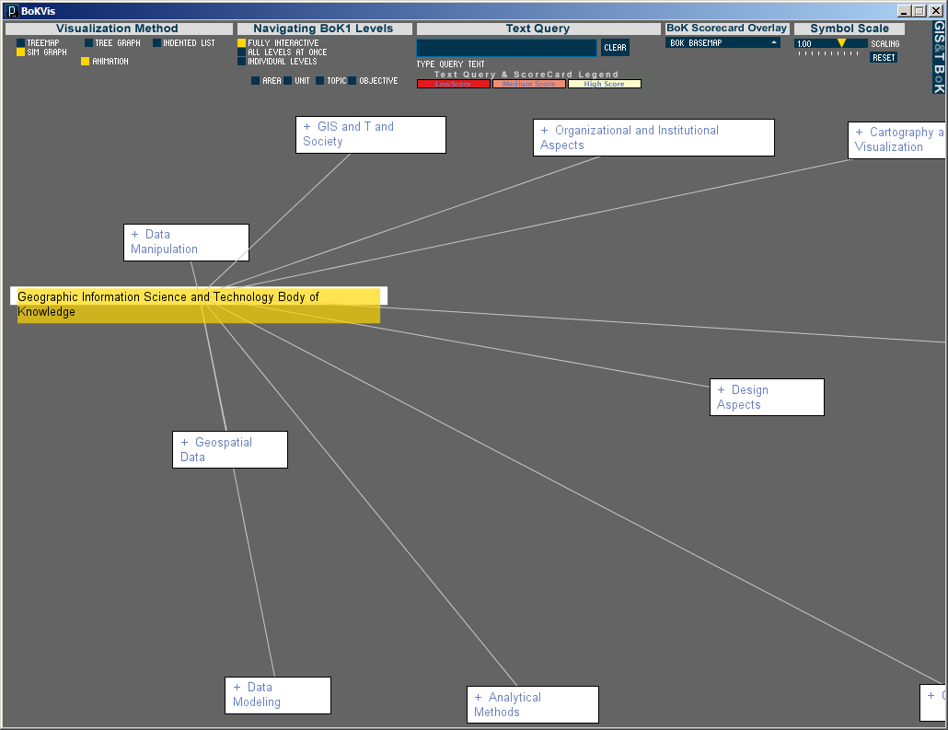
Notes:
This is the result of the SOM shown previously, with the coordinates imported back into processing. (flip back to other and show that the locations are the same)

Slide 11
BoK2 Conceptual Model
Hunter College: Ontology
SDSU: Visualization
BYU: Wiki
New Mexico State: VPE
Notes:
This visualization effort exists within a much larger framework- the BoK2 project- which aims to create a core ontology that will be informed, accessed and understood through various interfaces such as the visualization, VPE and Wiki (collaborative environment) and ontological projections (BoKScorecard). BokOnto will be a back end semantic web application and the applications layered around this core will be used as interfaces in which to access the content in the core.
BoK2 will ideally “Create and maintain a current Body of Knowledge in this rapidly evolving field…that will enable expansion of the knowledge base in a dynamic, interactive and collaborative fashion”
The end result will be a dynamic, bottom up version of the BoK1 that will expand on the functionality and objectives of the BoK1

Slide 12
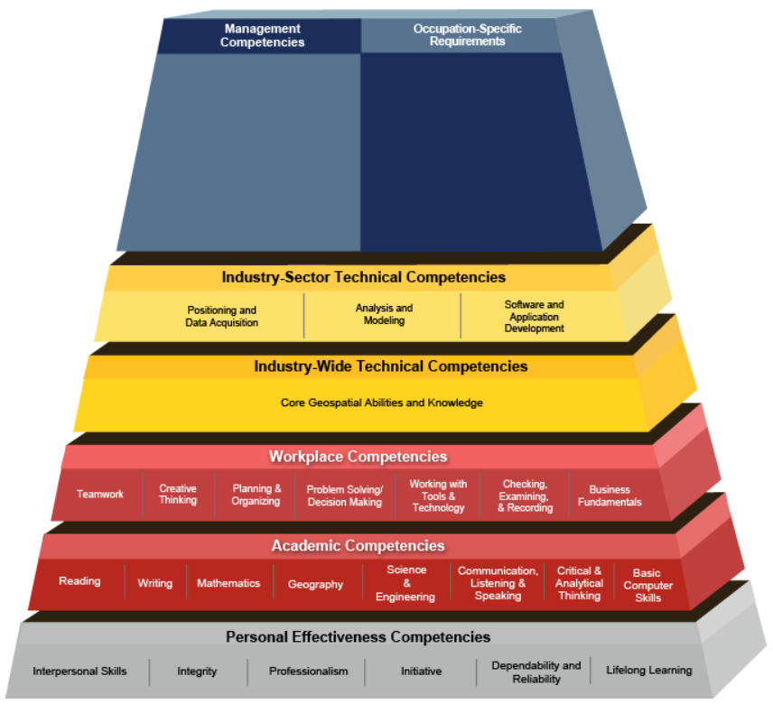
Geospatial Technology Competency Model
Notes:
I want to give you an example of how the Body of Knowledge visualization can be used in the world of professional GIS.
This is the GTCM or Geospatial technology competency model. In collaboration with the GeoTech Center, the Employment and Training Administration (ETA) has worked with industry and education leaders to develop a comprehensive competency model for Geospatial Technology. The model is designed to evolve along with changing skill requirements.
The industry model frameworks are based on the competency model building blocks which are modified to meet the industry needs.
//www.careeronestop.org/CompetencyModel/pyramid.aspx?GEO=Y

Slide 13
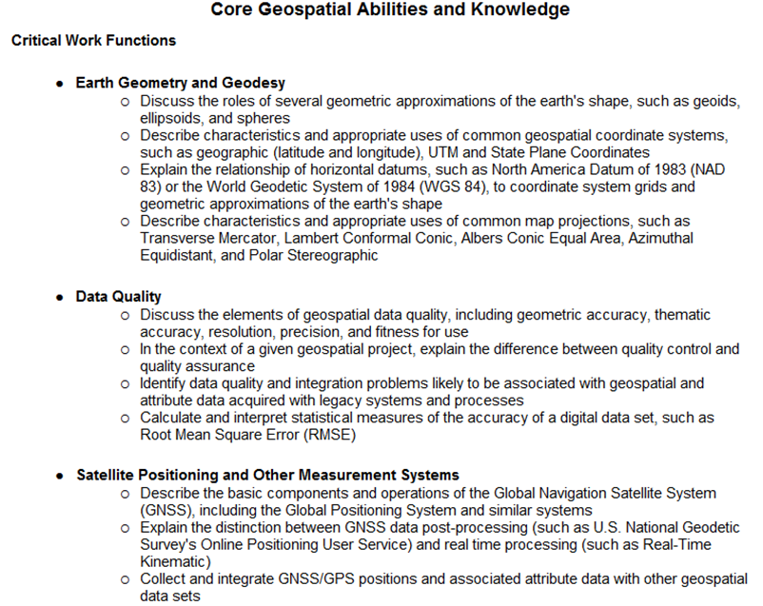
Geospatial Technology Competency Model
Notes:
The text document supporting the GTCM is available online (just a snippet is shown here), so to see how the GTCM fits into the knowledge domain of GIS&T, we just had to copy and paste!
http://www.careeronestop.org/CompetencyModel/pyramid.aspx?GEO=Y

Slide 14
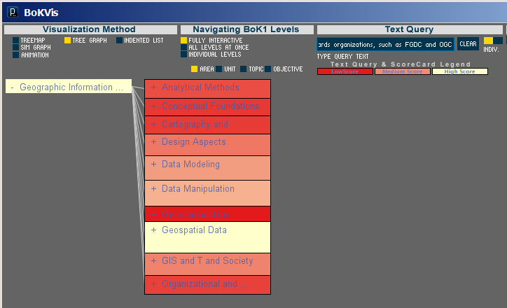
Geospatial Technology Competency Model
Notes:
This is the resulting GTCM4 for “critical work functionsoverlaid on BoK knowledge areas.
The full text listing (critical work functions) was pasted in the text query field in BoKVis. Color and size expresses the degree to which GTCM4 content is matched by BoK elements.
We can see that Geospatial Data is the most closely associated with the GTCM (which is fitting), followed by data manipulation and data modeling.

Slide 15
Visualization Demonstration
Notes:
Besides the GTCM, we now have the ability to map any number of elements onto the body of knowledge. Demo- MS1 scorecard or resume.
My user testing largely involves utilizing the interactive features of this application, so I can’t show too much at this time, but if you have questions or are interested in participating in the user testing, please see me after the meeting and I would be happy to chat and/or get your email address so I can contact you about the test within the next month or so.

