Slide 1

City of Encinitas
GIS Division Project
Encinitas in a Nutshell
Incorporated in 1986
Population 63,000
~ 25 square miles
~ 22,800 tax parcels
A GIS user since 1990
Growing Enterprise GIS since 2003
Presentation presented to SDGRC July 2010. Origins of presentation designed to present new Cadastral Data to City Staff & convey path going forward.

Slide 2
Workshop – introducing the new GIS Landbase
A legal boundary layer with survey accuracy!
Agenda
Overview
Process
Rich content
Usability
Q & A Discussion

Slide 3
Workshop – introducing the new GIS Landbase
A legal boundary layer with survey accuracy!
Goals
Introduce “content”
Define priorities for user accessibility
Web Delivery
Fast
Easy to use reports / tools / interaction
Staff input
  What would help you consume this data
  What kinds of analysis capabilities would you like to see
  More than just “background display”

Slide 4

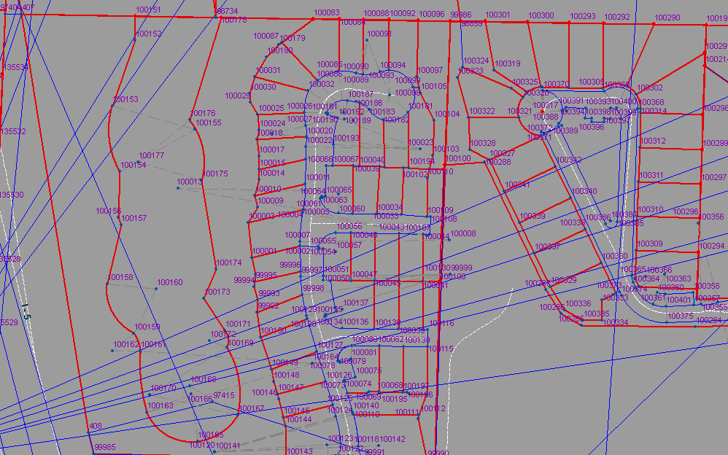
GIS Landbase - Overview
A legal boundary layer with survey accuracy!
What is meant by legal boundary “layer”?
Legal boundary – measured lines and points taken from instruments such as plat maps. These instruments are recorded with the County.
“Layer” a composition of: A network of points, lines and polygons that are interconnected through record measurements – creating a continuous “Fabric”.
Think of this Fabric as a large net cast over the City

Slide 5
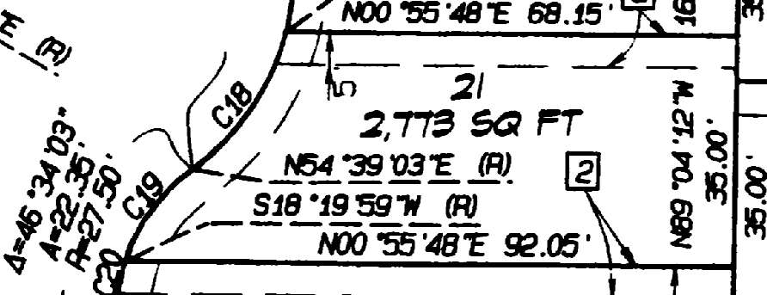
GIS Landbase - Overview
A legal boundary layer with survey accuracy!
What is meant by ‘Survey Accuracy’?
Each part of the net fits mathematically – much like a jigsaw puzzle
Every knot in the net (point in the network), has a known position on the ground
Positions are based on precise known locations. These known locations are referred to as Survey Control and can be positionally accurate to thousandths of a foot (.001)
Surveyed lengths & direction and point locations are all taken from the recorded plat
In the real world these points and lines translate as property corners and ownership boundaries.

Slide 6
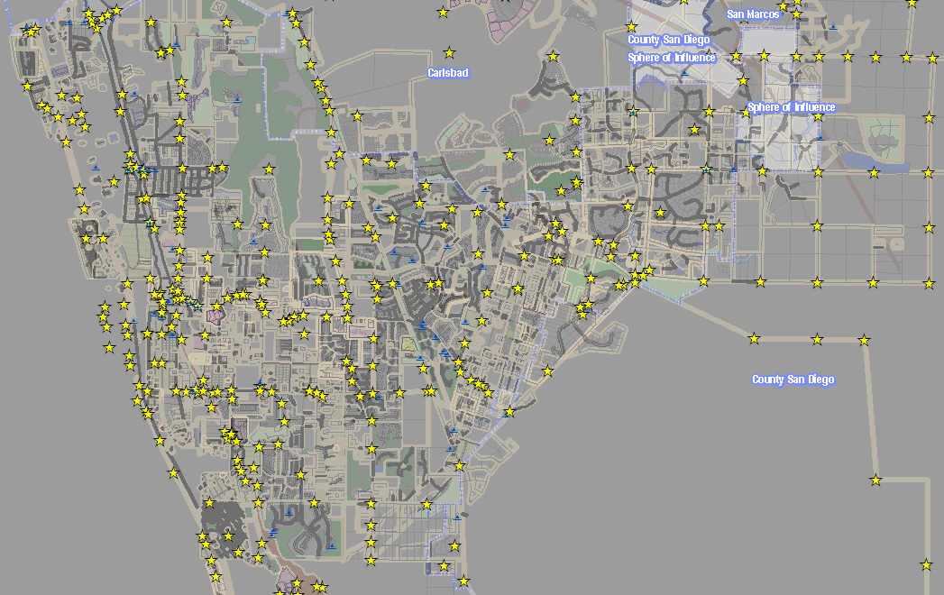
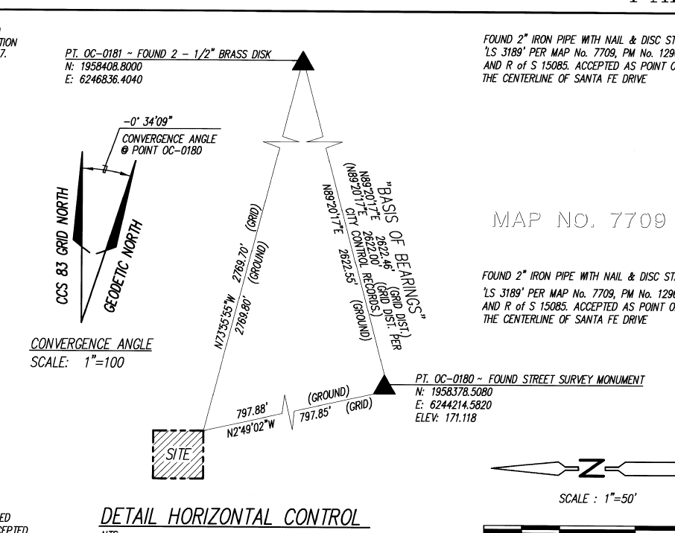
GIS Landbase - Overview
A legal boundary layer with survey accuracy!
Distribution of Control

Slide 7
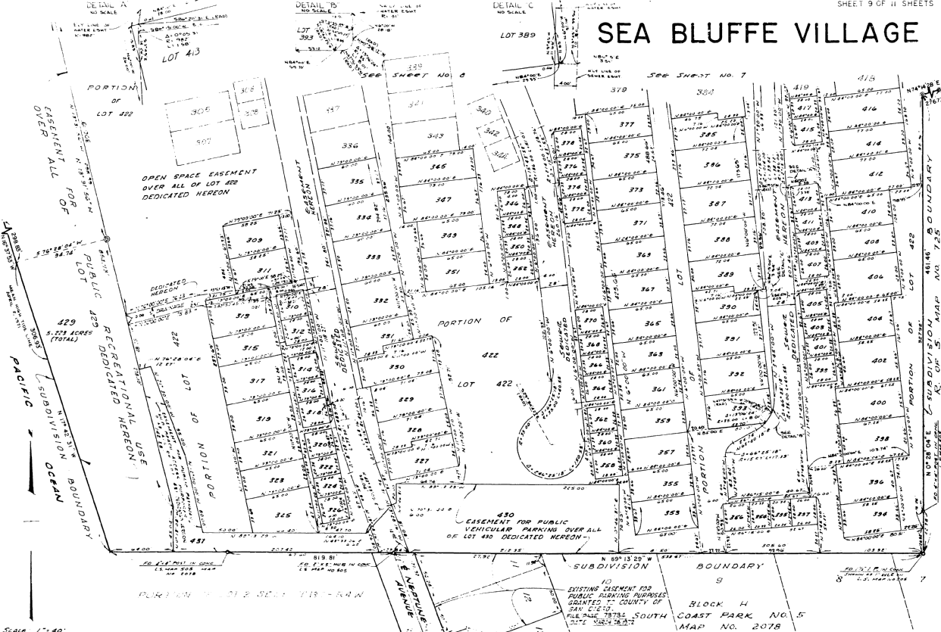
GIS Landbase - Overview
A legal boundary layer with survey accuracy!
How we go from this…

Slide 8
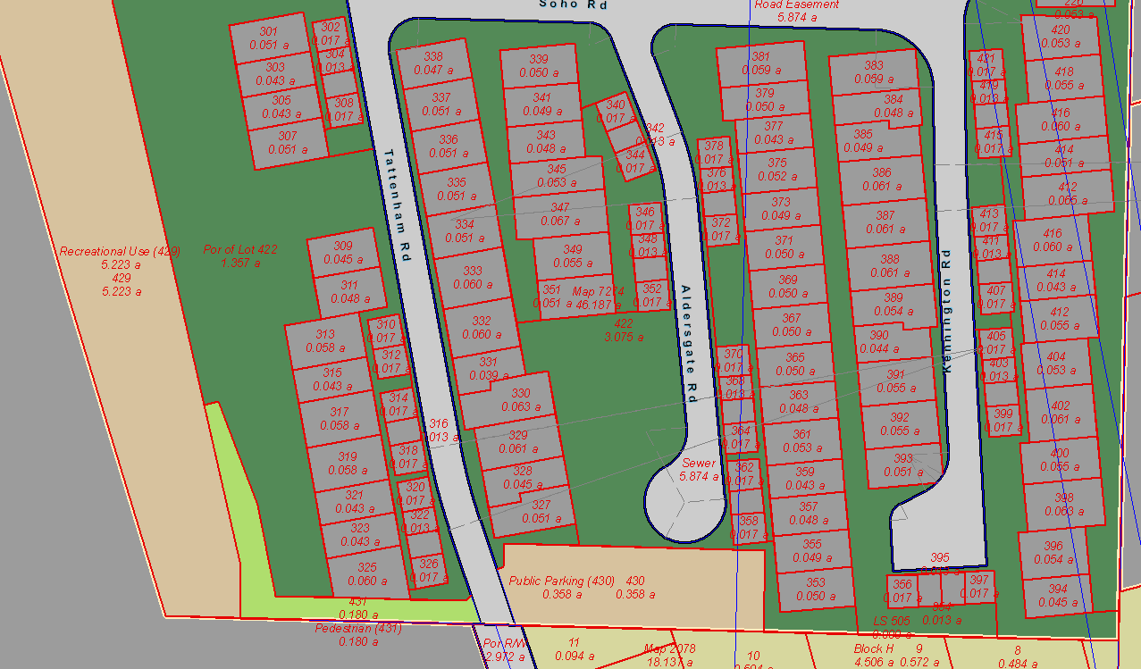
GIS Landbase - Overview
A legal boundary layer with survey accuracy!
To this…

Slide 9
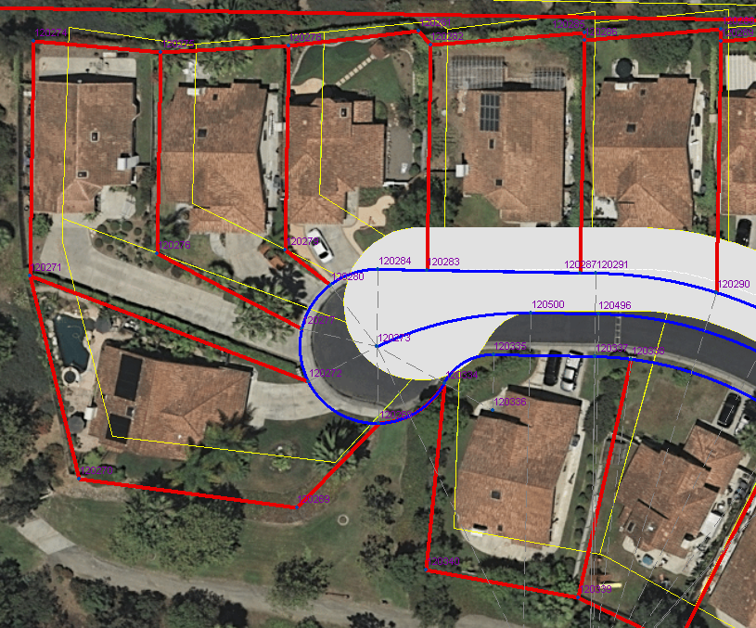
GIS Landbase – Approach
A legal boundary layer with survey accuracy!
Not a realignment
Built from Record Data
Use Coordinate Geometry (COGO)
COGO ‘core’ documents – late 1800s to present
    Subdivision Maps
    Records of Survey
    Parcel Maps
    Licensed Survey
    Miscellaneous Maps
    CalTrans Surveys & Relinquishments
    Start of easements & other encumbrances
Compile Complete Legal Record
  Entire plat entered for old & new
  Nothing deleted even when historic
Not done but could be in the future
  Road Surveys
  Highway 101
Does not include Deed Lots
25’ Delta

Slide 10
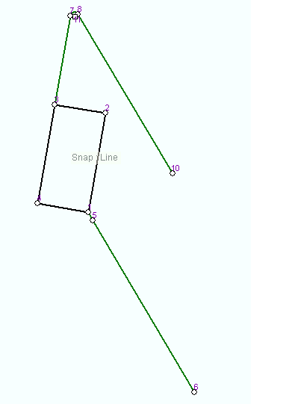
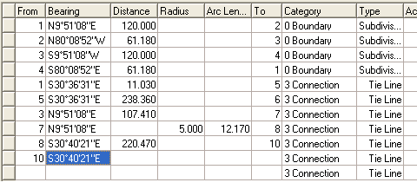

GIS Landbase – Process
A legal boundary layer with survey accuracy!
Capturing Plat Detail
Bearings & Distance from Plat
Input displayed in “page space”
First accuracy check -- Closure / mis-close

Slide 11
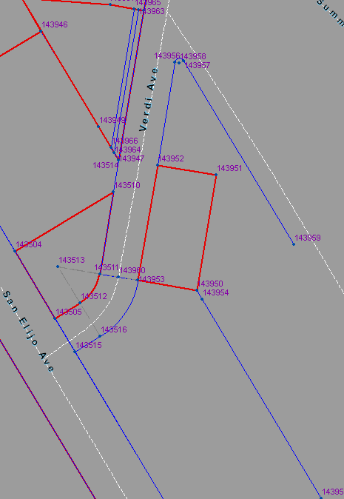
GIS Landbase – Process
A legal boundary layer with survey accuracy!
Going from page space to coordinate space
Join - Page Space to Coordinate Space
  to control
  surrounding Fabric
Measurements are key
Measurements differ
  depending on age of instrument
  Surveyor performing measurement
  Type of survey equipment used
Ideally all measurements fit together – like a puzzle

Slide 12
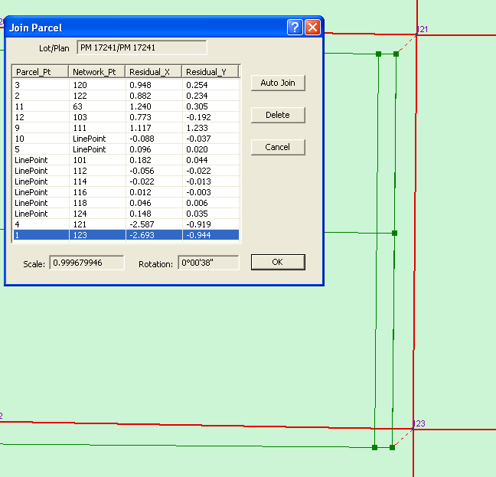
GIS Landbase – Process
A legal boundary layer with survey accuracy!
When the “puzzle” doesn’t fit… Piecing it together
Second accuracy check
Software reports how well records fit together
A low residual means you can be happy
A high residual means something is wrong ☹
  Error in data entry
  Error in record
  Error in joining to an incorrect point

Slide 13
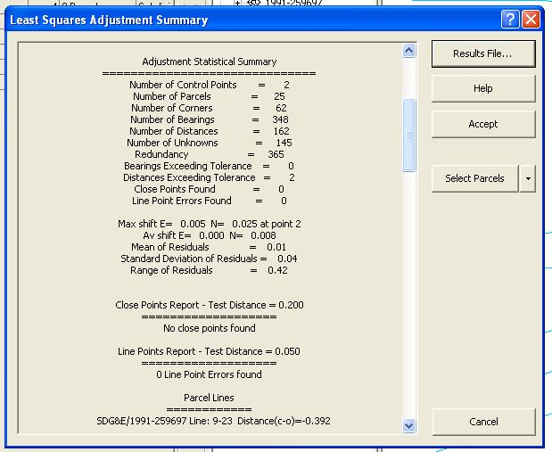
GIS Landbase – Process
A legal boundary layer with survey accuracy!
Adjusting – Further checking for error…
As a final step an adjustment can be run to create a “best fit view”
Differential errors
Original measurements are always preserved
As more control added or newer records the “best fit view” is updated

Slide 14
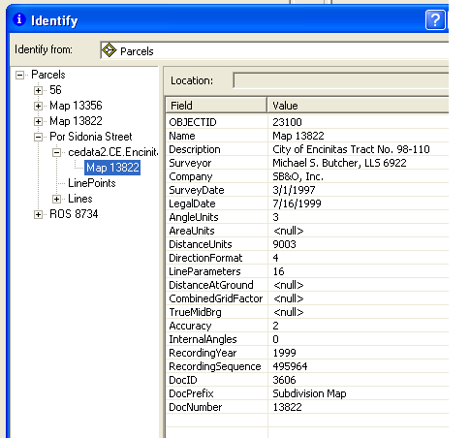
GIS Landbase – Intelligence
A legal boundary layer with survey accuracy!
“Plan” Detail
All boundaries & rights/restrictions can be traced back to their source
Trace chain of custody (historic never deleted)

Slide 15
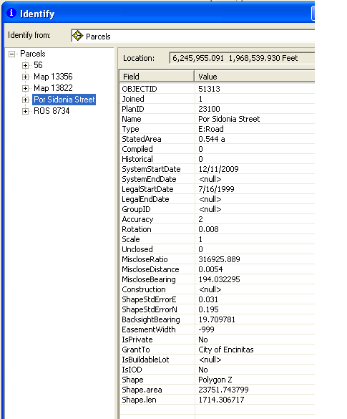
GIS Landbase – Intelligence
A legal boundary layer with survey accuracy!
“Parcel” Detail
  Plan Boundary in it’s entirety
  Block Boundary (found only on older maps)
  “Parcel” Boundary (Any closed polygon ‘type’-see next slide)

Slide 16
GIS Landbase – Intelligence
A legal boundary layer with survey accuracy!
Parcel Types
Flexibility was desired, maybe not all will survive the test of time…
Your input needed
Block | E: Emergency Vehicle Access - 15 | E: Sight Distance - 10 | Lot Open Space
CalTrans Relinquishment | E: Flowage - 16 | E: Slope - 19 | Lot Paper
Certificate of Compliance | E: Irrigation - 2 | E: Traffic Signal | Lot Parcel (default)
Corner Record | E: Landscape - 3 | E: Utility - 198 | Lot Remainder
Division Plat | E: Noise Protection - 7 | E: Water - 100 | Lot Road
E: Access - 54 | E: Open Space - 272 | Fuel Modification Zone - 1 | Lot Tax (testing this)
E: CalTrans | E: Other - 30 | Lot Bndry Adjustment (COC) | R/W
E: Clear Space - 11 | E: Pedestrian - 51 | Lot Condo - 280 | R/W Paper
E: Covenant - 2 | E: Road - 2253 | Lot Consolidation (COC) | Subdivision
E: Drainage - 197 | E: Sewer - 165 | Lot In Compliance (COC) | Vacation - 182
Abutters (note line) | E: Open Space - Bio

Slide 17
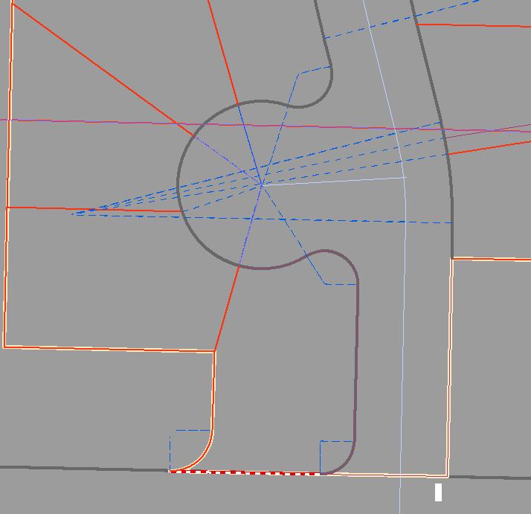
GIS Landbase – Intelligence
A legal boundary layer with survey accuracy!
Line Detail
Cartographic flexibility
Smart lines
  Origin
  Length
  Direction
  Type
Boundary
Frontage
Centerline
Subdivision
Abutters
MHTL
Encumbrance
Tie Line
Historic
Fwy Frontage
Control Tie
Radial
CR Boundary
Government

Slide 18
GIS Landbase
A legal boundary layer with survey accuracy!
Possibilities & Ideas
Prioritize with your input
Add your ideas to the list
Focus on simplicity in delivery
Ability to get directly at the information you need

Slide 19
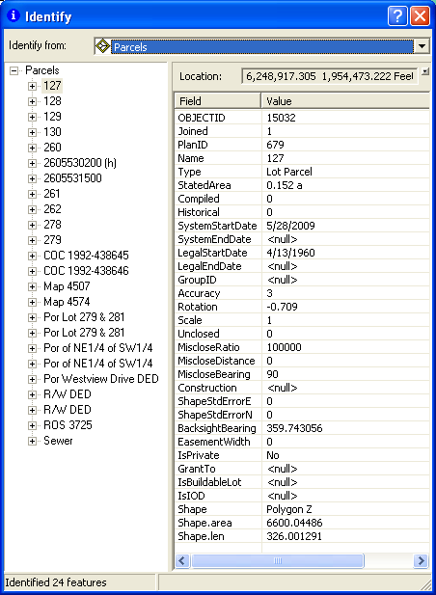
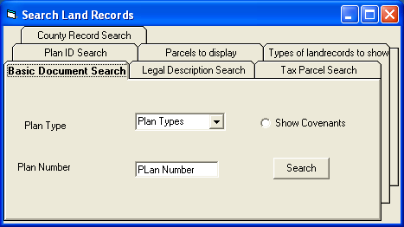
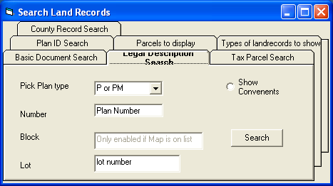
GIS Landbase – Drill Down & Find
A legal boundary layer with survey accuracy!
Full access to a complete Land Information System Search
Prototype

Slide 20
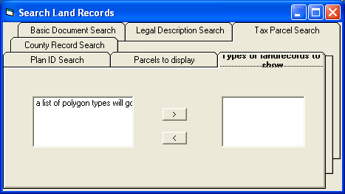
GIS Landbase – Filter Your View
A legal boundary layer with survey accuracy!
The Fabric is a “complete” historical record
  Older areas represent a lot of depth
  Encumbrances can make viewing ‘messy’
  Concept filtering mechanism
  Note: complete is relative, depends on what you put into it
Prototype

Slide 21
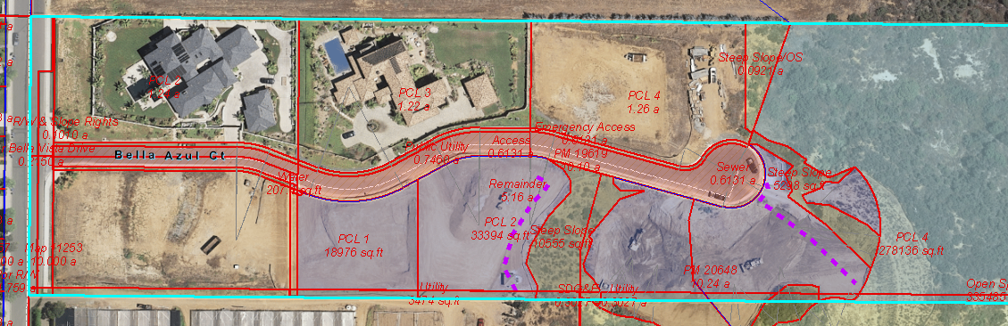
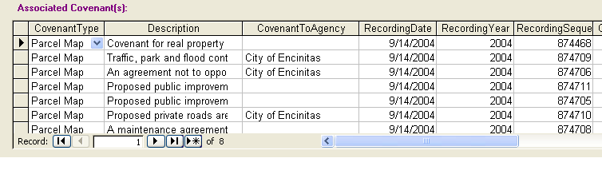
GIS Landbase – Related Covenants
A legal boundary layer with survey accuracy!
  Related covenants by Subdivision or Parcel Map

Slide 22
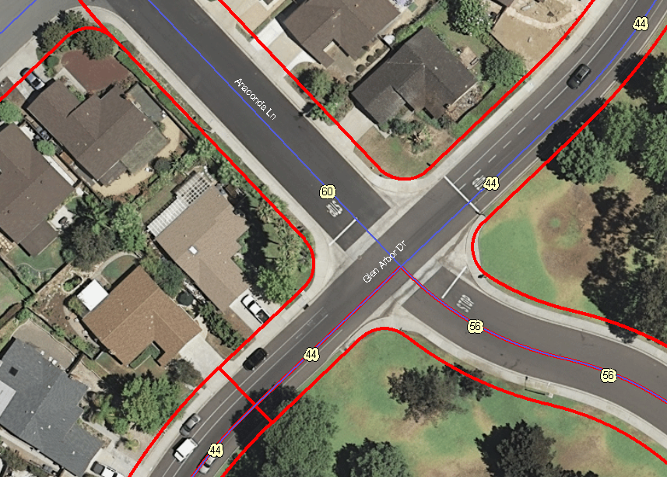
GIS Landbase – Right-of-Way Width
A legal boundary layer with survey accuracy!

Slide 23
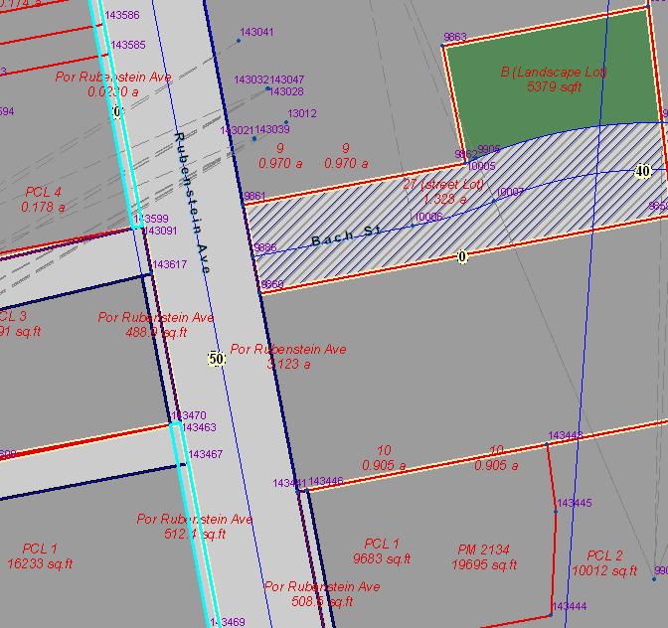
GIS Landbase – Right-of-Way Aquisition
A legal boundary layer with survey accuracy!
  Open Offers &
  Dedicated

Slide 24
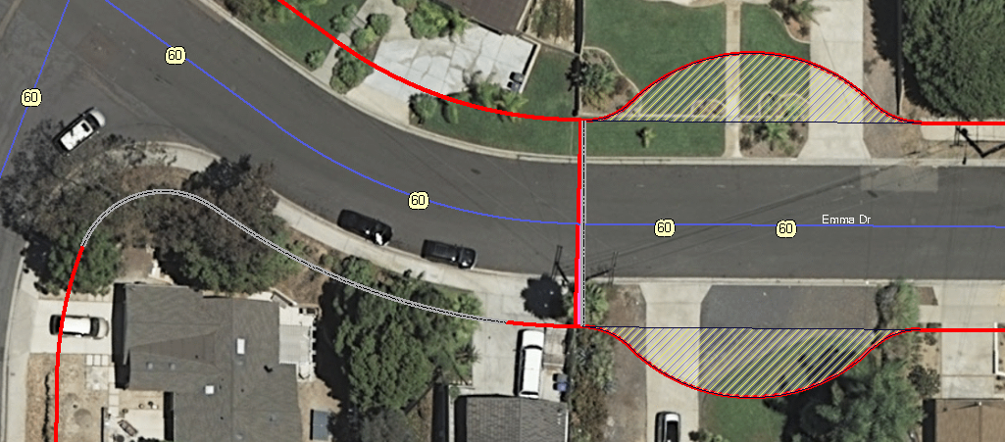
GIS Landbase – Right-of-Way Vacation
A legal boundary layer with survey accuracy!
  Vacated portion of Emma Drive
  Abutters rights of access relinquished

Slide 25
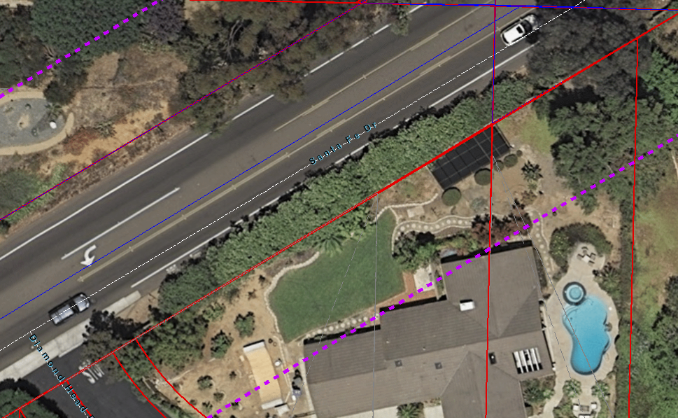
GIS Landbase – Building Line Restriction
A legal boundary layer with survey accuracy!
Defined setback from ultimate R/W
  Vacated portion of Emma Drive
  Abutters rights of access relinquished

Slide 26
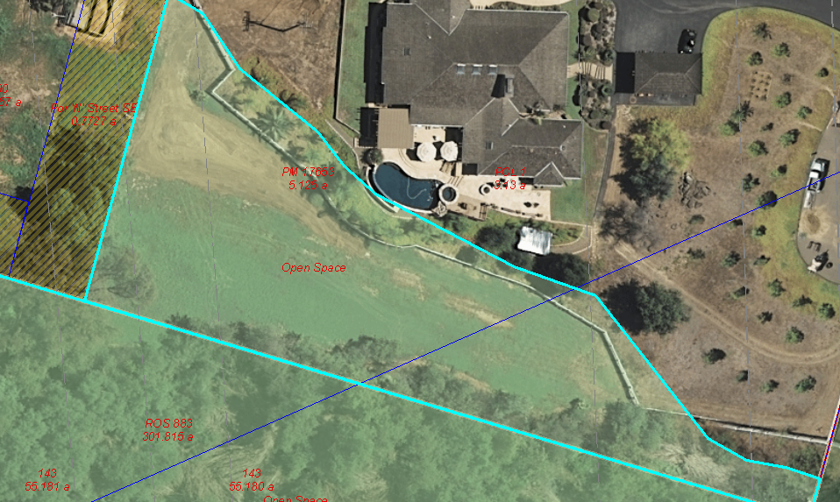
GIS Landbase – Encroachments
A legal boundary layer with survey accuracy!
  Potential Open Space Encroachment

Slide 27
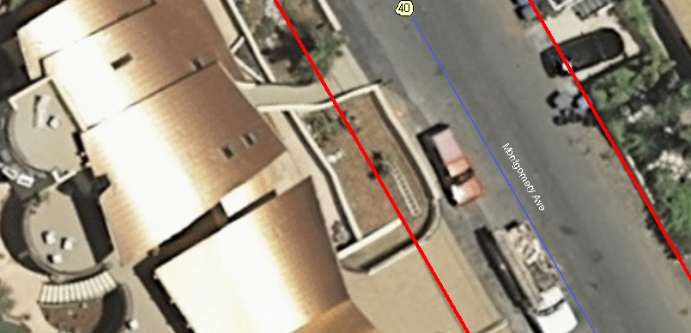
GIS Landbase – Encroachments
A legal boundary layer with survey accuracy!
  Potential R/W Encroachments

Slide 28
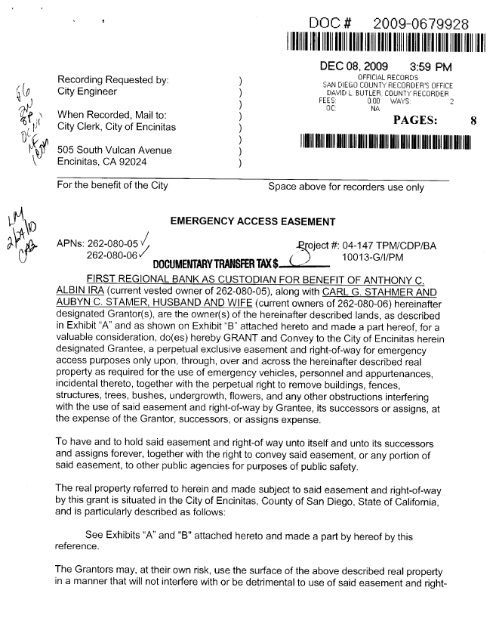
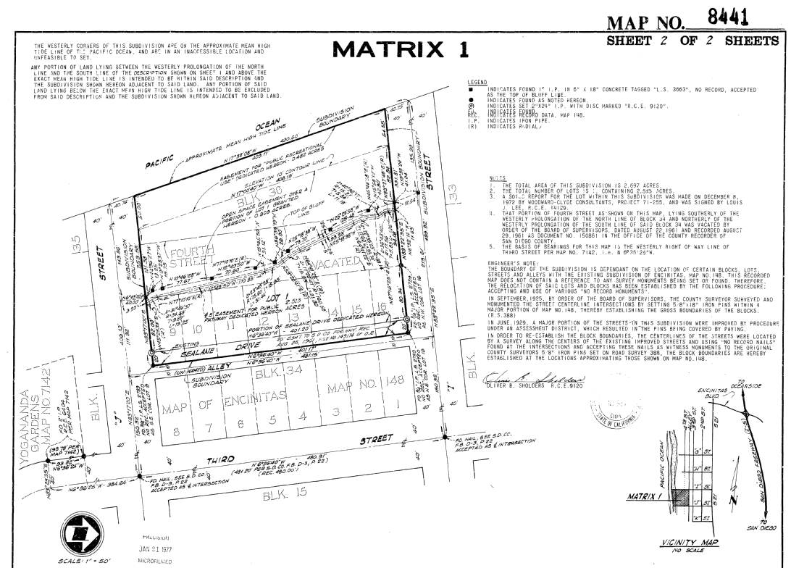
GIS Landbase – Hot Links to Laserfiche
A legal boundary layer with survey accuracy!
Click on a “parcel” bring up legal record

Slide 29
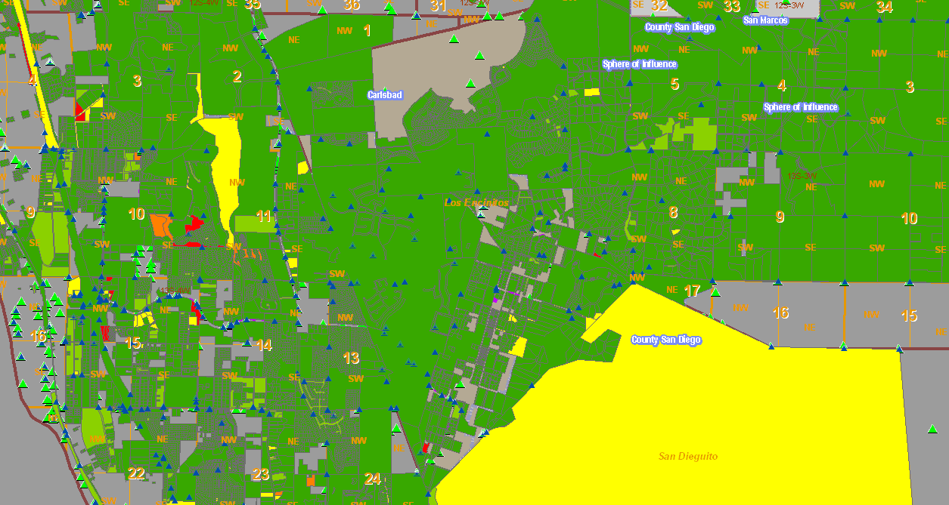
GIS Landbase – Accuracy Quantification
A legal boundary layer with survey accuracy!
Areas by mis-close
Misclose is but one example of an accuracy measurement
Green < .1’
Yellow .4 – 1’
Orange 1 – 2’

Slide 30
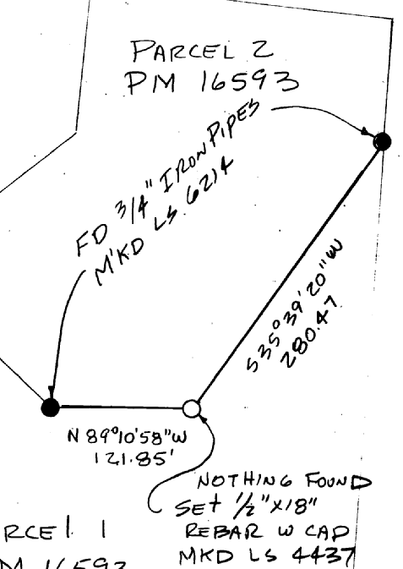
GIS Landbase – Monumentation
A legal boundary layer with survey accuracy!
Fabric Points
  Control & Attributes
  Monumentation & Attributes
Survey Control
Corner Records
    Capture monument size
    Capture monument text
    Capture monument type

Slide 31
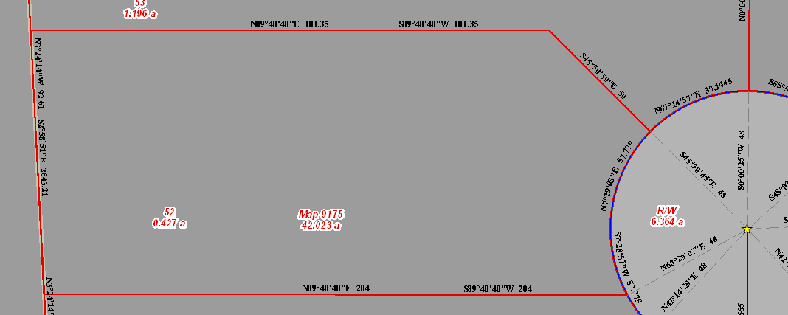
GIS Landbase – Record Dimensions
A legal boundary layer with survey accuracy!
  Bearings
  Distances
  Areas
  Frontage

Slide 32
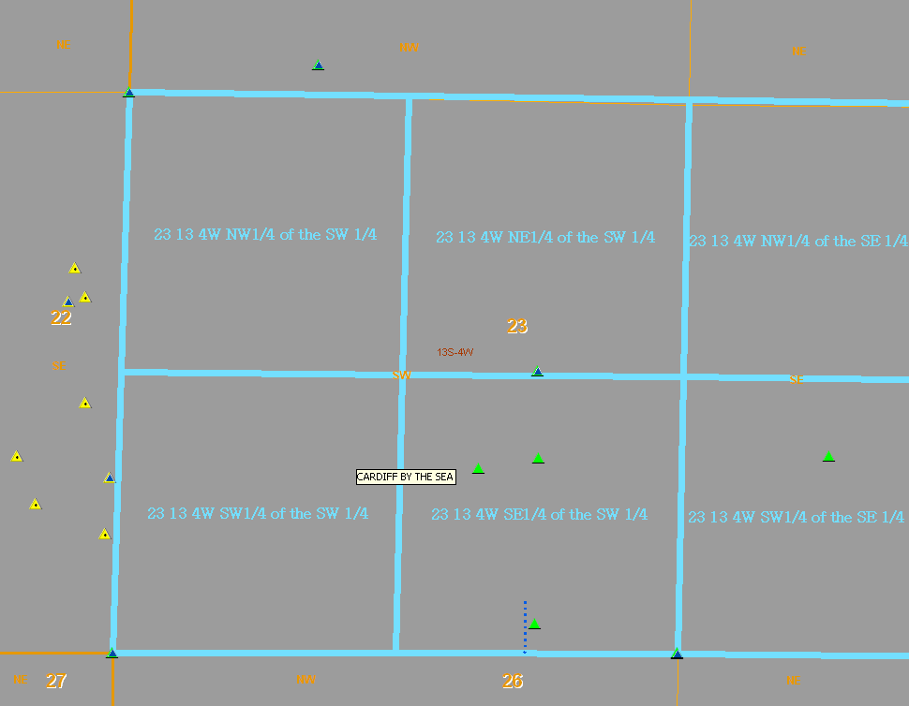
GIS Landbase – Public Land Survey
A legal boundary layer with survey accuracy!
Sixteenth Section Breakdown for the majority of the City
Example: Section 23-13-4W, NW ¼ of the SW ¼
Quick search “zoom to”

Slide 33
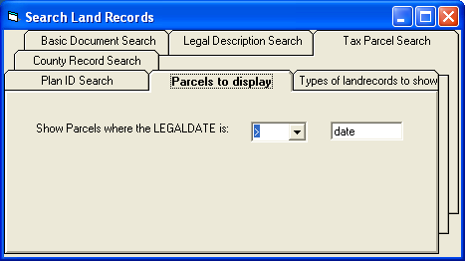
GIS Landbase – Any Point in Time
A legal boundary layer with survey accuracy!
Fabric represents a complete historical record
  Legal Start / End captured for each plan
  Nothing is deleted from the fabric
  In fact the more redundancy the better, historical records are a benefit and make the fabric stronger
  Complete boundaries, no “current portion only”
  Provides analytical capabilities for staff
Example …
Prototype

Slide 34
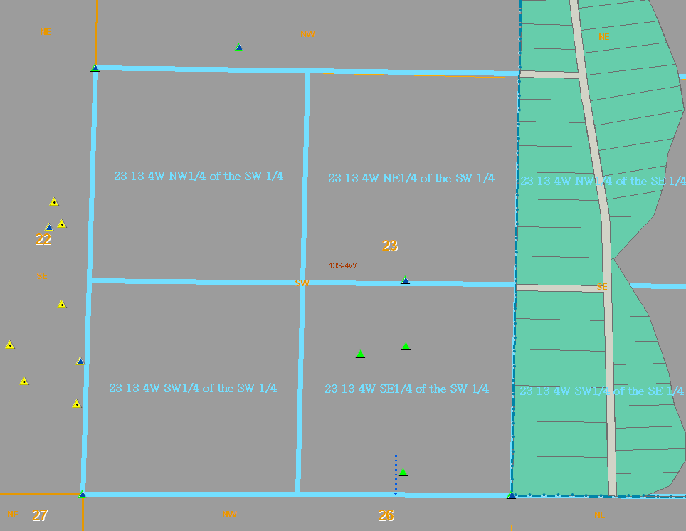
GIS Landbase – Dynamic “Time” Display
A legal boundary layer with survey accuracy!

Slide 35
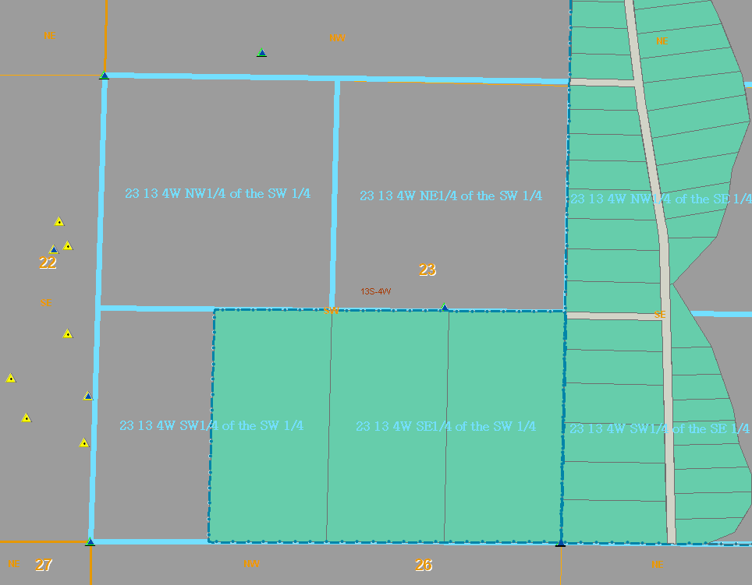
Subdivision Growth… Pre 1950

Slide 36
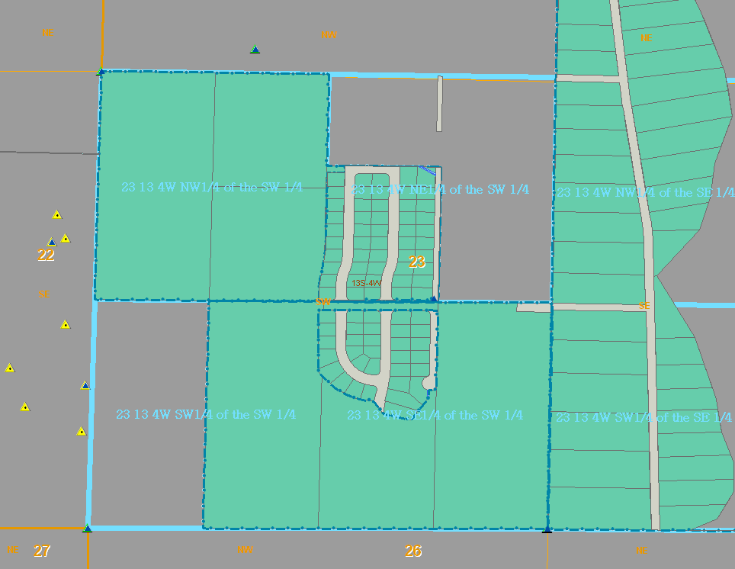
Subdivision Growth…Pre 1960
  Pre 1960

Slide 37
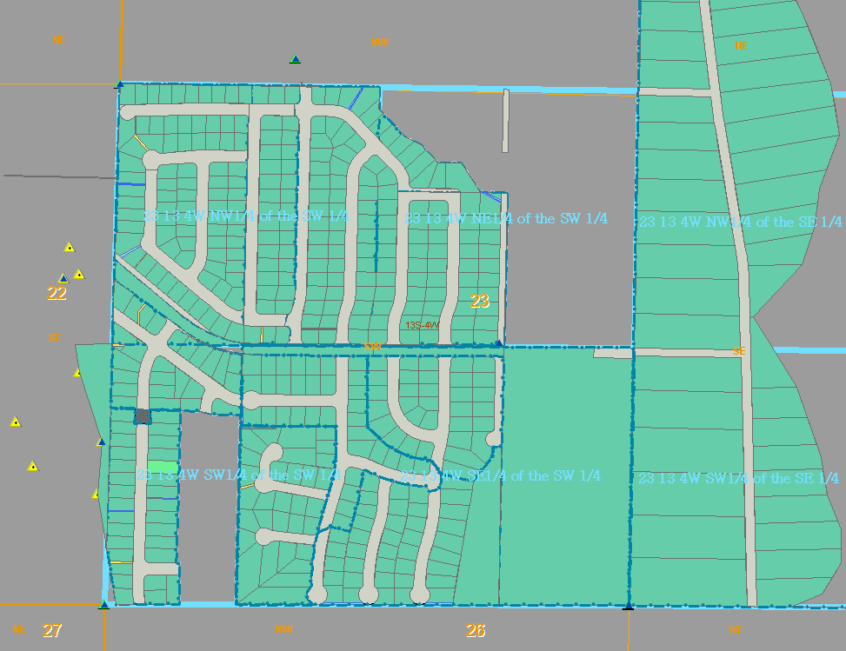
Subdivision Growth… Pre 1965
  Pre 1965

Slide 38
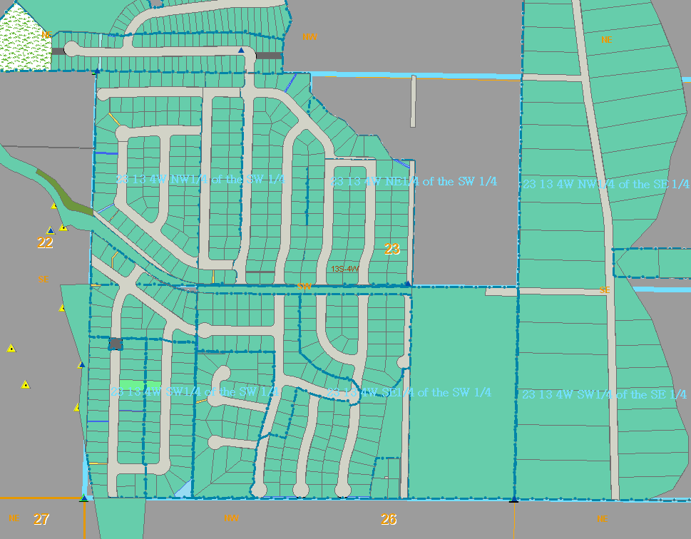
Subdivision Growth…Pre 1975
  Pre 1975

Slide 39
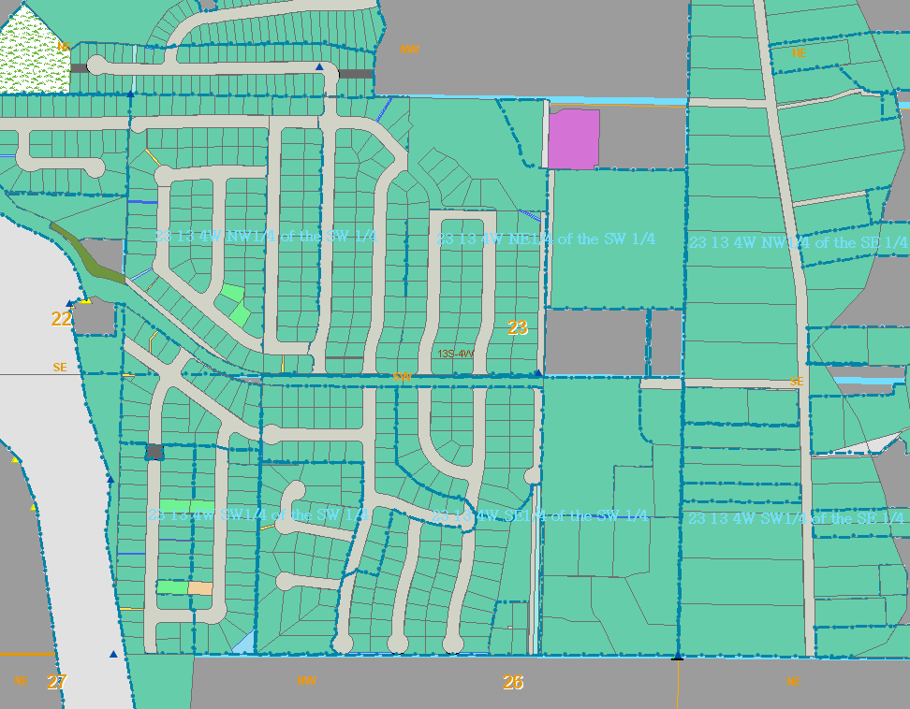
Subdivision Growth… Today

Slide 40
GIS Landbase – End Result
A legal boundary layer with survey accuracy!
Went from a “lot” layer with no intelligence, to:
Complete legal history back to the first division of land
Sub-foot spatial accuracy
  More positionally accurate than the Orthophotos
Correct configuration and alignment
  We can account for tenths of a foot in a parcel boundary
Foundation in which we can continue to build on for encumbrances
Foundation for new permitting system
Caught & Uncovered many mistakes in records
Improved quality of submitted plats to City (ongoing / pre-check)

