Slide 1
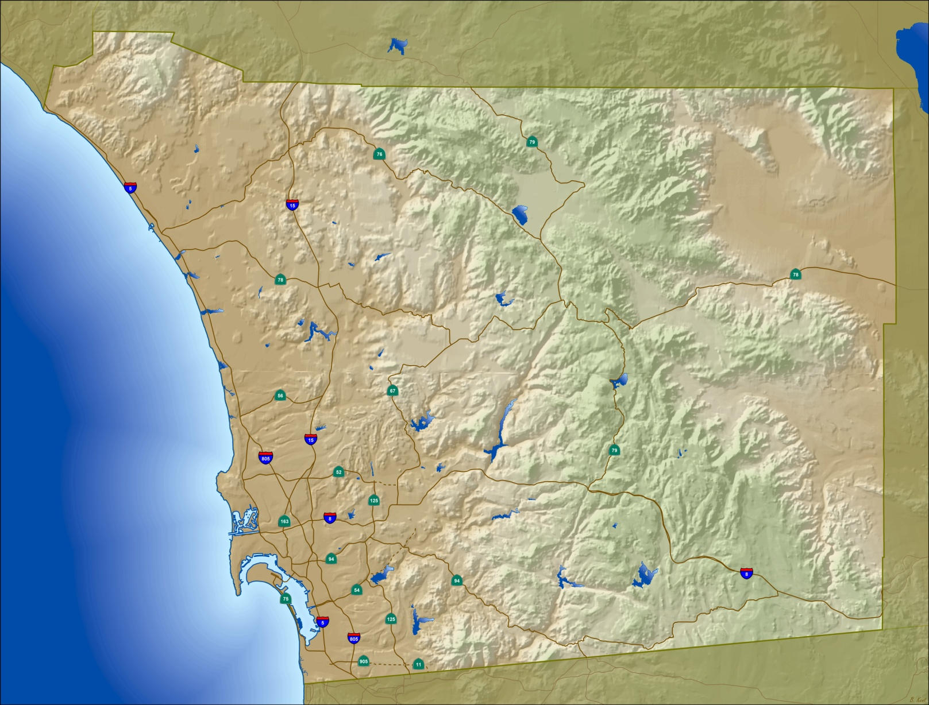
San Diego Regional GIS Council 2011 GIS Survey Results
Presented to SDRGC
July 20, 2011

Slide 2
2011 GIS Survey - Overview
Survey Focus
Software and Technology Usage
Agency GIS Staffing & Budgets
Current Data Usage
Data Updates : Local-to-Regional Workflows
Survey Structure and Timeline
9 Sections
38 Questions
Survey Open from March 7 to end of June
Key Stakeholders List – 1 person from every public agency directly invited, in addition, posted to SDRGC list
Respondents
Missing Data
5 Surveys were incomplete (including the County)
4 Surveys had unknown agency
44 Surveys Analyzed
Notes:
Software and Technology Usage
Agency GIS Staffing & Budgets
Current Data Usage – Regional vs. Agency Specific
Data Updates : Local-to-Regional Workflows

Slide 3
Key Findings
Mature GIS Community
42 out of 44 use GIS
GIS Staffing varied
Avg # Full-Time Staff = 3.5
Avg # Part-Time = 4.7
Avg # Contractors = 1.5
Many Agencies with Low Number of GIS Users
Notes:
We have a mature GIS community in San Diego.
Of the non-users, one has no plan to implement in the near future and one answered “maybe, no definite plans.”
42 of 44 agencies use GIS. 15 agencies have used GIS for more than 16 years.
In term of staffing, many agencies have fairly low number of GIS users. As you can see in this chart, 17 agencies have less than 10 gis users. The average number of full time staff is 3.5.

Slide 4
Software Use
Desktop Product Use
Web Mapping Software Use
Notes:
Top two are arcgis server and google maps.

Slide 5
Software Use
Database Product Use
Other GIS-related Software Use

Slide 6
Software Use
Programming Language
Operating Systems
Notes:
Programming and scripting languages- the top three are HTML, .net and Python.

Slide 7
Software Use
Enterprise License Agreements
GPS

Slide 8
Web Map Services
Sources:
Internally created
ArcGIS Online
Open Street Map
Google Maps
Esri Resources
USGS

Slide 9
GIS Data
SanGIS Data Usage & Updates
Data Sources
Other Vendors:
DMI
Merrick
Imperial County Tax Assessor
Notes:
34 answered yes. 11 skipped the question. Parcels and road center lines are the most popular sangis layers.
For the following data layers, please provide the source for your agency. If you use data from multiple sources, check all that apply. If it's a vendor, please list the vendor in the OTHER box.

Slide 10
GIS Data
Top 5 (by Average):
Imagery
Parcels
Rights-of-Way
Street Centerlines
Address Points
Top 5 (by Average):
Building Footprints
Easements
Rights-of-Way
Routable Network
Parcels

Slide 11
GIS Data
Top 5 (by Average):
Parcels
Street Centerlines
Rights-of-Way
Imagery
Address Points
Notes:
For the following data layers, please rank the importance to your agency. Select N/A if your agency does not use this type of data.
Is the majority of your agency's data available to others?
Comments:
Download through viewers
Reviewing fees and protocols
Current system capabilities don’t allow it
No tribal or student data
Except sensitive data
Hard copy or PDF
Written request to dept head
Only to campus members

Slide 12
GIS Data
Coordinate Reference System
Others listed:
WGS 1984 Web Mercator Auxiliary Sphere
Web Mercator Auxiliary Sphere for Web Map Services

Slide 13
GIS Applications
Applications tied to GIS (22 responded)
Are there any "outside" databases directly tied to your GIS? Check all that apply.
Answer Options | Response Percent | Response Count
Tax Assessor | 25.0% | 2
School enrollment | 25.0% | 2
Water usage | 50.0% | 4
answered question |  | 8
Notes:
77% Asset Management System
55% Document Management System
36 % Building Permits

Slide 14
GIS Applications
Geocoding Tool (20 responded)
Others listed:
Custom built (3)
Linear Reference Tool (TeleAtlas/TIGER)
3rd Party Applications
CommunityViz
Cityworks (2)
PowGIS & eZoning
FME (2)
GBA GIS Analyst
Permits Plus
Mapplet (2)
Geoviewer
InfoWater
FireView/CrimeView (2)
InfraMap (2)
Adjust.IT
Hansen
Laserfiche
Magik Components
TRAKiT
FileNet
StreetSaver
MapLibrary

Slide 15
GIS Applications
Internet Applications
http://redi.sandag.org
http://igr.sandag.org
http://gis.sandag.org/tficsr11/
http://gis.sandag.org/boundary
http://www.sandag.org/resources/maps_and_gis/jobsDensity.asp
http://www.sandag.org/resources/maps_and_gis/residentialDensity.asp
http://eassistance.cityofencinitas.org/
http://ezoning.cityofencinitas.org/
http://maps.geocortex.net/imf-5.2.2/sites/zoning/jsp/launch.jsp
http://209.242.148.137/ArcGIS/survey.html
PropertyFinder
OnPoint (development-related info)
http://www.sangis.org
http://209.242.148.137/ArcGIS/cip.html
http://209.242.148.137/ArcGIS/street.html
http://www.icommutesd.com/Bike/BikeMap.aspx
Intranet Applications
Emergency Response COP
Finder Map – site locator w/ownership
GIS Data Map Viewer for city staff
Dig Alert Tracking
OneStop GIS (query, view, print)
CVMapper (city staff map viewer)
EPIC planning tool
Parcel and Address Viewer / Site Profiler
Map imagery, parcel, streets and eventually sewer and storm drain
OnPoint general purpose viewer
ArcGIS Server Web ADF for employees
Plat map, engineering drawings, general geo for parcels and utilities
Water Utility App / Utility Viewer
Construction Project Info Viewer
ABC Lıcensing App
Online Ordering System
City app for code enforcement
Internal image server app
Survey Viewer
Notes:
Has your agency created any Internet/Intranet GIS Apps? Please list the type/purpose/customer of the app(s). If it is public, please provide the url.
Answer Options Response Percent Response Count
Internet1 (public) 50.0% 8
Internet2 18.8% 3
Internet3 12.5% 2
Intranet1 (internal) 93.8% 15
Intranet2 56.3% 9
Intranet3 37.5% 6 a
nswered question 16 skipped question 29

Slide 16
Agency GIS Budgets
Agency Budget & Funding Means
Budget Wish Lists
$10k = Hardware, Training, Imagery, Staffing, Assistance w/EOC Plan, GPS Hardware/Data, Software, Data, Application integration
$100k = Software, Hardware, Cloud Services, Data/Licensing, Staffing/Consultants, Integration Services, Digital plan submission program, Custom app/web development, GPS Hardware
$500k = Above + Enterprise Licensing/System Integration, GDB implementation, mobile hardware/software for field personnel

Slide 17
Agency GIS Budgets
How the GIS Budget is Broken Down (29 responses)
How the GIS Data Budget is Broken Down (24 responses)

Slide 18
GIS Use by Departments/Functions
Notes:
An additional question asked the respondents to estimate the % of time spent for each type of work: map making, Analysis, App Develop/Support, and Data Maintenance for the departments/functions that are supported. Results can be shared upon request.

Slide 19
Regional GIS Council & Participating Agencies
San Diego Regional GIS Council Participation
Thank you to the following agencies for participating. If you responded but do not see your name, please let us know as we had a few without the agency listed.
City of Carlsbad |  | Borrego Water District |  | SANDAG
City of Chula Vista |  | Calrans District 11 |  | SanGIS
City of Coronado |  | Camp Pendleton IGI&S |  | Santa Fe Irrigation District
City of Del Mar |  | Coronado Unified School District |  | SDDPC
City of El Cajon |  | County of San Diego |  | SDUSD
City of Encinitas |  | Helix Water District |  | Sweetwater Authority
City of Escondido |  | Imperial Beach |  | U.S Forest Service
City of La Mesa |  | Poway Unified School District |  | U.S. Fish and Wildlife Service
City of National City |  | Ramona Unified School District |  | UC San Diego Libraries
City of Oceanside |  | Regional Task Force on the |  | USGS
City of Poway |  | San Diego County Water Authority |  | Valley Center Municipal Water District
City of San Diego |  | San Diego Unified Port District |  | Vista Irrigation District
City of San Marcos
City of Solana Beach
City of Vista

Slide 20
2011 GIS Survey Results
Poster at 2011 ESRI UC
Final Report to RTC (Regional Technology Center)
Publish on SDRGC website

