Slide 1
City of Carlsbad GIS
Karl von Schlieder, GIS Manager
October 12, 2011

Slide 2
Background
1991 to 2005 – in Community Development
Since 2006 – now a division within IT
Serve the GIS needs of all City departments
Provide GIS services to outside entities on time & materials basis

Slide 3
GIS in Carlsbad
Core GIS division in IT – 3 staff members
Public works inventory group in Transportation Dept. – 3 data entry techs
Planning & Econ Dev – low-level ArcView users (< 3 staff)
All other staff use GIS division services and intranet mapping applications

Slide 4
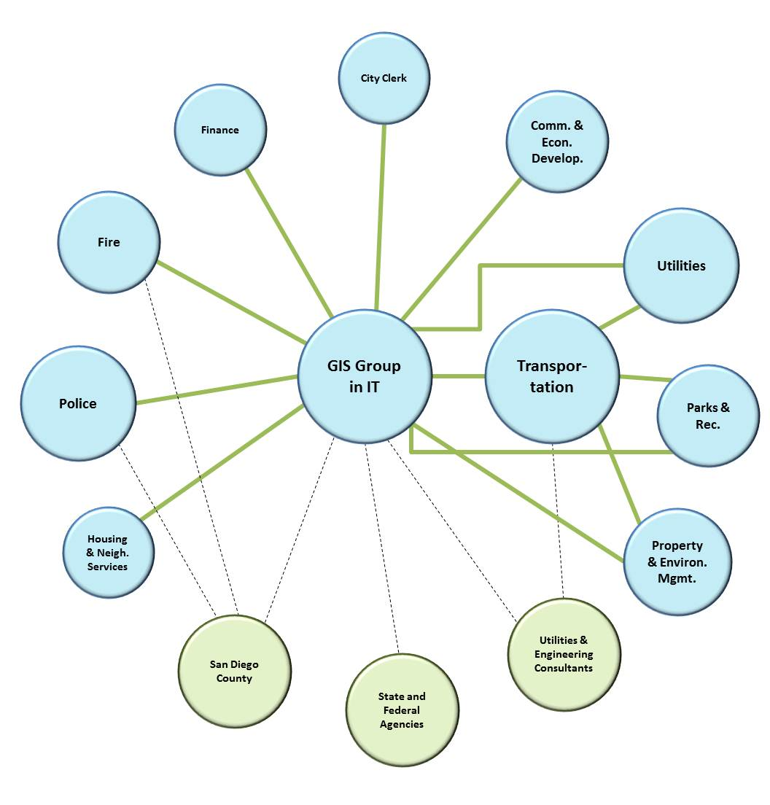

Slide 5
GIS Software
All Esri products:
ArcGIS for: Desktop, Server, Mobile
Rolta OnPoint mapping software
Intranet apps for general users, public works-oriented uses, DMS input, addressing
Internet app for zoning and general development information

Slide 6
Related Applications - Dependent
Hansen CMMS
Marshall GeoResults for Hansen
GBA Pavement Management system
Granite XP CCTV Pipeline Inspection system
Coming soon! Constituent Relationship Management (CRM) system

Slide 7
Related Applications - Linked
Permits Plus
Future:
Water utility billing
Business license

Slide 8
Funding for GIS
IT chargeback to all departments
Based on number of pcs/dept
Additional charge back amounts for dedicated COTS software maintenance, custom applications

Slide 9
Data Distribution
Currently we distribute all our non-proprietary data at no charge for data, charging only for labor to extract, format and deliver.
Done as response to Public Records Act requests

Slide 10
Current Projects
GIS strategic plan
Creating a standard address file
More internal OnPoint map services
Enhance internet e-zoning
Create lightweight Silverlight-based internet maps for individual departments
Embed GIS into CRM application

Slide 11
Current Issues
Outsourcing
What’s a commodity that can be sourced?
Internal cost vs. sourced cost
A continuum of services available
Managed Competition
IT (w/GIS) or GIS as separate entity?
Internal cost vs. competition
Where’s the value?

Slide 12
Questions?

