Slide 1
San Diego’s Regional Planning Agency
Smart Growth Concept Map Application
Presented at the San Diego Regional GIS Council meeting on October 12, 2011

Slide 2
Topics
Introduction of the Smart Growth Concept Map
Update of Smart Growth Concept Map
Old Process vs. New Process
Smart Growth Map Review Applications
Internet and Intranet Apps
Conclusion and Summary

Slide 3
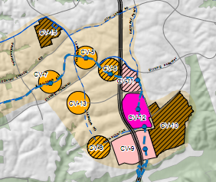
Smart Growth Concept Map
Shows areas that compete for Smart Growth Funding
Needs to be updated based on input from local jurisdictions and data from the SR12 Forecast and the 2050 RTP.
Notes:
Rachael

Slide 4
Old Review Process
SANDAG prints out hardcopies of maps
SANDAG sends maps to local jurisdictions
Local jurisdictions review and markup maps to identify changes
Local jurisdictions send maps back to SANDAG
SANDAG updates their GIS database based on feedback
Notes:
Rachael

Slide 5
New Review Process
SANDAG develops and publishes Web-based map
SANDAG sends link and login instructions for Web-based map to local jurisdictions
Local jurisdictions review Web-based map and electronically submit comments to identify changes to the map
SANDAG reviews comments as they come in from local jurisdictions
SANDAG updates the GIS database based on feedback
Notes:
Rachael

Slide 6
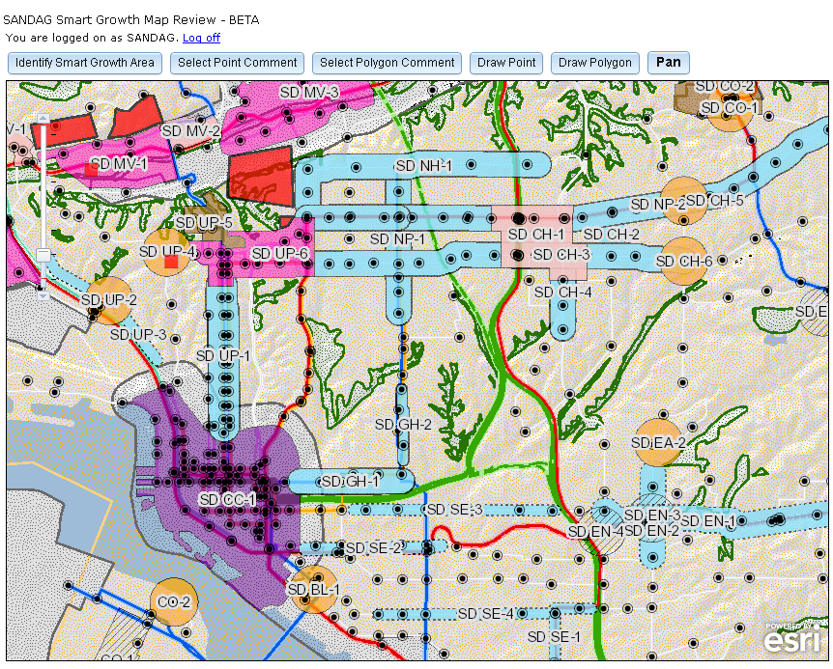
Smart Growth Concept Map Application Purpose
Review and Comment Smart Growth Opportunity Areas
Location
Boundaries
Type
Notes:
Steve

Slide 7
Smart Growth Concept Map Application
Internet App
Security Features
Open by invitation to a select group of planners from 19 local jurisdictions
Notes:
Steve

Slide 8
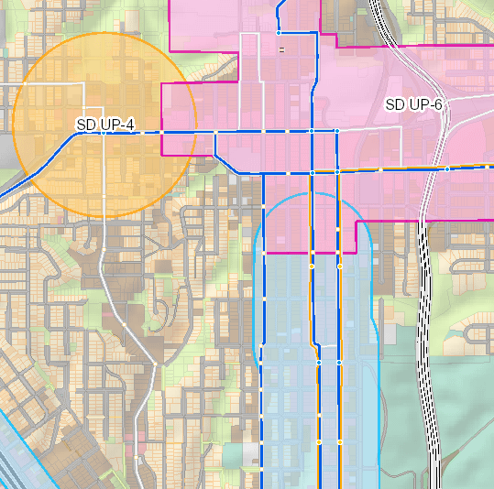
Smart Growth Concept Map Application Layers
Smart Growth Opportunity Areas
Symbology based on area type
Basemap
Freeways and Major Roads
Transit Facilities
Land-use by parcel

Slide 9
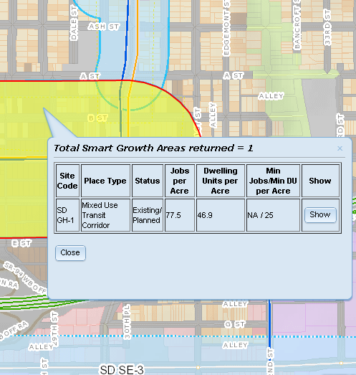
Smart Growth Concept Map Application Features
Identify Smart Growth Opportunity Areas
Site code
Place type
Jobs/Dwellings per Acre
Minimum Jobs/DU’s per Acre
Identify Parcels
Land-use codes
Forecasted dwelling units

Slide 10
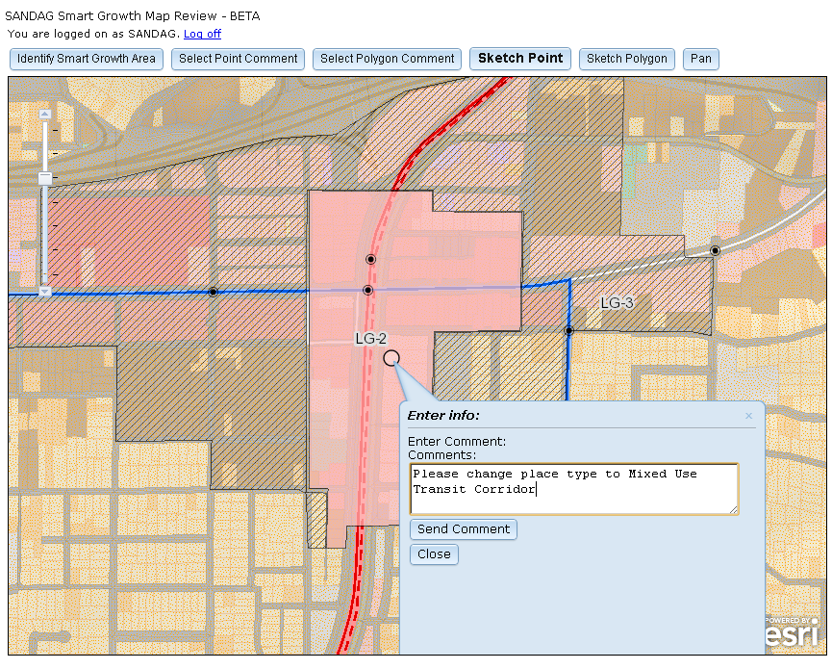
Smart Growth Concept Map Review: Request Change in Place Type

Slide 11
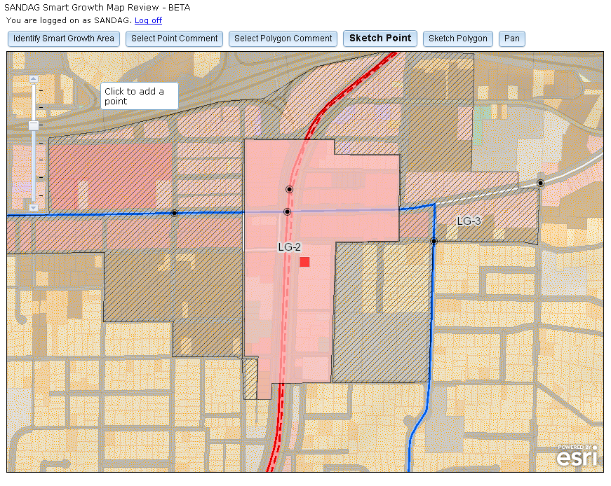
Smart Growth Concept Map Review: Request Change in Place Type

Slide 12
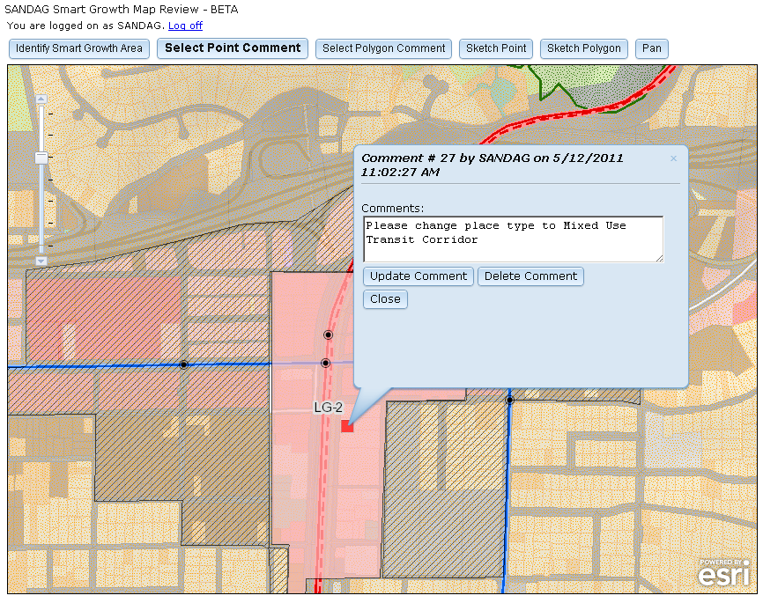
Smart Growth Concept Map Review: Request Change in Place Type

Slide 13
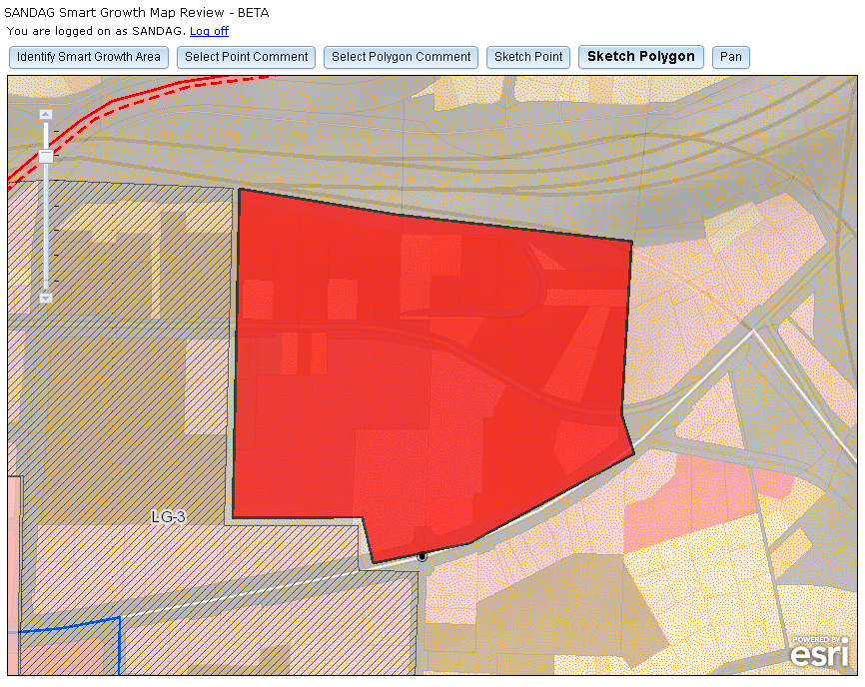
Smart Growth Concept Map Review: Request Additional Area

Slide 14
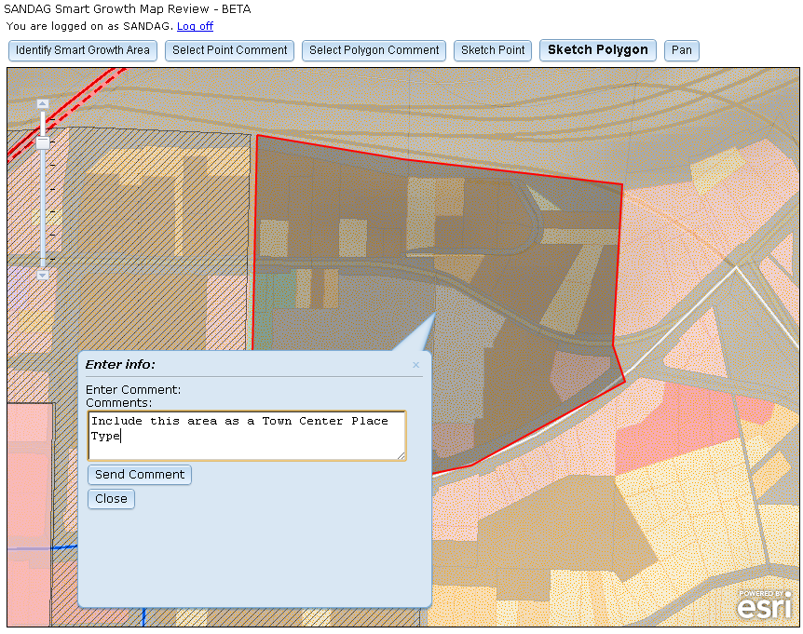
Smart Growth Concept Map Review: Request Additional Area

Slide 15
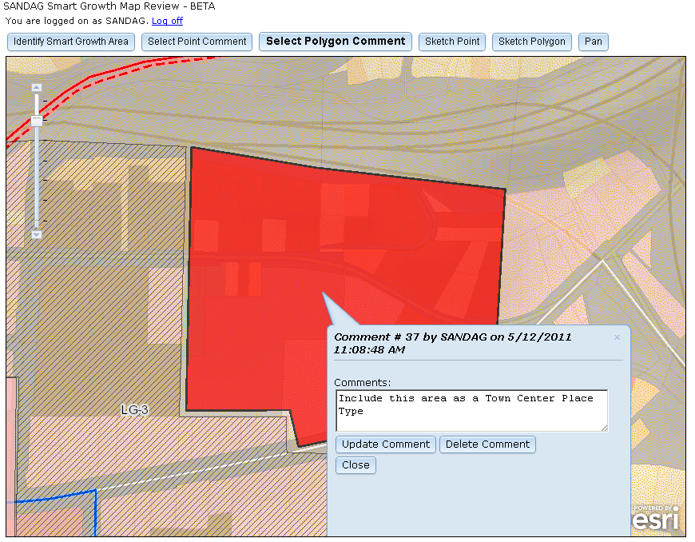
Smart Growth Concept Map Review: Request Additional Area

Slide 16
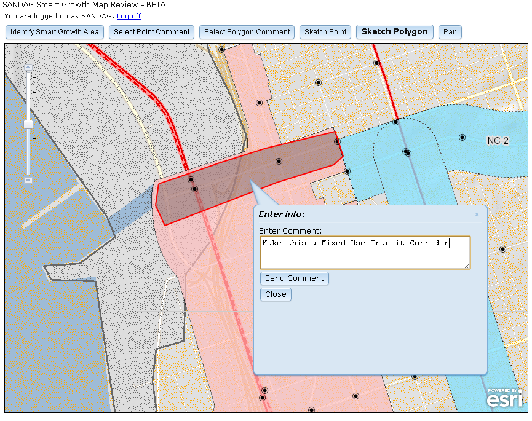
Smart Growth Concept Map Review: Split Smart Growth Site Area

Slide 17
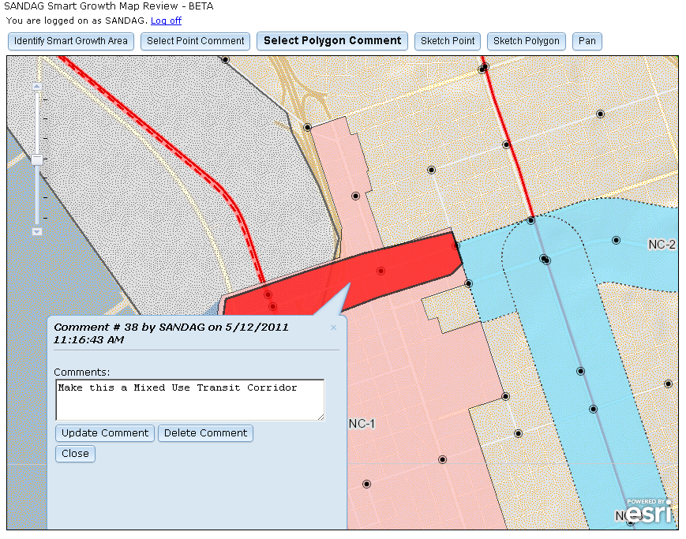
Smart Growth Concept Map Review: Split Smart Growth Site Area

Slide 18
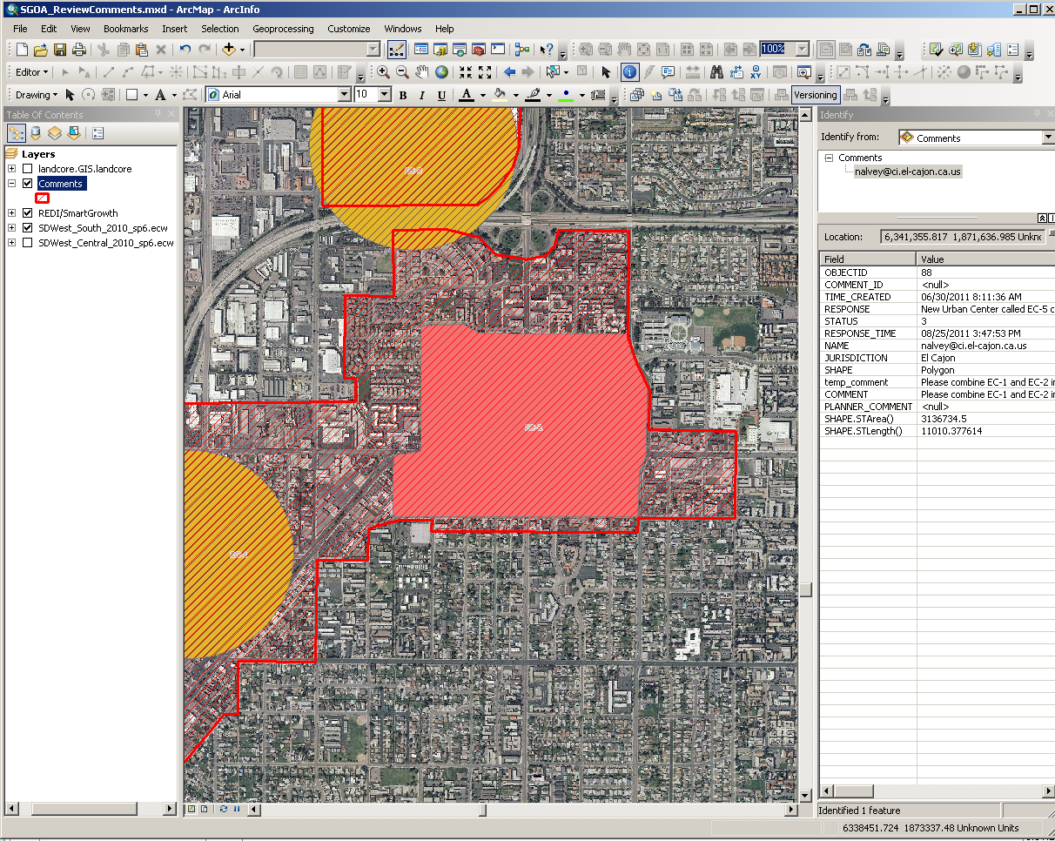
Smart Growth Concept Map Comments in ArcMap

Slide 19
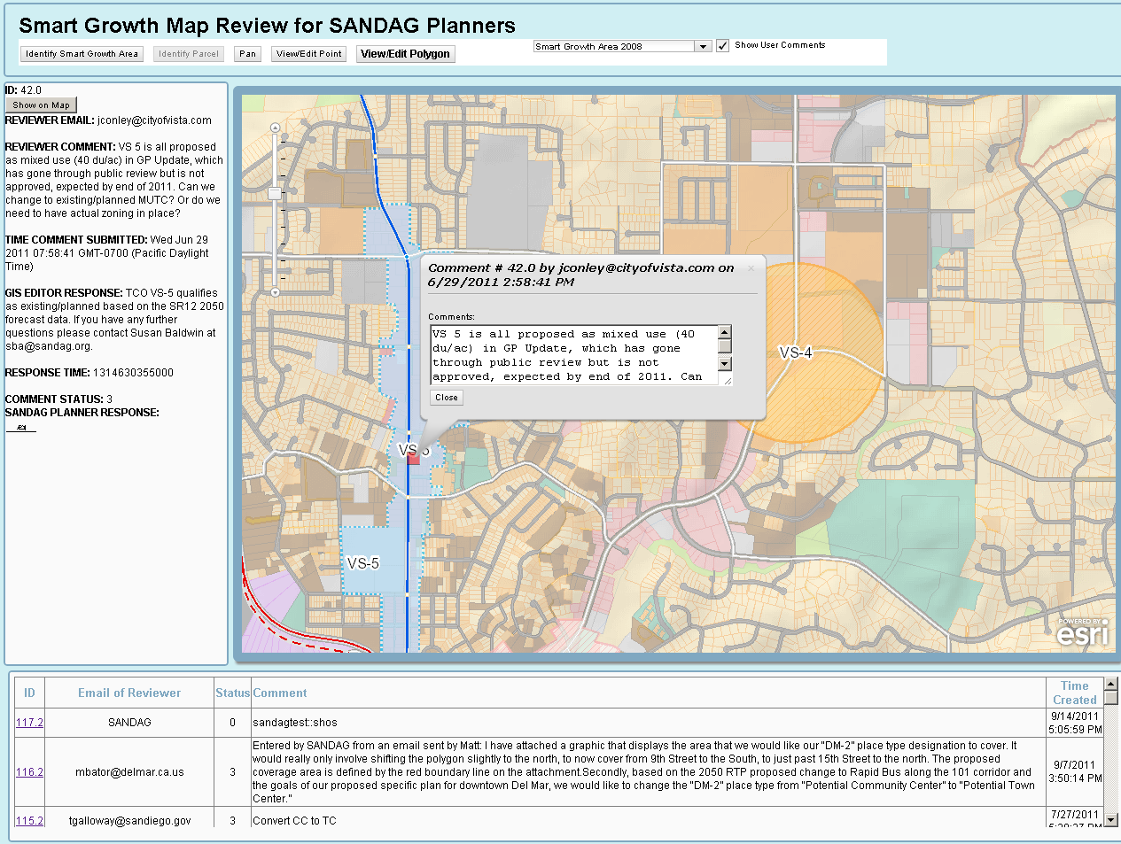
Smart Growth Concept Map Intranet Application

Slide 20
Technologies used for Smart Growth Concept Map Application
Client-Side
ArcGIS API for JavaScript Version 2.3
Server-Side
ArcGIS Server 10.0
Microsoft ASP.NET 3.5
Database
Microsoft SQL Server 2008
ArcSDE 9.3

Slide 21
Results
Received over 50 comments through the application
Some comments came in from other means
Shapefiles
Graphics
Comment period was one month
Revised Smart Growth Map ready a month later
Notes:
Steve

Slide 22
Conclusions
Better record keeping
All comments are stored in a central database
Easier for Collaboration with Jurisdictions
No need for printing a map for every jurisdiction
Accessible through the Web
Easier for SANDAG Review
Comments are immediately viewable in ArcMap
SANDAG Planners could easily use Intranet app
Update process not complete
Review entire process to determine lessons learned

Slide 23
More Info
www.sandag.org
GIS Staff
Steve Hossack – shos@sandag.org
Rachael Rider – rri@sandag.org
Project Manager
Carolina Gregor – cgr@sandag.org
Notes:
Steve

