Slide 1
Automating Aerial Imaging
Christopher Lippitt
Grant Fraley

Slide 2
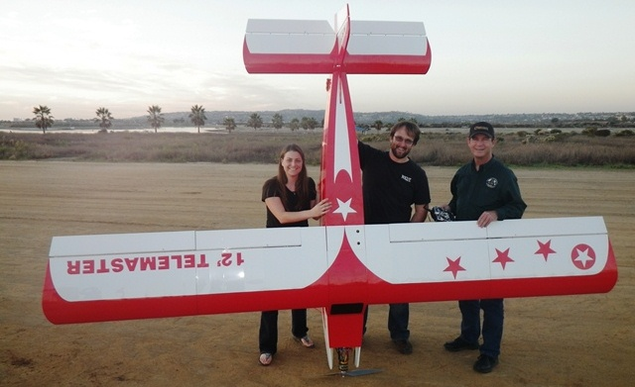
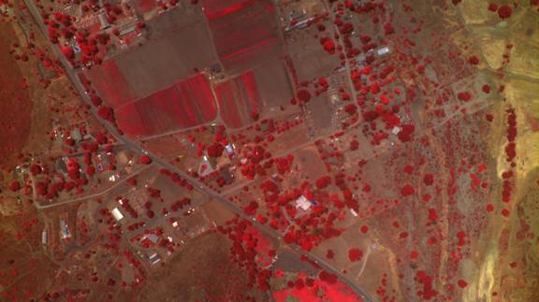
The Beginning
SDSU CESAR
TerraPan Labs
Spinoff of CESAR
Camera + Velcro + RC Airplane
Portable, flexible, remote sensing
“Plan-Fly-Map”
SDSU CESAR
UAV
Image Management

Slide 3
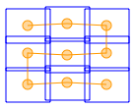
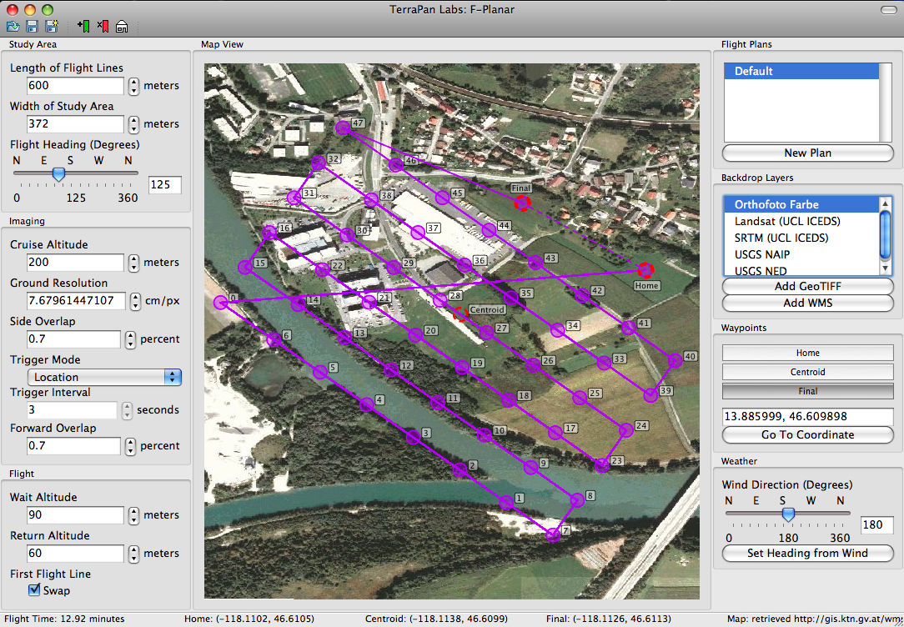
F-Planar: Plan
Interactive flight planning
Automated waypoint generation
Supports any frame camera
Output to UAV autopilot
Output to KML, GPX, and others for manned flight
SDSU CESAR
UAV
Image Management

Slide 4
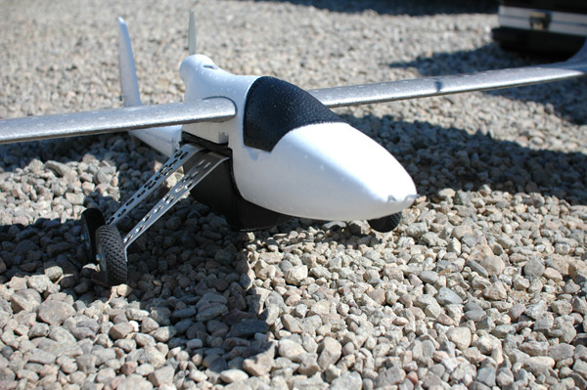
LOUIS: Fly
Autonomous unmanned imaging system
30 min duration with ~ 2sq. mile coverage at ~7cm
RGB, UV, NIR 10 megapixel sensor (3648x2736)
Optically stabilized Leica Lens
GPS + inertial data
Laptop ground control station
2.4 GHZ Remote Control (RC)
Week long training on RC piloting and system operation
SDSU CESAR
UAV
Image Management

Slide 5
Bloodhound: Map
Directifi
Rapid orthocorrection desktop software
Bloodhound
High precision mosaic and terrain generation in the “cloud”
1-2 pixel horizontal accuracy
~2 pixel vertical accuracy
Fully automatic
SDSU CESAR
UAV
Image Management

Slide 6
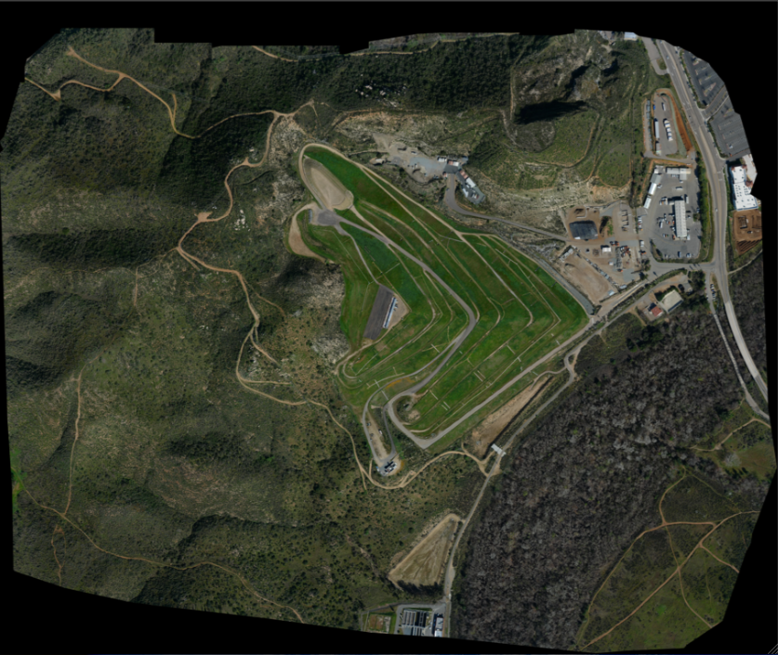
Bloodhound: Map
Example map: Mean projection error 0.865278 pixels, 0.6 mile coverage, 5cm resolution
SDSU CESAR
UAV
Image Management

Slide 7
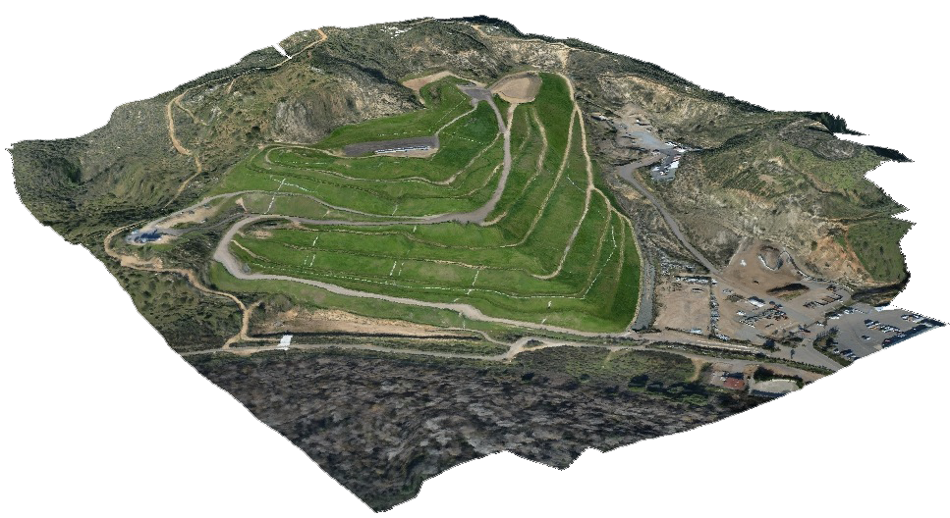
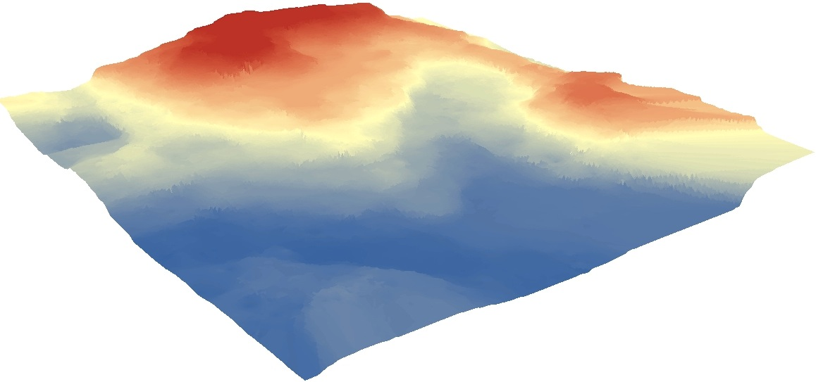
Bloodhound: Map
Example map: Mean projection error 0.865278 pixels, 0.6 mile coverage, 5cm resolution
SDSU CESAR
UAV
Image Management

Slide 8
FAA & UAVs in National Airspace
FAA Certificate of Authorization (COA)
Issued for 1 year, can ‘renew’ certificate once
Currently available to Government agencies only
State, local, and Federal agencies
State Universities
Law enforcement, first responders
Application assistance available
SDSU CESAR
UAV
Image Management

Slide 9
TerraPan Labs: Moving Forward
Managing multi-temporal archives of imagery
Post-earthquake change analysis project
Monterrey Naval Post-graduate School
SDSU
TerraPan Labs
Interactive data viewer
On-the-fly change analysis
Visual management of enormous image databases
SDSU CESAR
UAV
Image Management

Slide 10
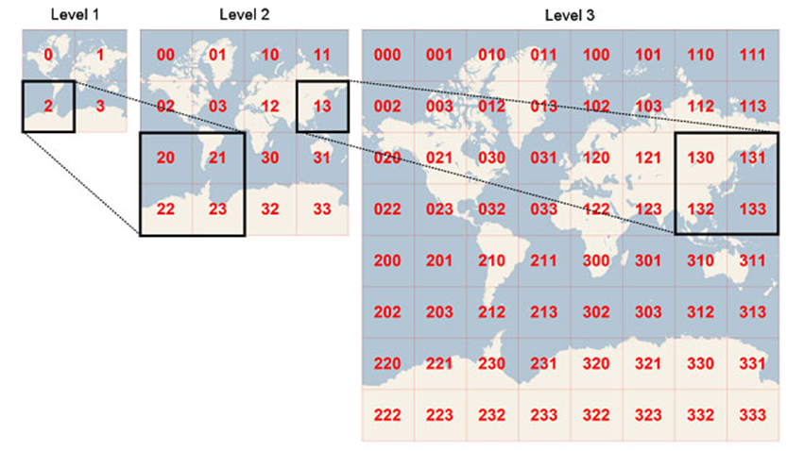
ImageTank
Extending the web-based model of tiles and zoom levels
Layers of data with movable ordering
Handles temporal or overlapping imagery
Breaking free of the single mosaic
On-the-fly analysis and visualization of results
SDSU CESAR
UAV
Image Management

Slide 11
ImageTank
Subscription-based cloud service for hosting and processing of imagery
Social (public) or private sharing of views into your database
Low resource footprint for municipalities and organizations
SDSU CESAR
UAV
Image Management

Slide 12
ImageTank: Comments?
Imagery management solutions
Sharing of imagery publicly or privately
Collaborative analysis
IT Resources (storage, security)
SDSU CESAR
UAV
Image Management

Slide 13
Questions?
More info:
Lippitt@TerraPanLabs.com
Fraley@TerraPanLabs.com
www.TerraPanLabs.com
Facebook.com/TerraPanLabs
Twitter.com/TerraPanLabs

