Slide 1
County of San Diego
Geographic Information Systems Technology Platform
Geospatial Strategy Document-GeoSD
2014-2016 GIS Strategic Plan
The County GIS Strategic Plan - Method and Roadmap ahead

Slide 2
COSD GIS Strategic Plan Methods
Background Justification and how we did it

Slide 3
Why we did it
Geospatial technologies are growing rapidly - amazing and dramatic changes in applications are now possible in government services
“The where” of things now matters at an enterprise scale
Strategic planning is necessary for effective management Information Technologies (IT) implementation
Notes:
Speak as a group if desired about growth of enterprise applications (use IPTS and Accela as an example)

Slide 4
What we wanted
To review our current and future Geospatial technology use and develop a roadmap for our enterprise GIS platform and people
Build it as a reusable tool for San Diego County’s GIS Vision, Mission, and Goals
Realign the County GIS functions and SanGIS Land base to better support service delivery
Notes:
Jeff please speak to bullet point 2 about realign the mission for collaboration between SanGIS and Assessor.

Slide 5
COSD GIS Strategic Plan Methods
Vision Highlight - What Was
GIS Projects and Operations
Actions
“Strategy”
Planning
Before
Notes:
Simple diagram that shows strategy was more of a reaction before and now is a method used before action.

Slide 6
COSD GIS Strategic Plan Methods
Vision Highlight – The Strategic Planning Cascade
Plan Strategy
Execute Strategy
Budget for Objective Actions
Review Objectives Planning
Assess Impacts on GIS Operations and Projects
Document Results
Plan Objectives
Make Corrective Actions in Objectives
Avoid projects that are not useful
Execute Objective Actions and Projects
Collect New Objectives
Review Strategy
Plan Objectives
After
Notes:
Jury is out on whether this should stay or the clock should be included.

Slide 7
Detailed Summary
Who was involved?
A group of County executives formed the Executive Committee. A group of GIS Users and Experts wrote the plan as the Steering Committee.
Which and how many staff were involved?
The effort employed staff from HP and a professional facilitator. Approximately 12 people.
This is a living document
What did we produce?
A usable planning document that will evaluate the current major GIS projects in the County and the Current resources available to accomplish them.
Notes:
Ross can comment on the groups involved and product made. Color commentary needed here.

Slide 8
More Facts
What is the immediate benefit?
Current projects that will require GIS resources and coordination will be considered on a whole in relation to the County’s overall needs. Gaps will be bridged.
How long did it take?
About 3.5 months were planned for the entire process – October was our deadline from County leadership to have the draft
Funding needs?
The effort was funded by the LUEG Exec office and the plan will be maintained long term by COSD GIS Manager.
Notes:
Ross can comment on the immediate benefit and timing aspect. Color commentary needed here.

Slide 9
Committee Participants and Jobs
Executive Committee ( alphabetic order )
Sarah Aghassi
Ernest Dronenburg
Mikel Haas
Ashish Kakkad
Ron Lane
Nick Macchione
Steering Committee
Was required to collect and vet content and process it into the strategic plan
Regional Entities/Pro groups
SANDAG
SanGIS
SDRGC
ESRI
Operational Users
Were required to research concepts and ideas of current and future operational uses of GIS
GIS Subject Matter Experts
Were required to research the potential concepts and strategies using specific GIS technology
Notes:
Ross can describe the groups and their roles

Slide 10
Timeline
Milestones | Date
Final Proposed Project Plan | 5/1/2013
Socialization with Executives/Departments (participants identified) | 5/25/2013
Strategic Plan Kickoff | 6/7/2013
Workshops | 7/15/2013-9/15/2013
Final Approval by Executive Steering Committee | February 2014
Closure Presentation | March 2014
Notes:
Make a note that it took 10 months to complete, but the bulk of the work was done in 2 months.

Slide 11
How did we do this?
COSD GIS Strategic Plan Methods PLAN Approach
Collaborative, Concentrated, Strategic Workshops
A Facilitator
Simplicity
Vision, Mission - Objectives Driven focused on GIS as a strategic platform – We created a simple and useable document
NOW?, WHERE?, HOW? method
Notes:
Ross can speak to the method, but I would really like someone to comment on the workshops or process.

Slide 12
Here we are today
Now what?
1-7-36
Notes:
Intro to where we are now. The “Formula” for our strat plan

Slide 13
It is done
Notes:
Picture of the plan as it is now. Once the presentation is done – so too is the plan started.

Slide 14
Summary of Plan
Help the County accomplish its strategic goals
Make it easier
Save money
Notes:
This is the barebones summary of the mission statement

Slide 15
One Vision
GIS is a strategic platform around which County staff support the County’s three strategic initiatives:
Safe Communities * Sustainable Environments * Healthy Families
To support these initiatives, we must:
Guide the increase, effectiveness, innovation, reliability, accuracy, and value of geospatial information and tools; while lowering costs for the organization as a whole.
Notes:
Ross can do this slide to comment on the County’s strategic initiatives are our “initiatives” and that we have one vision statement.

Slide 16
Many Missions
From the County’s vision, it has built a list of mutually desired guiding principles, or design maxims. Here it seeks to:
Develop mutually accepted standards, policies, and business practices; and to make them self-referential, easily understood, and supported.
Communicate the value of GIS to County departments and agencies. When good things happen, tell people and popularize the success stories and allow others to leverage the knowledge.
Encourage collaborative GIS efforts among County, external government, and related organizations. Collaboration is one of the things that makes the County of San Diego great.
Ensure that GIS resources are available for day-to-day operations: look for high availability IT design approaches that are both robust and flexible; and to focus on the core business practice of GIS - not fixing the GIS as the core practice.
Maximize the cost-effectiveness of GIS investments. Use functional threading and economies of scale to build partnerships within region.
Cultivate the advanced use of GIS. County staff must not only stay current, they must also remain well-read and agile. Not all technological avenues produce fruit forever.
Pursue the innovative use of GIS and related technologies. Look for research on practical applications and use pilot studies with the technology. Move technology quickly into practical tests.
Integrate GIS technologies into County business operations. Where it is appropriate and timely, use it! Don’t fear change; look for obvious returns on investments.
Support emergency and disaster planning, response, and recovery. If there is one thing that must be done right, it is to help people when they need it most.
Notes:
This slide is a red herring – I will joke that I am going to read it out load to them, then switch out to the next slide with the goals.

Slide 17
Seven Goals
Create, collect, maintain, and distribute high quality, up-to-date, and complete geospatial data
Ensure that the County’s GIS systems and data are available for day-to-day County/regional purposes
Share the County’s GIS data and services as widely as possible
Cultivate the advanced analytical use of GIS
Raise the awareness of GIS
Assist agencies to integrate spatial technology into their business processes and applications.
Support emergency planning, response, and recovery
Notes:
Robby can speak to the 7. Support Emergency Planning Goal, Ross can speak to the goal 6. Assist agencies in moving forward with GIS, Isabel can you speak to 5. raising awareness? Adrienne, can you speak to the 3. share the County's GIS data and services? Melanie, Can you speak to 2. Ensure that the County’s GIS system is available? Jeff, Can you comment on the Goal 1. collect and maintain and distribute?

Slide 18
Thirty Six Objectives
(By goals)
2-6 (creating self-service mapping infrastructure) or 3-2 (online web mapping & query)
4-2 (or 4-6) access to internal expert or outside training at various levels of expertise
6-3 (core GIS support staff to support GIS services)
Notes:
Isabel will refactor this slide to reflect the perhaps more attractive objectives, Jeff will speak to one for certain about parcel editing.

Slide 19
The 36 - Continued
Medium - Adopt a County of San Diego address standard and document the address correction life-cycle (Goal 1)
Short - Develop a plan for resuming the previous user group meetings on a regular basis
Long - Take ownership and the responsibility of day forward updates of the parcel layer (which currently resides with SanGIS) (Goal 2 and 6).
Notes:
Isabel will refactor this slide to reflect the perhaps more attractive objectives, Jeff will speak to one for certain about parcel editing.

Slide 20
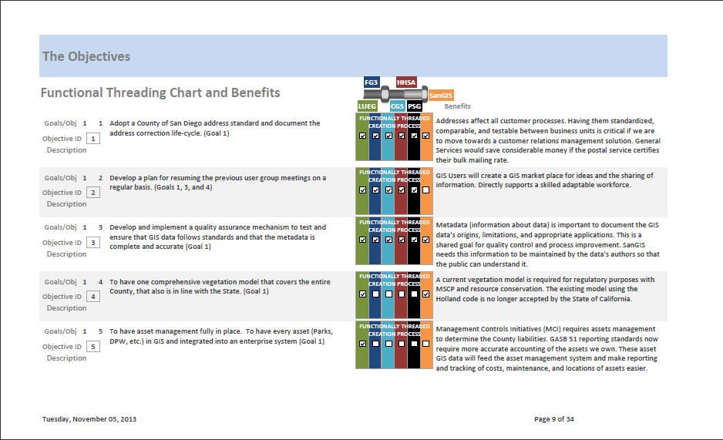
Easy to use
Notes:
Ross Can Comment here about the functional threading chart and the rational or benefit statements

Slide 21
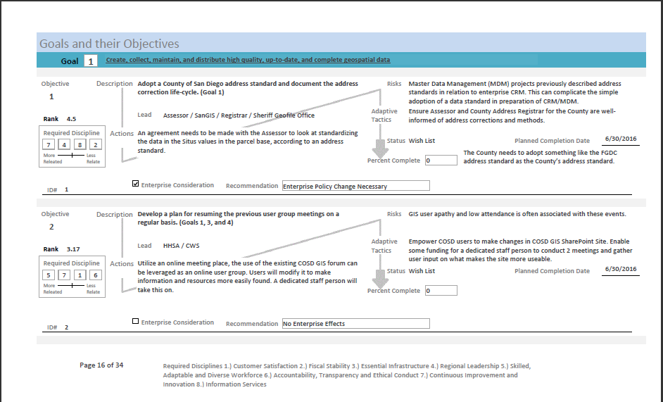
Built as a reference
Notes:
Ross will comment about the flow of objectives as a reference document – how it includes adaptive strategies

Slide 22
Maintain a 2 year discipline clock
Execute Strategy
Complete Objectives
(July) Report Results
(Jan) Plan Strategy/ Objectives
Document Results
(July) Report Progress
Complete Objectives
(Jan) Collect and Correct
Year 2
Year 0
Year 1

Slide 23
“We have a strategic plan…. It’s called doing things.” -Herb Kelleher Done Done and Done Thank you

