Slide 1
Metadata Status
Presentation to the San Diego Regional GIS Council
April 23, 2014

Slide 2
Regional GIS Metadata Working Group
John Hofmockel (SANDAG)
Brad Lind (SanGIS)
Louise Wedley (SanGIS)
Scott Daescher (City of San Diego)
Melanie Casey (County of San Diego)
And others
Sign-up sheet for Regional GIS Metadata Working Group
Meeting Dates:
Jan 16
Jan 30
Feb 13
Feb 25
Mar 13
Mar 26
Apr 17
Next meeting May 7

Slide 3
Metadata Goals
Use ArcGIS 10.1 Metadata Editing Tools
Use ISO 19139 Metadata Standards
Keep the metadata editing and maintenance procedures simple
Limit customization
Notes:
Ask SDRGC: How many ArcGIS 9.3? 10.0? 10.1? 10.2?

Slide 4
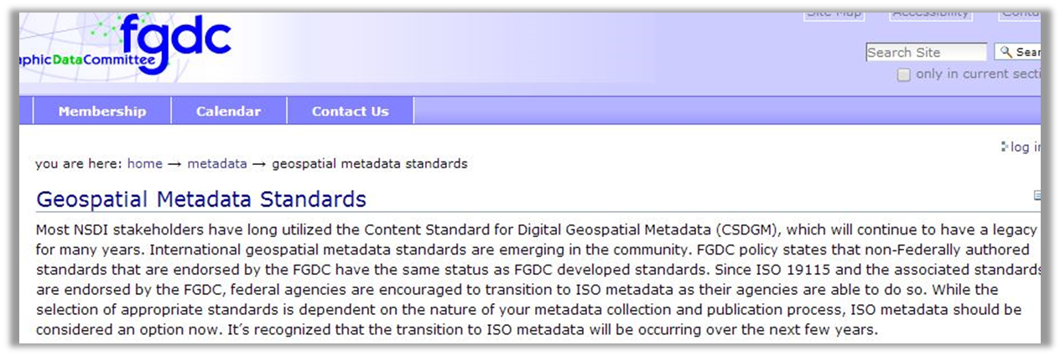
ISO vs. FGDC
FGDC - The Federal Geographic Data Committee
ISO - International Organization for Standardization
Notes:
the organization adopted "ISO", derived from the Greek word isos (ἴσος, meaning equal), as its abbreviated name.

Slide 5
Some products
Metadata Editor Manual
Quick Reference Guide
Metadata Custom Stylesheet
Display
Publishing
Editing (flag required elements)

Slide 6
Quick Background
ArcCatalog Description tab
ArcCatalog Metadata Style
ArcCatalog Metadata Editor

Slide 7
Description tab

Slide 8
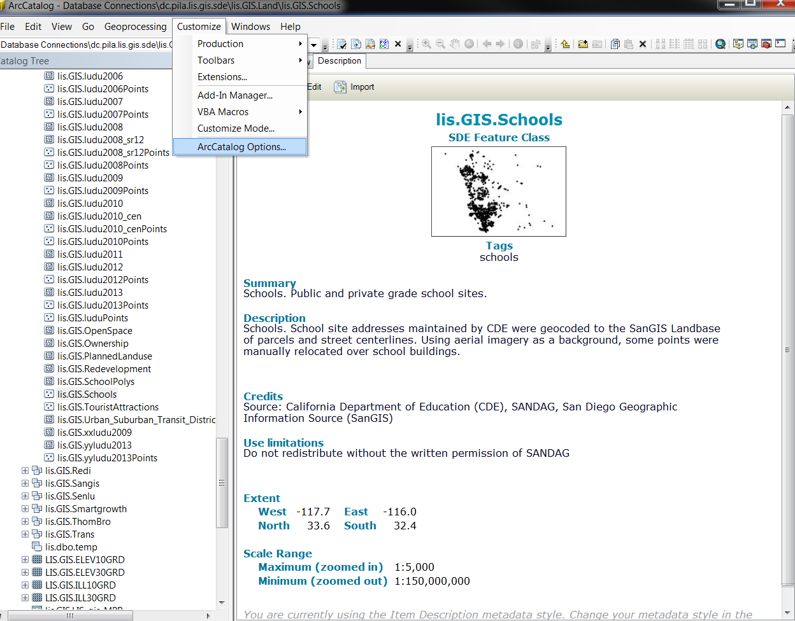
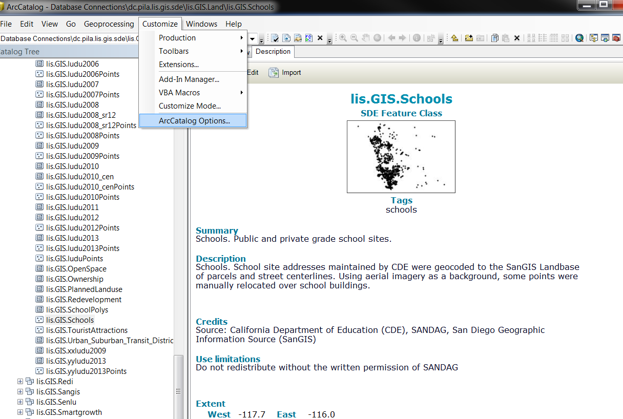
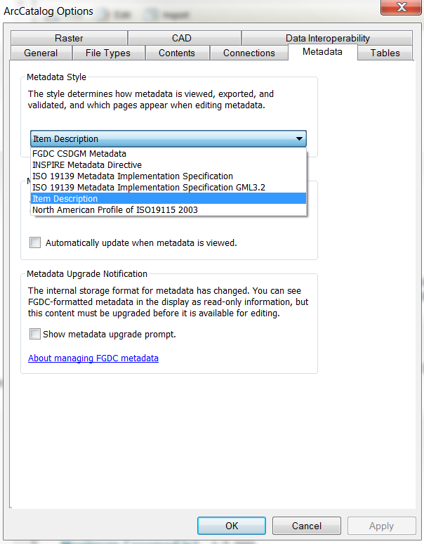
Metadata Style

Slide 9
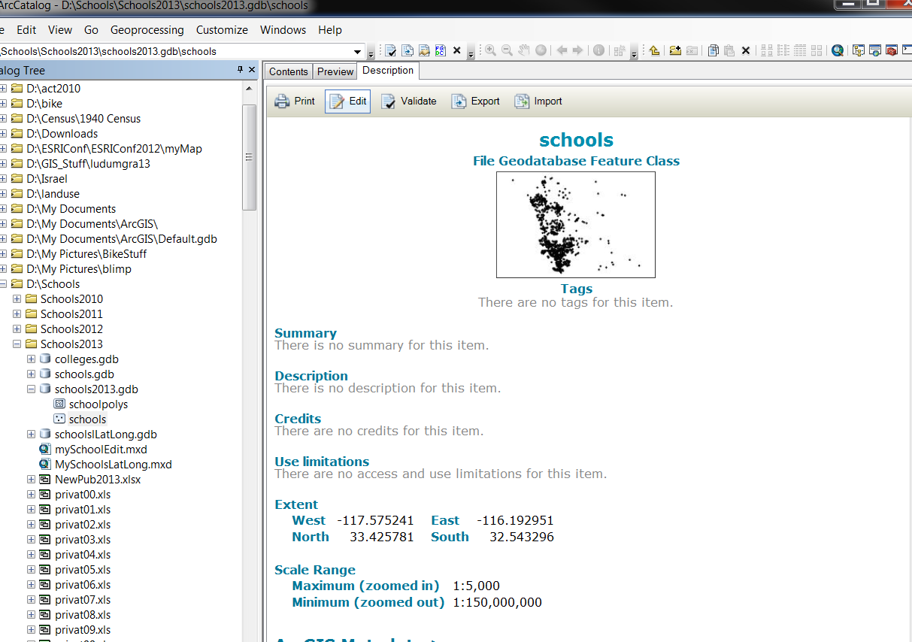
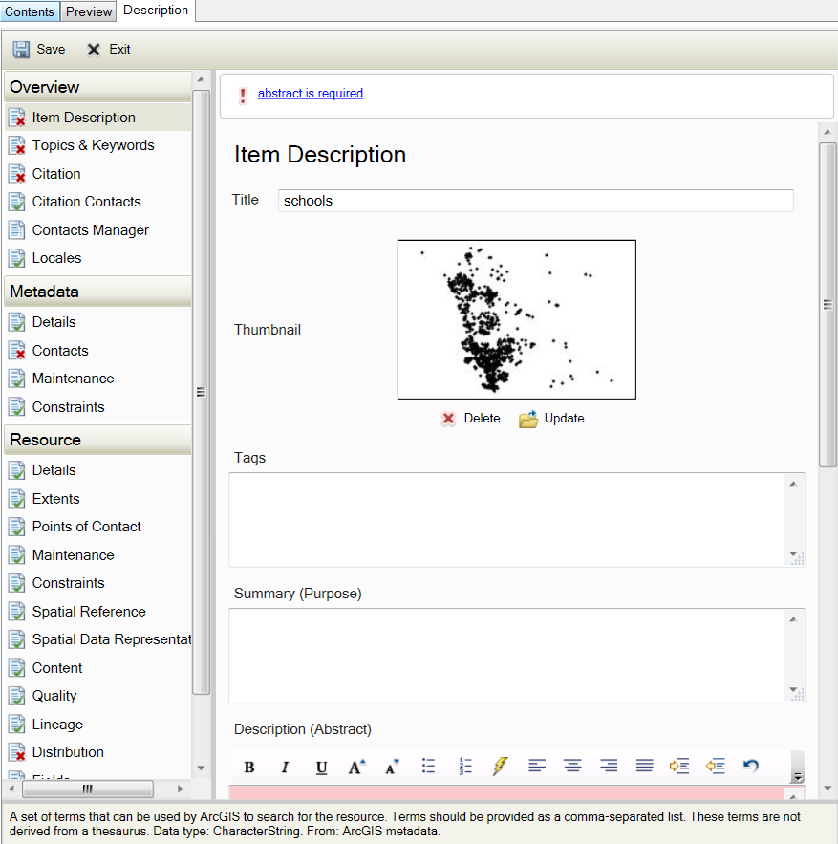
ArcCatalog Metadata Editor

Slide 10
Some “tools”
ArcGIS Resources Blog:
A new approach for Metadata with ArcGIS 10 (parts 1, 2, 3)
ArcGIS Metadata Toolkit 10.1 SP1
ArcGIS Metadata Toolkit.pdf
ArcGISmetadataEditor.xml
ArcGIS Metadata Details.xls
SanGIS Recommendations Spreadsheet

Slide 11
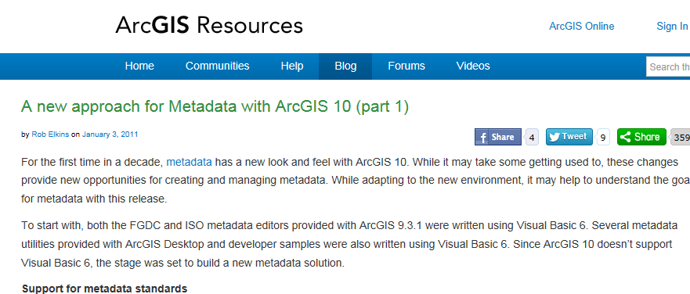
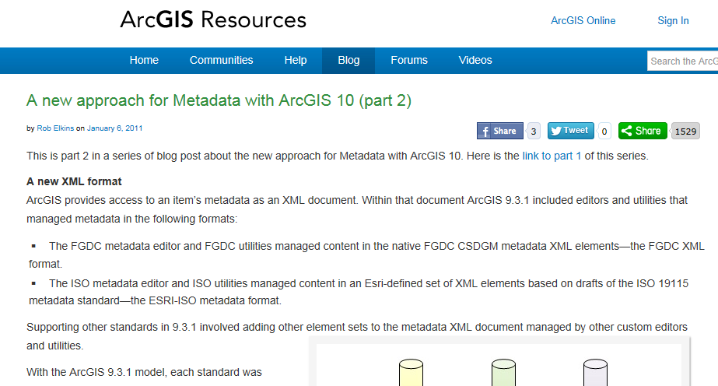
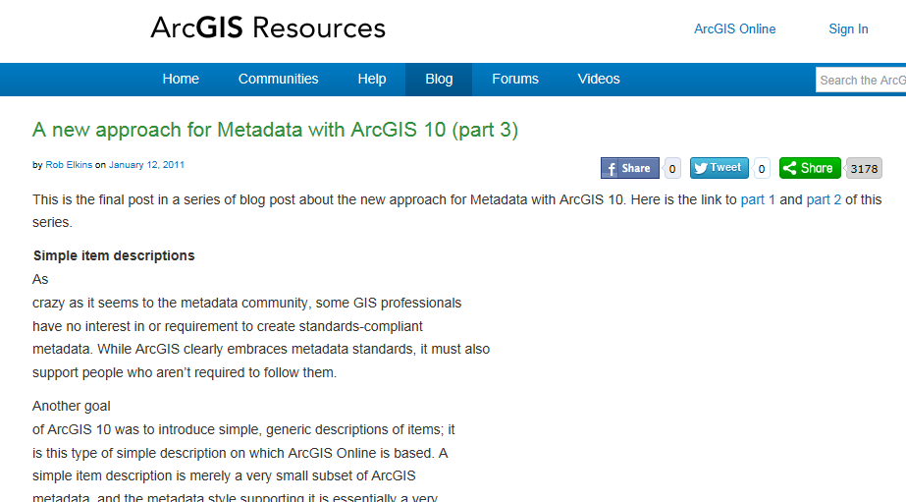
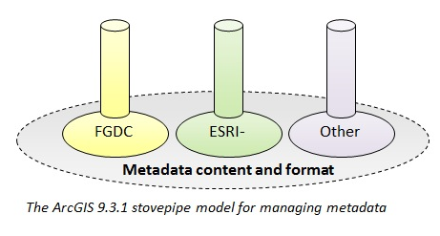
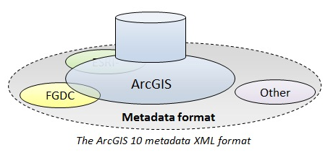
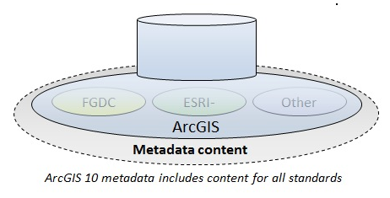
A new approach for Metadata with ArcGIS 10 (circa 2011)
http://blogs.esri.com/esri/arcgis/2011/01/03/a-new-approach-for-metadata-with-arcgis-10/
http://blogs.esri.com/esri/arcgis/2011/01/06/a-new-approach-for-metadata-with-arcgis-10-part-2/
http://blogs.esri.com/esri/arcgis/2011/01/12/a-new-approach-for-metadata-with-arcgis-10-part-3/

Slide 12
ArcGIS Metadata Toolkit 10.1 SP1
The toolkit is a set of folders with
XML metadata samples
Metadata format documentation
Custom style sheets
Knowledge of Visual Studio useful
No toolkit software to install, just files
http://support.esri.com/en/downloads/samples-and-utilities/view/productid/17/metaid/1937

Slide 13
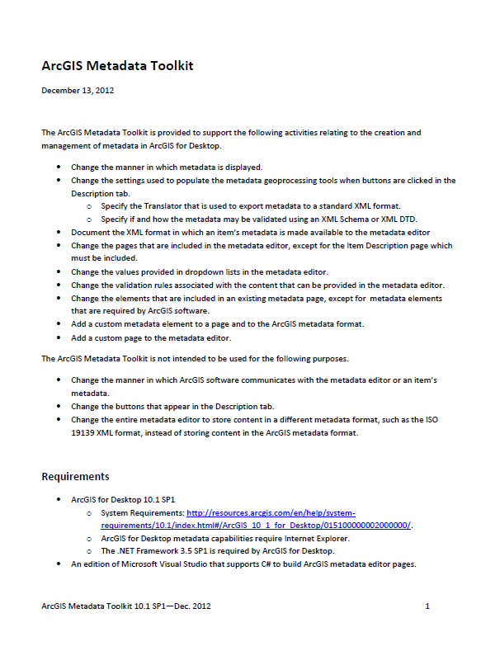
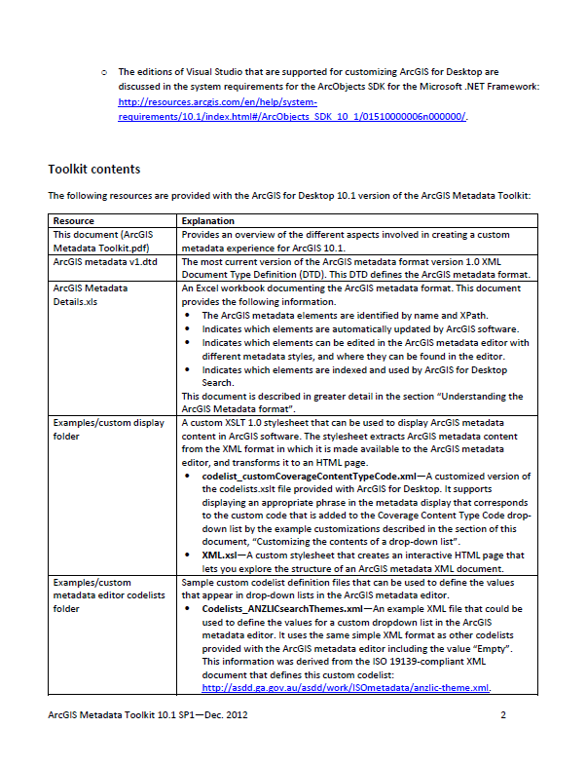
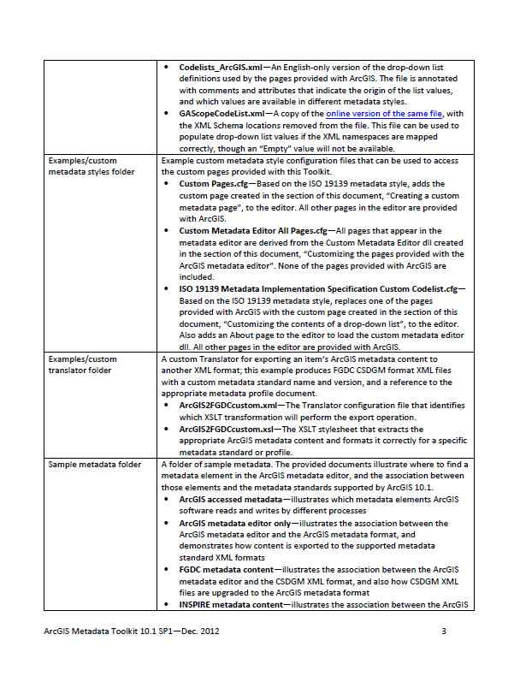
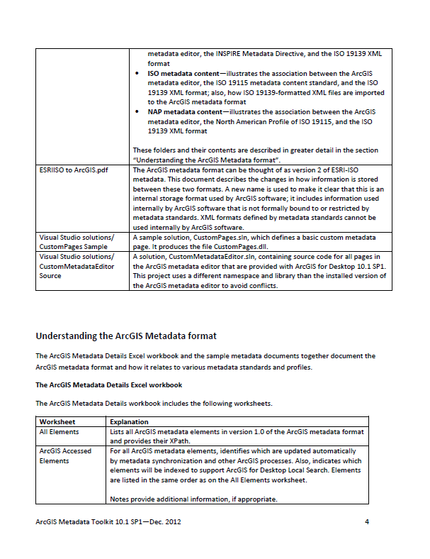
ArcGIS Metadata Toolkit.pdf
67 page document

Slide 14
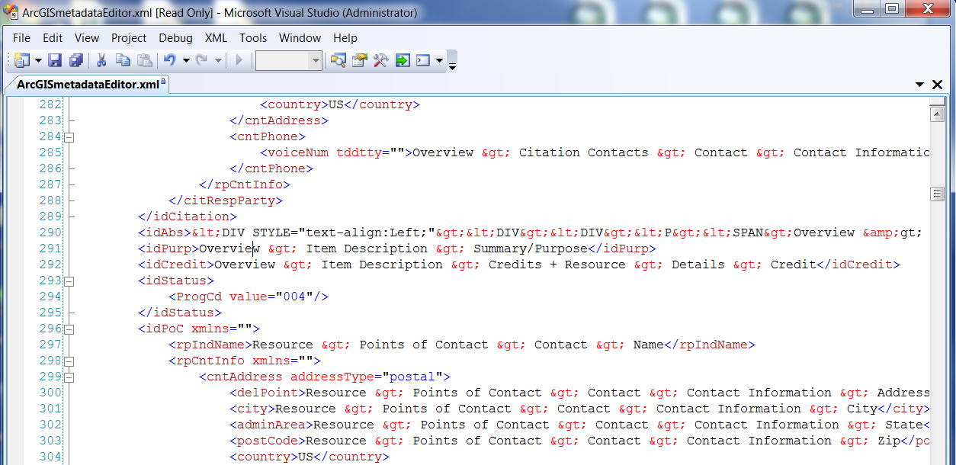
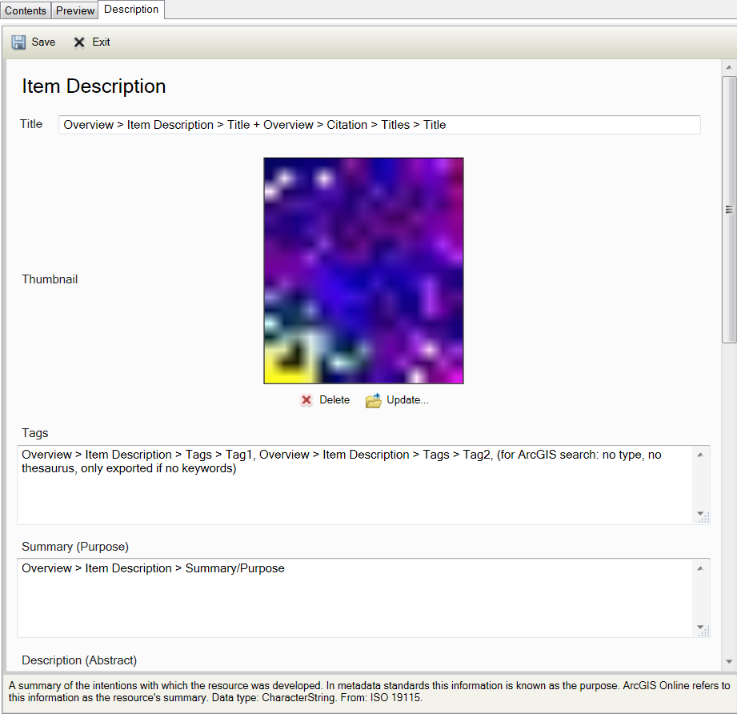
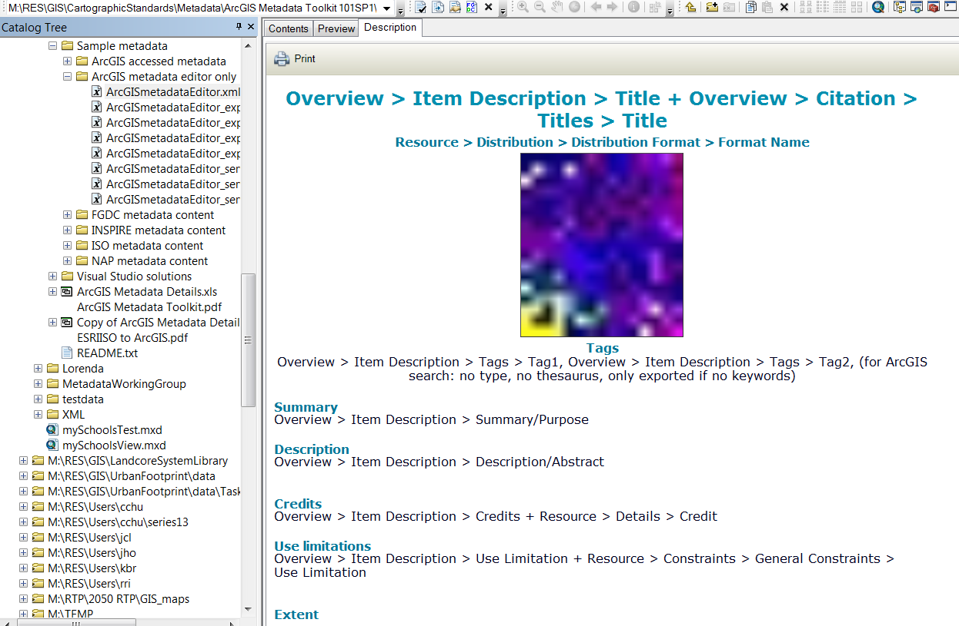
ArcGISmetadataEditor.xml

Slide 15
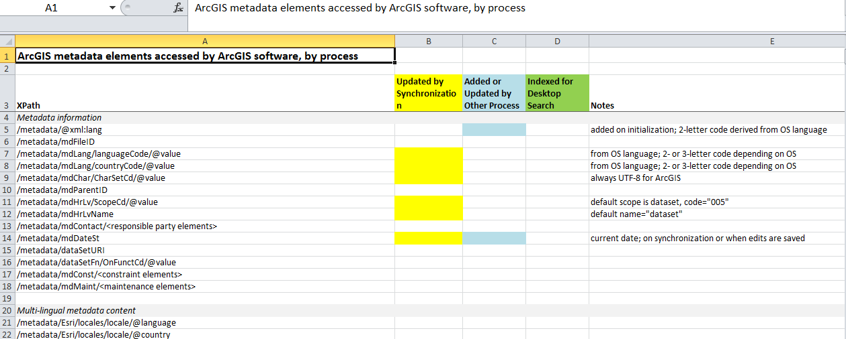
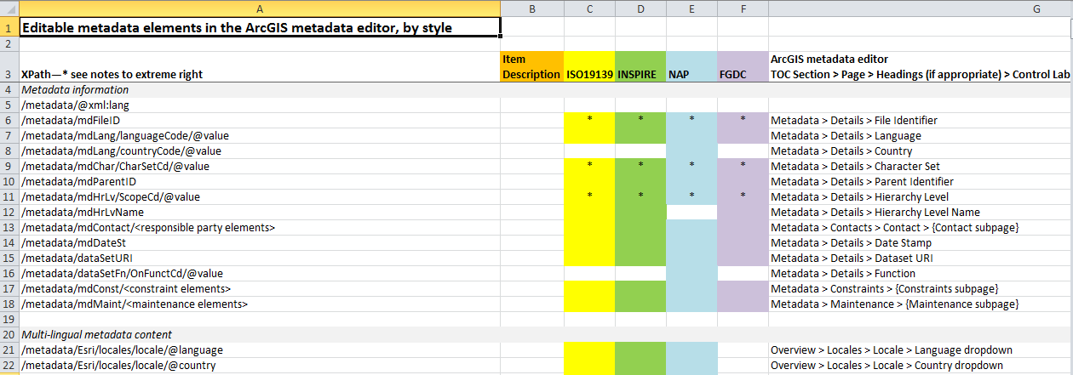
ArcGIS Metadata Details.xls
Notes:
747 rows

Slide 16
SanGIS Recommendations Spreadsheet
Notes:
ISO 19139 Elements Worksheet – 7 pages, 291 Rows
Details Worksheet – 2 pages, 75 Rows

Slide 17
Metadata Dates
Required:
Publication Date
Date-of-the-Data
Edition Date and/or
Temporal Instant
Optional:
Creation Date

Slide 18
Some products (again)
Metadata Editor Manual
Quick Reference Guide
Metadata Custom Stylesheet
Display
Publishing
Editing (flag required elements)

Slide 19
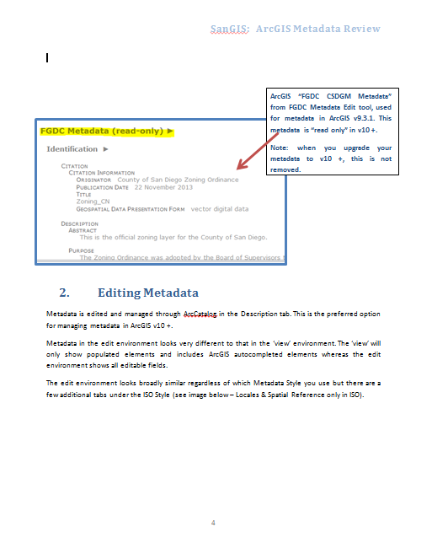
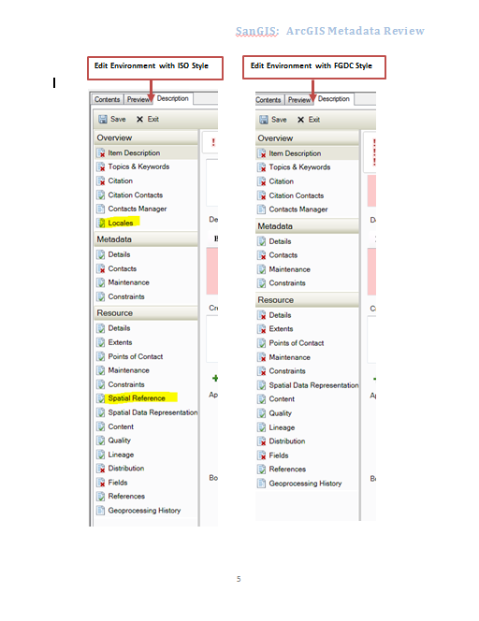
Metadata Editor Manual
Notes:
Multi-page document with screen captures, pointers, and examples.

Slide 20
Quick Reference Guide

Slide 21
Metadata Custom Stylesheet(s)
Display
Startup as one page
Important fields prominent
Hide/Show functionality
Editing
Flag required fields as pink and/or red !
Publishing
PDF
???

Slide 22
Future
How to engage other agencies into the MWG
Continue investigation of custom stylesheet for display
Metadata Publication format
PDF
Custom Publication stylesheet?
Web Map Services
ArcGIS 11?
ArcGIS Professional?

Slide 23
Metadata Update Timeline
June 30th – have procedures in place
End of CY 2014 – SanGIS updated
End of CY 2014 – County of San Diego 95% of layers updated
FY 2015 – City of San Diego updated

Slide 24
Questions and Open Discussion
Questions for John, Brad, Louise, Melanie, Scott
Sign-up sheet for Regional GIS Metadata Working Group
Next Meeting:
Regional GIS Metadata Working Group
Wednesday, May 7, 2014
2:30 pm – 3:30 pm
SANDAG Conference Room 8B
jho@sandag.org

