Slide 1
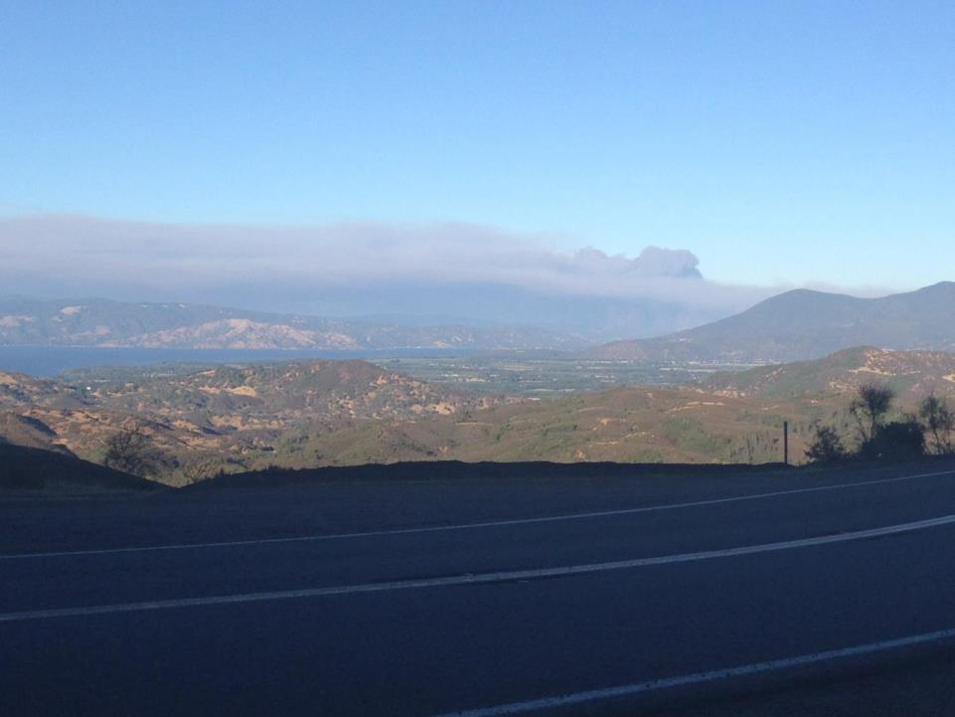
Mapping Wildfires – A GIS Perspective
Matthew Turner
GIS Analyst
San Diego County Fire

Slide 2
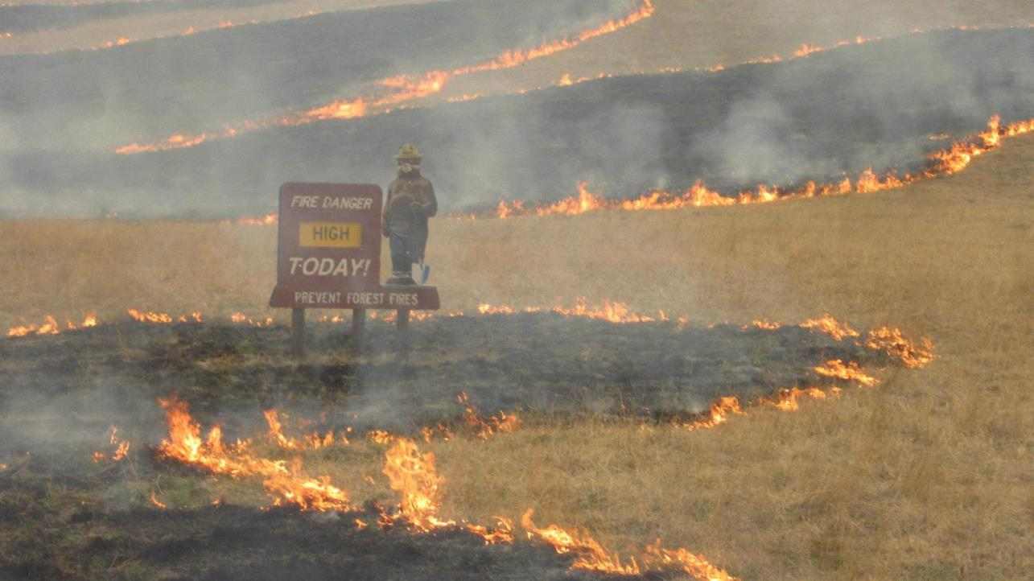
* All wildland fires are managed using the Incident Command System (ICS) * ICS is a standardized approach to the command and coordination of emergency response, and is a scalable model that can be used for any size incident
GIS Specialists (GISS) & the Incident Command System (ICS)

Slide 3
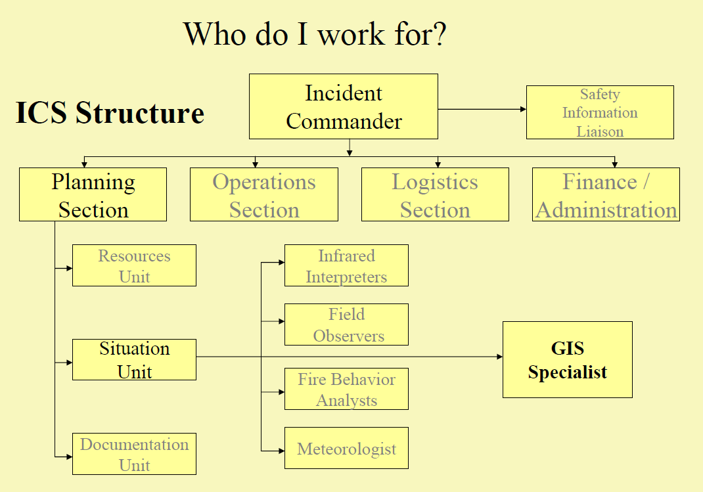
ICS Organizational Chart

Slide 4
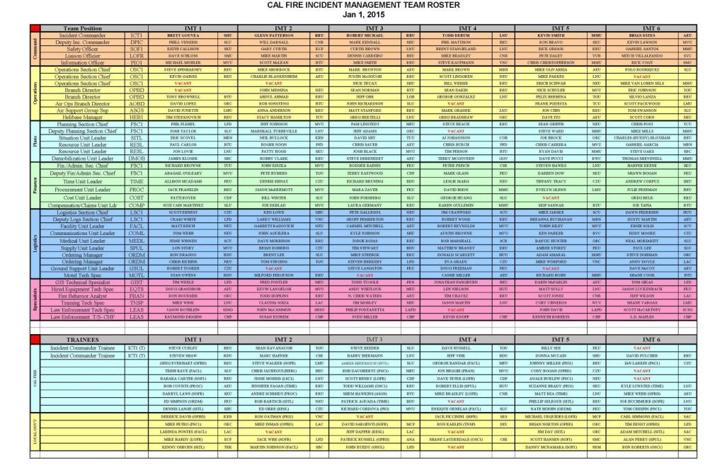
Becoming a GISS

Slide 5
* All GISS candidates must first complete the S-341 class (GIS Specialist for Incident Management). Candidates MUST have some ArcGIS skills, or will otherwise be completely lost. * Completion of the class “initializes” the GISS task book (aka “position qualification”), which allows the GIS Trainee (GIST) to begin working fires. * It generally takes between 8-to fire assignments to complete a task book. * Completed task books are then presented to the California Incident Command Certification System committee, who will thoroughly review candidate task books to determine if enough has been completed to qualify a GIST to become a GISS.
Becoming a GISS

Slide 6
* FIMT is a specialized toolset, downloaded to ArcMap, that is the basis for Incident Mapping * The S-341 class teaches students all the FIMT bells and whistles, and of the standardized mapping products that are used on wildland fires * FIMT creates a standardized FGDB, with imbedded domains and standard symbol sets for consistency * CALFIRE Toolset is also used regularly
It’s all about FIMT
(Fire Incident Mapping Tools)

Slide 7
Initially, or at least during the “Initial Attack” phase of a wildfire, there are 3 required mapping products that must be produced for the first Operational Briefing: 1) The Operations Map (or Ops map) 2) The Incident Action Plan map (commonly referred to as the IAP map) 3) The Big Area Map (BAM map)
Most Common Incident Mapping Products

Slide 8
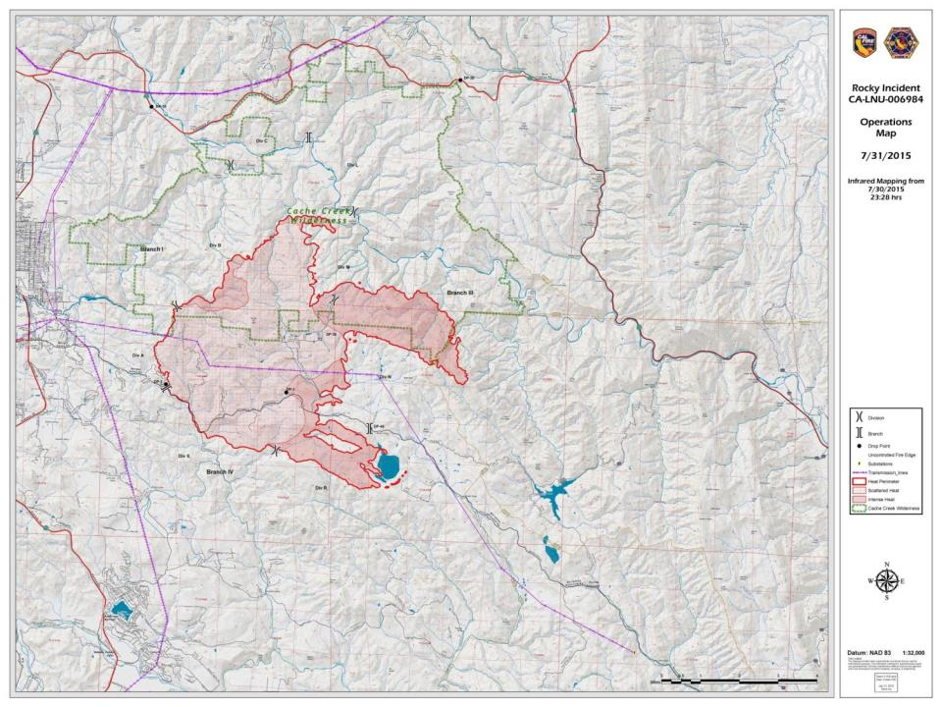

Slide 9
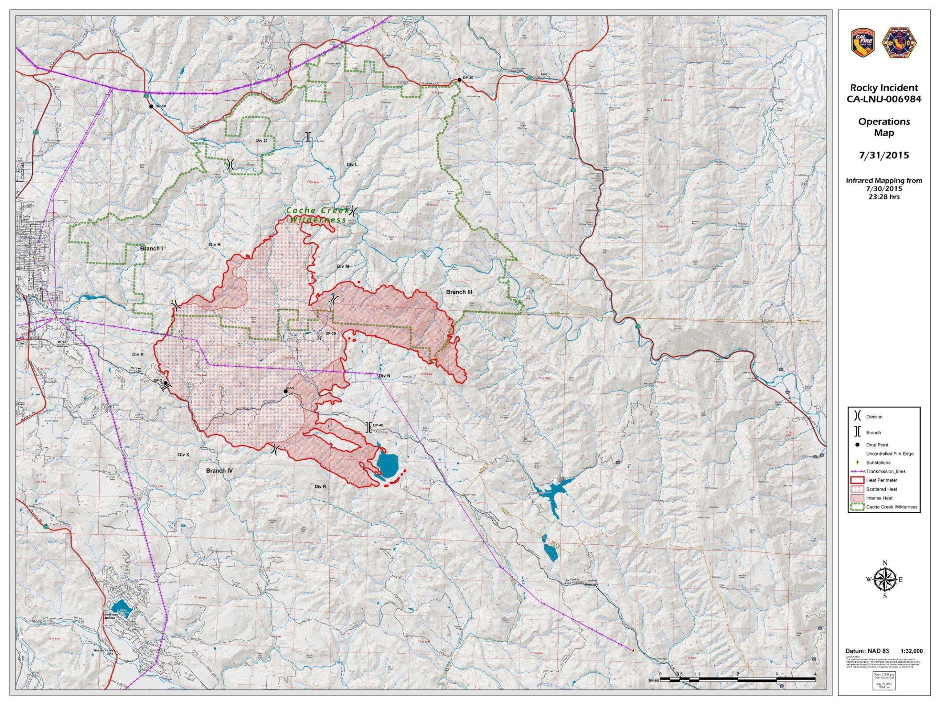

Slide 10
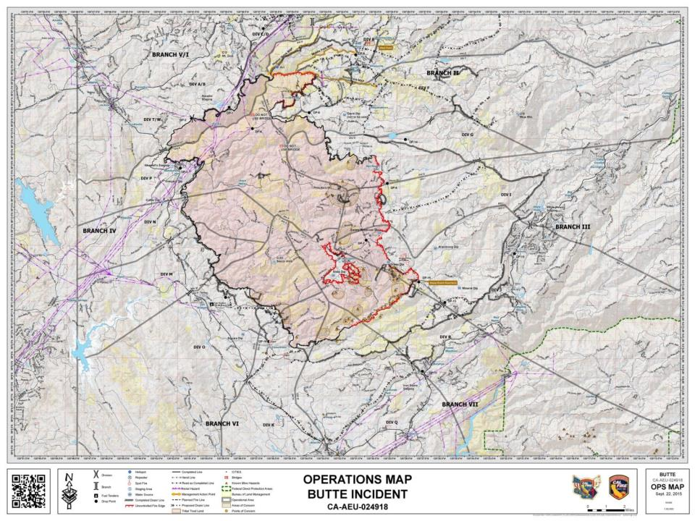

Slide 12
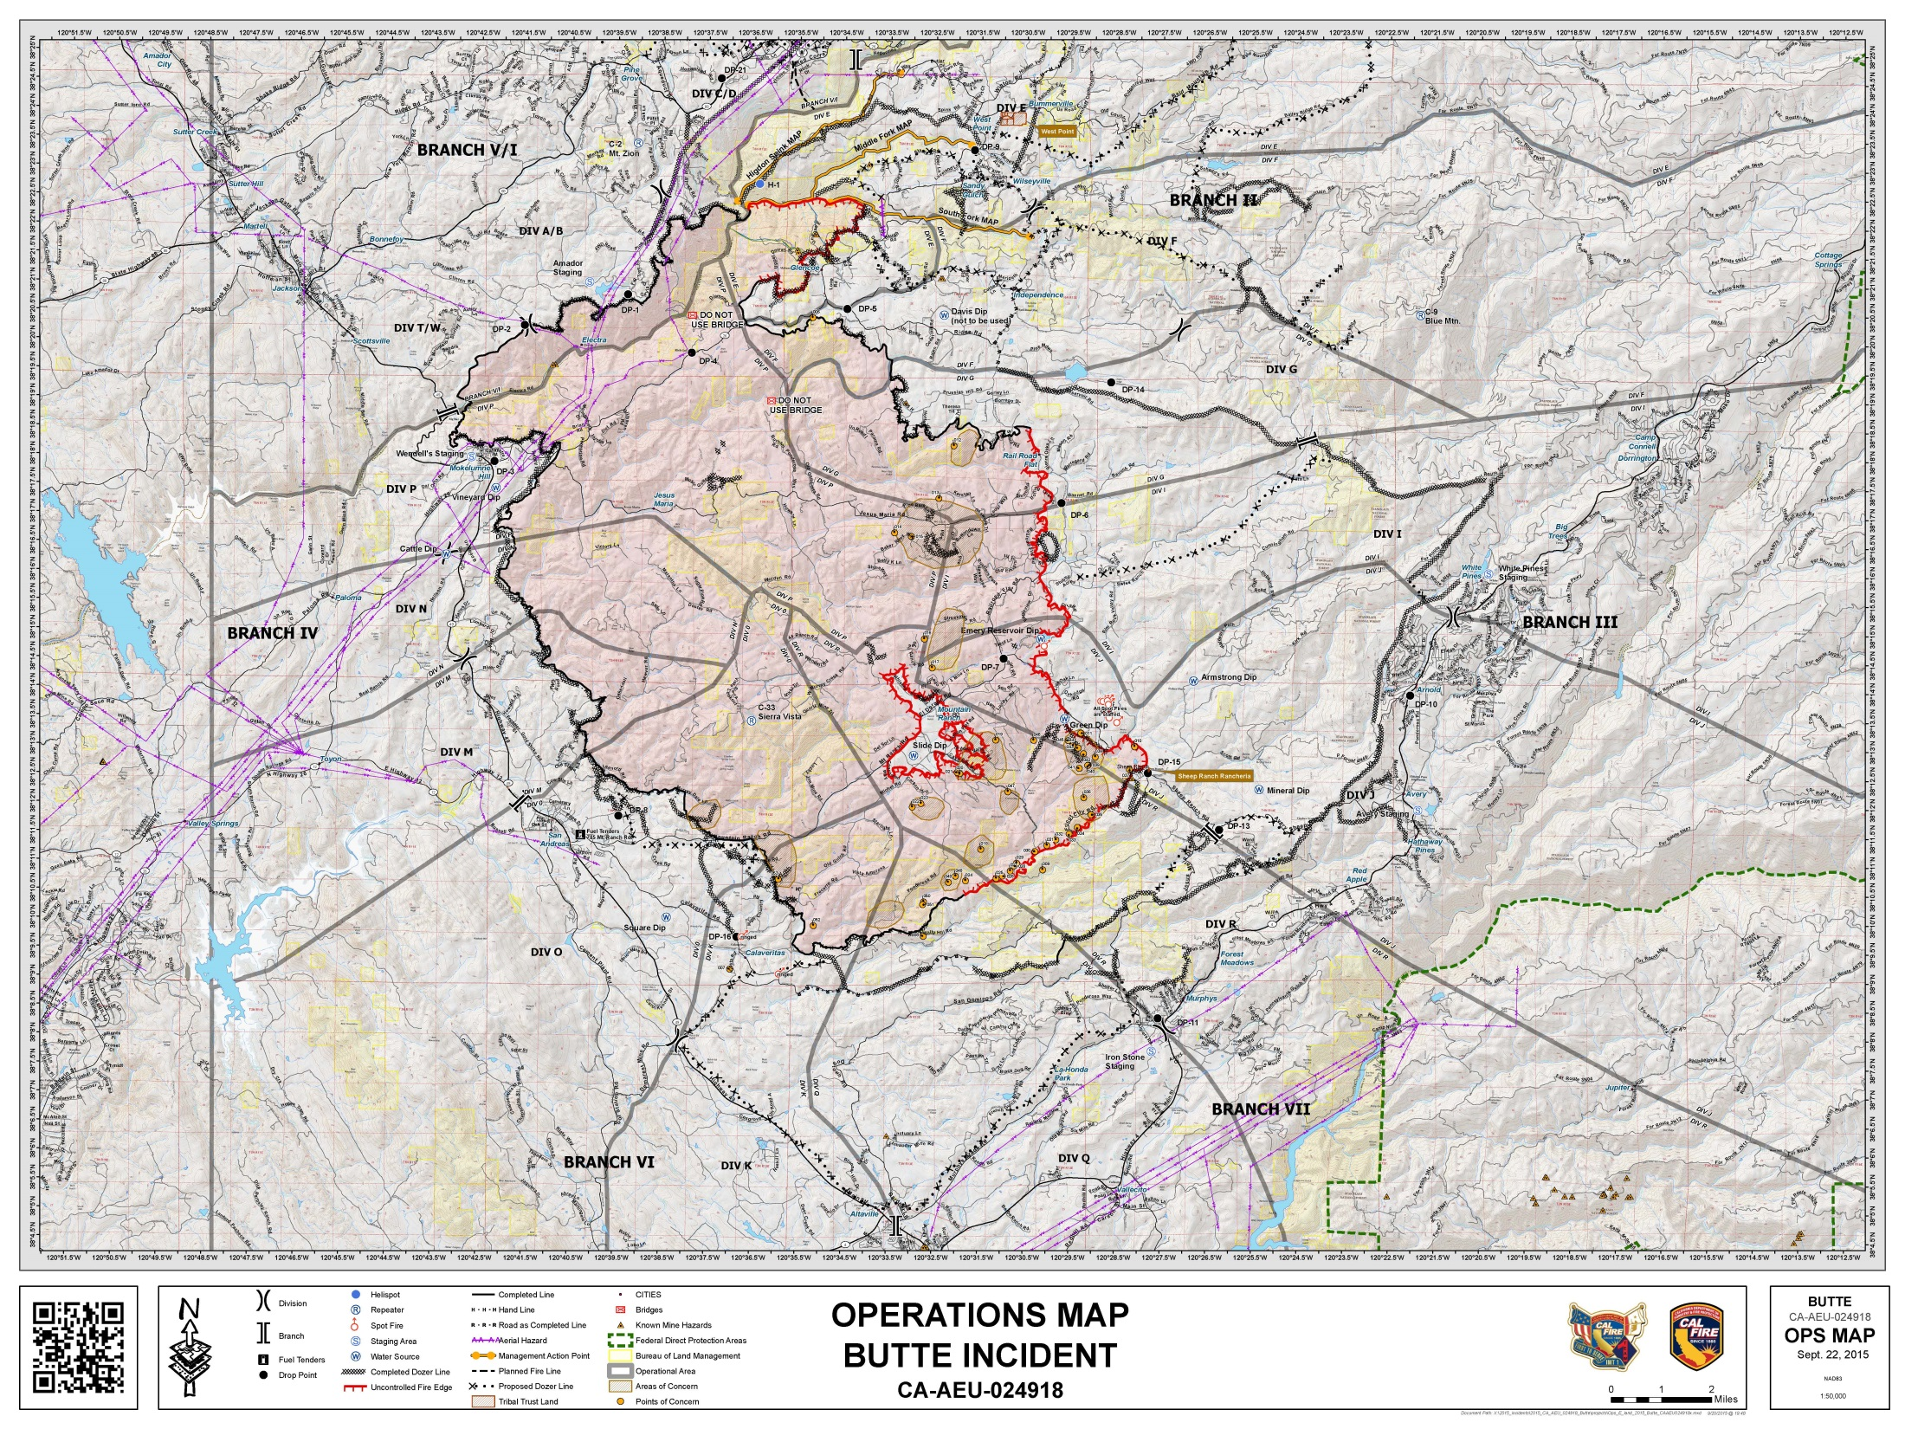

Slide 13
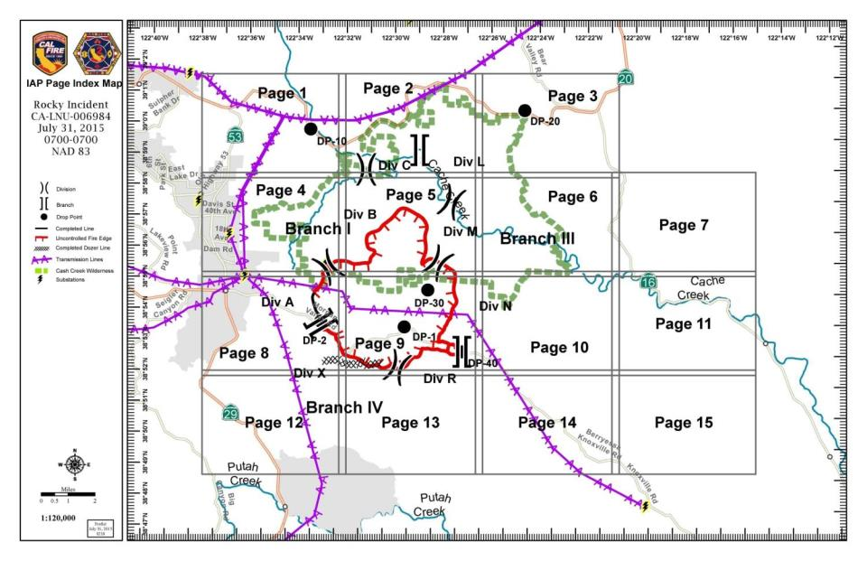

Slide 14
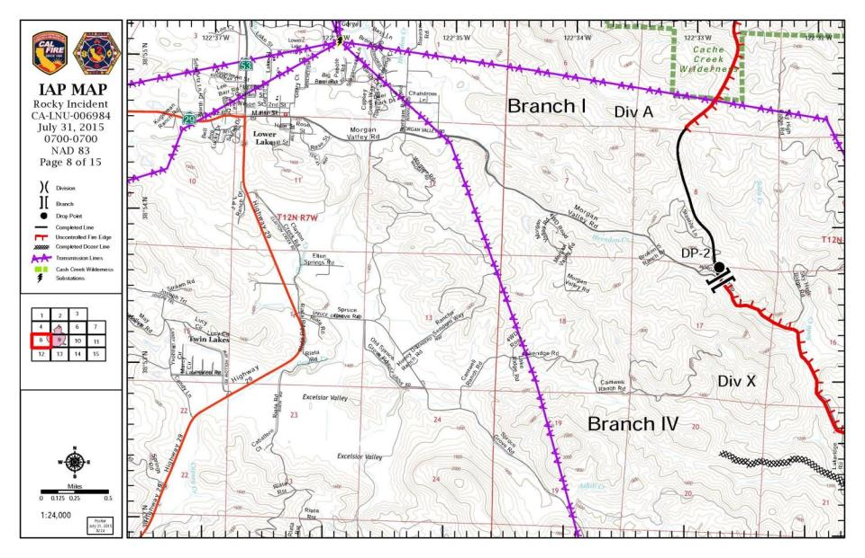

Slide 15
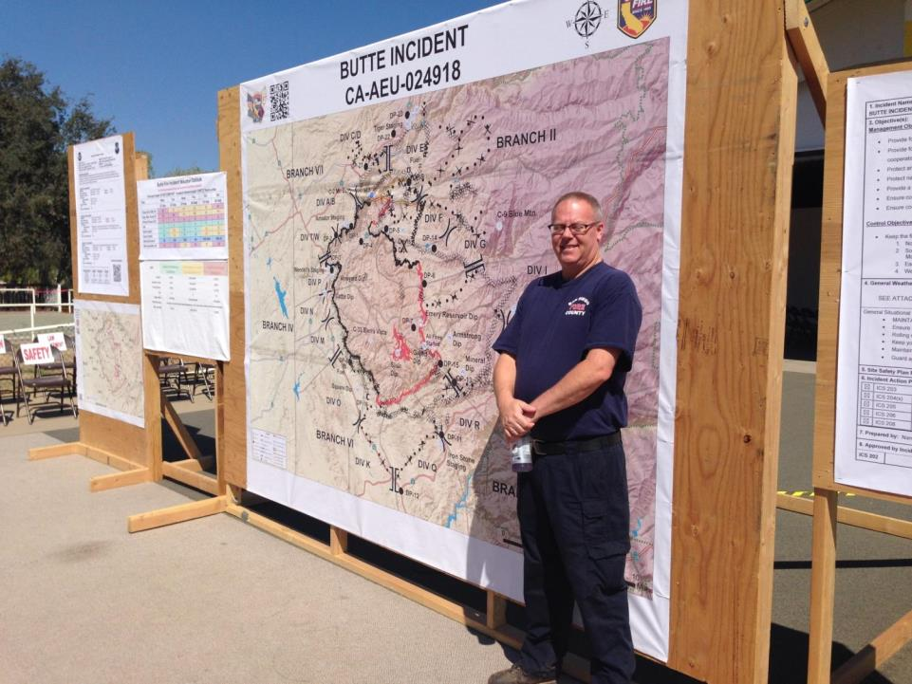

Slide 16
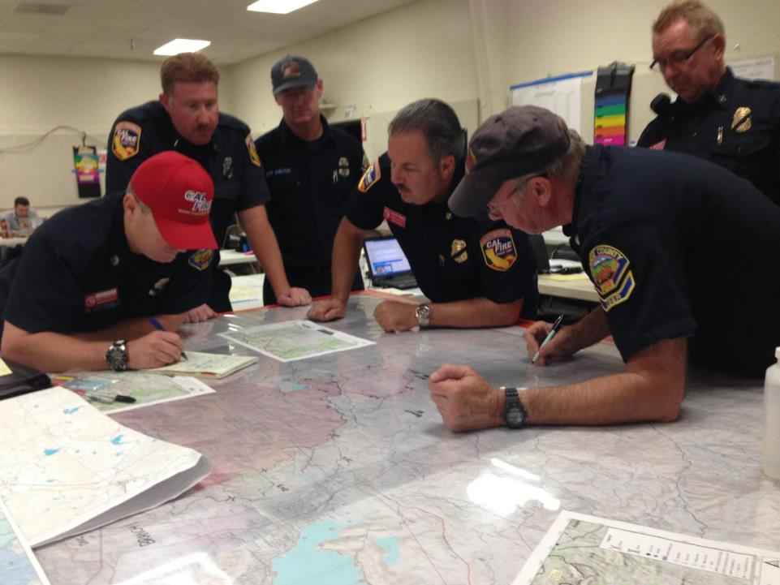

Slide 17
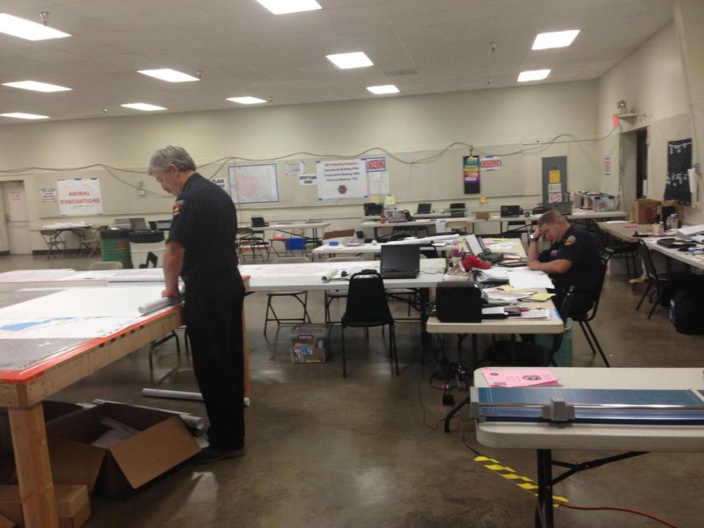

Slide 18
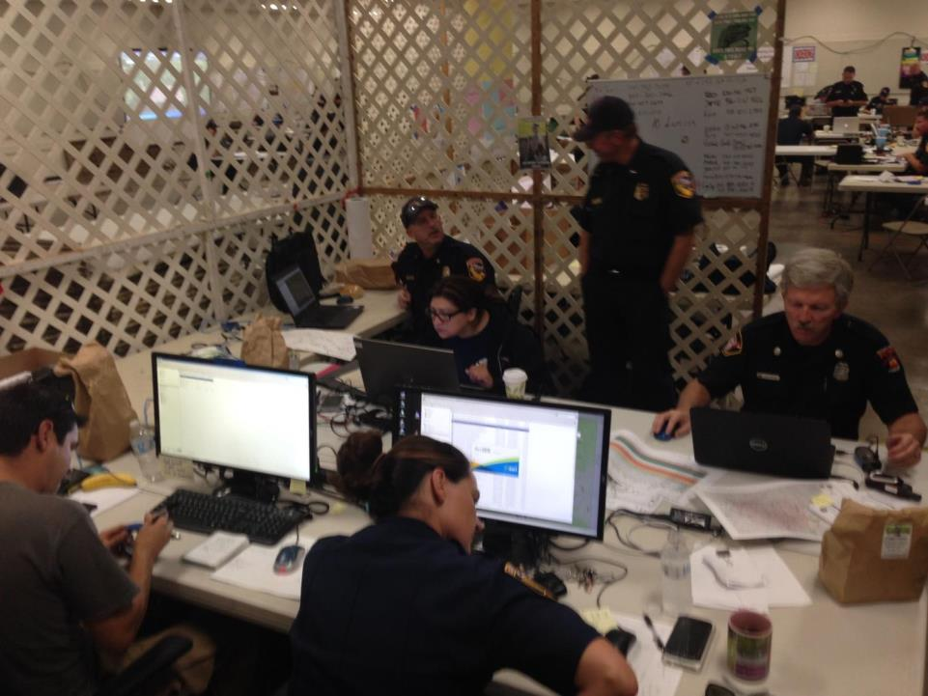

Slide 19
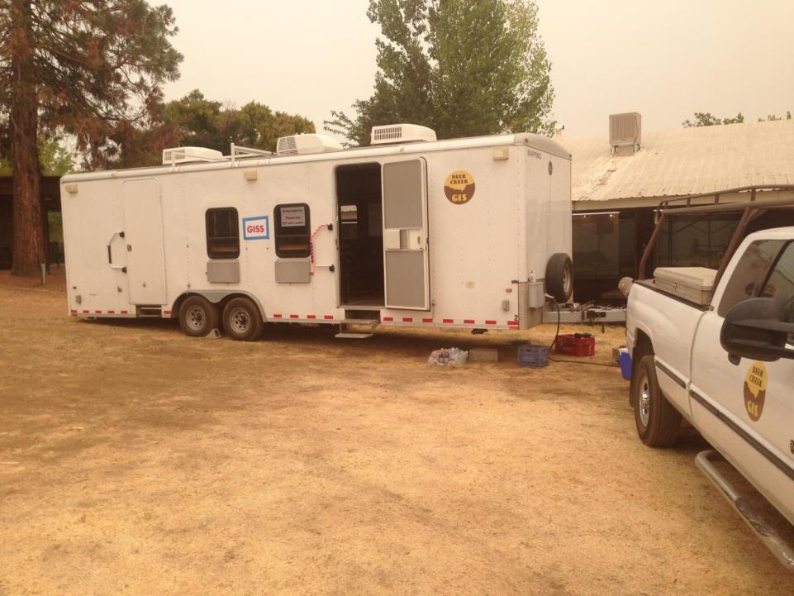

Slide 20
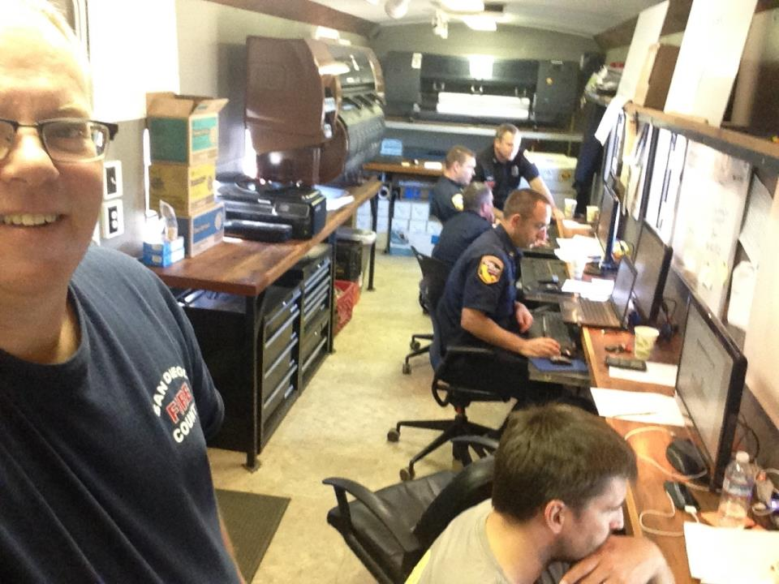

Slide 21
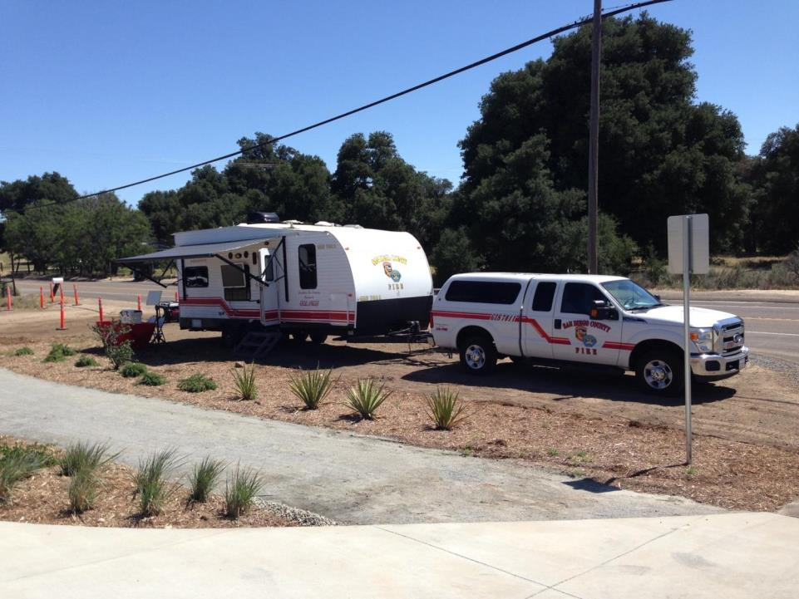

Slide 22
* Early IC “swag” or via NICS (Next Generation Incident Command mapping system * Helicopter GPS flight data * Nightly IR data capture via fixed wing aircraft * Field Observers (FOBS) * Regular interaction with the Situation Unit Leader (SITL) and/or the Plans Chief Data includes perimeter info (uncontrolled & completed fire lines, dozer lines, drop points, ICP, dip sites (water locations), staging areas, etc.
Incident Mapping: Data Sources

Slide 23
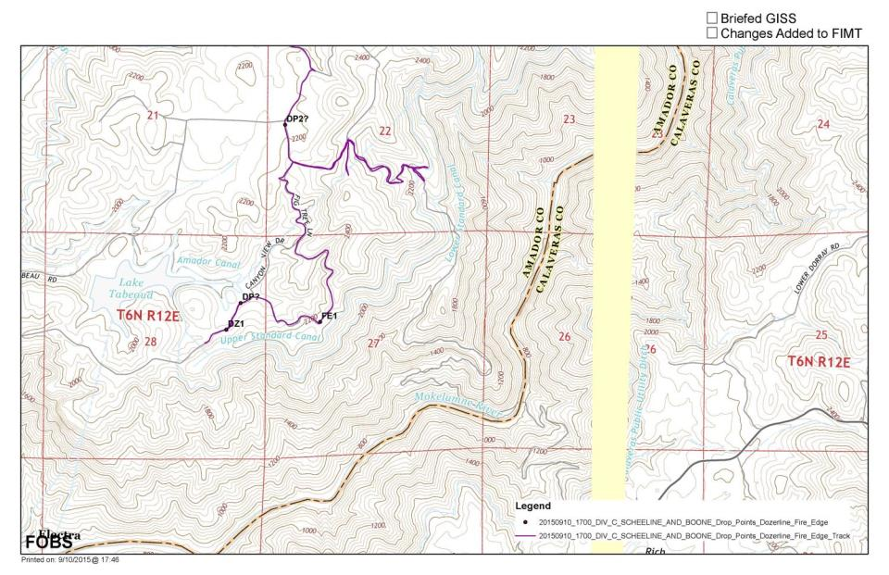

Slide 24
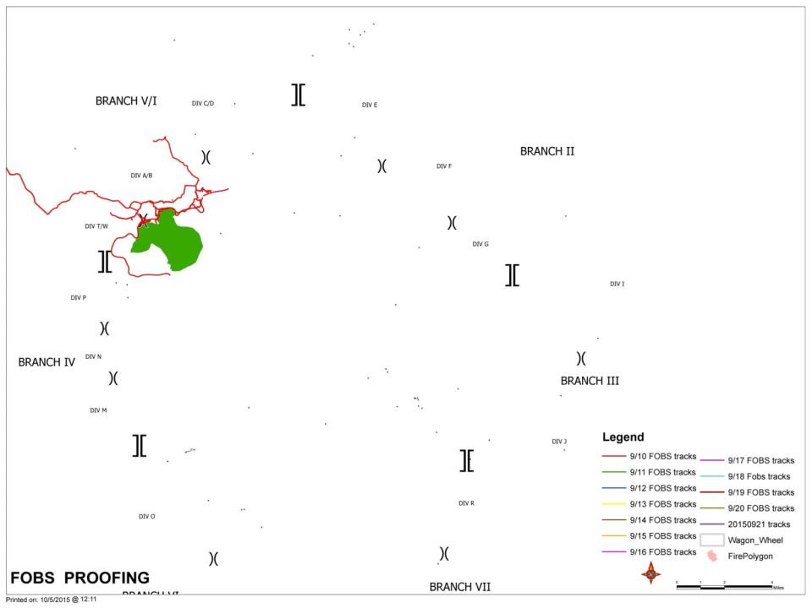

Slide 25
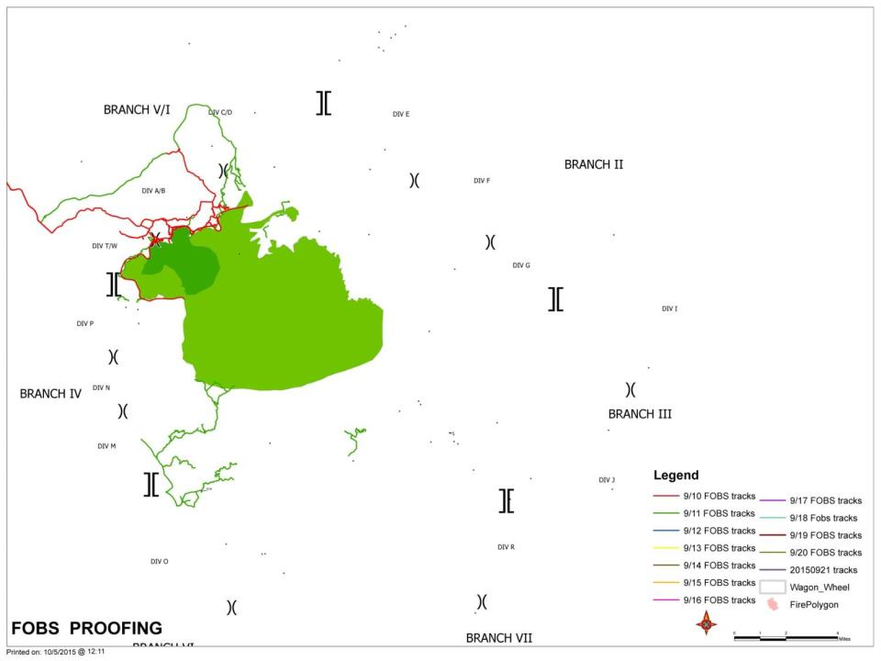

Slide 26
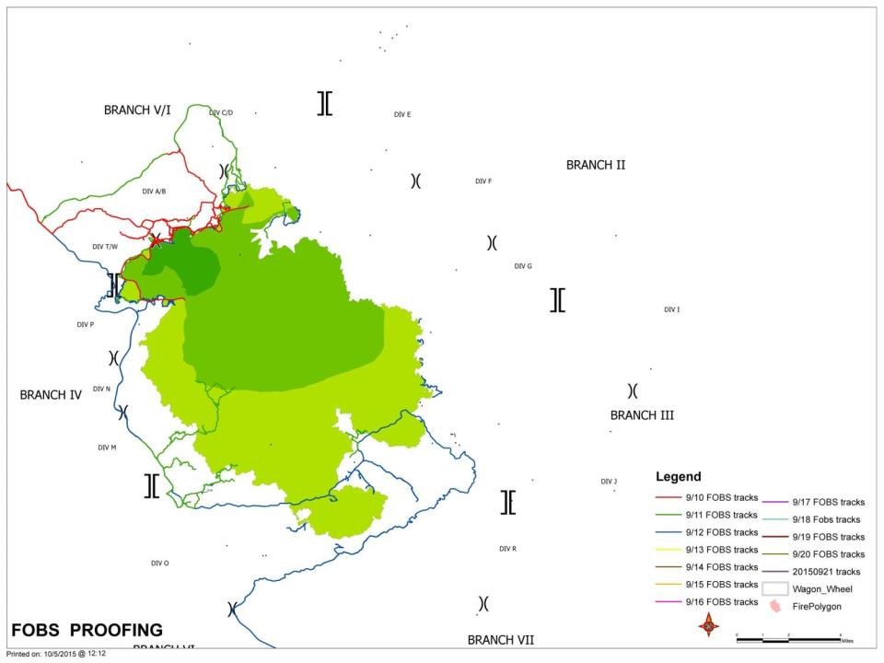

Slide 27
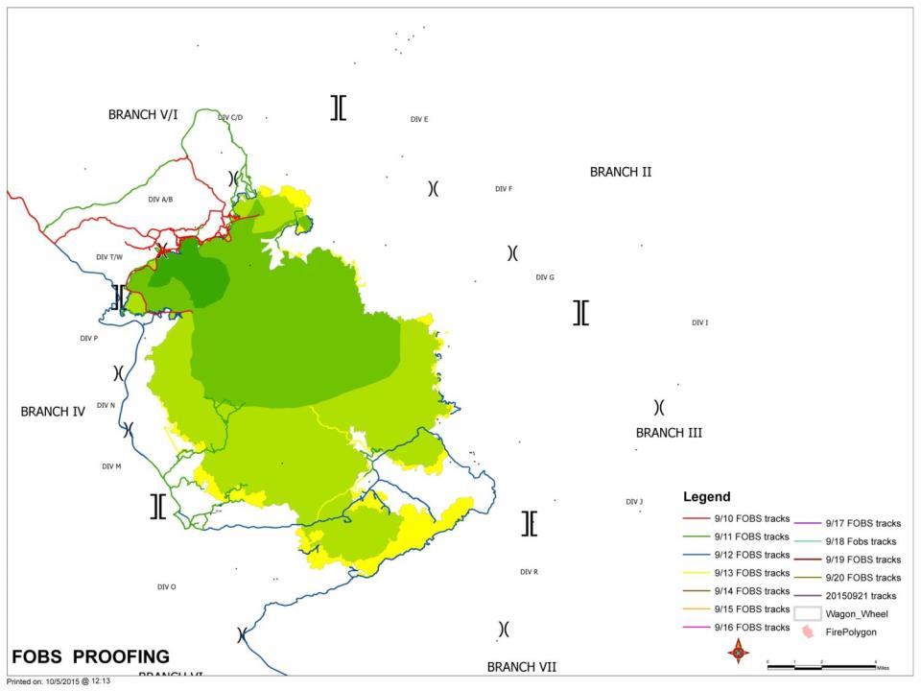

Slide 28
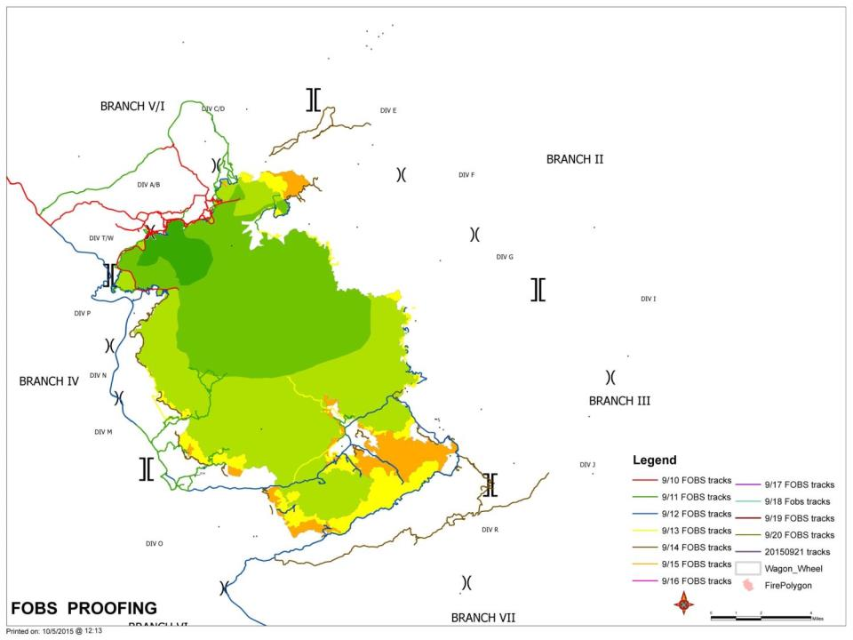

Slide 29
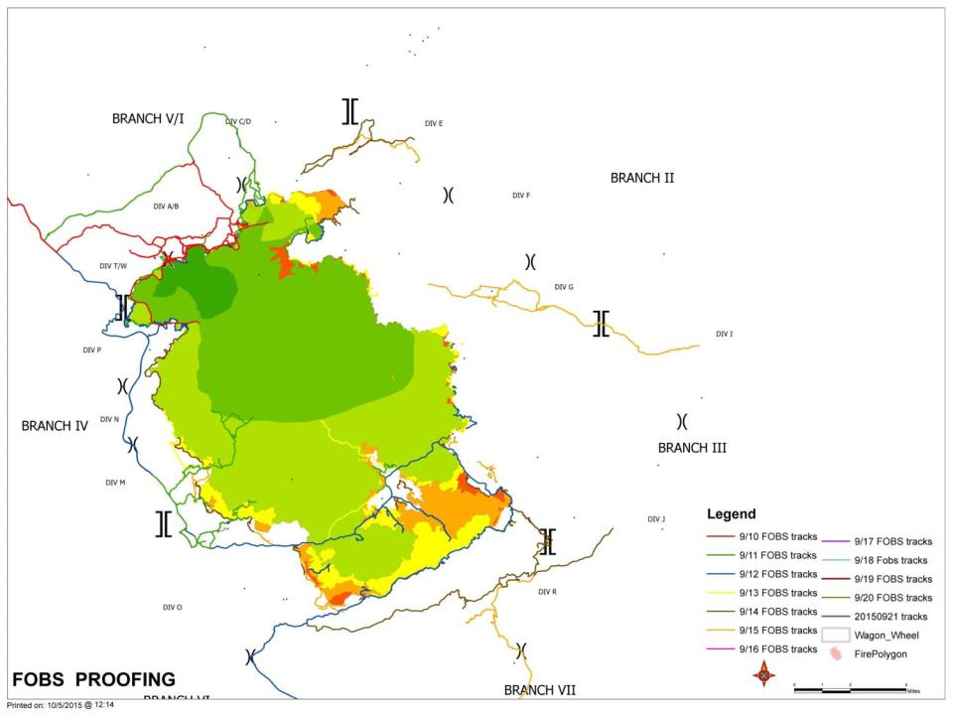

Slide 30
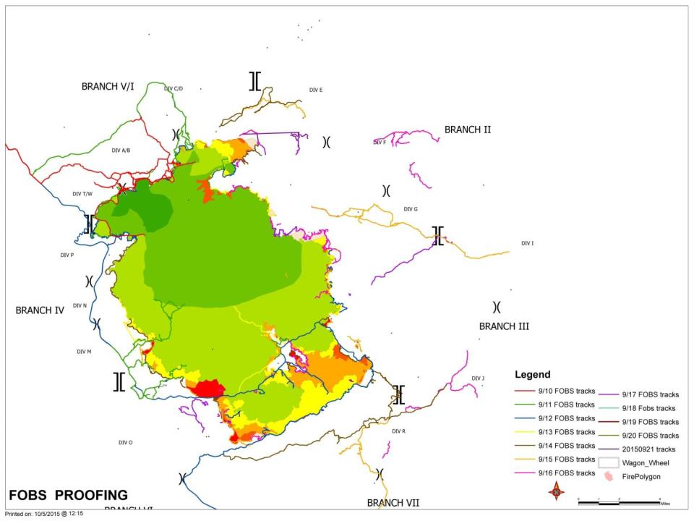

Slide 31
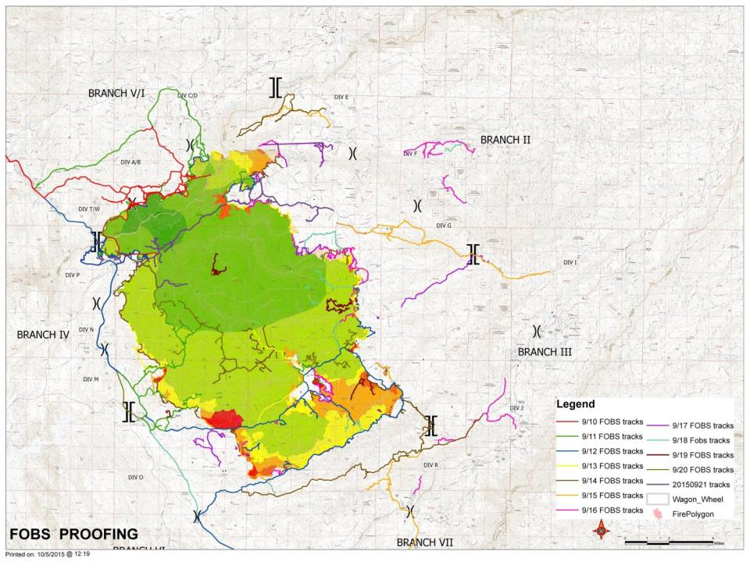

Slide 32
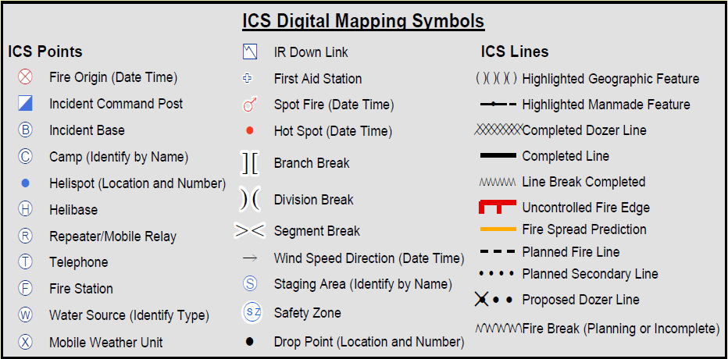

Slide 33
* Big Area Map (BAM) * Travel Maps * Air Ops * Ownership * Fire History * Fire Progression * PIO * Rehab * Suppression Repair * Damage Inspections * Arch Sites * Contingency * Evacuations
Other Mapping Products

Slide 34
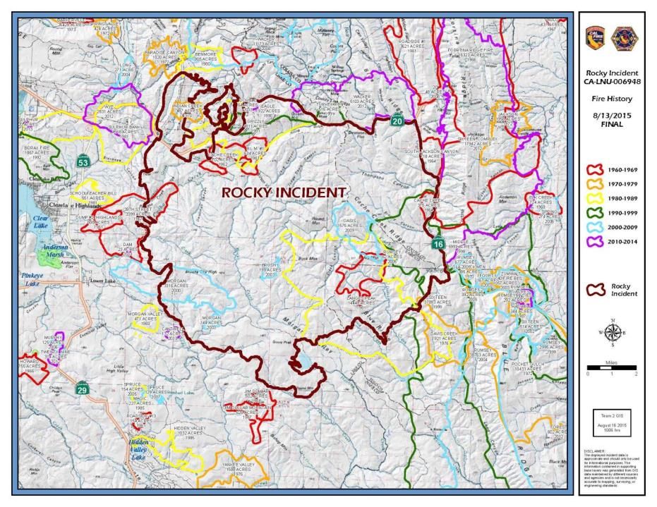

Slide 35
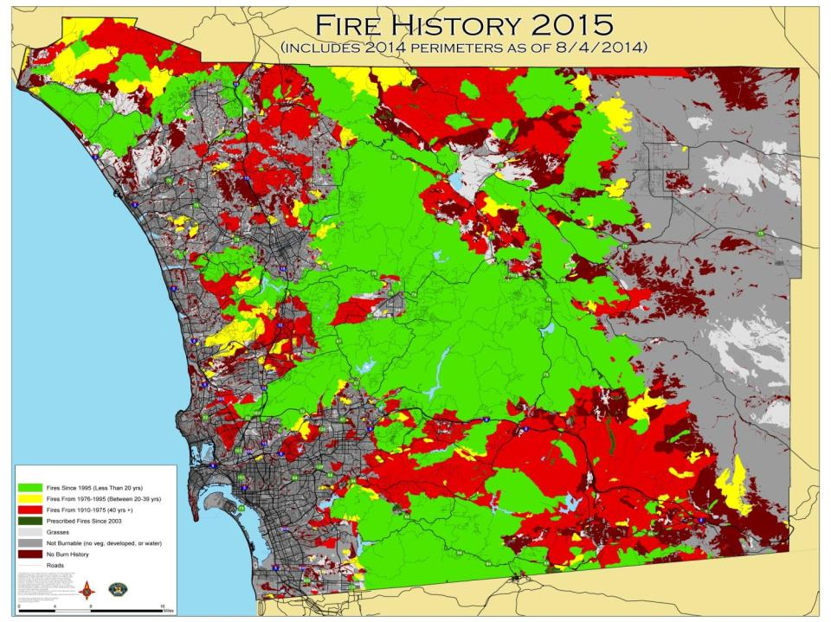

Slide 36
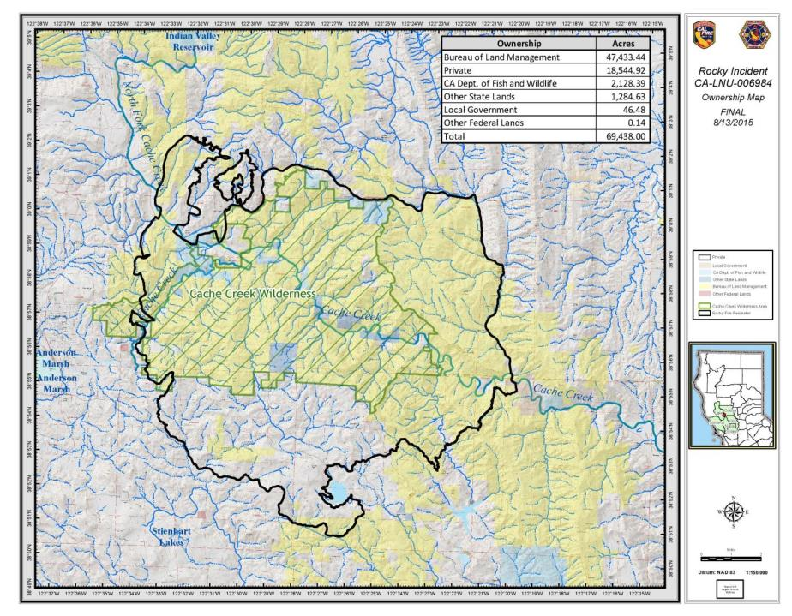

Slide 37
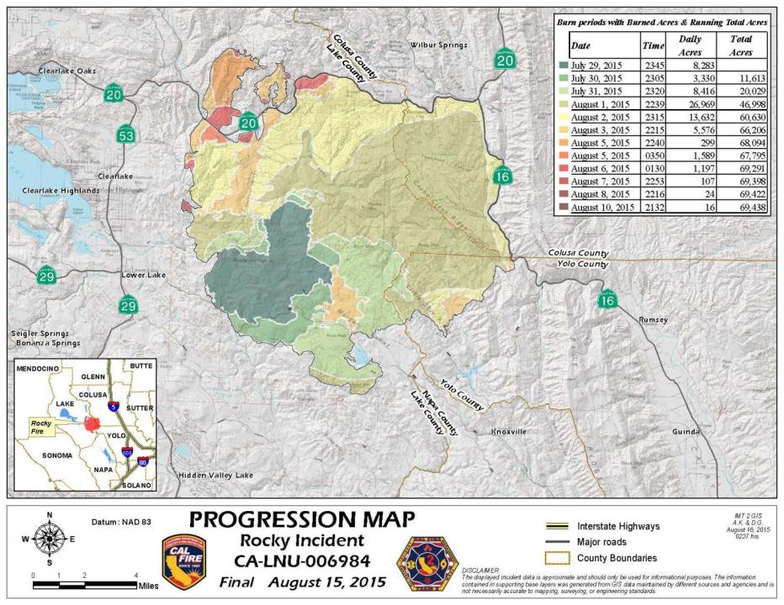

Slide 38
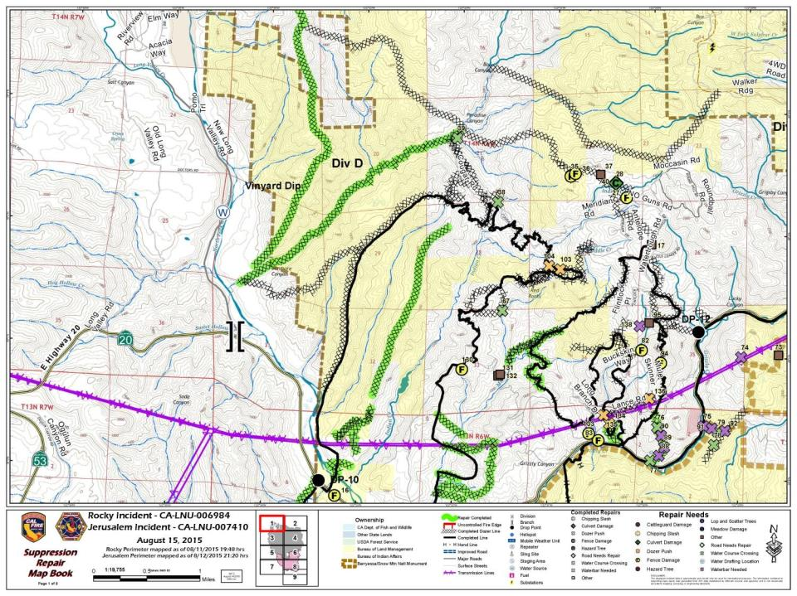

Slide 40
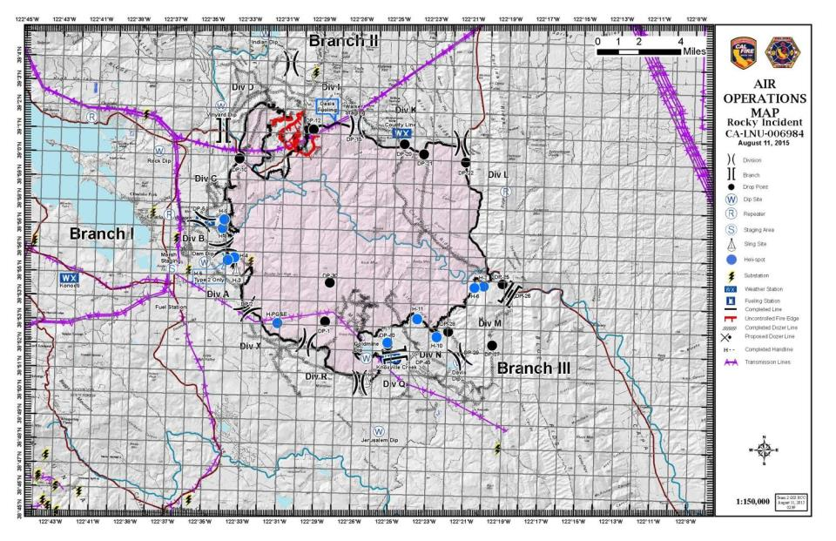

Slide 41
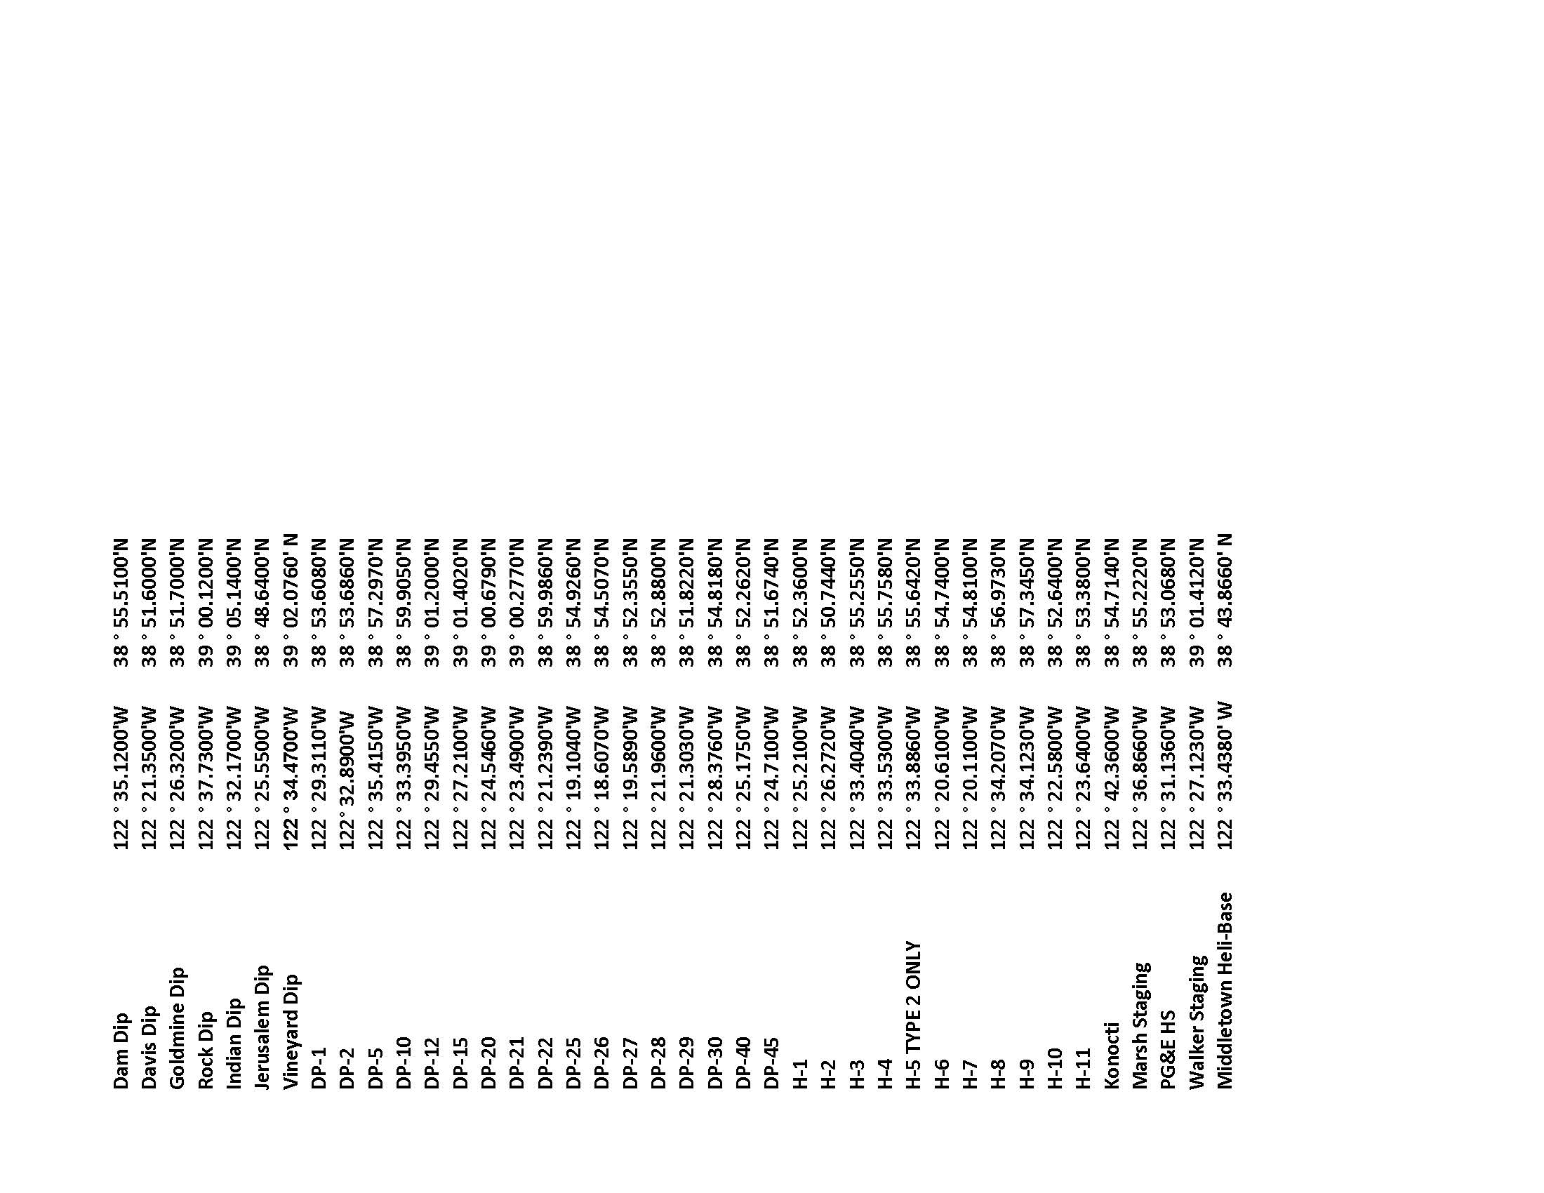

Slide 42
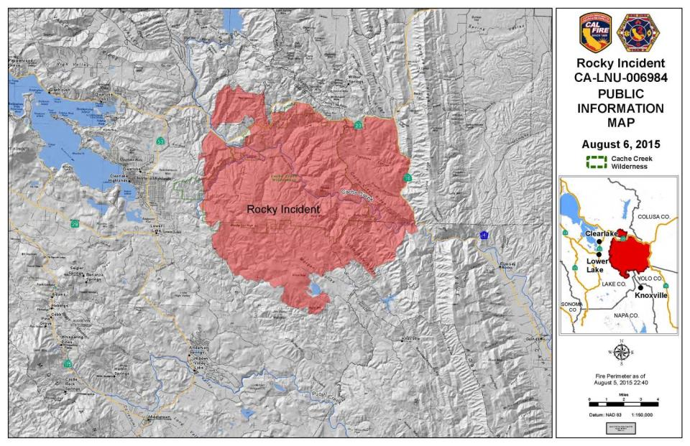

Slide 43
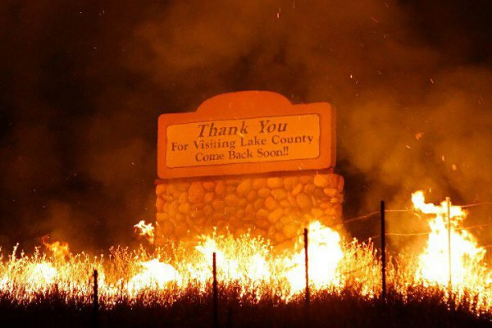
gis.nwcg.gov/index.html
QUESTIONS?

