Slide 1
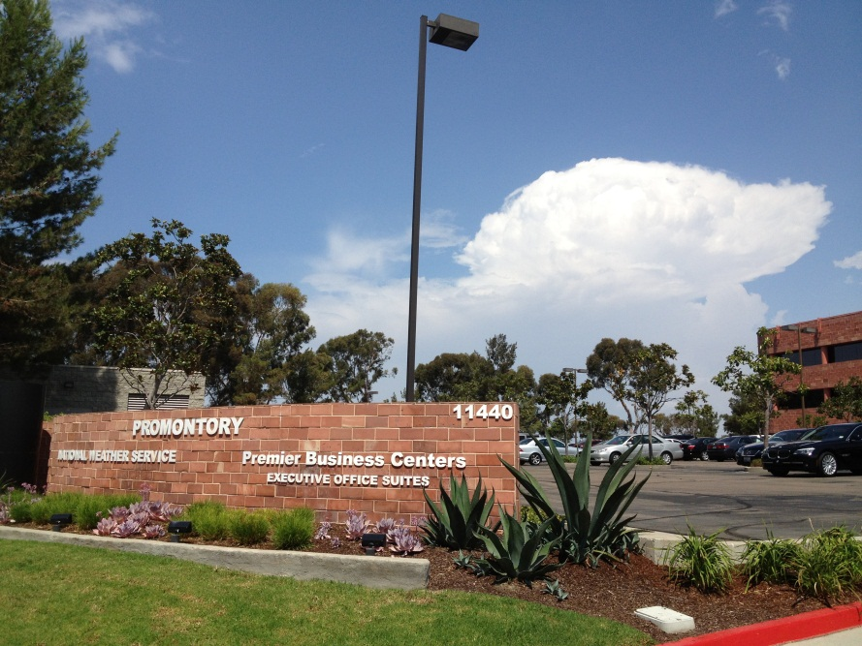
National Weather Service San Diego
Weather Spotter Training
Alex Tardy
Warning Coordination Meteorologist

Slide 2
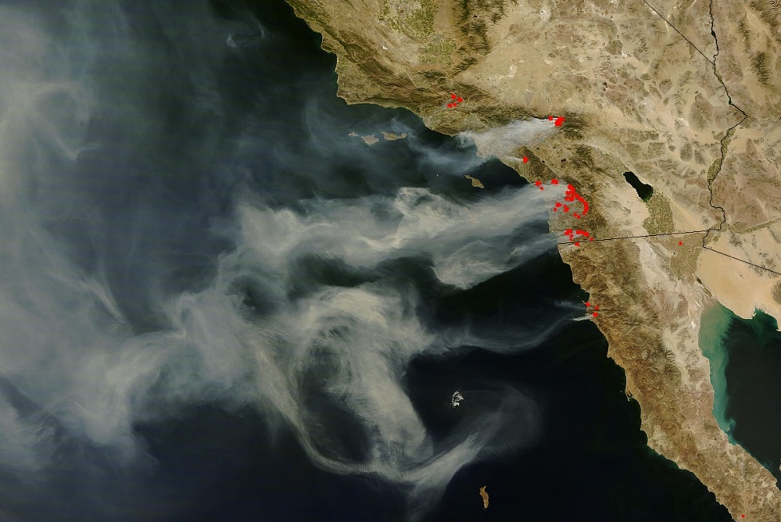
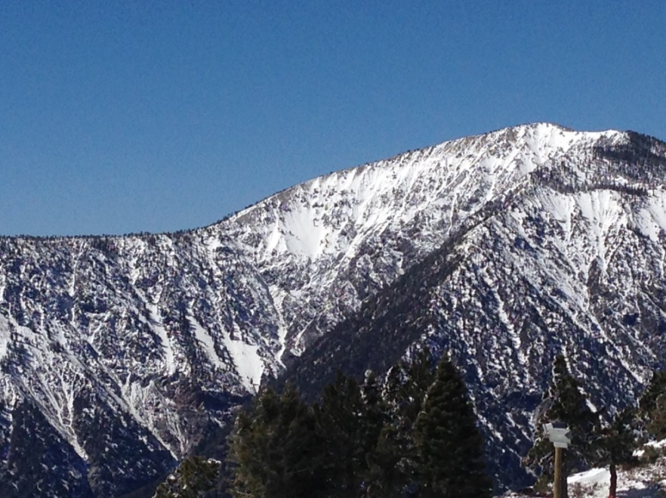
NWS San Diego Forecasts, Warnings and Impact Decision Support Services
2007
Alex Tardy Warning Coordination Meteorologist April 13, 2016
alexander.tardy@noaa.gov

Slide 3
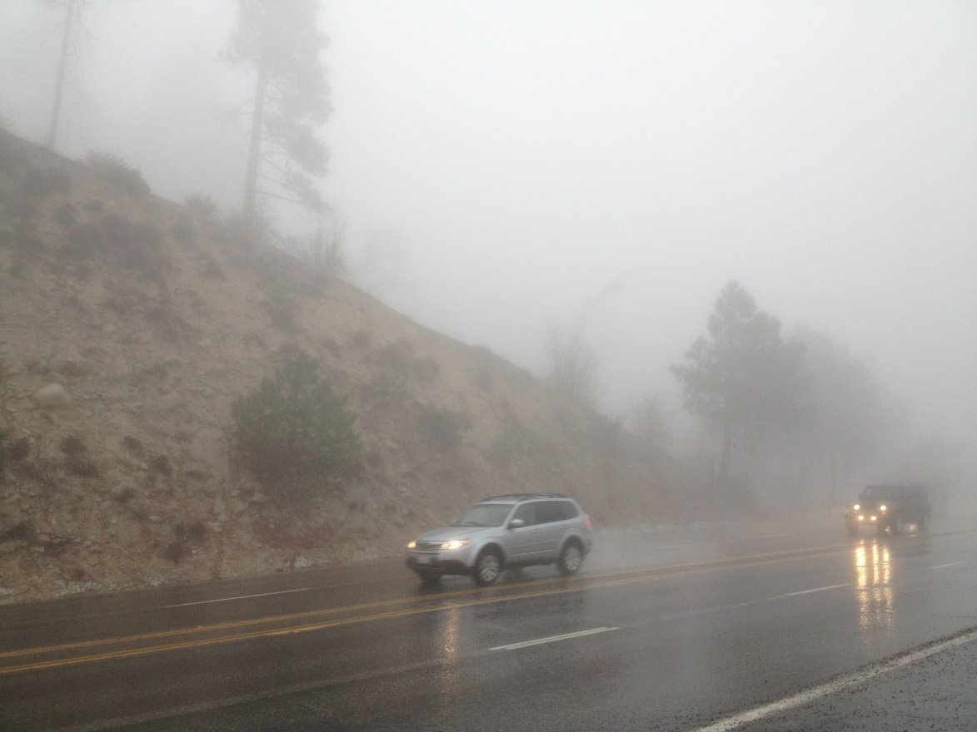
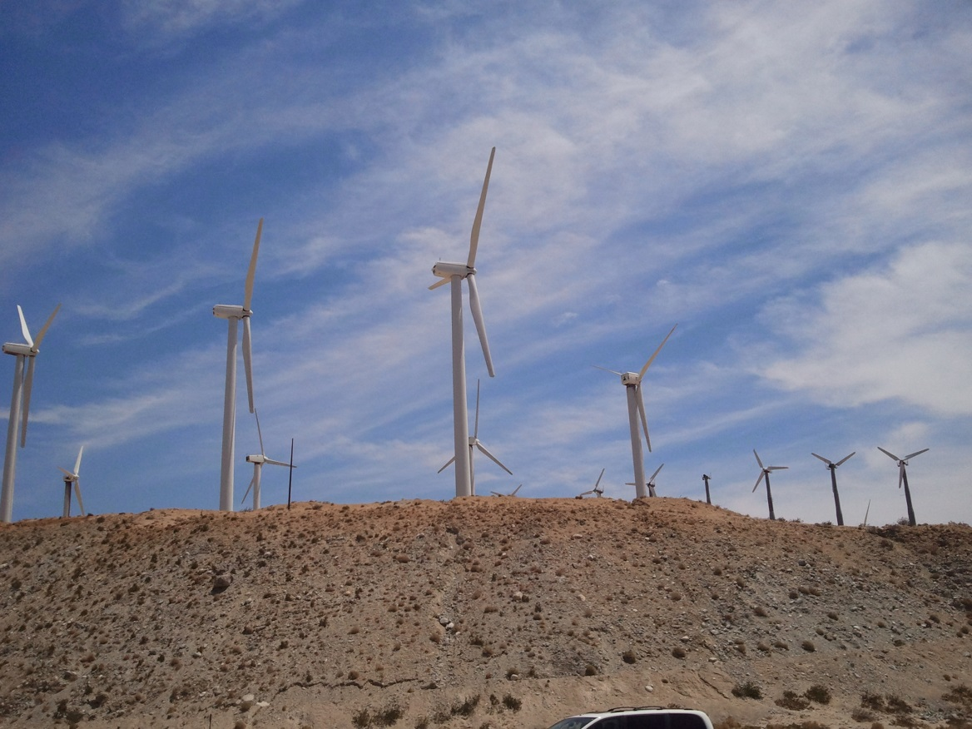
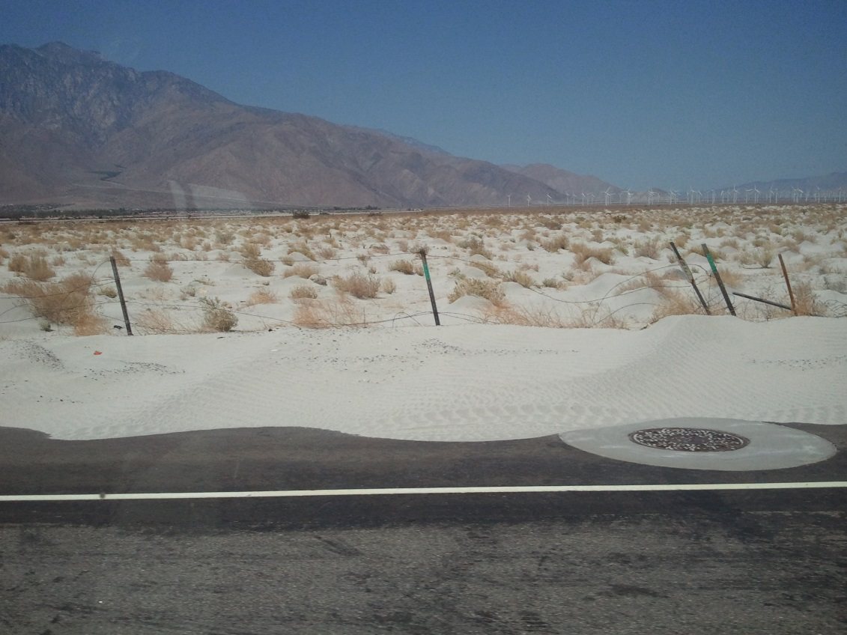
Various DSS support
WET Southern California Challenge DRY

Slide 4
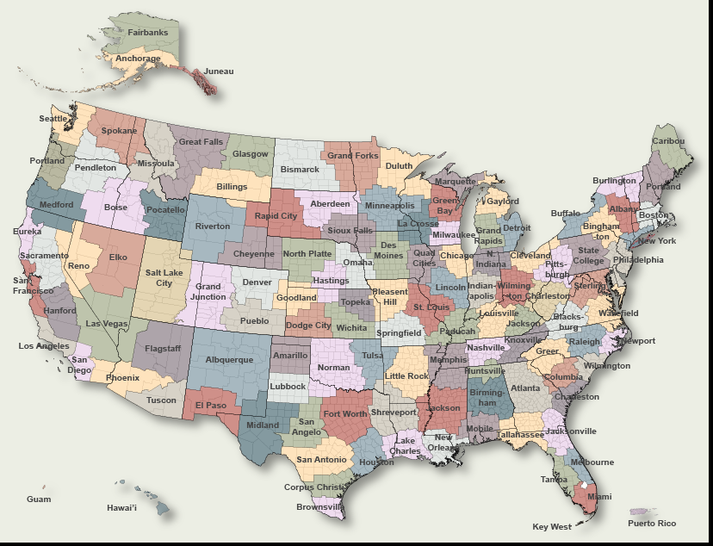
NWS - Nationwide
122 Forecast Offices

Slide 5
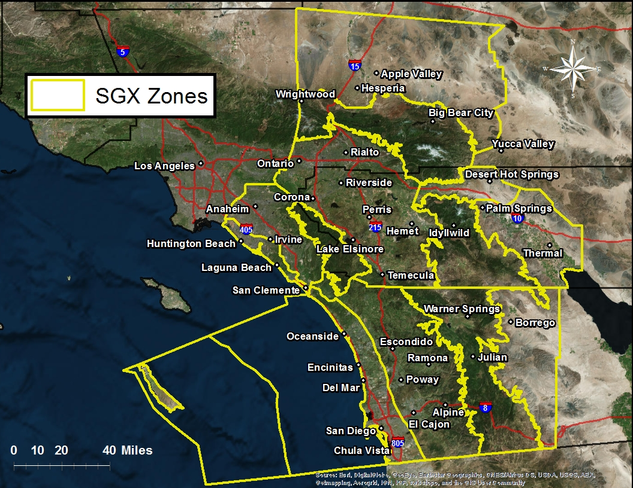
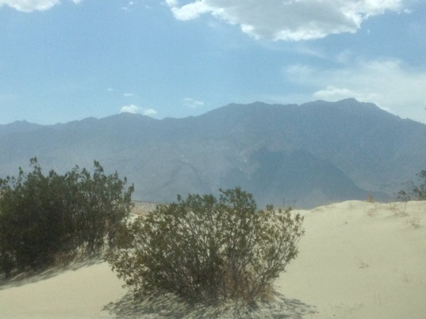
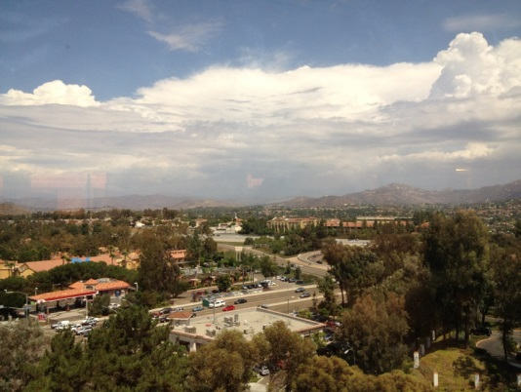
NWS SGX Service Area
Max Elevation 11, 400 feet MSL
Max Elevation 6,200 feet MSL
View from Office

Slide 6
San Diego County New boundary/zones using GIS
Old Zones
New Zones
Northern and southern portions of SD
Coast/valley boundary adjusted. Mtn
Zone no longer cuts across Anza Borrego

Slide 7
NWS Operations
Mission: Provide weather forecasts and warnings to protect lives and property; and for the enhancement of the national economy
Event-based Watches and Warnings
Forecast Operations
Public, Aviation, Marine, and Fire Wx
Public Service Unit
Climate, Media Interviews
NOAA Weather Radio All-Hazards Broadcast
EAS activation
Digital Forecast Database

Slide 8
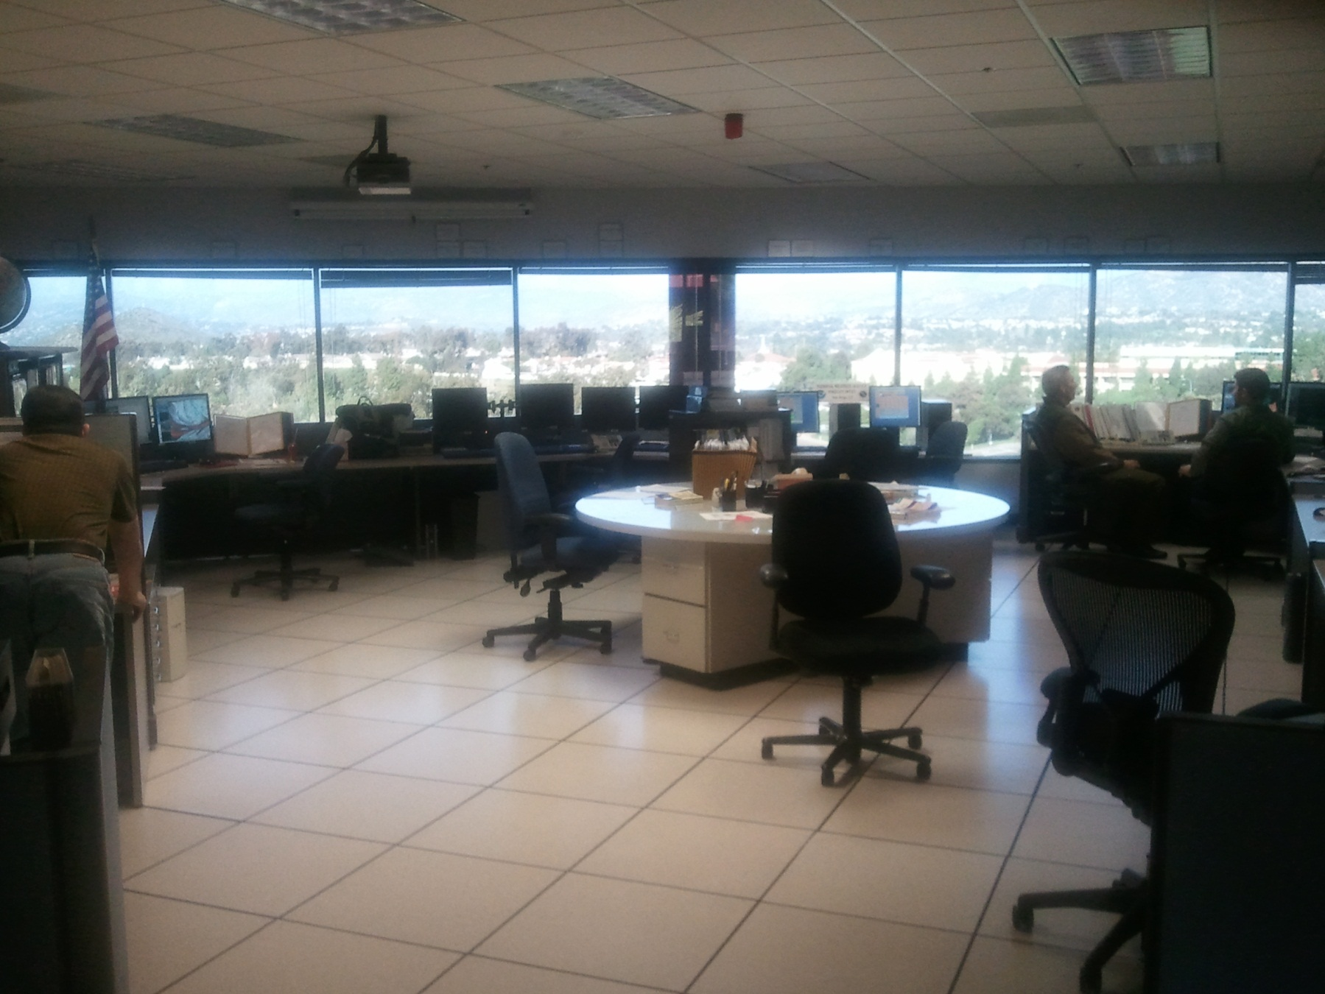
Operations Floor
We look out the window!
View!

Slide 9
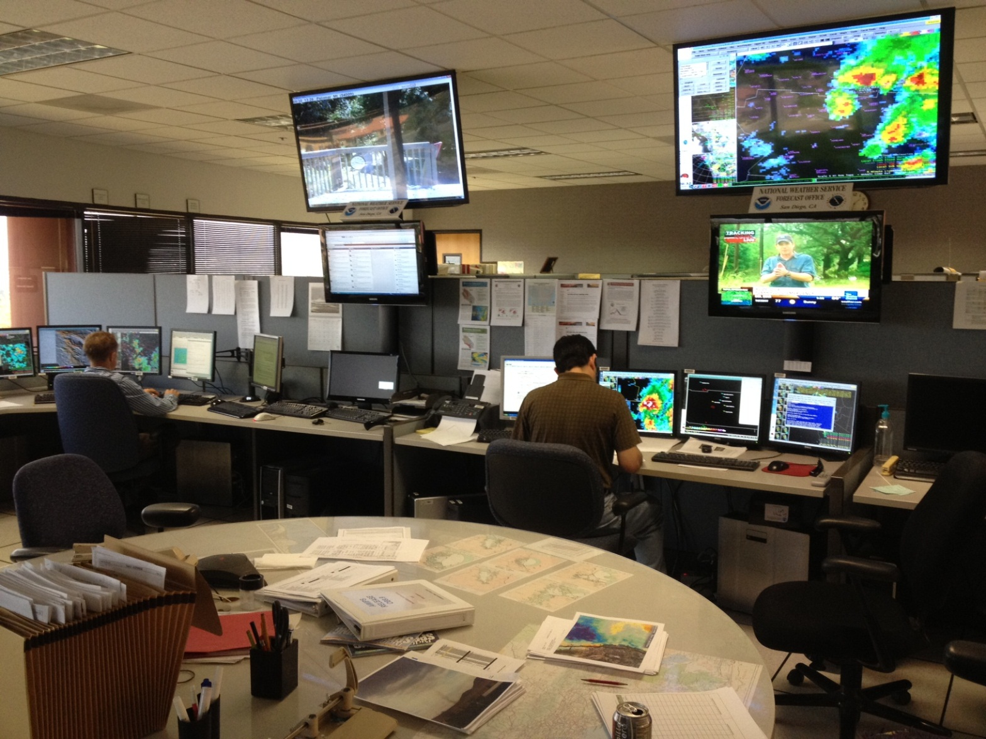
View of operations Situational awareness

Slide 10
Point and Click Forecast weather.gov/sandiego

Slide 11
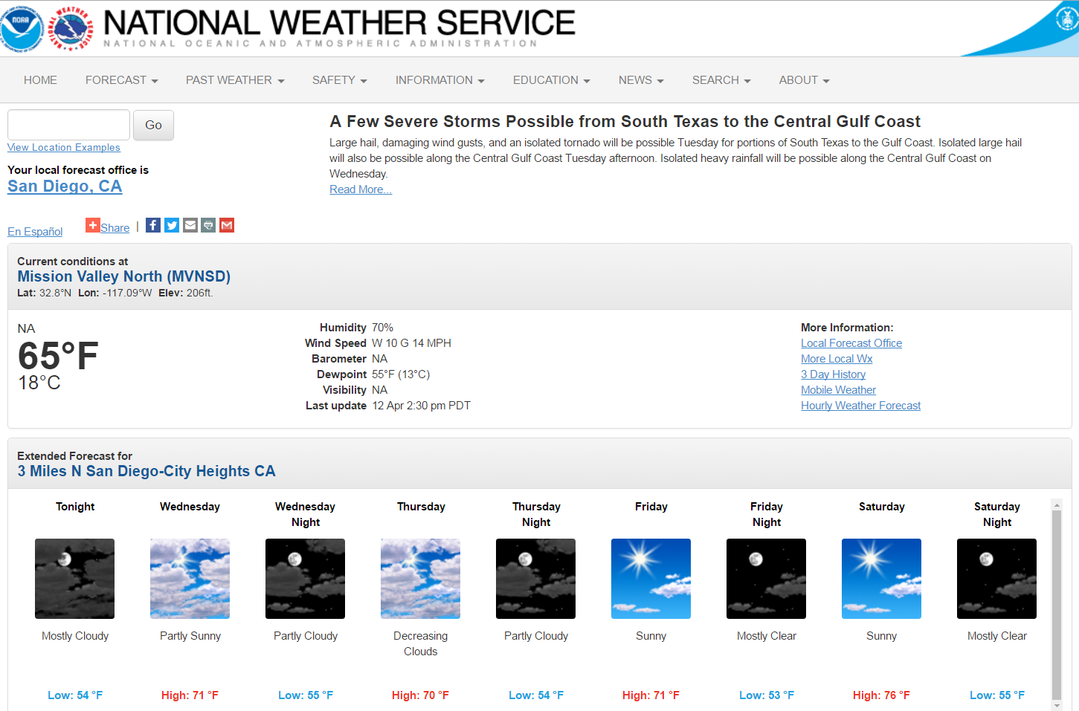
Point and Click forecast

Slide 12
NWS webpage - Hourly Graphs

Slide 13
Hourly Forecast Table

Slide 14
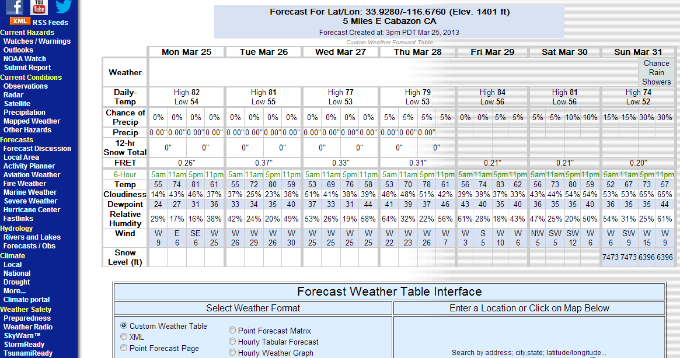
Planning Forecast Table

Slide 15
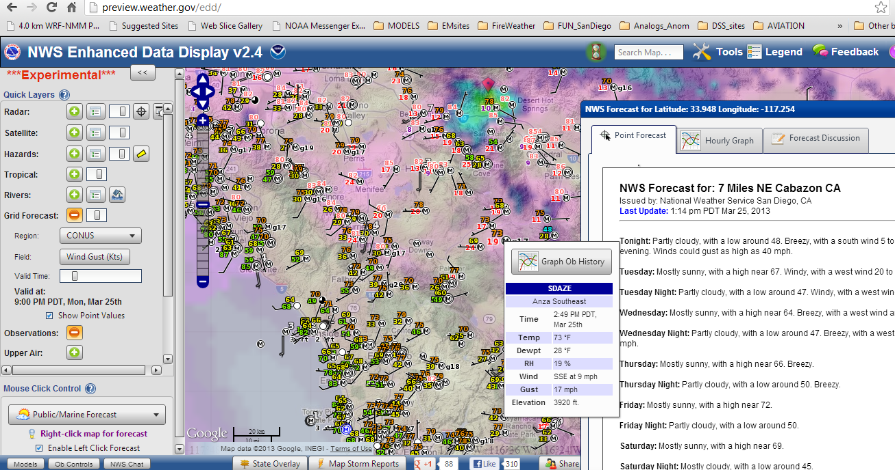
Observations, forecasts and graphics preview/weather.gov/edd/

Slide 16
Recreation Page http://www.wrh.noaa.gov/wrh/rec/?wfo=sgx

Slide 17
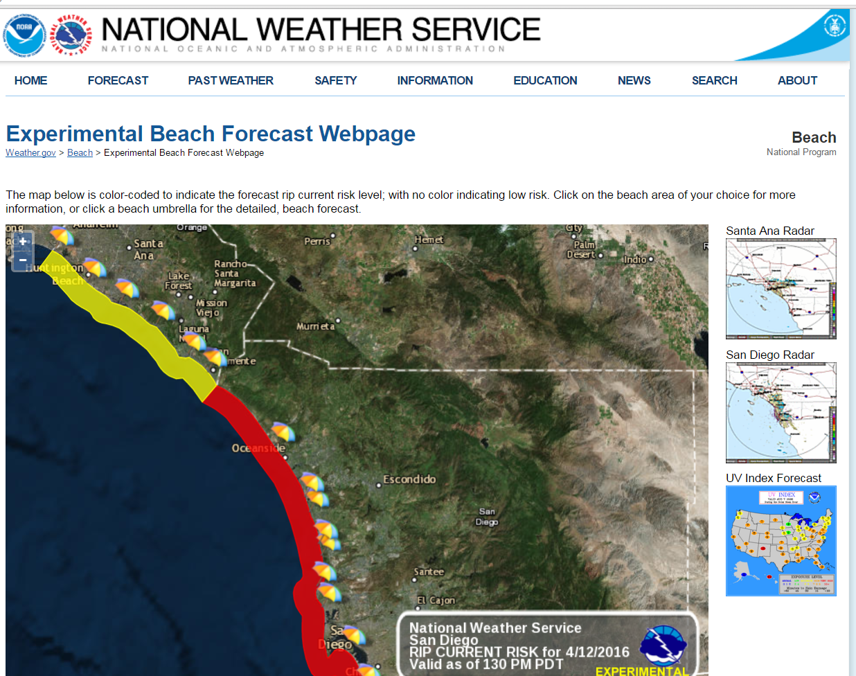
Beach Forecast Page http://www.weather.gov/beach/sgx

Slide 18
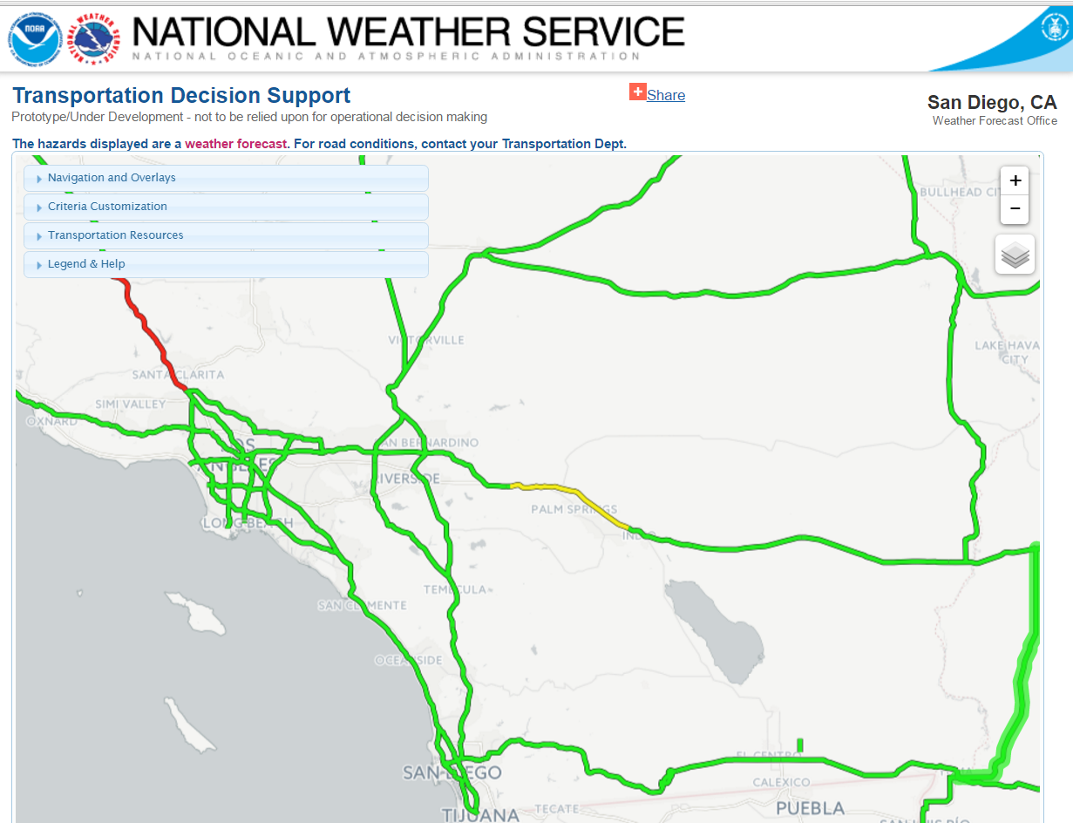
Transportation hazard page http://www.wrh.noaa.gov/wrh/travel/?wfo=sgx

Slide 19
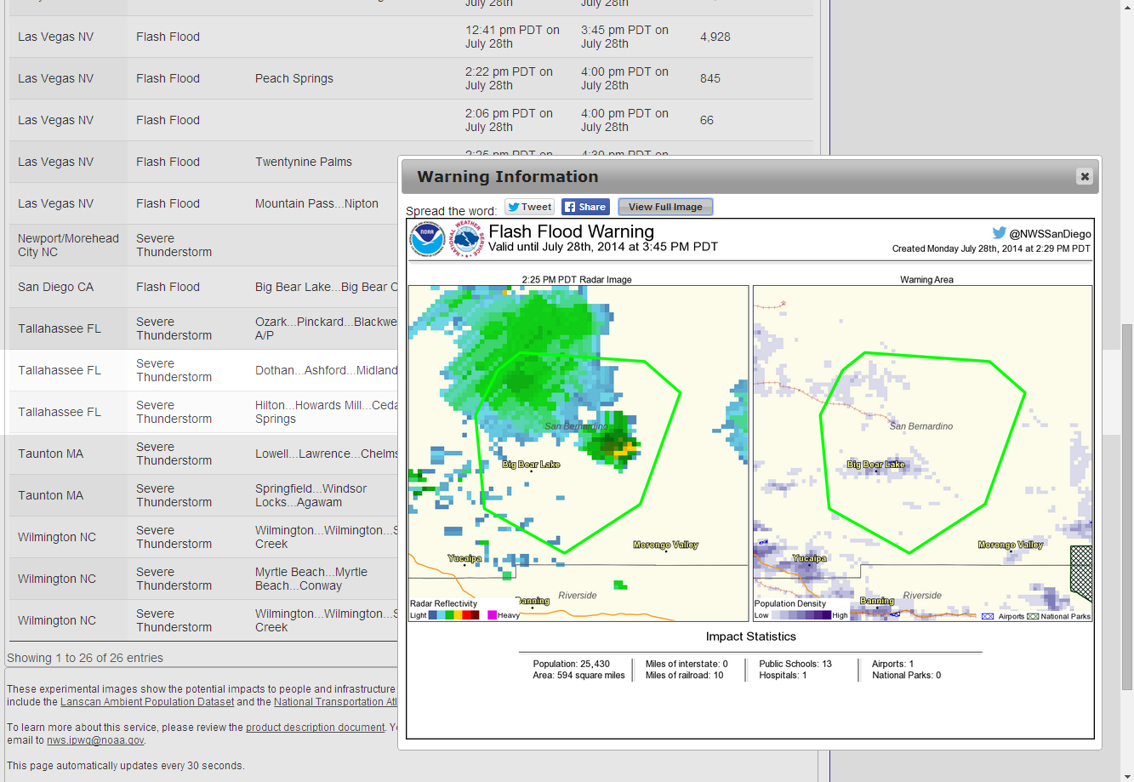
Impacts Graphics www.crh.noaa.gov/crh/?n=impact

Slide 20
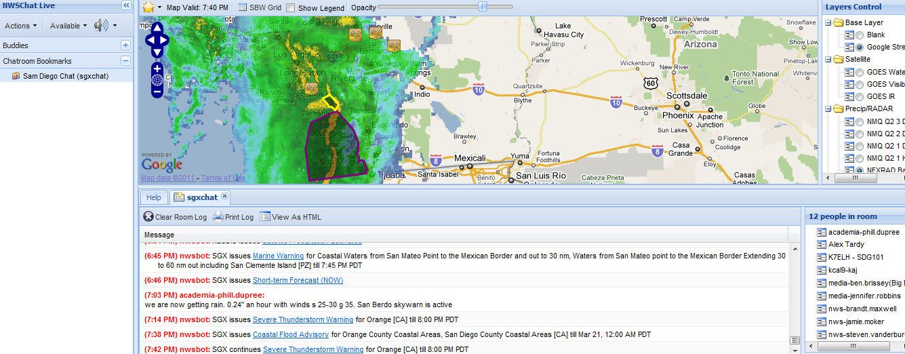
https://nwschat.weather.gov/live Chat with forecaster and follow weather

Slide 21
NWS Digital Forecast Database digital.weather.gov
NDFD
National
Regional
Local

Slide 22
What is NDFD?
National Weather Service National Digital Forecast Database
Gridded forecasts of surface sensible weather elements from current time out to 7 days
Major paradigm shift in the way we produce our products and provide forecast services
Graphical Forecast Editor (GFE) is used.
Forecaster populates grids with model data, and/or will use tools to modify existing or new grid.
Traditional text products created from database with formatter software – ensuring consistency among products
Near seamless mosaic of digital forecasts from NWS field offices
Users can create tailored forecast (“push vs. pull”)
Text, graphic, gridded, and image products

Slide 23
Submit Reports weather.gov/SanDiego
Click on Map

Slide 24
Spotter Reporting form

Slide 25
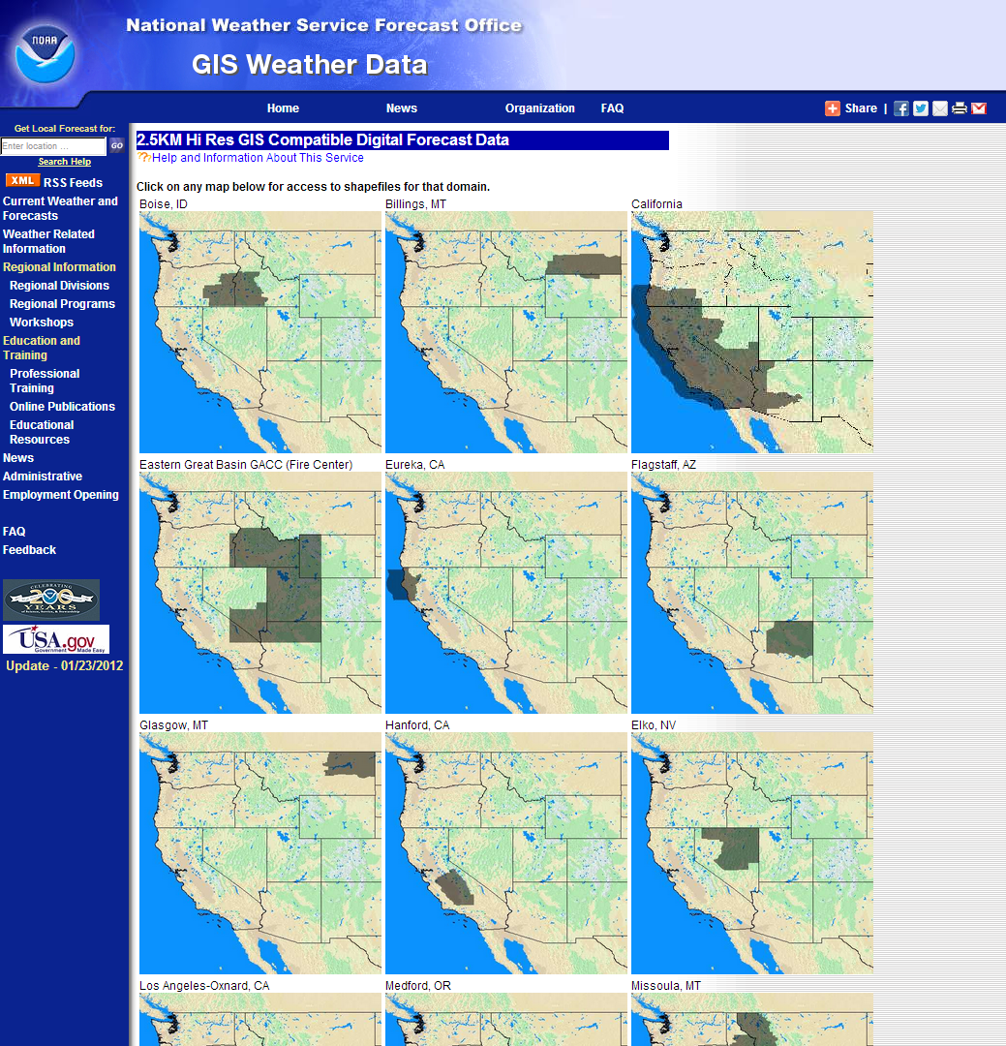
Western Region 2.5 km Forecast GIS Shapefile Service
http://www.wrh.noaa.gov/gis/index.php

Slide 26
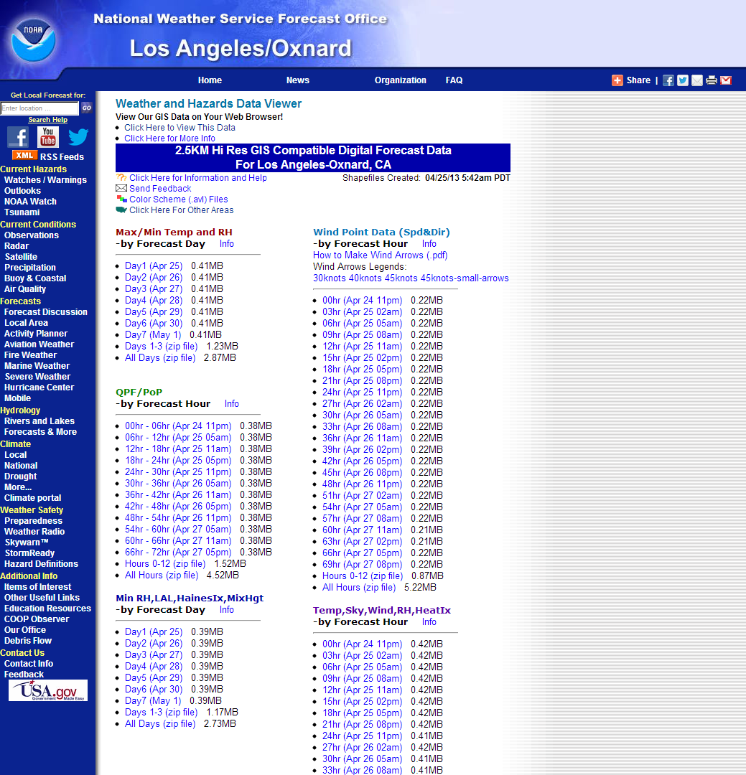
Western Region 2.5 km Forecast GIS Shapefile Service
http://www.wrh.noaa.gov/gis/shape.php?area=sgx

Slide 27
Use of WR GIS Shapefile Service for Wildfire Decision Support
Southern California Wildfire outbreak late October and early November 2007
NDFD shapefiles used to create weather forecast briefing images
Images created by State of California, U.S. Department of Homeland Security, and National Geospatial Intelligence Agency
Images used by Joint Field Office (JFO) staff for planning and decision making
Images used for briefings at Pentagon

Slide 28
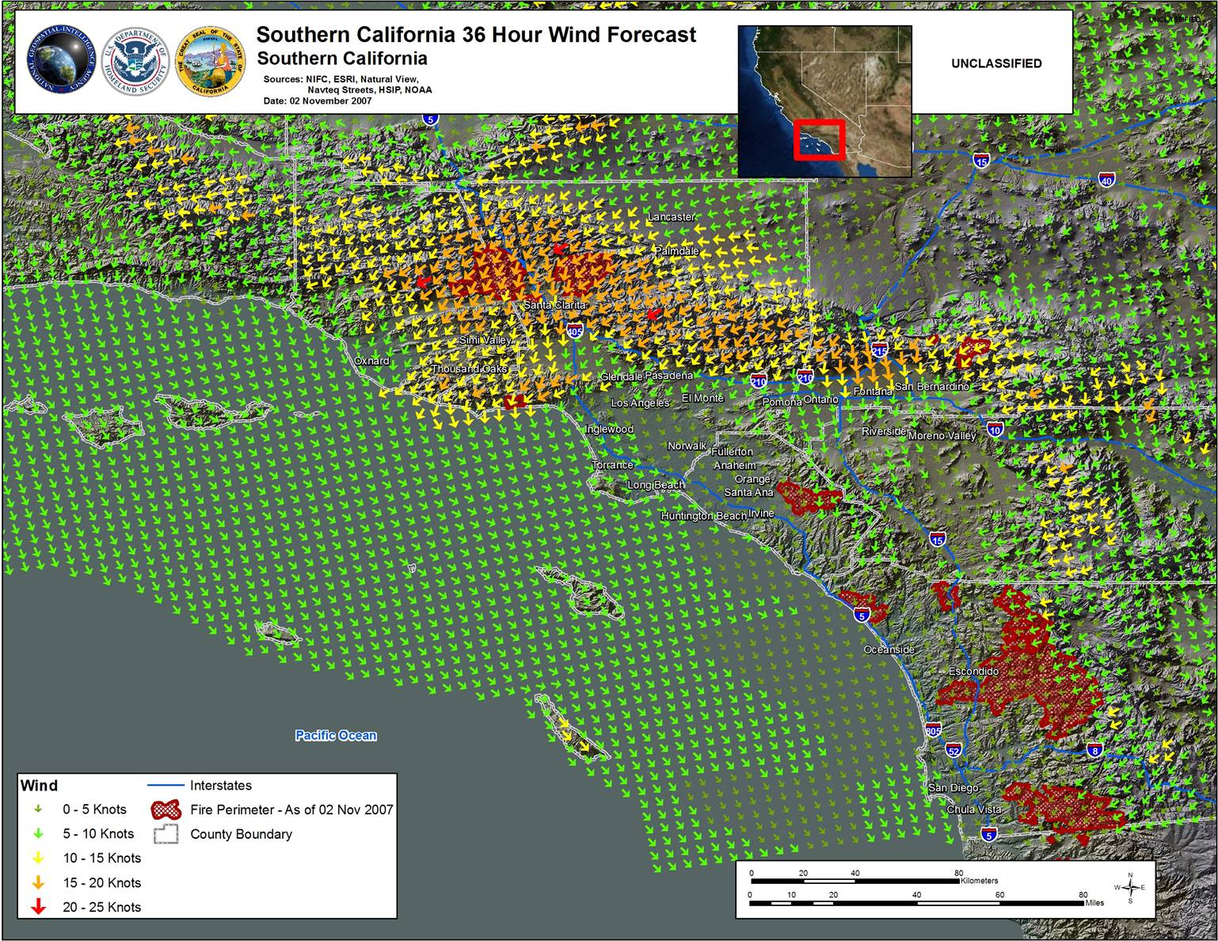
Wind Speed and Direction in ArcGIS Varying wind vector symbol sizes and colors
28

Slide 29
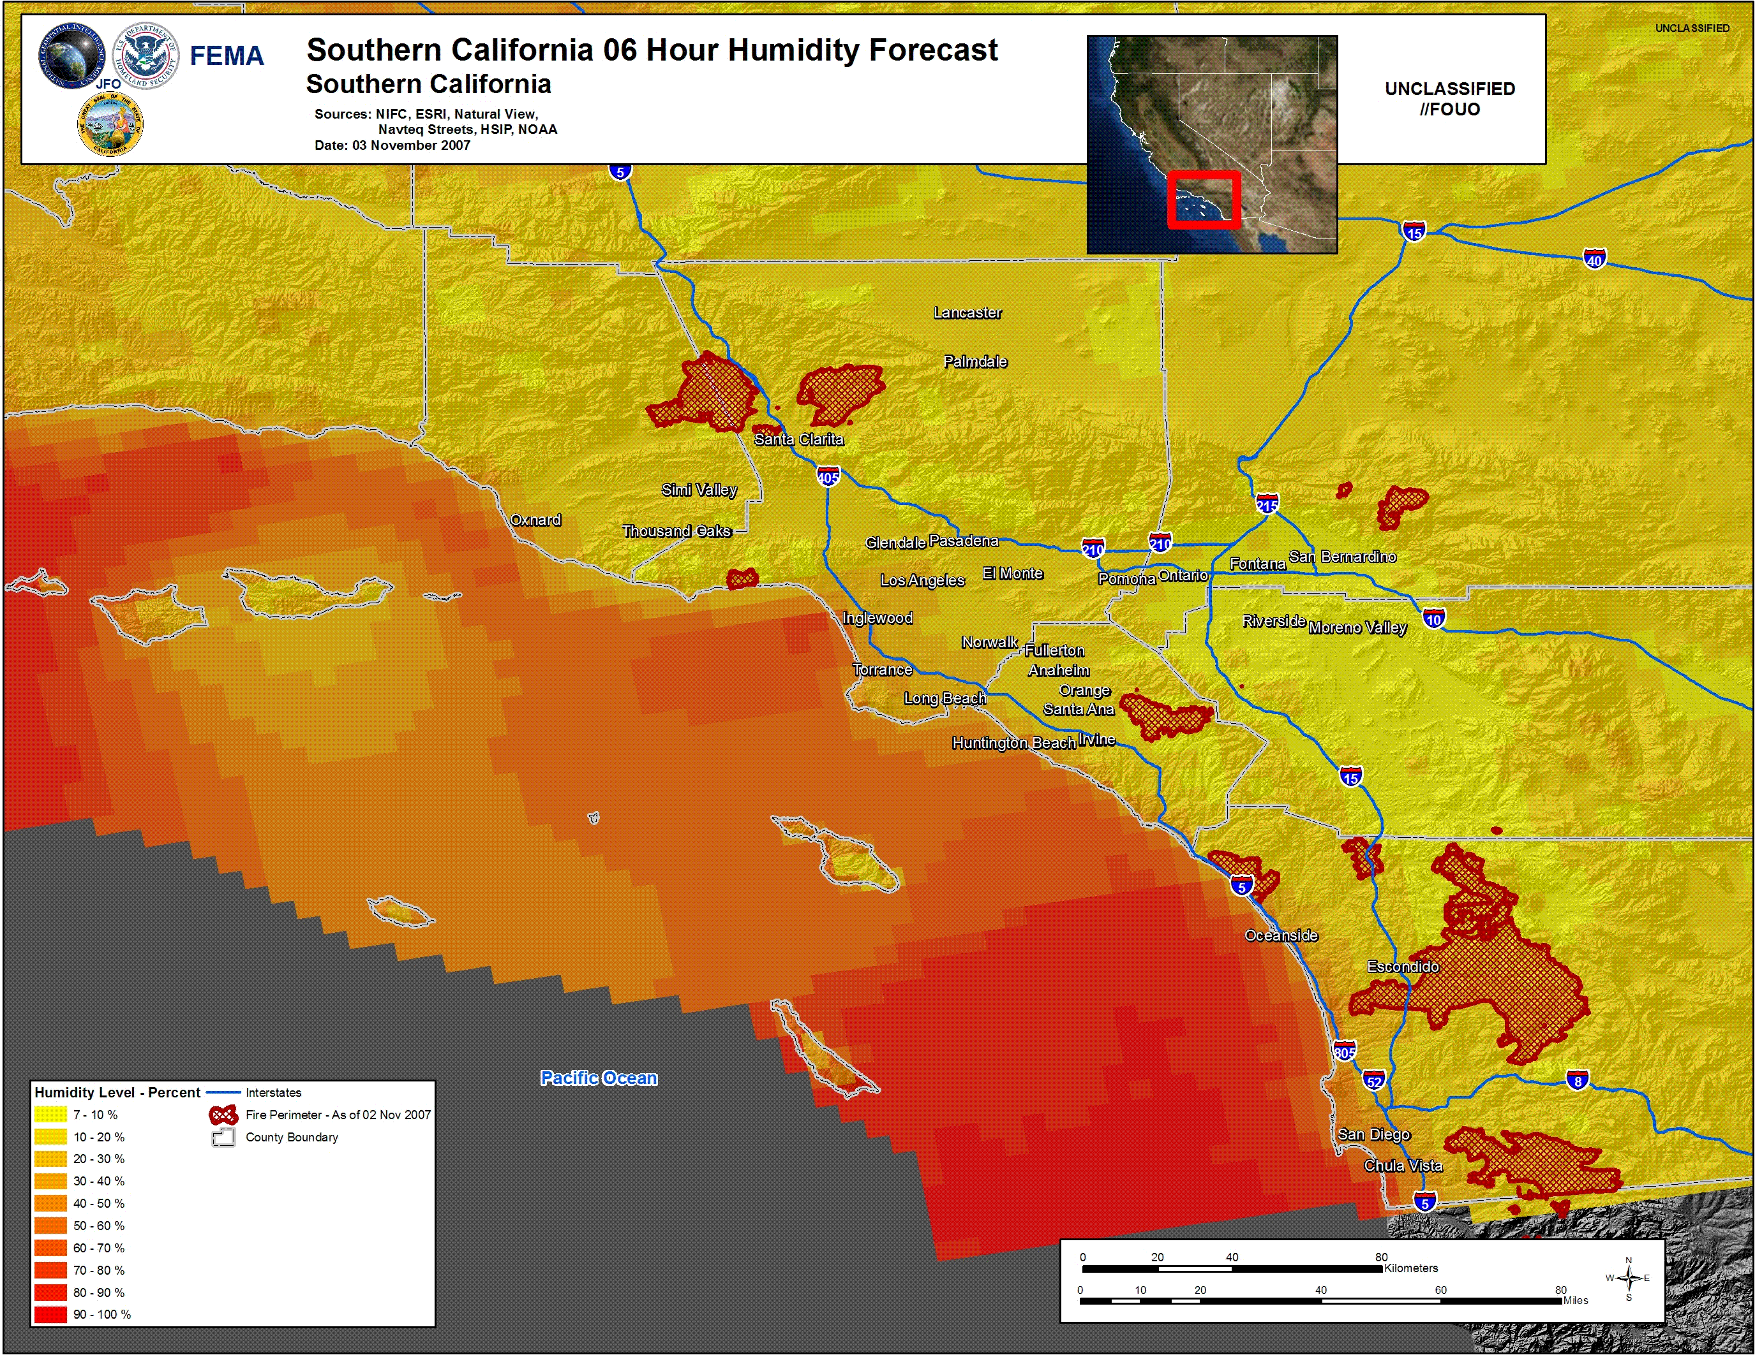
29

Slide 30
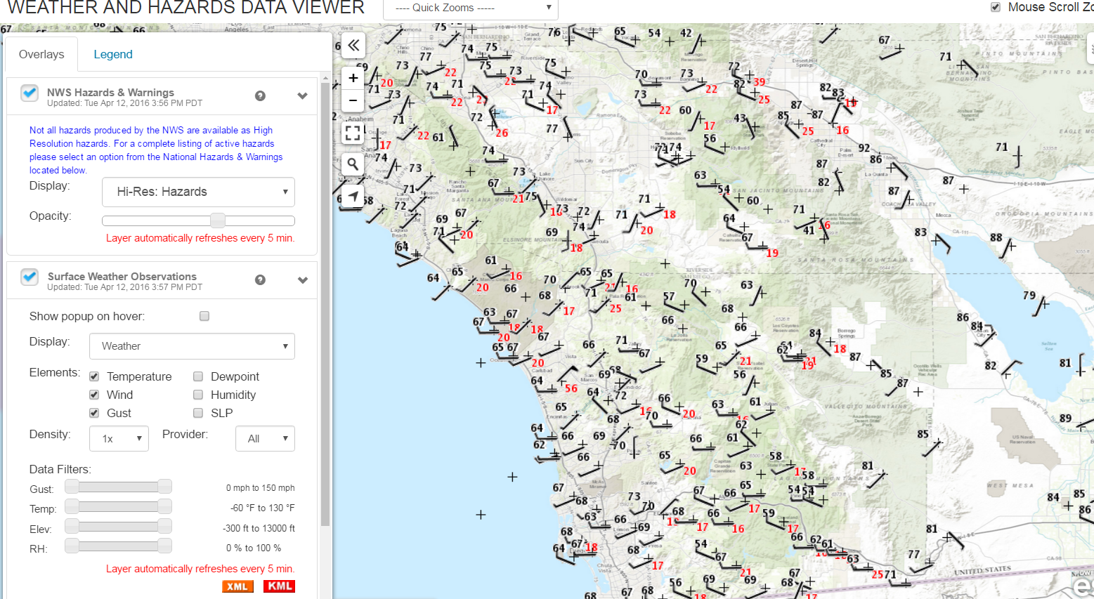
National Weather Service Weather and Hazards Data Viewer
http://www.wrh.noaa.gov/wrh/whv/

Slide 31
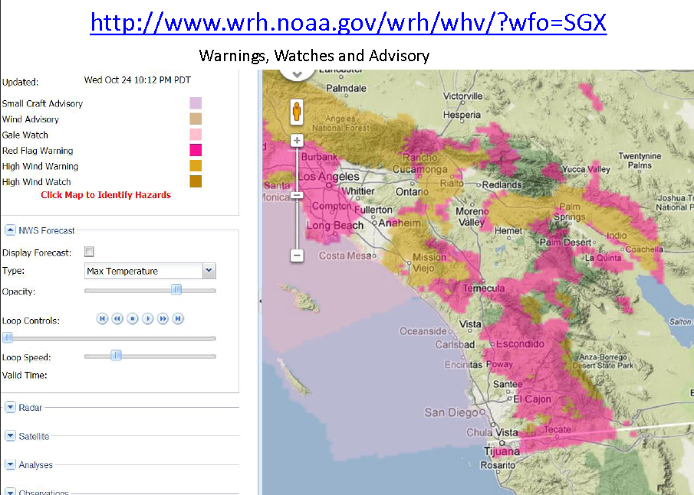
Displaying Hazards

Slide 32
Types of Services for Partners
Legacy Text Products (ZFP, FWF)
Spot Weather Forecast (point locations)
Gridded Forecasts (graphics, point and click generated tables and graphs)
Special Weather Statements and Hazardous Weather Outlooks
Conference Calls
Weather Story Graphics
Headlines on the Home Page
Email with summary of highlights
Email with highlights and accompanying graphics
YouTube video briefings
GoToMeeting (webinars, virtual)
Real-time Social Media information sharing on Twitter and Facebook
NWSchat proactive messaging and interactions
Specialized partner “heads-up” messages for impact events (Fog for US Border Patrol, Heat for County Health Departments, Santa Ana for fire weather)
Storm and Post-storm information sharing of impacts
iNWS messages and Wireless Emergency Alerts
Calls to Emergency Manager partners

Slide 33
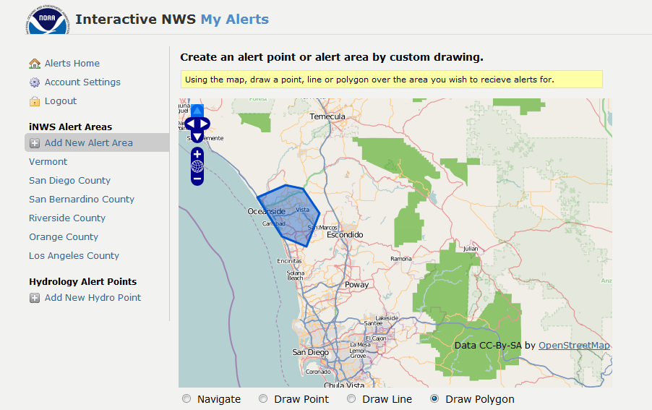
iNWS push notification

Slide 34
Notification Text and Email Alerts
Website: inws.wrh.noaa.gov
Available for NWS core partners only
Emergency managers, community leaders, first responders, and other government agencies

Slide 35
Gridded Forecasts from NWS How we make the forecast

Slide 38
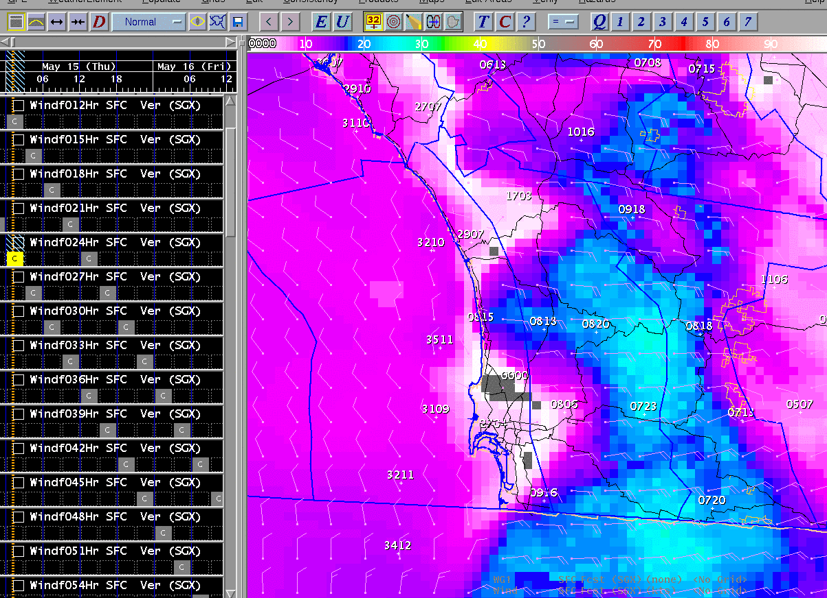

Slide 43
Fire Weather Observations Poinsettia Fire observations May 14
Sea breeze versus Santa Ana

Slide 44
Wind May 15

Slide 45
May 15 at 1 pm Cocos Fire
Sea Breeze Versus Santa Ana

Slide 46
645 am August 20, 2014
lightning

Slide 48
6 hour lightning plot

Slide 49
6 hour lightning plot

Slide 50
Significant Lightning Potential
http://www.spc.noaa.gov/exper/ltgfuel/

Slide 51
Flash Flood and Severe Warnings

Slide 52
Main Surge Flash Flood Watches August 2, 2014

Slide 53
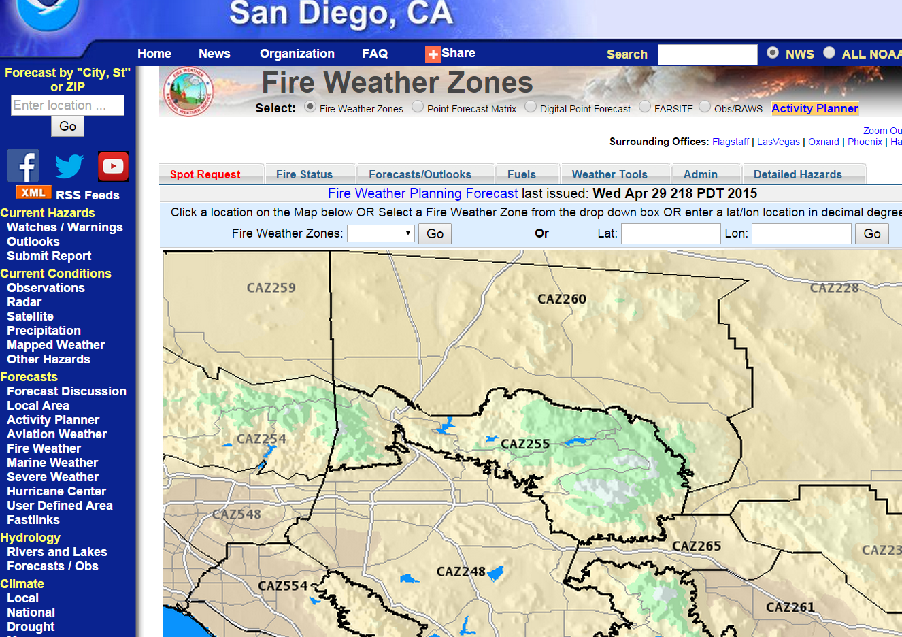

Slide 54
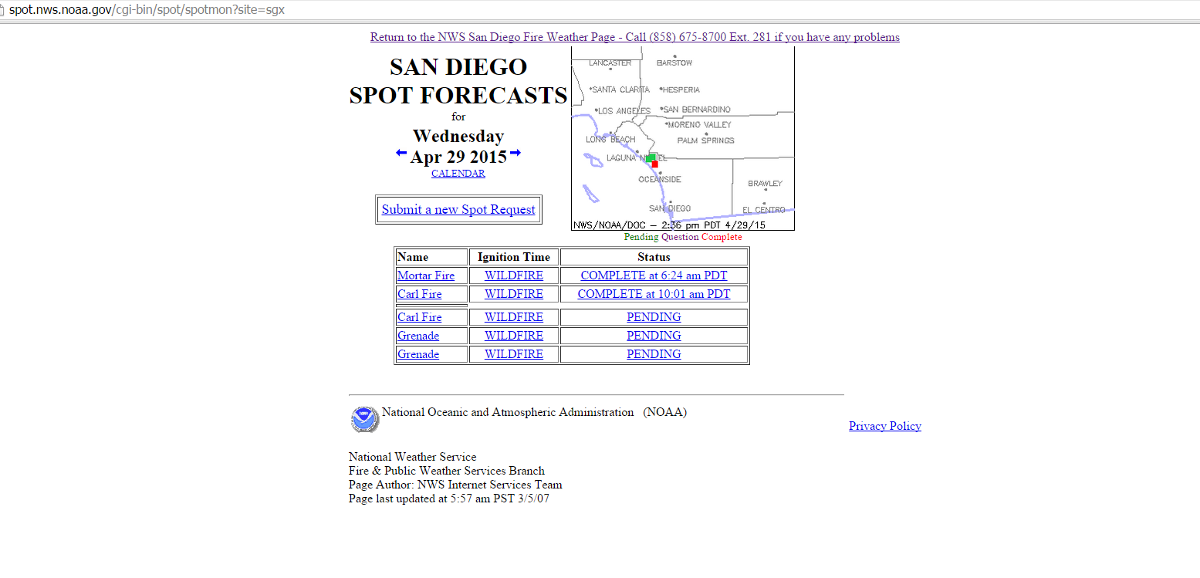
Spot Forecast Page

Slide 55
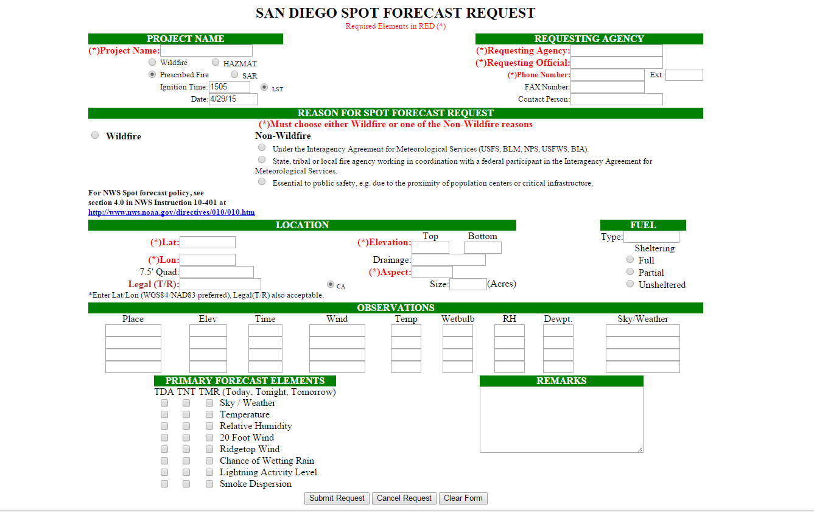
Submitting Call 24/7 858-675-8711 (8707)

Slide 56
Spot Forecast weather.gov/fire

Slide 57
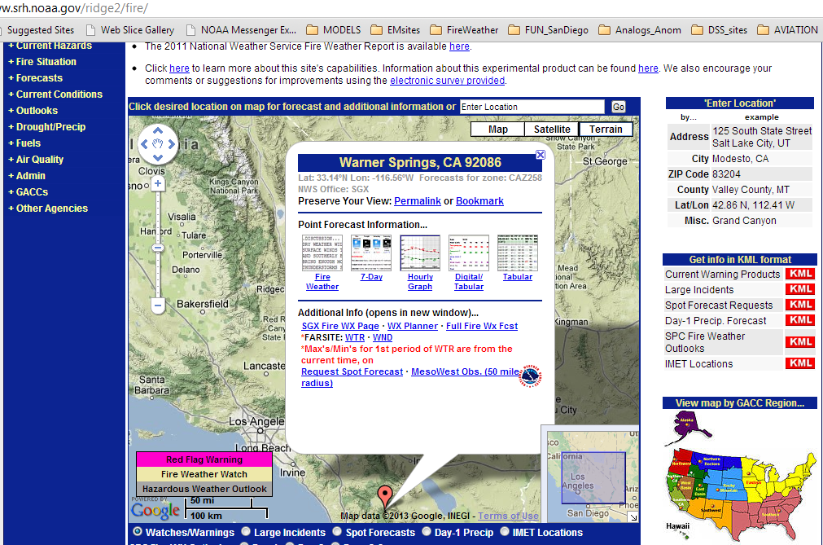
All in one fire information
Weather.gov/fire

Slide 58
Hourly model output example numerical weather prediction

Slide 59
Hourly WRF Output Example

Slide 60
Hourly WRF Output Example

Slide 61
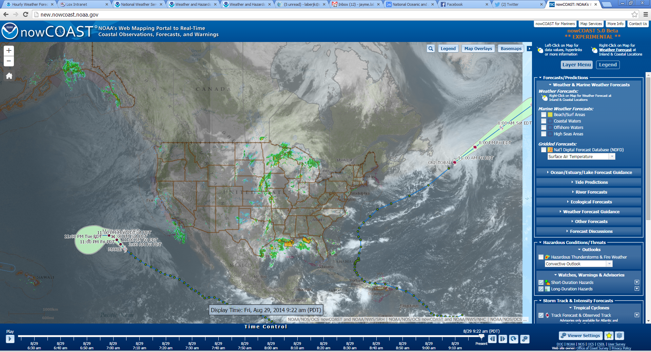
nowCOAST
http://nowcoast.noaa.gov/

Slide 62
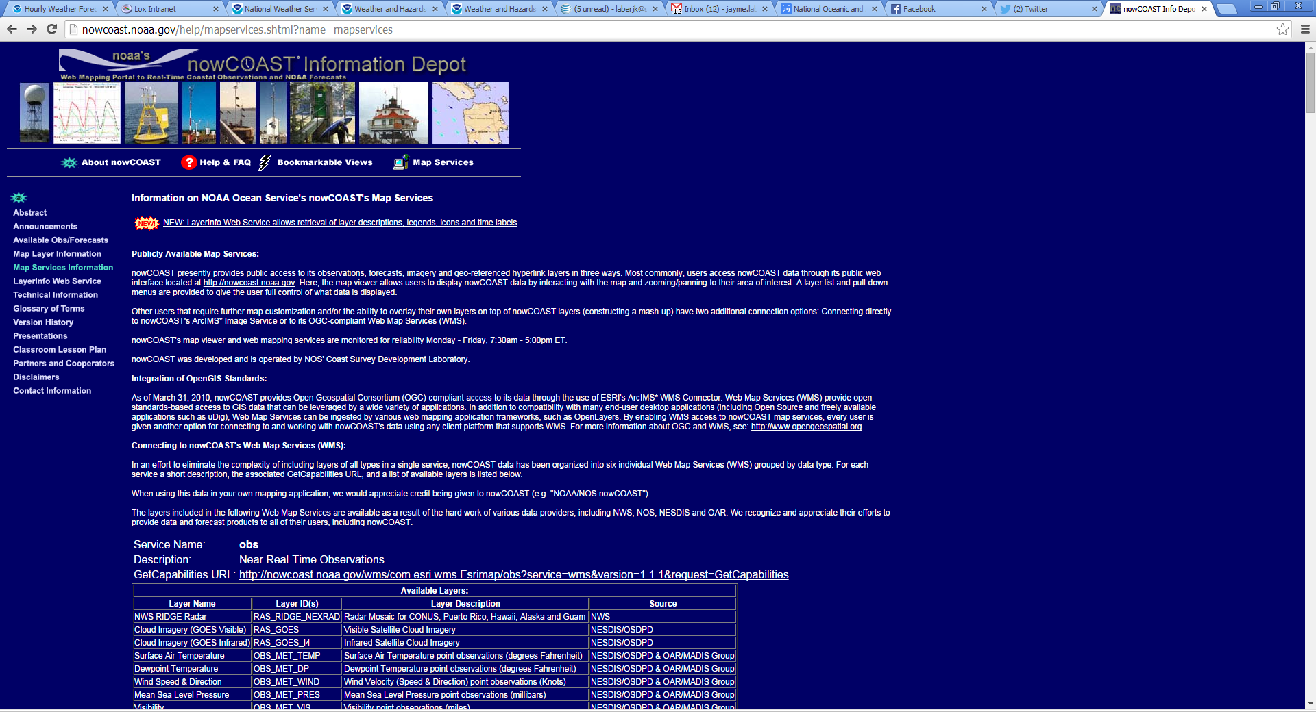
nowCOAST Map Services
http://nowcoast.noaa.gov/help/mapservices.shtml?name=mapservices

Slide 64
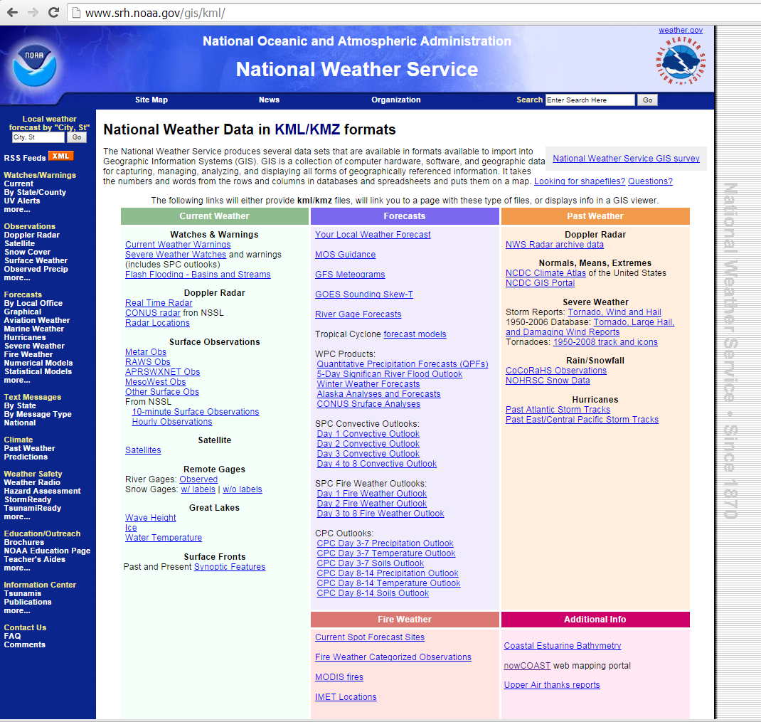

Slide 65
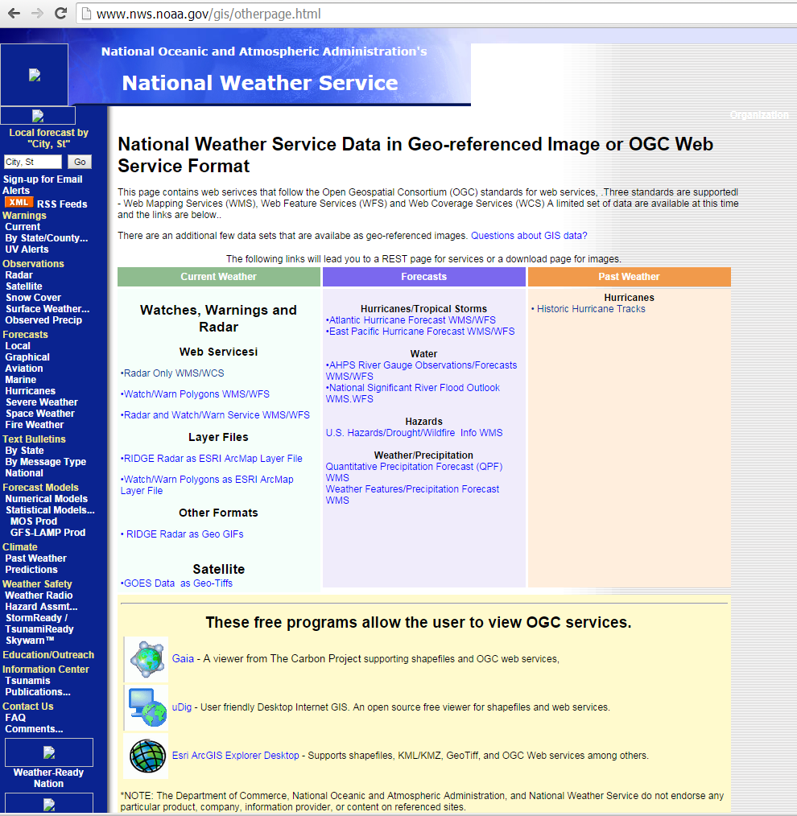

Slide 66
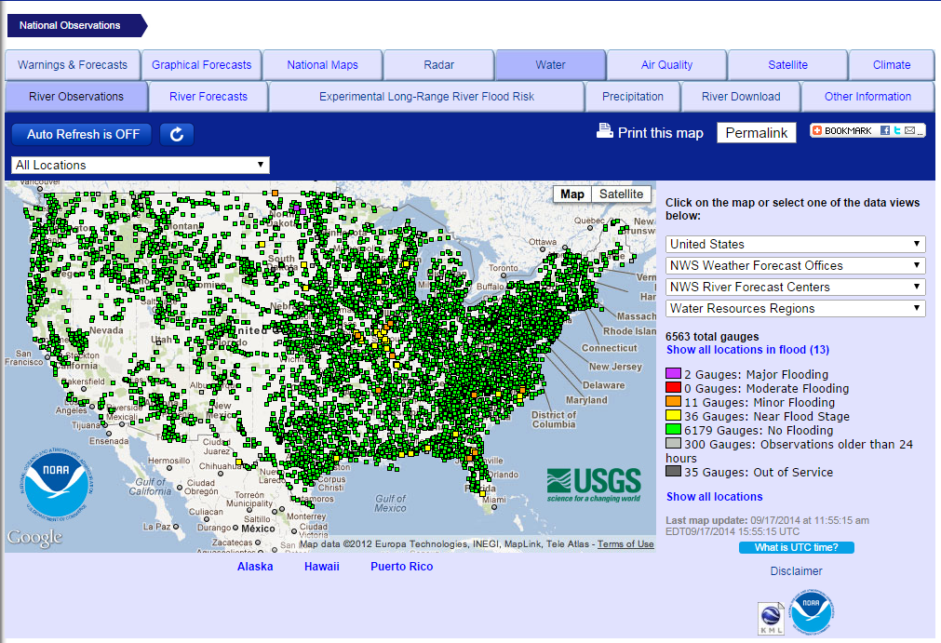
NWS River Forecasts
http://water.weather.gov/ahps/index.php

Slide 67
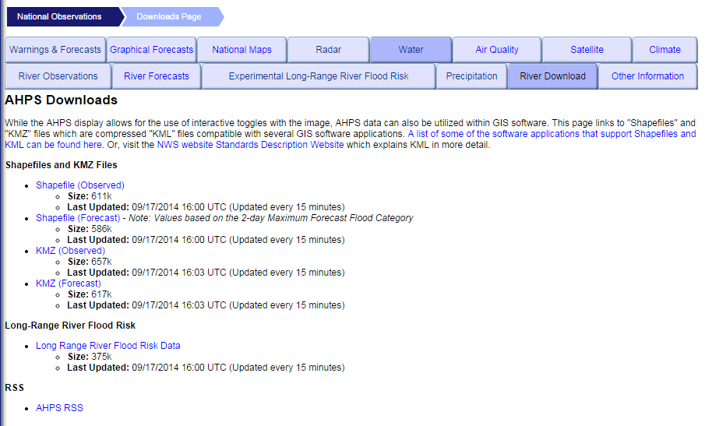
NWS River Forecasts
http://water.weather.gov/ahps/download.php

Slide 68
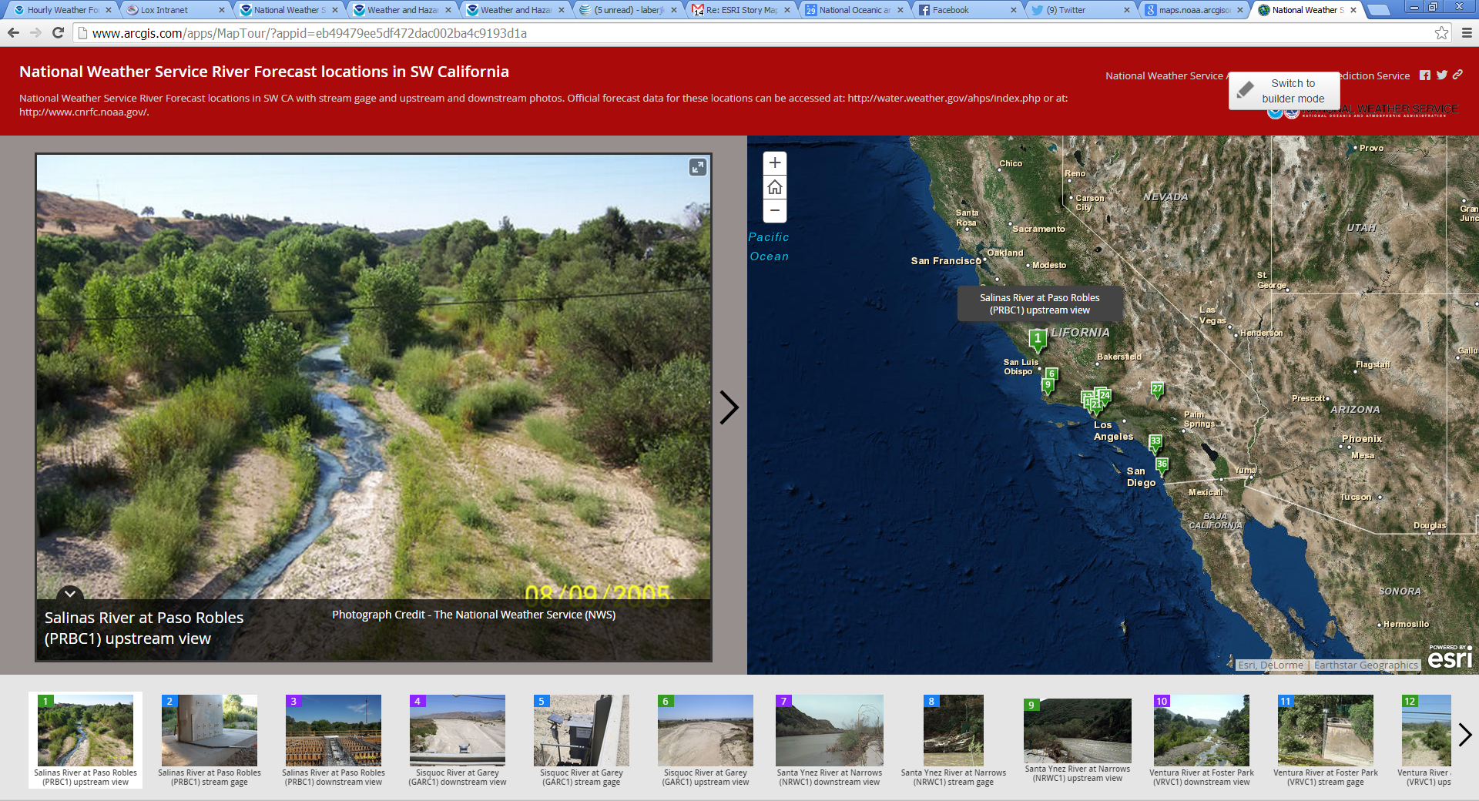
NWS ESRI Story Map Sample

Slide 69
Creating ESRI Story Maps
First step is to sign up for a NOAA ArcGIS online account through the NOAA GeoPlatform
https://sites.google.com/a/noaa.gov/gis-community/esri-ela/arcgis-online
ArcGIS Online allows you to create interactive web maps that you can share with anyone.
Build web maps like you do in ArcGIS desktop

Slide 70
Story Map Apps
http://storymaps.arcgis.com/en/app-list/

Slide 71
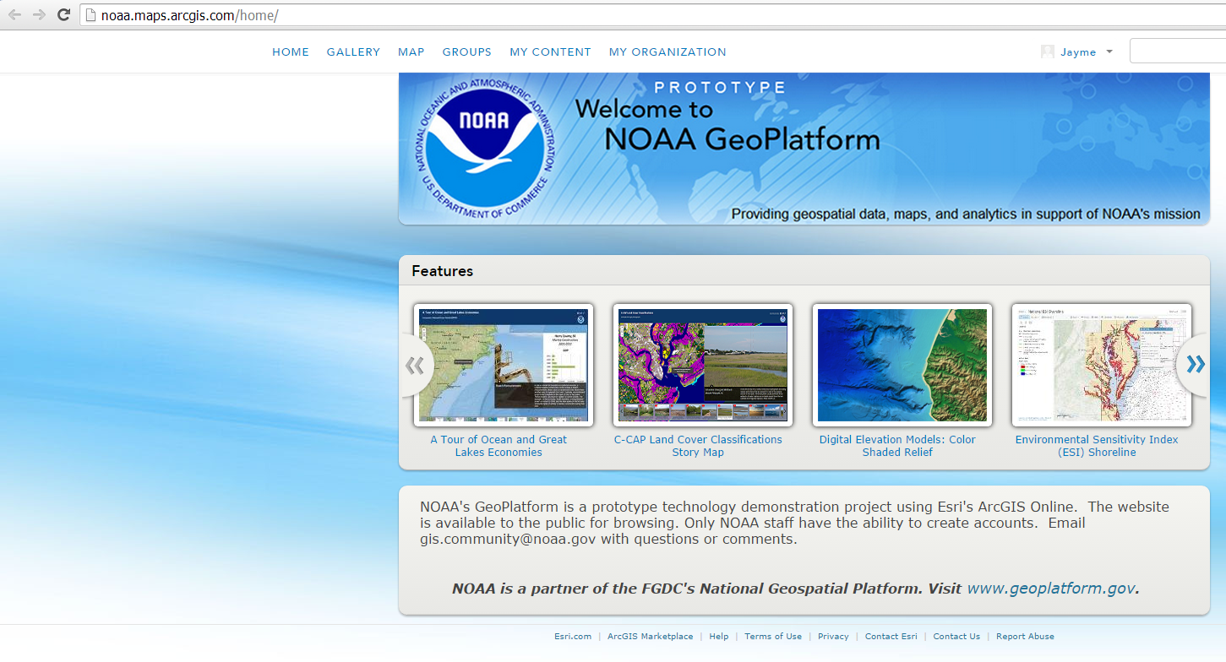
NOAA GeoPlatform

Slide 72
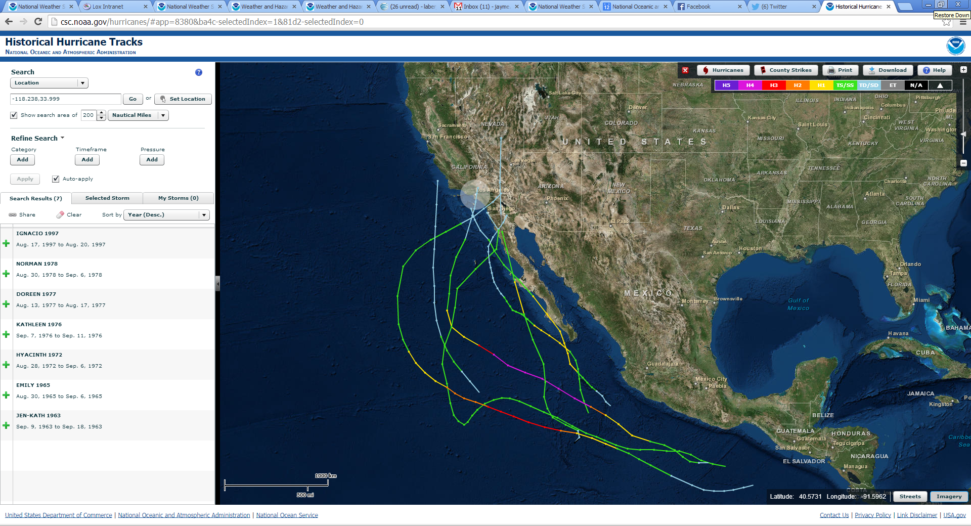
Historic Hurricane Tracks

Slide 73
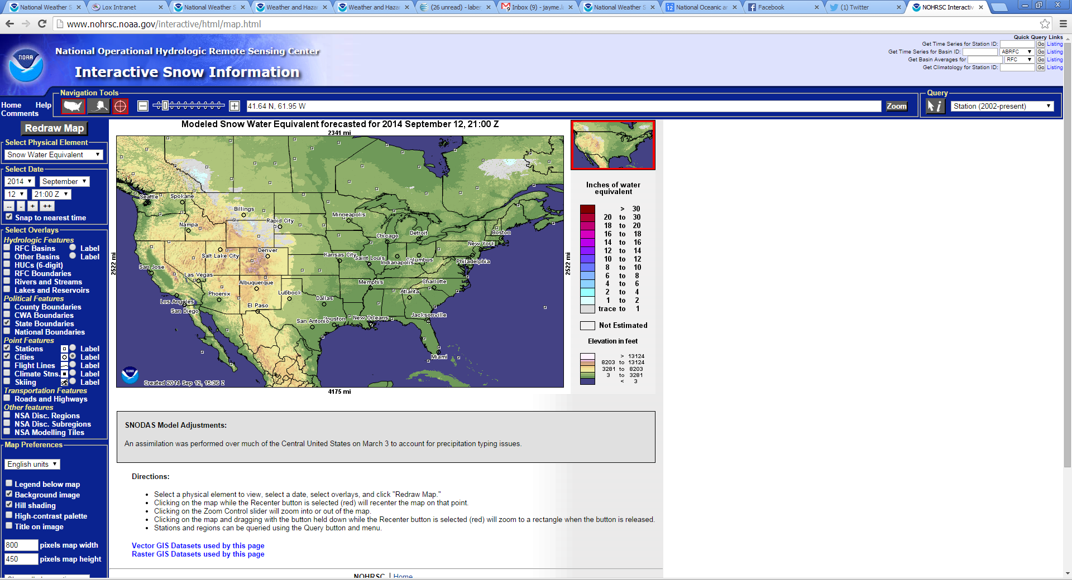
Snow – National Operational Hydrologic Remote Sensing Center (NOHRSC)

Slide 74
Links
www.weather.gov/losangeles
http://www.wrh.noaa.gov/gis/index.php
http://www.wrh.noaa.gov/gis/shape.php?area=lox
http://www.wrh.noaa.gov/wrh/whv/
http://nowcoast.noaa.gov/
http://nowcoast.noaa.gov/help/mapservices.shtml?name=mapservices
http://preview.weather.gov/edd/
http://www.nws.noaa.gov/gis/
http://water.weather.gov/ahps/index.php
http://www.arcgis.com/apps/MapTour/?appid=eb49479ee5df472dac002ba4c9193d1a
http://www.arcgis.com/apps/StorytellingSwipe/?appid=f9994ab96ce64259a4789b6ef20996c1
http://www.arcgis.com/apps/OnePane/azuretwitter/index.html?appid=1dded698095b494e8c6ce8014abfb41e
https://noaa.maps.arcgis.com/home/
http://csc.noaa.gov/hurricanes/
http://www.nohrsc.noaa.gov/interactive/html/map.html

Slide 75
In Summary
Accessibility to NWS GIS data and tools is important to users
NWS GIS Tools developed collaboratively with users
NWS GIS data is a key component for improving decision support services to users of NWS forecasts

Slide 76
Steps Toward Impact-Based Decision Support Services
NWS Tools You Can Use

Slide 77
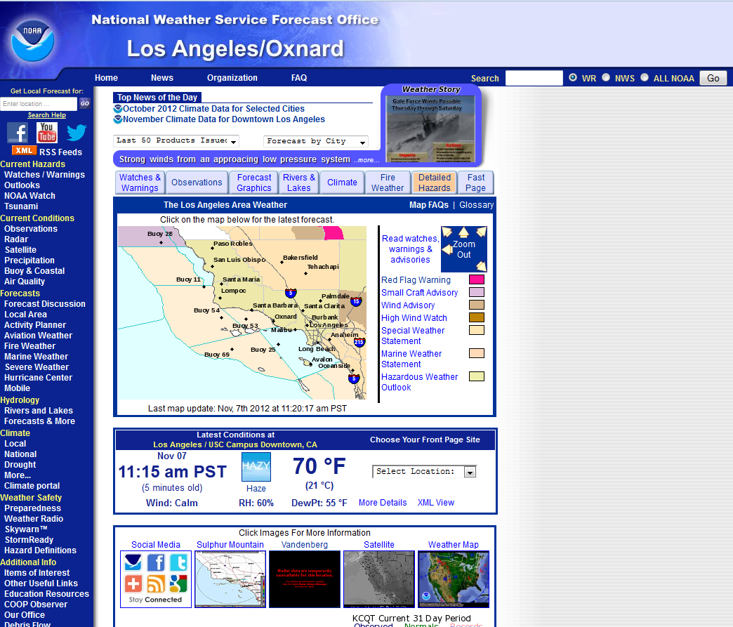
Weather Story Images – Prior To and During Storms
Also look for headline information here – may show up as a large red banner during urgent situations

Slide 79
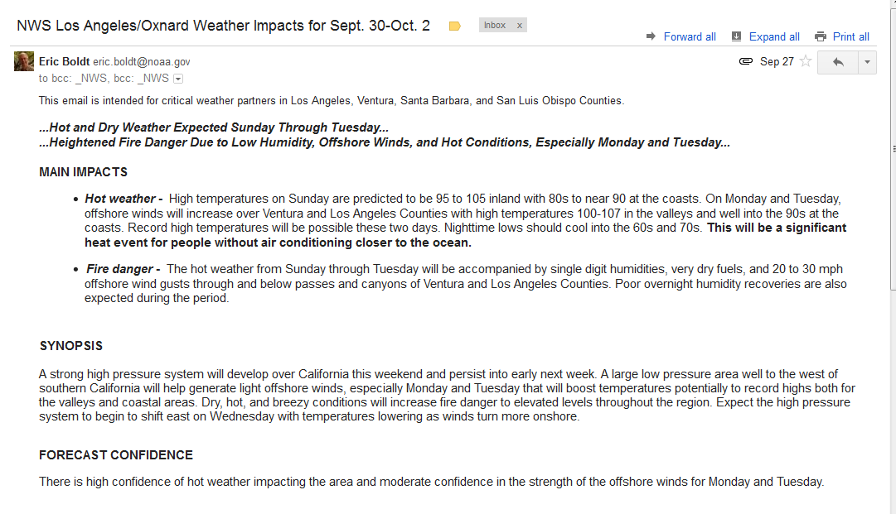
Heads Up Email
To be on this list - eric.boldt@noaa.gov

Slide 80
“Live” GoToWebinar Briefings
Major winter storms with multiple impacts
Virtual weather briefing by PC and phone
Email notification – usually 24-hrs in advance

Slide 81
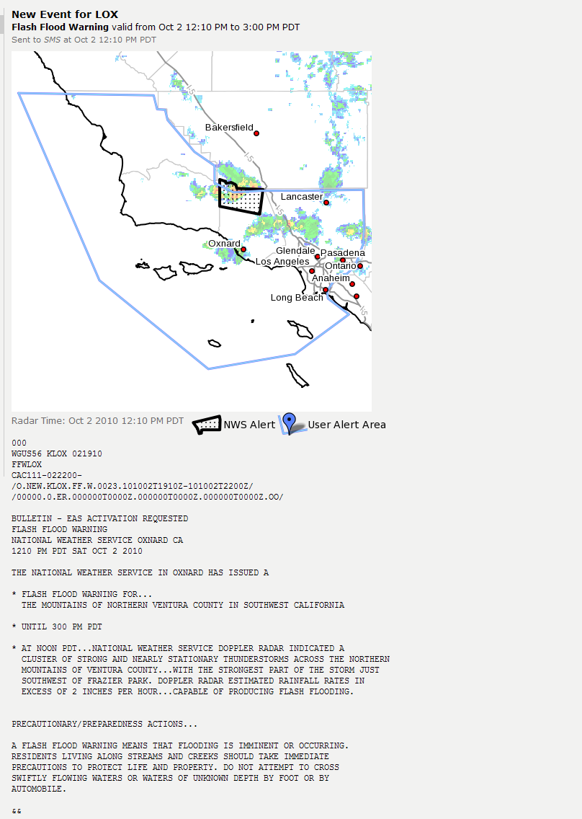
Simple text message, plus iNWS will give you a visual of the warning area with radar overlay, and the full text.
Example: Lockwood Valley flash flood Saturday, Oct. 2, 2010

Slide 82
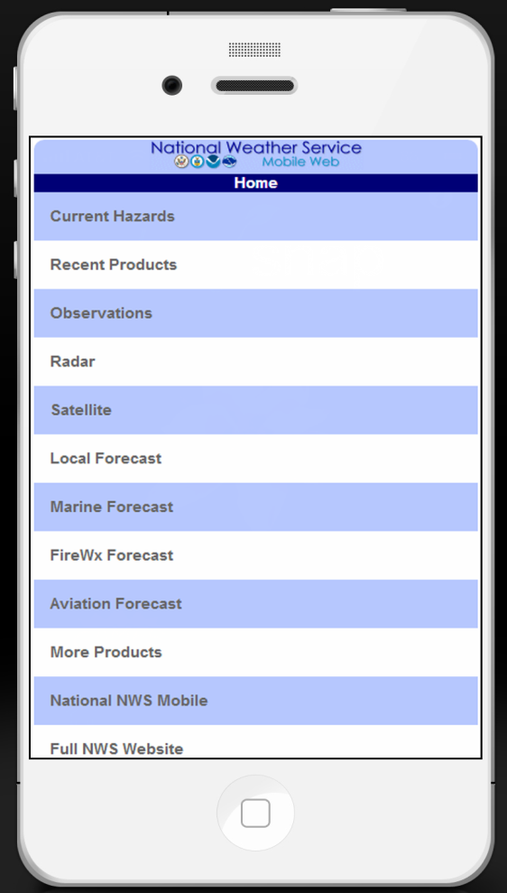
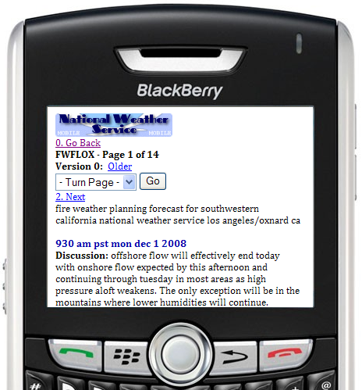
Mobile Webpage
weather.gov/losangeles/mobile
NWS forecasts, watches, advisories, and warnings for southern California
Observations
Radar and satellite imagery

Slide 83
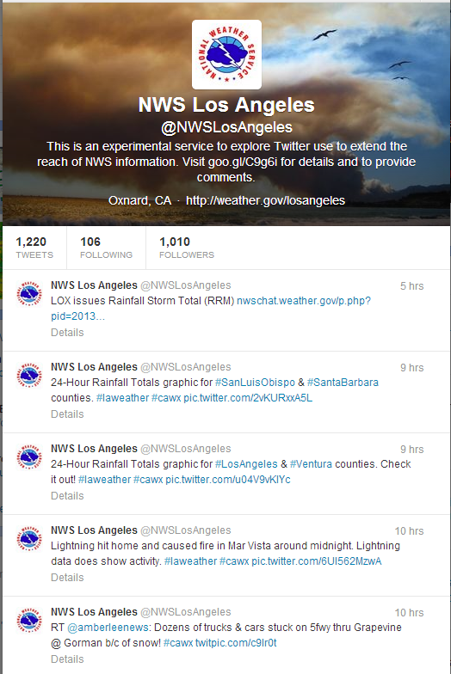
Twitter
Follow us at: @NWSLosAngeles Weather information, short-fused weather updates, info on watches and warnings, relay of partner news, etc.

Slide 84
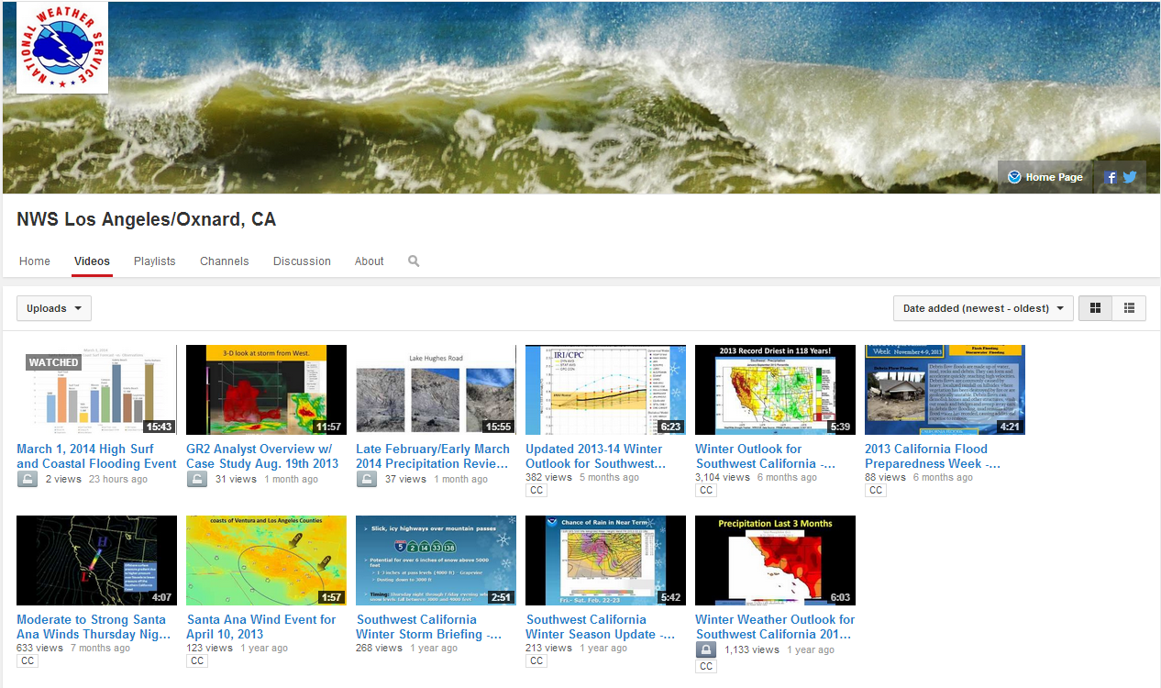
Subscribe and/or watch NWSLosAngeles
Recorded weather briefings, outlooks, and educational information

Slide 85
NWS Alert Information
Hazardous Weather Outlook / Special Weather Statement
Several days in advance of approaching weather system
Watch (1-3 days ahead)
Potential of life or property-threatening weather hazard. Conditions favorable but there is still some uncertainty.
Warning (minutes to 1 day ahead)
Life or property-threatening weather hazard is occurring or imminent.
Advisory (minutes to 1 day ahead)
Nuisance level weather hazard is occurring or imminent.

Slide 86
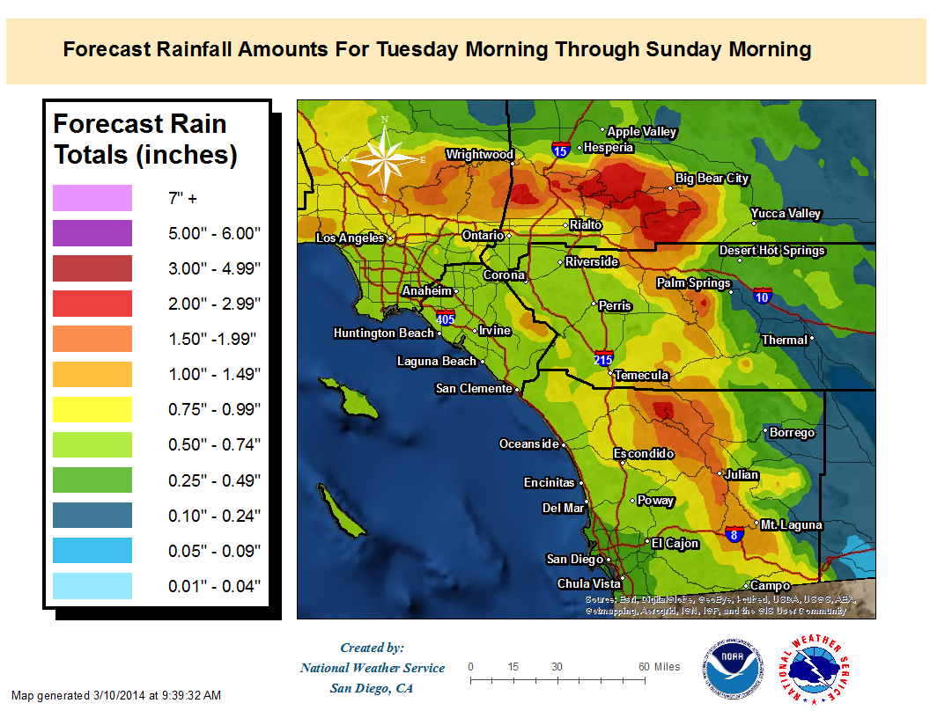
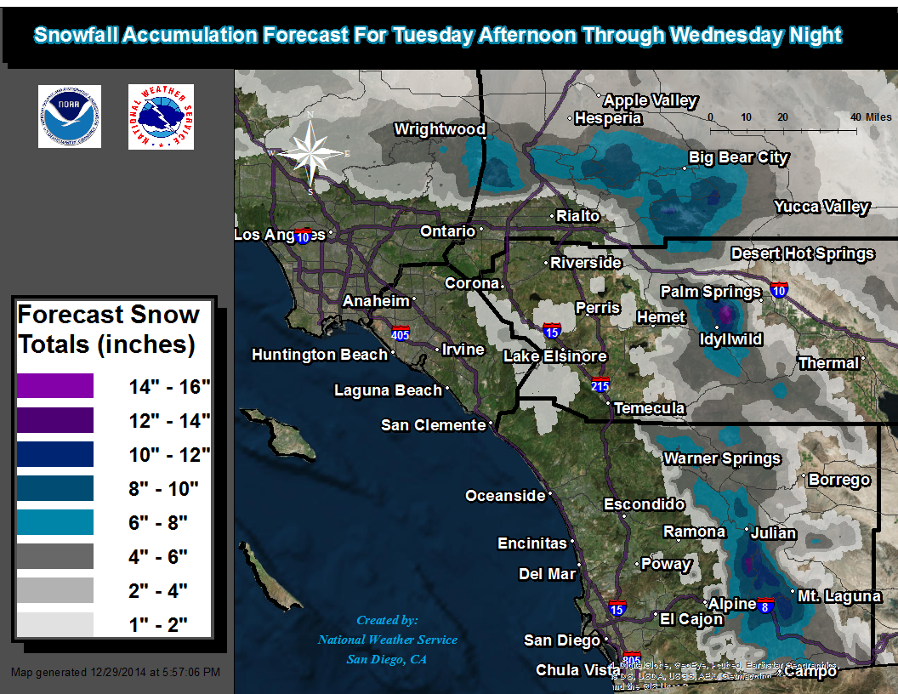
NWS SAN DIEGO
LOCAL GIS USE
Presented by:
NWS Meteorologist James Thomas
Notes:
Hello My name is James Thomas, a forecaster at the meteorologist at the San Diego NWS. Over the next 10 minutes or so, I will be share with you the local uses of GIS within out office.

Slide 87
Forecast And Observed
GIS Maps
Forecast GIS database…
Source: NWS NDFD forecast grids
Time Frame: User input on local AWIPS machine
Type: Net CDF 2.5 km raster grids are converted into table form in model
builder and are interpolated in by the natural neighbors tool
in ArcMap GIS
Observed GIS Rainfall database…
Source: Hydro-database… includes Alert stream gauges,
NWS Mesonets, ASOS, CoCoRaHS network,
and RAWS stations. Over 400 stations in all.
Type: Microsoft Excel files in table form and interpolated in GIS
Notes:
Our office produces both forecast and observed GIS graphics. The forecast graphics are derived from our 2.5 km grids and are interpolated by using the natural neighbors
tool in ArcMap. Observed graphics, such as rainfall amounts utilize Excel spread sheets, which contain over 400 observations across Southwest California including Alert Stream Gauges, NWS Mesonets, ASOS, and CoCoRaHS sites. These values are automatically updated every 5 minutes and are interpolated using the IDW interpolation tools in ArcGIS.

Slide 88
EXAMPLES OF LOCAL NWS
FORECAST GIS GRAPHICS

Slide 89
Forecast High Temperatures
Notes:
This forecast high temperature graphic features a dynamically changing scale, color coded backdrop, and labels with values for specific more well known cities.

Slide 90
Forecast Low Temperatures
Notes:
Through GIS capabilities, we are able to color-code specific thresholds. For example, on this low temperature forecast graphic, we choose to highlight locations in Southern California where frost, temperatures between 32 and 36 degrees, may occur (shaded in light blue) and where freezing conditions, temperatures at or below 32 degrees may occur (dark blue). Sometimes text products do not do the weather related threat justice. With GIS mapping we can convey to partners exactly where threat exists.

Slide 91
Forecast Santa Ana Wind Event
Notes:
Here is another example of how our forecast GIS graphics help NWS partners by showing exactly where the impacts from a forecast will occur. The red in this graphic indicates strong and damaging wind speeds that are forecast to be over 60 mph. The strongest winds are expected to occur in an area between Alpine and Julian in San Diego County.

Slide 92
EXAMPLES OF LOCAL NWS
OBSERVED GIS GRAPHICS

Slide 93
Plotting Observed Rainfall Data
Variables used…Amount, LAT, and LON (format seen below)
IDW interpolation - Inverse distance weighting
An interpolation technique that estimates cell values in a raster from a set of
sample points that have been weighted so that the farther a sampled point is
from the cell being evaluated, the less weight it has in the calculation of the cell's value.
Notes:
This is a sample spreadsheet that we would utilize for rainfall interpolation. This spread sheet will update automatically with new data every 5 minutes for 1, 2, 3, 5, or 7 day precipitation. The columns used are simply Amount, LAT, and LON. During the interpolation, the Inverse distance weighting method give a higher weight the reports that have a higher density. This method will help keep reports that are far and in between, such as in the deserts, from acquiring a smeared or blotchy appearance.

Slide 94
Example of Observed Precipitation
Notes:
In this accumulated rainfall graphic, one can observe that over an inch of rain fell on the east/west facing slopes of San Bernardino County, rain shadowing in the inland empire, and the dry deserts.

Slide 96
Example of Observed Lightning Density
Notes:
This is a lightning density map of our region. Each bolt represents the location of a lightning strike within a 2.5 km grid. The color of the bolt represents how many times, or the density) of

Slide 97
How Are These Maps
Being Utilized?
*Post as NWS Weather Story
Audience: Public, Media, EMs
*Post to NWS Social Media Sites including Facebook and Twitter
Audience: Public, Media
*Attach to Partners email
Audience: Media, EMs
*Featured in NWS U-tube briefing videos
Audience: Public, Media, EMs

