Slide 2
Brief Summary of SanMAPS
Common Operating Data
Secure.
Simple to use.
No need to be a techie or GIS expert.

Slide 3
Why SanMAPS?
Before, During, and After Crises/Disasters...
Need for Interactive Maps, as opposed to static maps.
Need to simplify the rapid exchange of GIS information. (No need for *.abc or *.zap files.)
Need for removing data sharing inefficiencies.
Need for Common Operating Data/Information.
Need for common applications.

Slide 4
What is SanMAPS?
P.A.L.
People: Regional Group
Applications: Standardized Applications
Library: Data Library

Slide 5
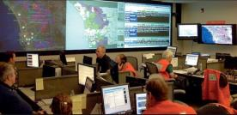
People - The Regional User Group
Connecting the people who need the data:
Emergency Managers
1st Responders
EOC/DOC Staff

Slide 6
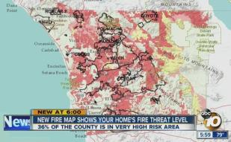
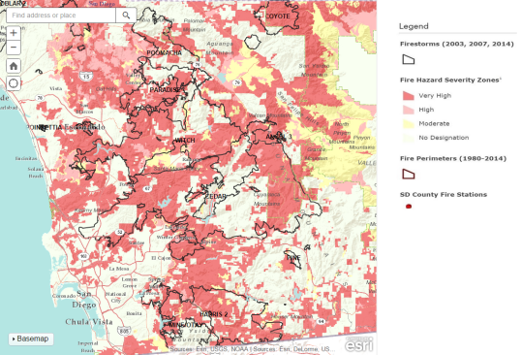
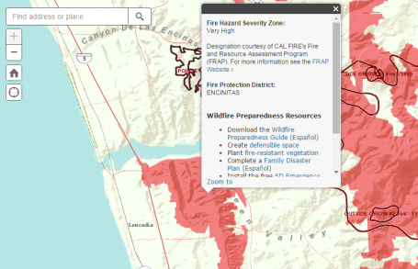
Applications
Wildfire Hazard Map

Slide 7
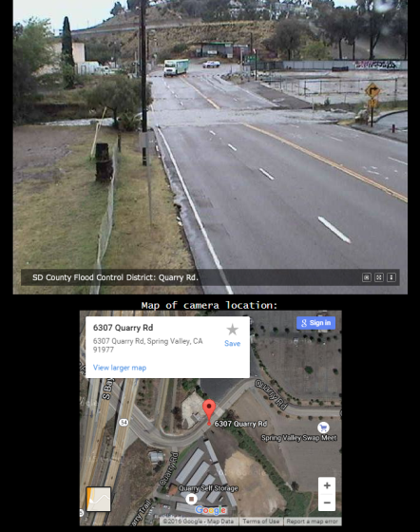
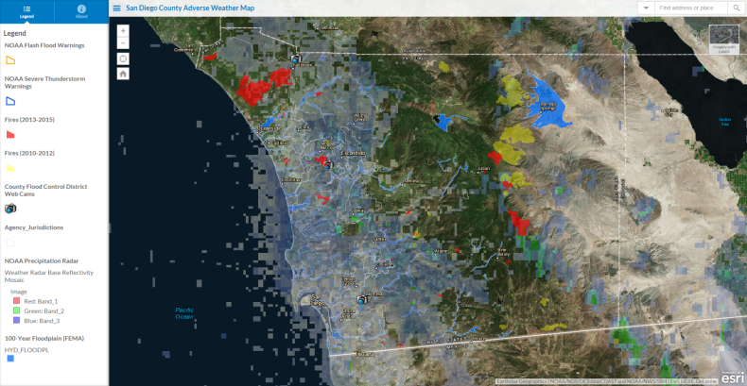
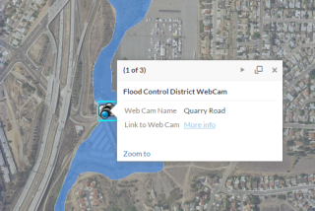
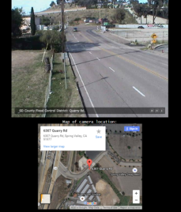
Applications
Adverse Weather Map

Slide 8
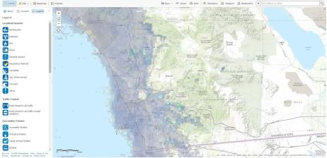
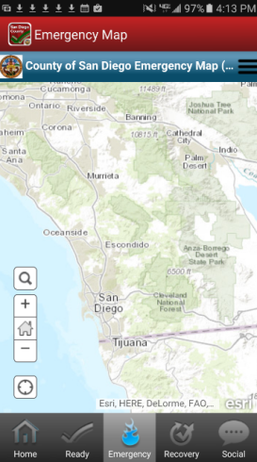
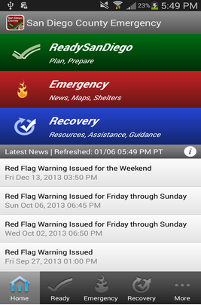
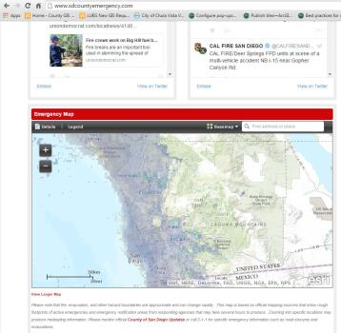
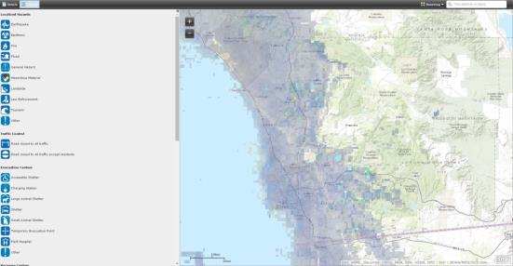
Applications
SD Emergency Map (Web Map)
SD Emergency App
www.sdcountyemergency.com
Viewing larger map from www.sdcountyemergency.com

Slide 9
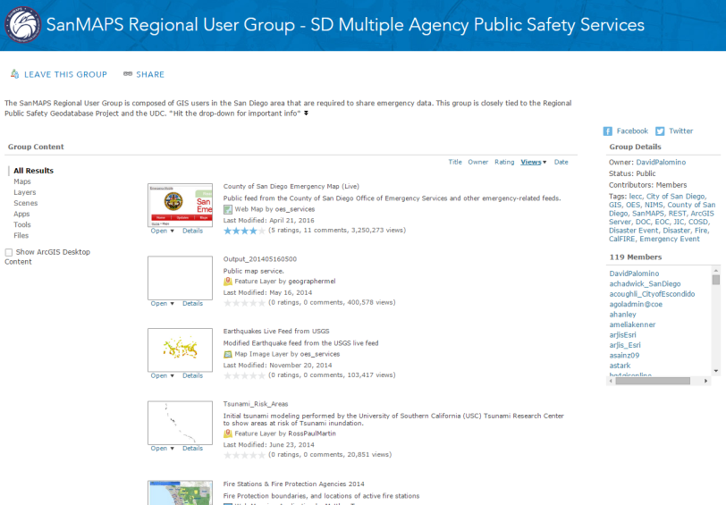
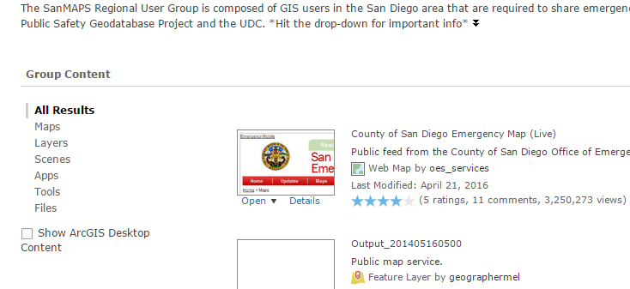
(Data) Library

Slide 10
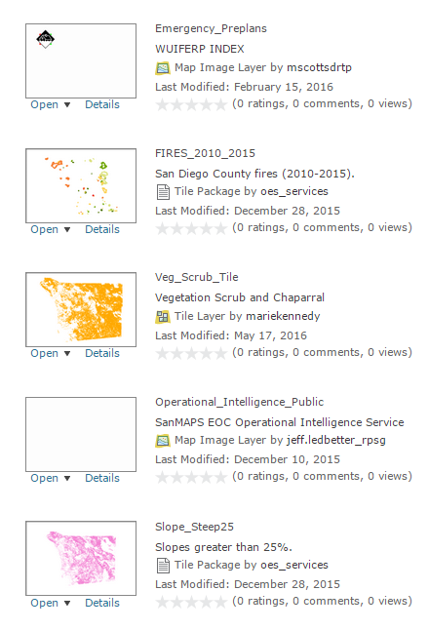
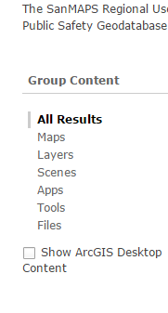
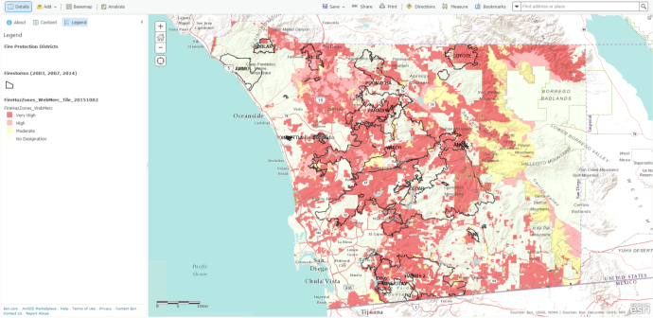
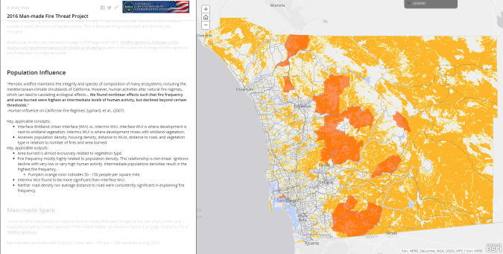
(Data) Library
Administrative Borders
Critical Infrastructure Key Resources (CIKR)
Fire
Flood Hazard
Geological Hazards
Medical Facilities
Operational Intelligence
Pre-Plans
Traffic
Weather

Slide 11
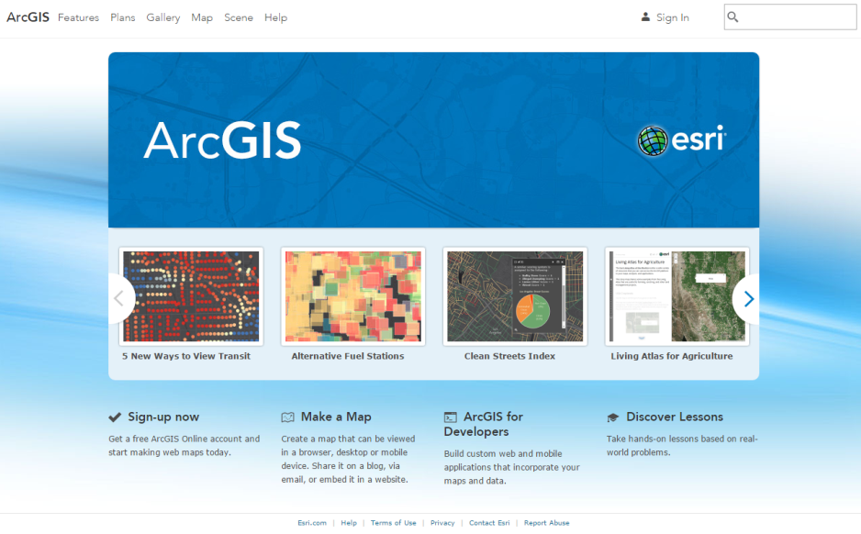
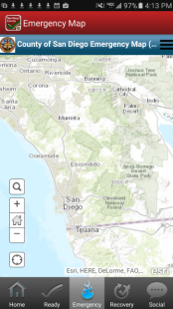
Technology Platform
Optimized for massive amount of hits.
Emergency Map…
10 million hits
750,000 unique views
In one day!

Slide 12
How To Join SanMAPS
You must have an Organizational AGOL Account
(not a Public Account)
Login in to AGOL at
www.arcgis.com

Slide 13
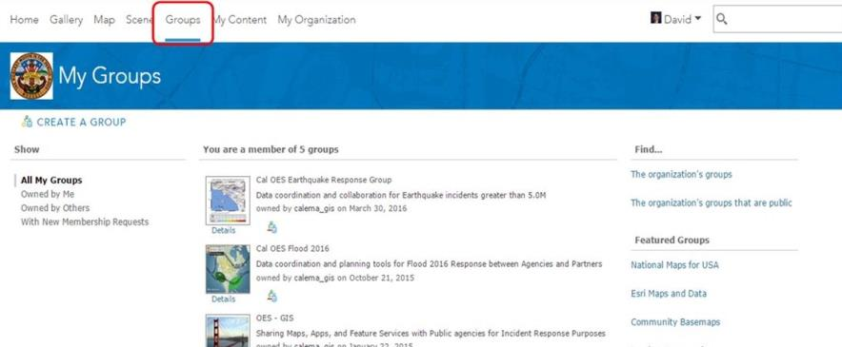
How To Join SanMAPS
You must have an Organizational AGOL Account
(not a Public Account)
Go to “Groups”

Slide 14
How To Join SanMAPS
You must have an Organizational AGOL Account
(not a Public Account)
In the Search Box, type “SanMAPS” and select “Search for Groups”

Slide 15
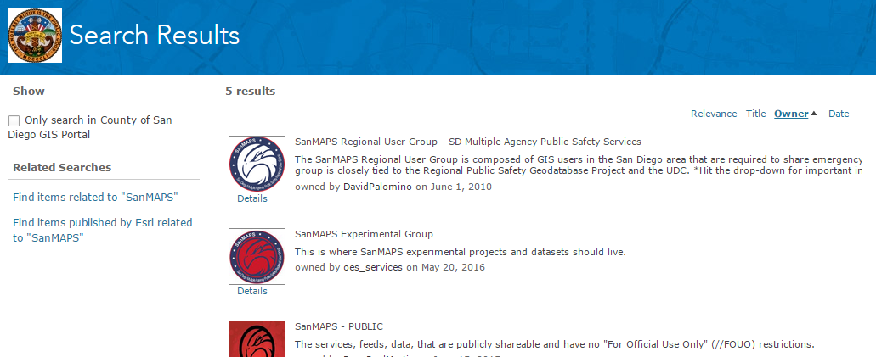
How To Join SanMAPS
You must have an Organizational AGOL Account
(not a Public Account)
Go to “SanMAPS Regional User Group – SD Multiple Agency Public Safety Services”, and click the icon.

Slide 16
How To Join SanMAPS
You must have an Organizational AGOL Account
(not a Public Account)
Click “JOIN THIS GROUP”

Slide 17
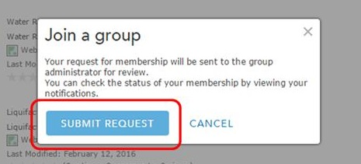
How To Join SanMAPS
You must have an Organizational AGOL Account
(not a Public Account)
Click “SUBMIT REQUEST”

Slide 18
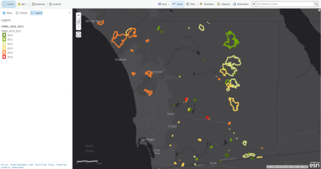
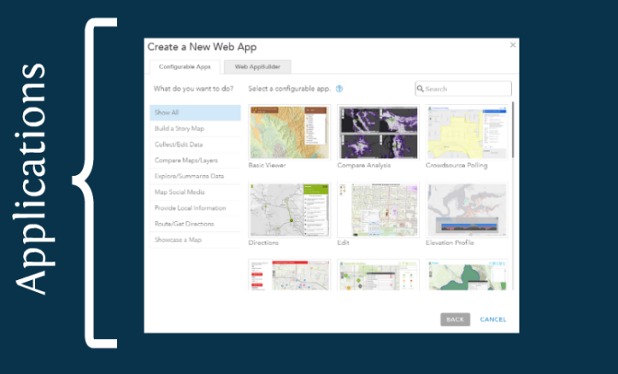
Using AGOL to Create a Map
From Scratch From and Existing Map

Slide 19
Sharing Data to the SanMAPS Library
You MUST follow these steps when saving or sharing with the SanMAPS Regional Users Group.
Add a title, tags, and a brief summary.
Add “FOUO” (For Official Use Only) or “Confidential” in the title and tags if this is sensitive information.
Add access and use constraints (such as “FOUO” or “Confidential”) and properties.

Slide 20
Sharing Data to the SanMAPS Library
All data in SanMAPS are curated by the SanMAPS Administrator.
HOWEVER,
It is the responsibility of the data owner to ensure that their datasets are up-to-date and are the official sources of truth.

Slide 21
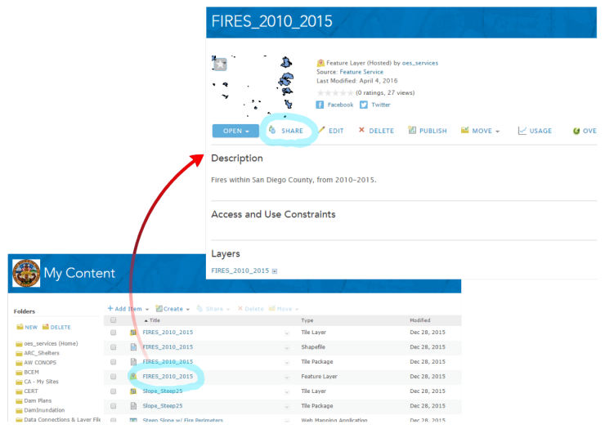
Sharing Data to the SanMAPS Library
Sharing a Layer

Slide 22
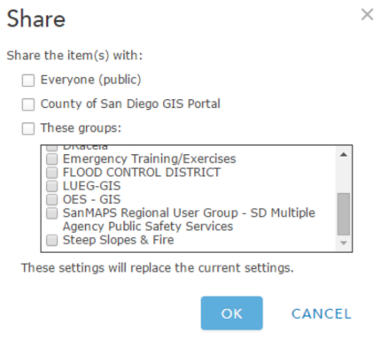
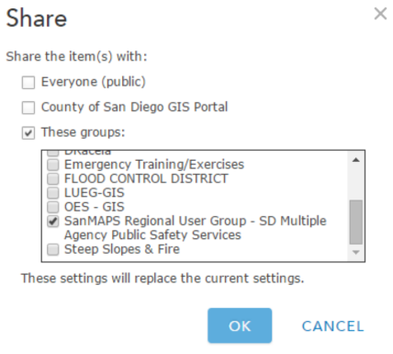
Sharing Data to the SanMAPS Library
Share Internally
Share with SanMAPS

Slide 23
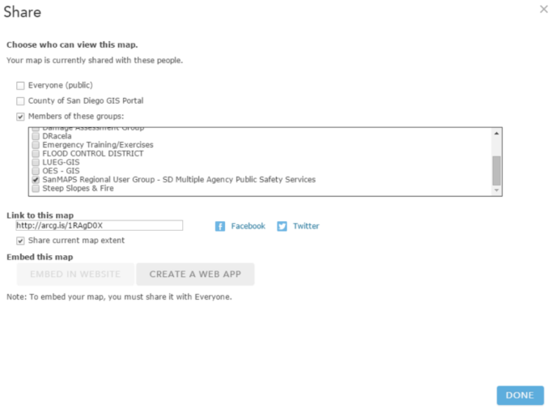
Sharing Data to the SanMAPS Library
Sharing a Web Map with SanMAPS

Slide 24
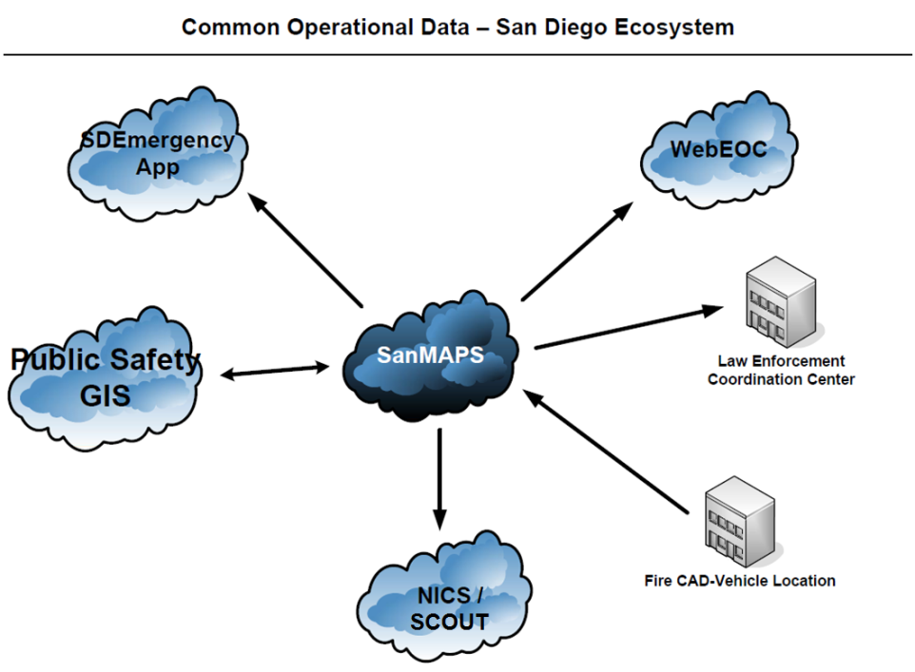
The SanMAPS is the Region’s
Official Location for
Common Operational Data

Slide 25
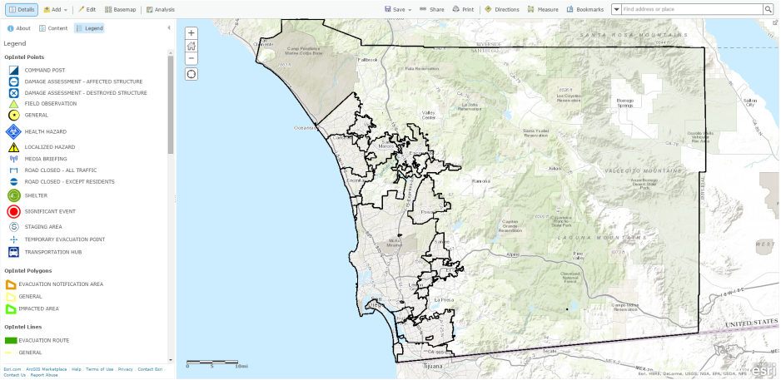
The SanMAPS EOC Incident Map

Slide 26
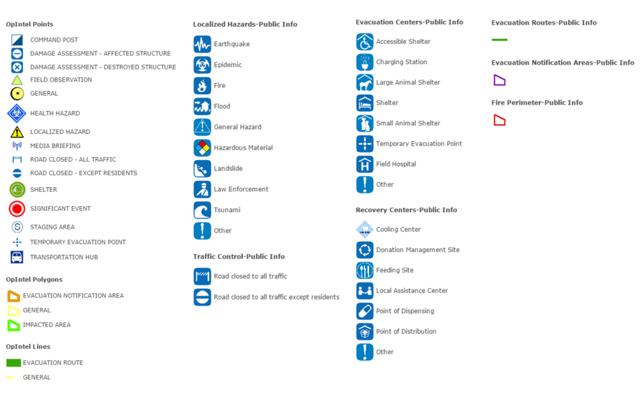
The SanMAPS EOC Incident Map
Intelligence - Not Vetted Information - Vetted for Public Viewing
EOC Incident Map Public-Facing Emergency Map

Slide 27
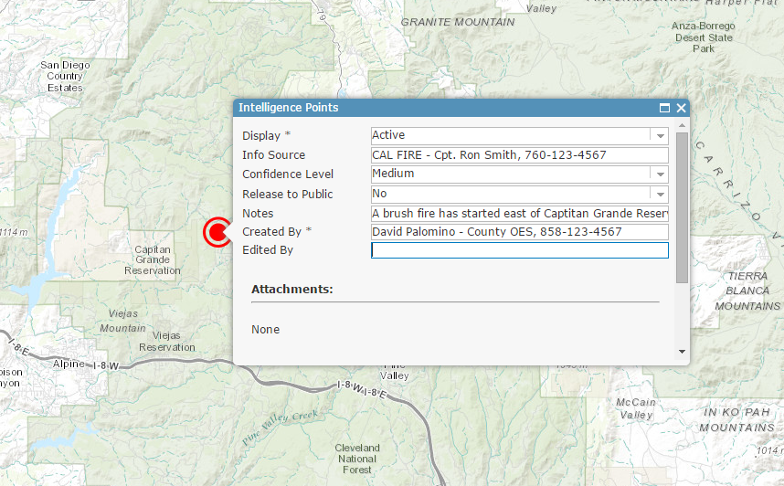
The SanMAPS EOC Incident Map

Slide 28
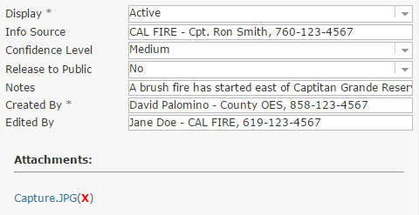
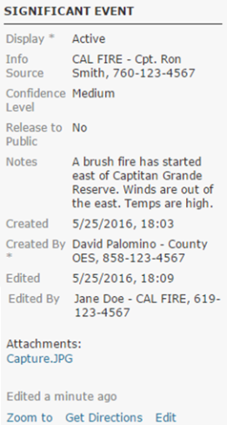
The SanMAPS EOC Incident Map
Pop-Ups
Edit Mode
Saved Mode

Slide 29
The SanMAPS EOC Incident Map
When disaster strikes, the County's OES SDO or GIS Team will create the Incident Map.

Slide 30
The SanMAPS EOC Incident Map
Same Name
SanMAPS EOC Incident Map
Name of the EOC Incident
+ “FOUO”
WebEOC
Document
Edits in
WebEOC
Name of the WebEOC Incident

Slide 31
Accessing the SanMAPS EOC Incident Map During Emergencies
Option 1 (easy)
Option 2
Login to WebEOC.
Go to the “Regional Significant Events” board.
Search for “Incident Map”.
There will be a message reading “An EOC Incident Map has been created”, along with a link to the map.
Click on the link
This will prompt you to login to AGOL
Login to WebEOC.
Note the name of the Incident.
Login to AGOL
Go in to the SanMAPS Regional User Group.
Search for the incident name.
Open the EOC Incident Web Map for this incident.

Slide 32
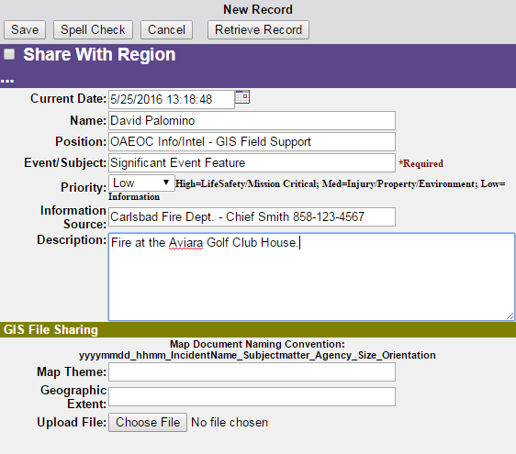
SanMAPS EOC Incident Map and WebEOC During Emergencies
Whenever you add or edit a feature to the EOC Template Map, document this in the OAEOC GIS Event Log in WebEOC.

Slide 33
This is the Hardest Part of the Workshop….Logging In
Logging in to WebEOC
First and Last Name
Official Email Address
WebEOC Position
Logging in to AGOL
If you have an Organizational Account, but are not a member of SanMAPS, let us know.
If you don’t have an organizational account, we can provide you with a training account for today.

