Slide 1
San Diego Regional GIS Council
January 11, 2017 – City of Imperial Beach
GIS for Small Cities:
Building a functional GIS in Imperial Beach with limited resources
Russell Mercer
GIS Administrator – Imperial Beach, CA

Slide 2
It’s a Process
IB Stats
History of IB GIS
Initial Improvements
Implementing PostgreSQL
Where are we now?
Where are we going?
Final Thoughts

Slide 3
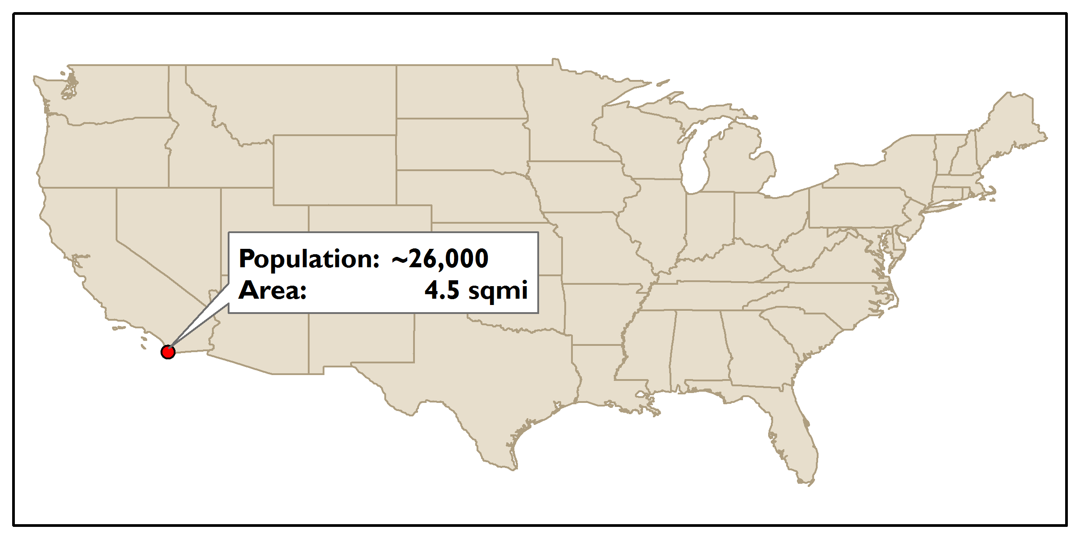
Obligatory City Info Slide
~90 Employees
20-25 use GIS on a daily basis
5 city departments

Slide 4
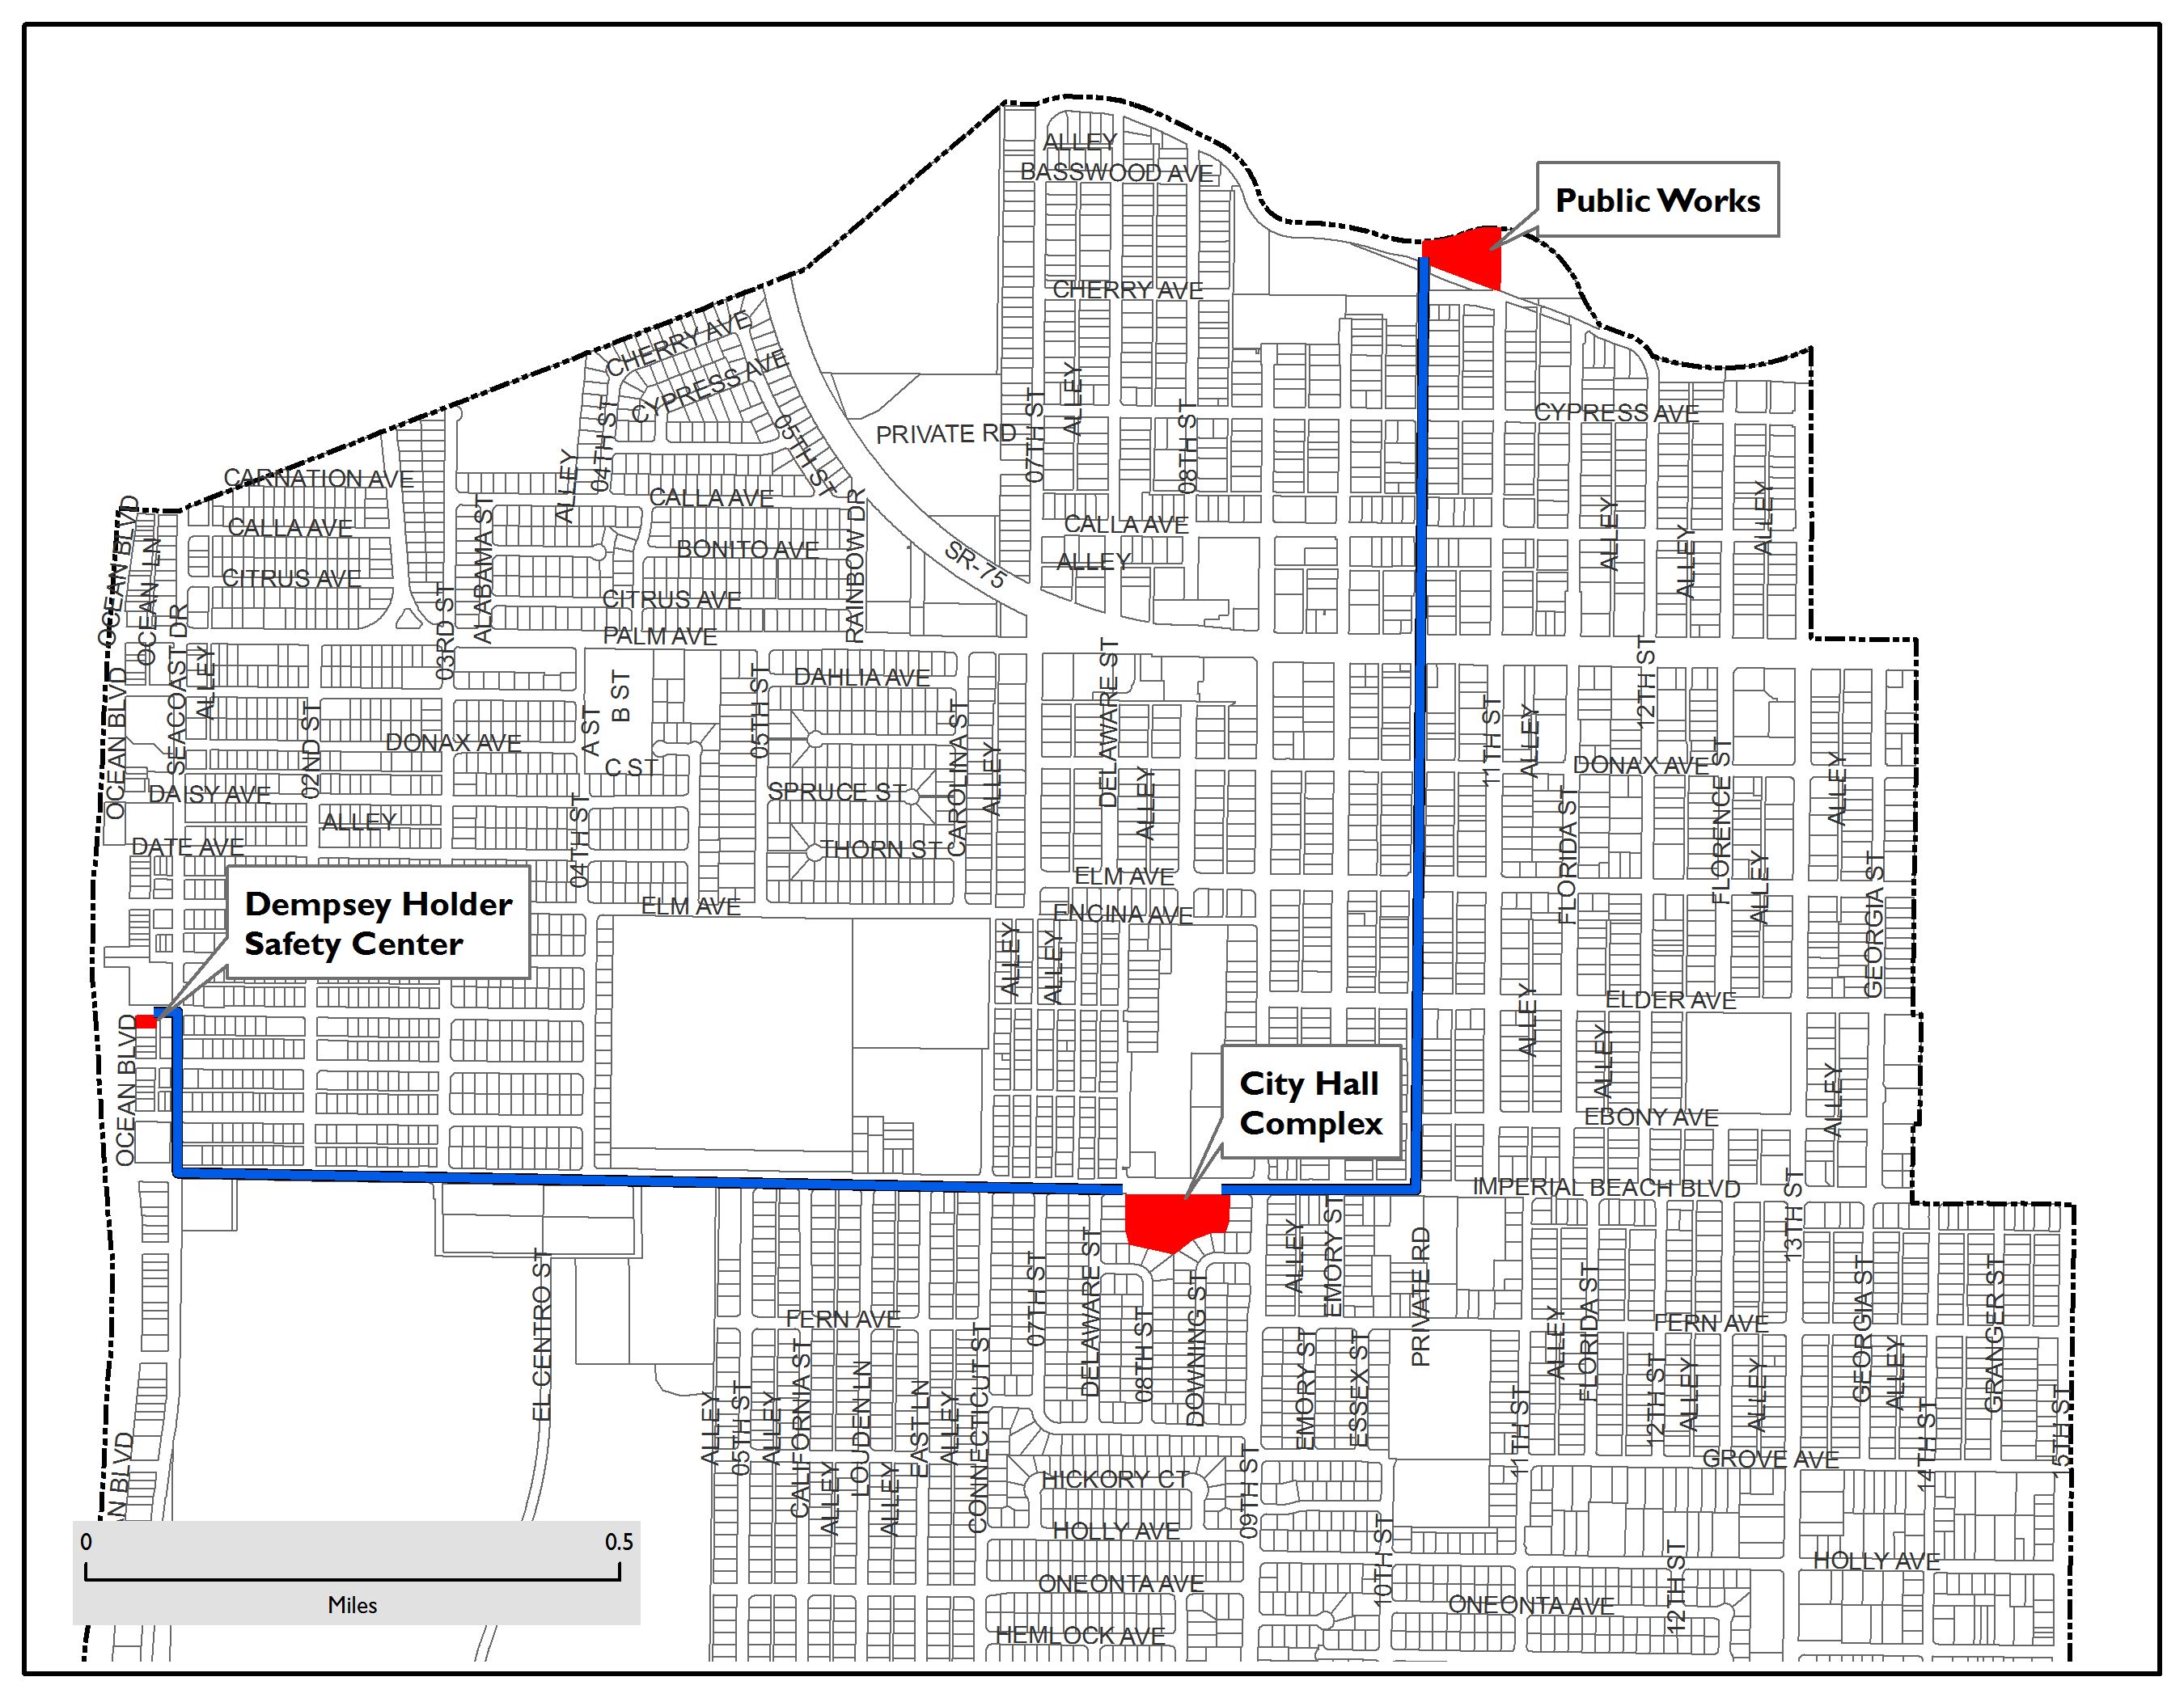
City Facilities

Slide 5
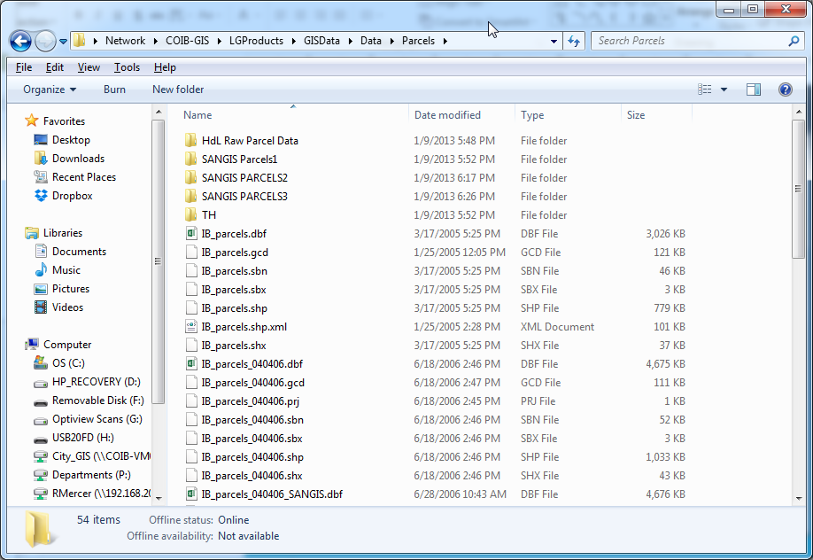
GIS in IB: Where it Started
1.
2.
3.
4.
5.
6.

Slide 6
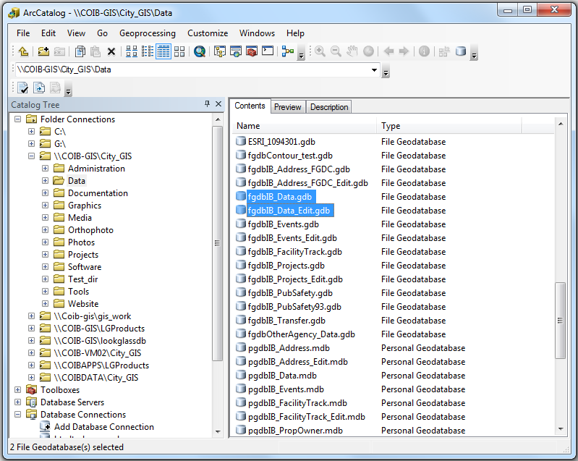
GIS in IB: Initial Improvements

Slide 7
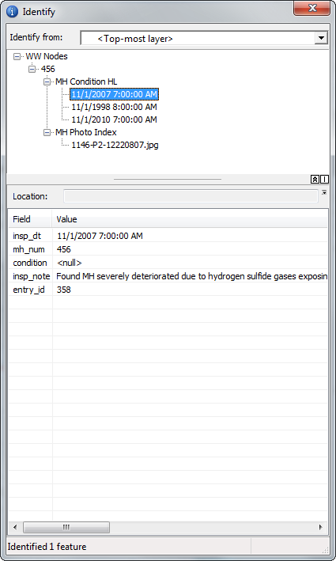
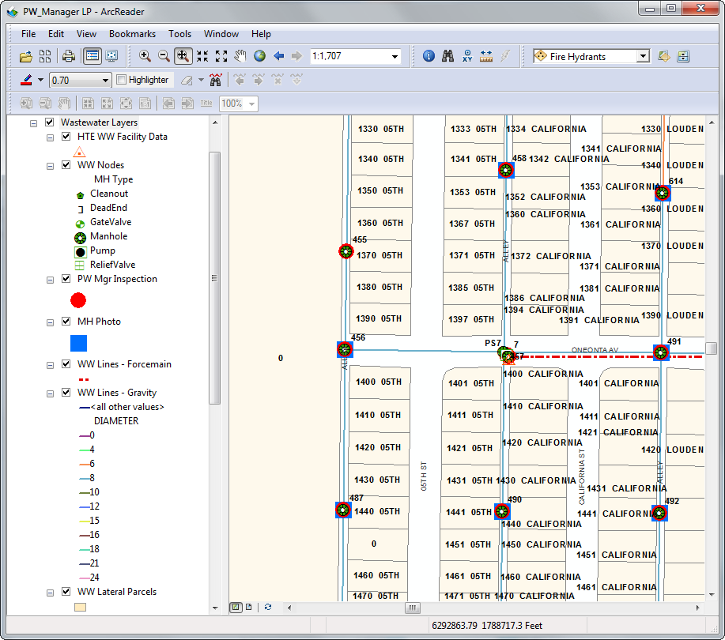
GIS in IB: Initial Improvements

Slide 8
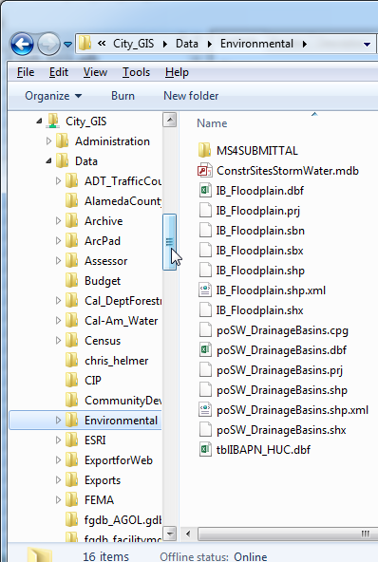
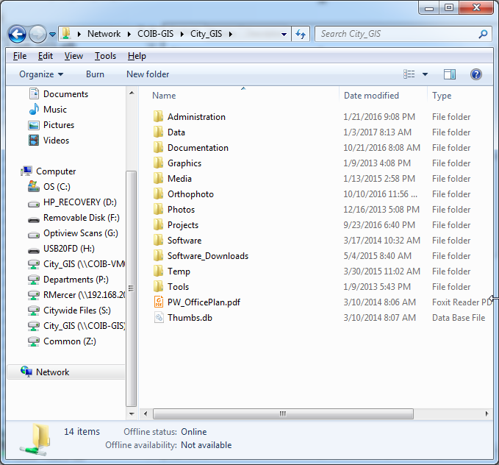
GIS in IB: Initial Improvements

Slide 9
Initial GIS Configuration
Public Works
City Hall
File GDB
File GDB
ArcGIS
ArcReader
Multiple Users
Lifeguards

Slide 10
Issues Arise
Layer locking in File GDB
Closed data format
Slow data access

Slide 11
Issues Arise
Public Works
City Hall
File GDB
File GDB
Editing
Production
ArcGIS
QGIS
ArcReader
Multiple Users
Lifeguards

Slide 12
Story time
Storytime Graphic
Reference indoc and seeing amount of improvement in city with limited staff and funding
Impressed with need to find a solution, essentially that best utilizes funds available, and make it work.

Slide 13
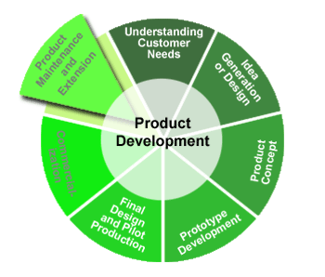
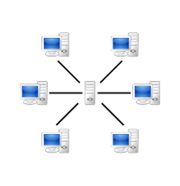
Why PostgreSQL/PostGIS?
www.postgresql.org
www.opengeospatial.org
www.postgis.net

Slide 14
Implementation Process
Install
Attribute Data only at first.
Pause to work on other projects
Crash course in DB security
Set up users and groups
Begin to set up Data Schema
Set up default privileges functionality

Slide 15
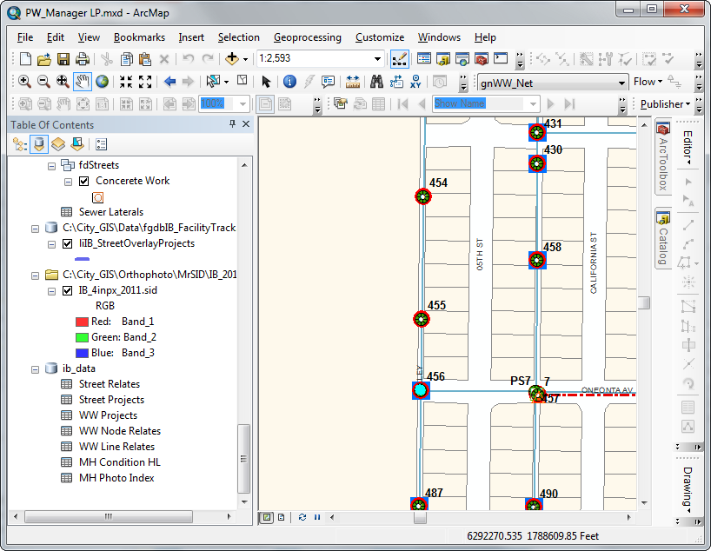
Attribute Layers

Slide 16
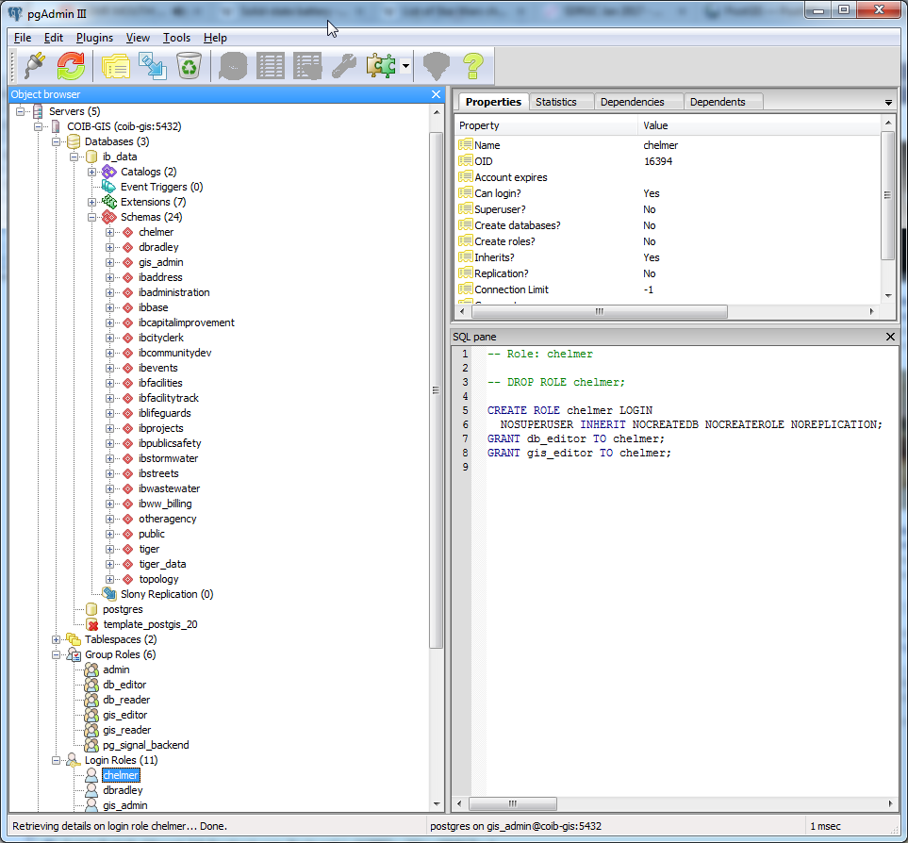
User Roles

Slide 17
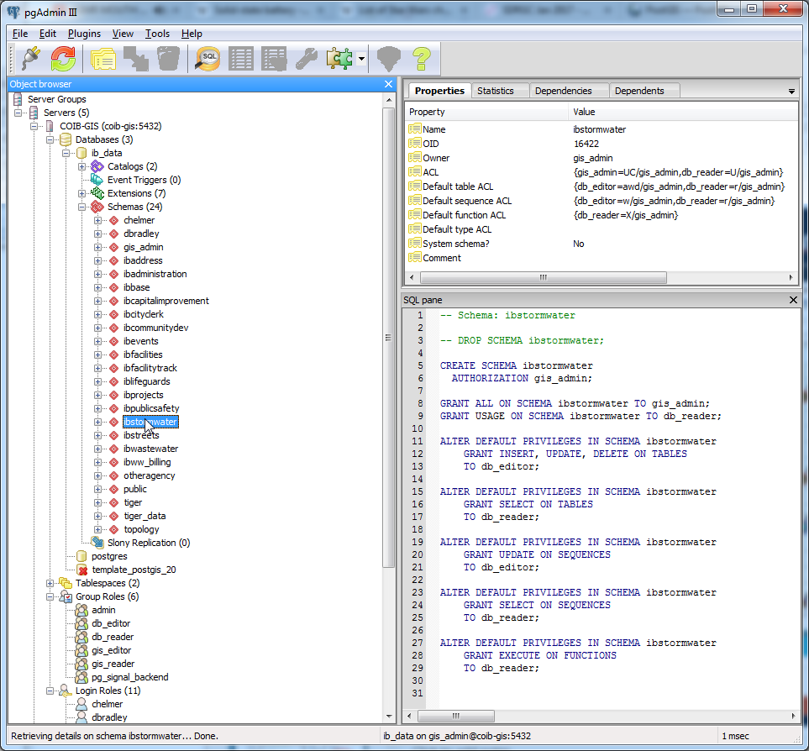
Data Schema – Default Functionality

Slide 18
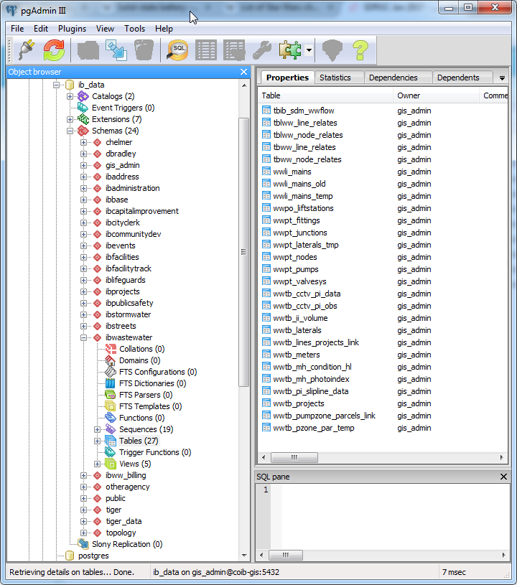
Data Schema – Naming Convention

Slide 19
But what about………..?
Editing
Data Conversion
SQL
www.gdal.org
www.google.com
gis.stackexchange.com
www.qgis.org
www.osgeo.org

Slide 20
Full Roll-out Issues
Slow network connection between offices
Connecting all users to PostgreSQL at Public Works would put undue stress on network
Solution – Database Mirroring – Recently had become part of the core product.
Wish it was this simple

Slide 21
Current GIS Framework
Public Works
City Hall
File GDB
Postgresql
Postgresql
Excel
ArcGIS
QGIS
ArcReader
Multiple Users
Lifeguards

Slide 22
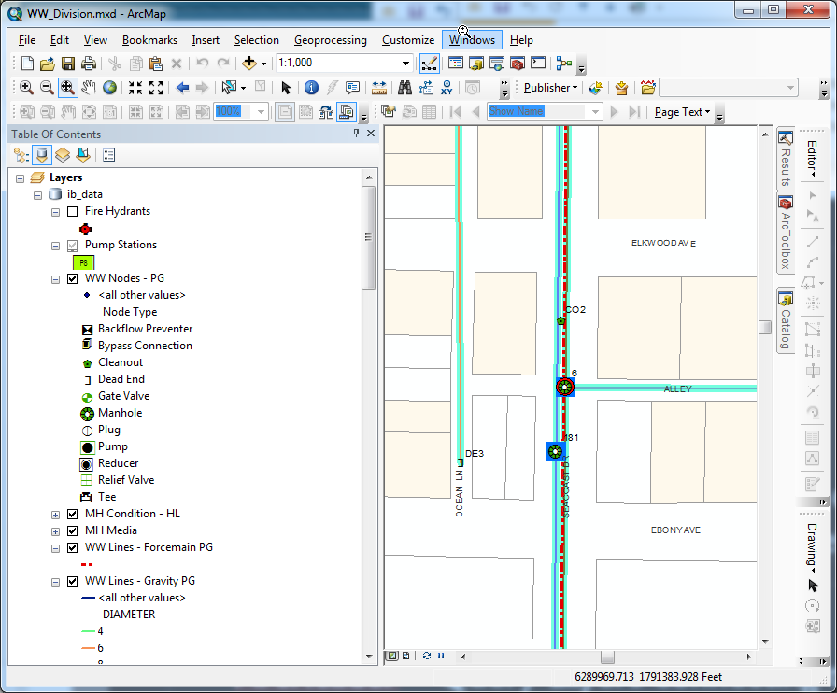
Query Layers – From PostgreSQL

Slide 23
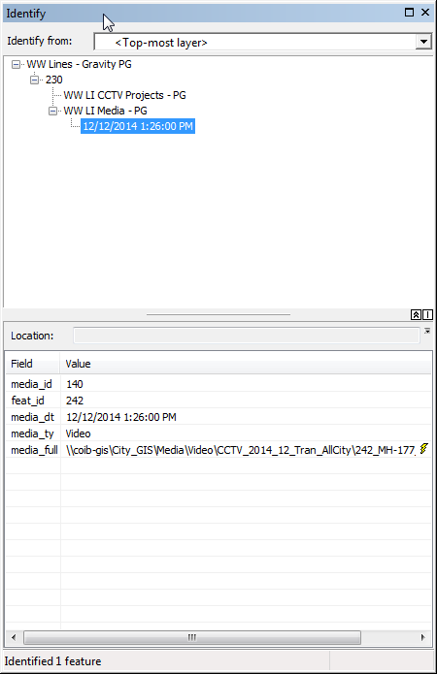
Linked Media

Slide 24
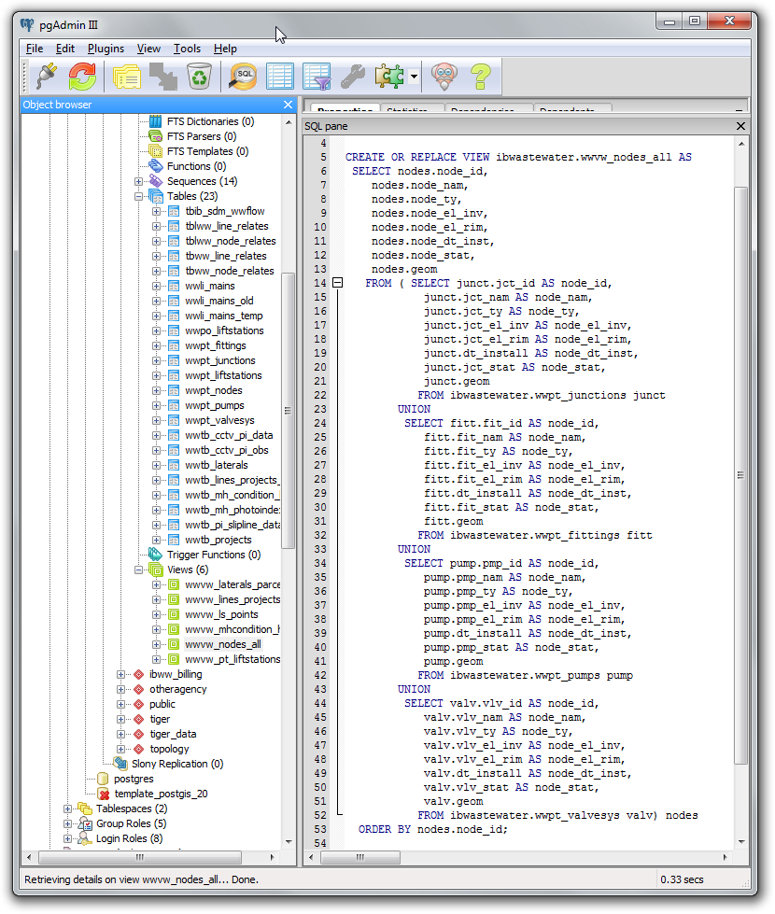
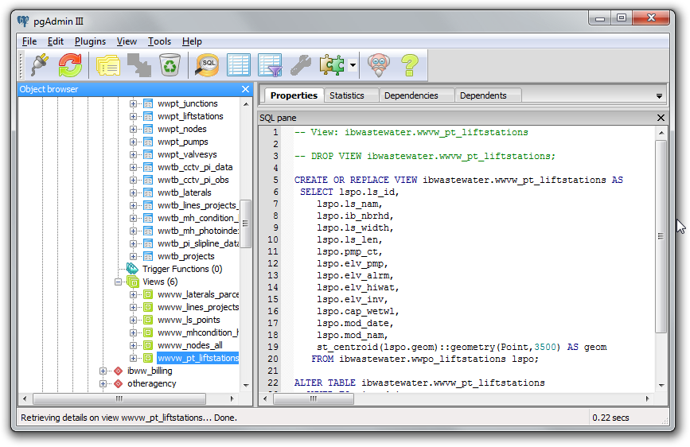
Efficiencies
– Spatial Functions
, Saved Views

Slide 25
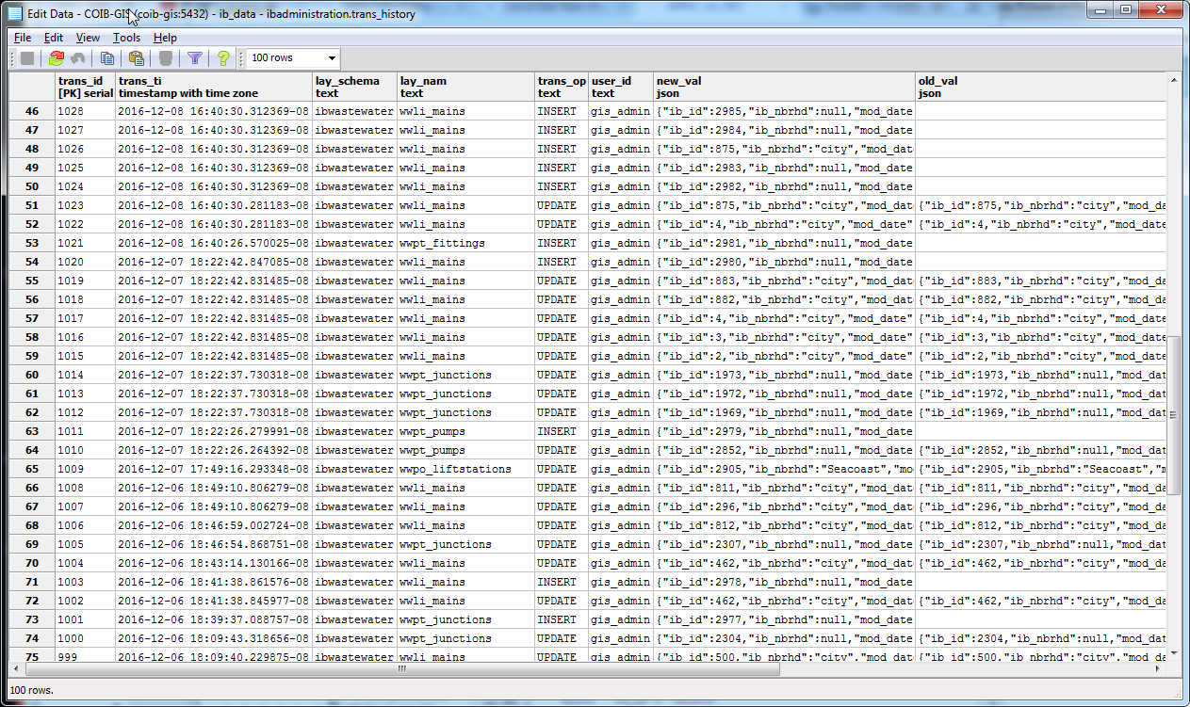
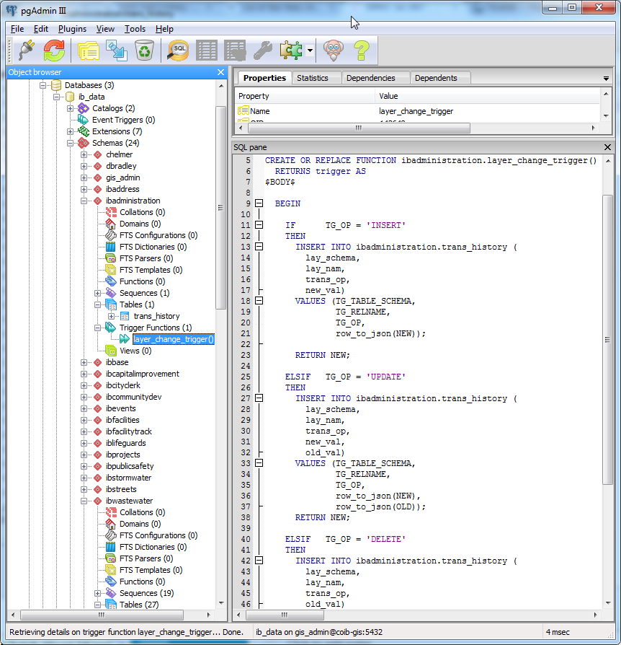
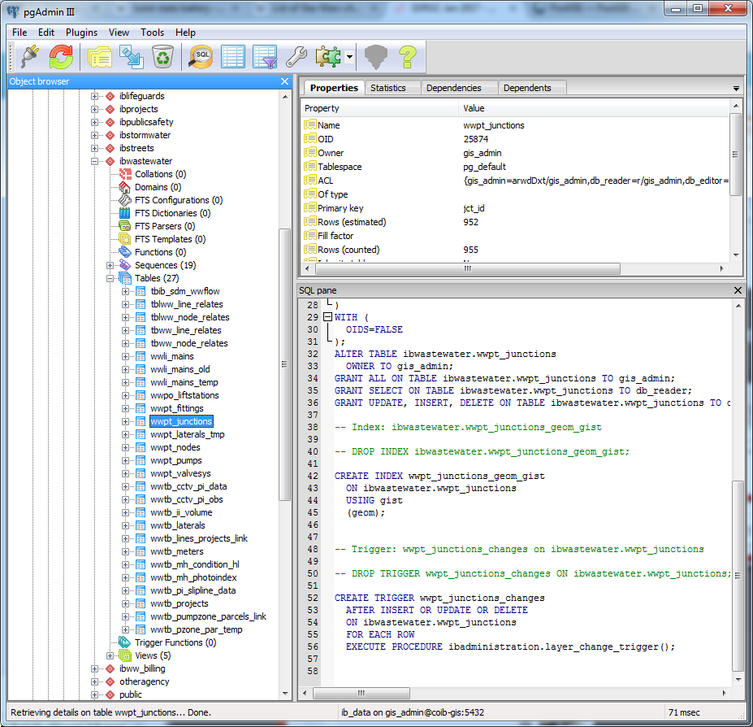
Efficiencies
– Triggers
, Stored Functions

Slide 26
Wait! Do you even Internet?
Web Server
Public Works
City Hall
File GDB
Postgresql
Postgresql
Postgresql
Excel
ArcGIS
QGIS
ArcReader
Multiple Users
Lifeguards

Slide 27
Demo, but only a small one

Slide 28
Coming soon……
More Cleerio – Editing in the field
New Finance Software – Integration
May require AGOL link
GIS Needs Assessment
Ensure critical infrastructure layers exist
Refine data schema
Expand use of functions and triggers to automate tasks and tracking.
Implement functions to generate metadata using SD standard

Slide 29
Have I learned anything?
It is Possible
Rule your resources
Make them work for you.
Get your hands dirty
Ask Questions
Learn SQL

Slide 30
Questions?
Russell Mercer
GIS Administrator
City of Imperial Beach
rmercer@imperialbeachca.gov
(619) 210-1647

