Slide 1
UAS Integration with GIS
Wing Cheung
Palomar College
Professor of Geography

Slide 2
What are UAS?
(Unmanned Aircraft Systems or Drones)

Slide 3
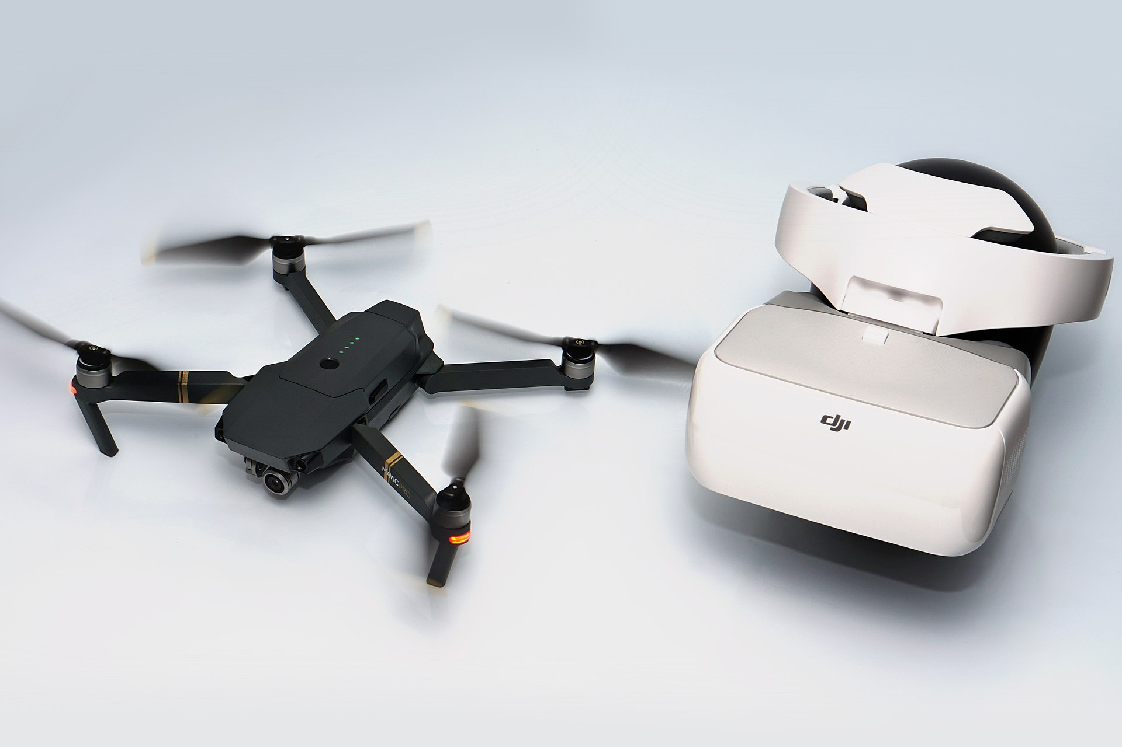

Slide 4
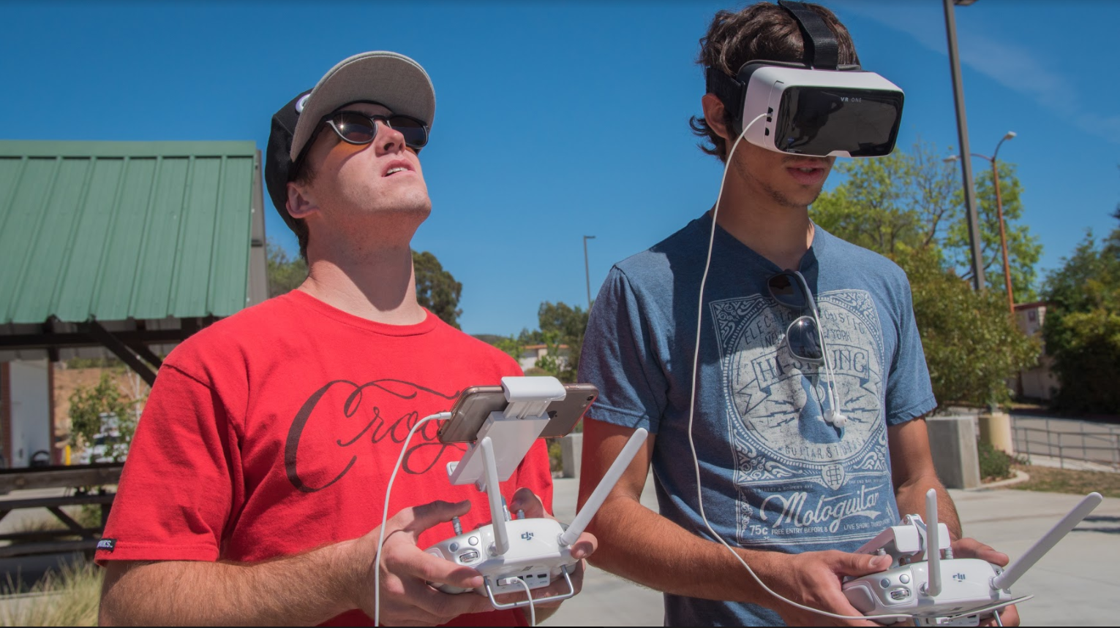

Slide 5
What Can you do with UAS?

Slide 6
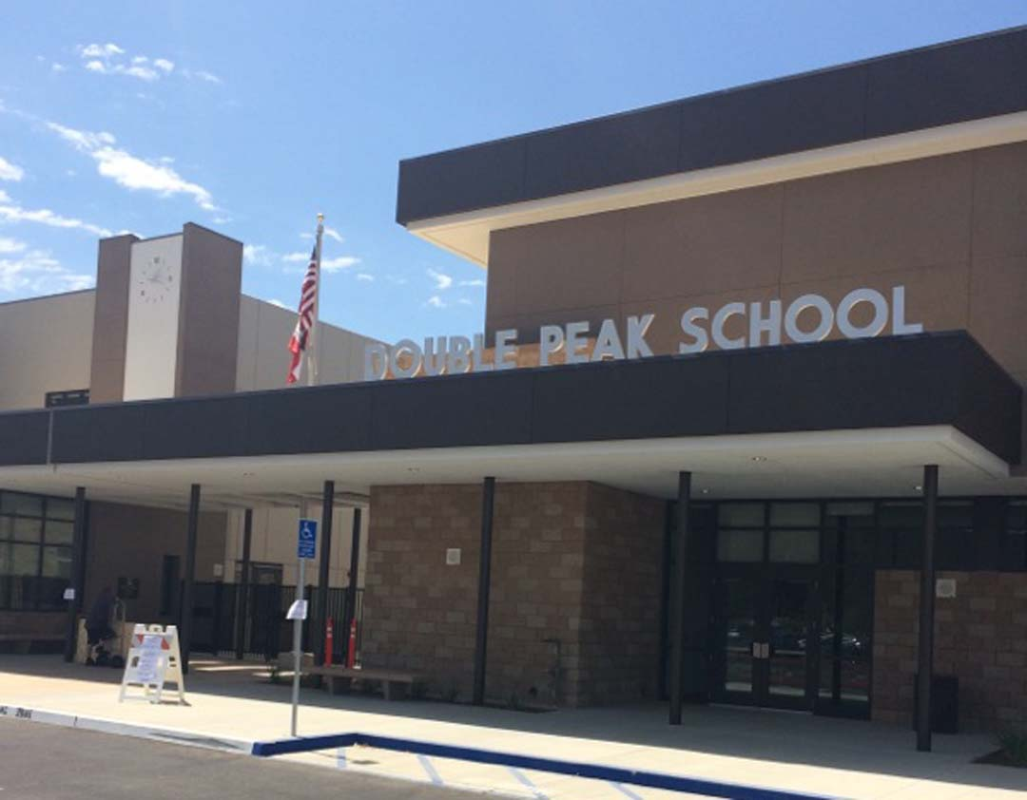
Ortho-
Imagery
TRY IT!
www.tinyurl.com/pcstem1

Slide 7
Ortho-
Imagery
Asset mapping
Inspection
Low Impact Development
Pre-Plan Field Inventory
Others?

Slide 8
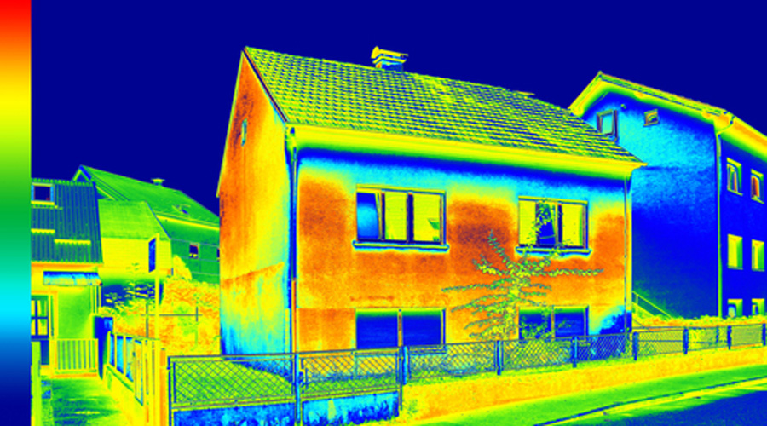
Infrared and Thermal
Imagery
TRY IT!
www.tinyurl.com/pcstem2

Slide 9
Infrared and Thermal
Imagery
Inspection
Leak detection
Energy Auditing
Search and rescue
Others?

Slide 10
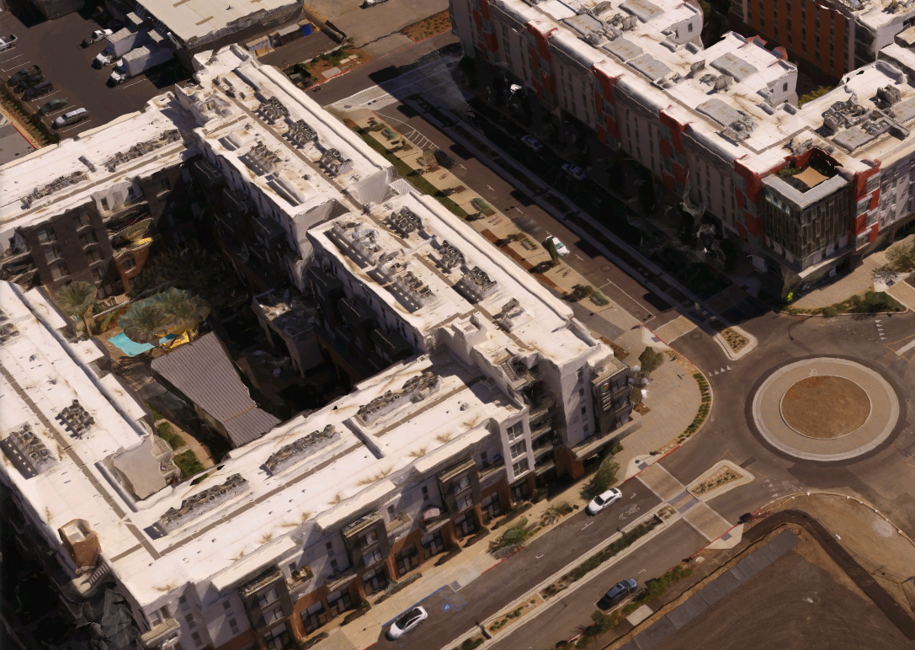
3D
Modeling
TRY IT!
www.tinyurl.com/pcstem3

Slide 11
3D
Modeling
Stockpile measurements
Construction inspection
View shed analysis
Others?

Slide 12
Drones at Palomar College

Slide 13
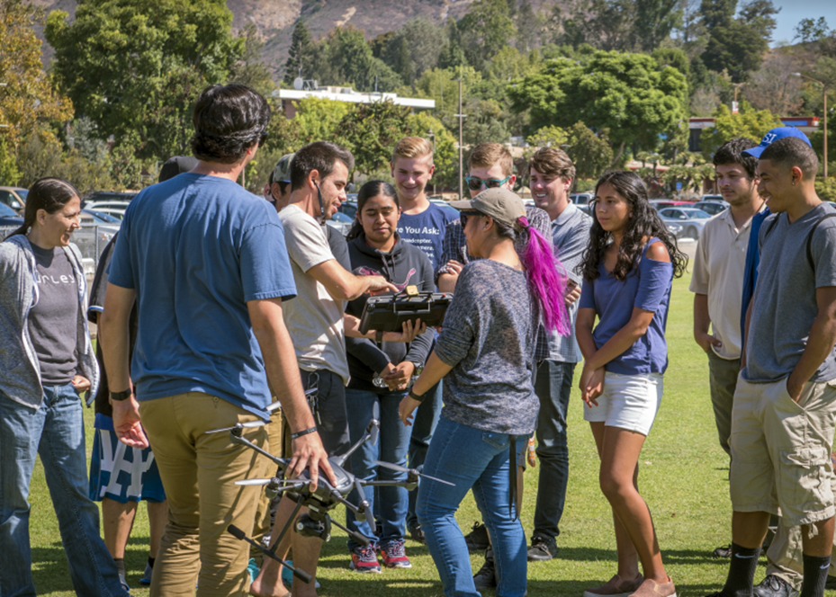
Notes:
http://www.onetonline.org/link/summary/15-1199.05

Slide 14
Join us at Palomar College!
Drone-Con (July 6th, Friday)
www.palomaruas.weebly.com
Starting a drone education program
Regulations and risk management
Construction and inspection
Mapping and surveying
Environmental conservation
Filming and photography
Business and entrepreneurship
Career pathways for veterans
UAS maintenance
Notes:
http://www.onetonline.org/link/summary/15-1199.05

Slide 15
Join us at Palomar College!
Certificate in UAS (1 year)
Associate’s Degree in Drone Technology (2 years)
Find out more at: www.uastep.org
Notes:
http://www.onetonline.org/link/summary/15-1199.05

Slide 16
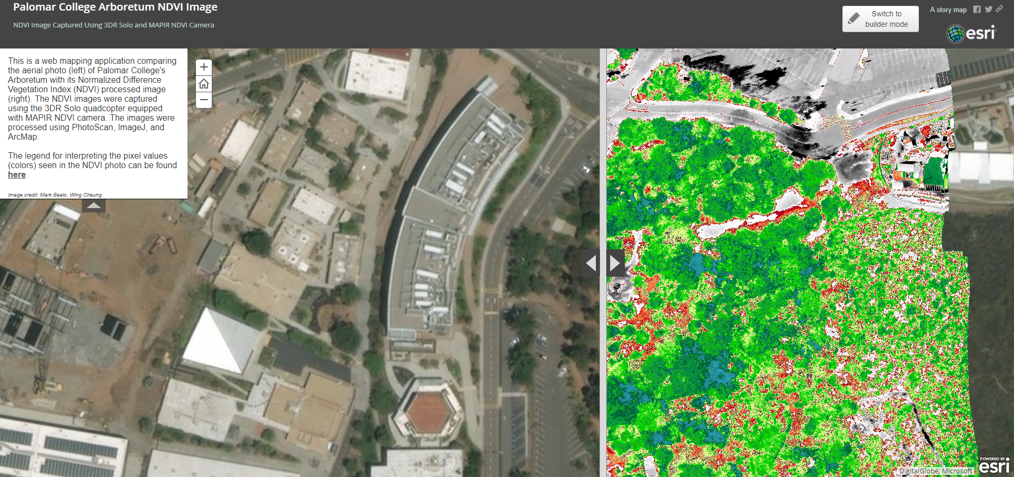
Tell your Drone Story with GIS
Check out our GIS certificate/degree program!
www.palomar.edu/GIS

Slide 17
Wing Cheung
wcheung@palomar.edu
The UASTEP project is funded by the National Science Foundation DUE# 1700552

