Slide 1
Risk Assessment of Data for Enterprise GIS Operations
R.A.D.E.G.O.

Slide 2
Background
Business decisions based on data quality require:
Data Origin/Background
Data Maintenance History
Metadata: can typically answer most questions about data quality, however:
Requires user investment/specific knowledge to interpret
Decision support requires data mastery and time.
RADEGO: Saves time by simplifying Risk of Impact of Use and Ownership

Slide 3
Assessment
RADEGO Methodologies Evaluate
Currency – Accuracy – Risk – Effort – Precision
Method Assumptions:
Establish Impact of Risk and Frequency of Risk Impact
Help departments prioritize layer maintenance scheduling
Net effect: determination of staffing required to keep GIS data layers in an Enterprise GIS Data Warehouse up-to-date
Scoring of GIS Data simplifies the Risk and Impact of Use and Ownership of a GIS dataset to a 9 point data test.

Slide 4
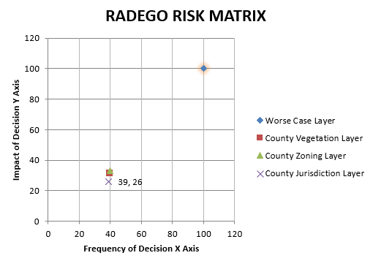
Assessment
Variables to Assess:
Positional Accuracy (Y)
Typological Accuracy (Y)
Metadata Compliancy (Y)
Level of One-Time Maintenance (X)
Level of Routine Maintenance (X)
Frequency or Rate of Change (X)
Automation Capability (X,Y)
Combined Impact: (X,Y)
Frequency of Use Impact (X)
Decision Risk Impact (Y)
Scoring represents a dataset’s level of risk/impact to an organization.
Scores have both a real world value and a semi-quantitative value (0-20).

Slide 5
Positional Accuracy
United States National Mapping Accuracy (NMAS)
Standard of precision based on level of published scale
Smaller Scales (< 1:20,000) → <= 1/50 inch error
Larger Scales (> 1:20,000) → <=1/30 inch error
Planimetric accuracy values for NMAS at common scales:

Slide 6
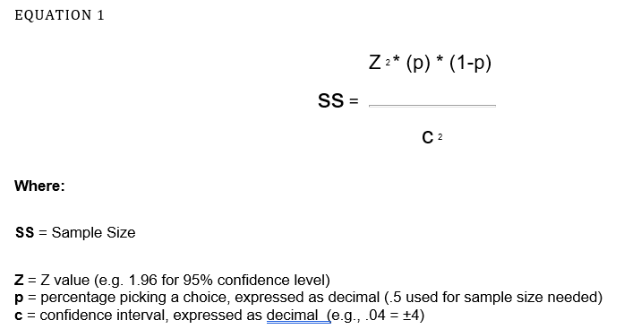
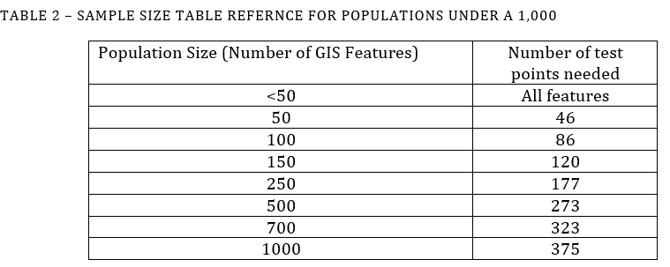
Sampling – Positional Accuracy
Larger datasets (>1,000 records):
NMAS → 10% sample size for a dataset
Smaller Datasets (< 1,000 records):
Statistically significant sample size determined

Slide 7
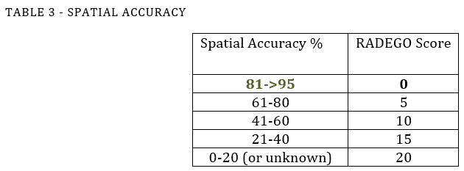
Testing – Positional Accuracy
Sample Size → Random Grid of Point Test Locations
Locations are assessed for accuracy of positional error
Pass or Fail → Percentage → RADEGO Score
These values will affect the Y or impact axis of the risk matrix.

Slide 8
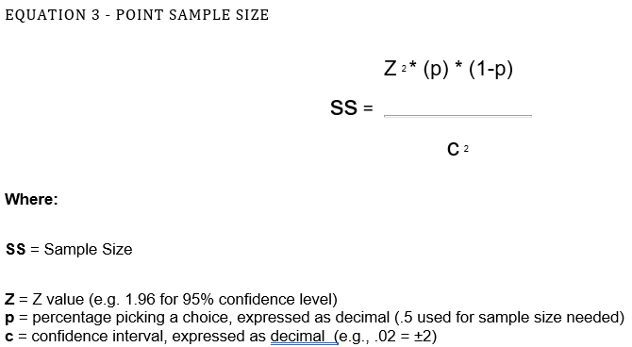
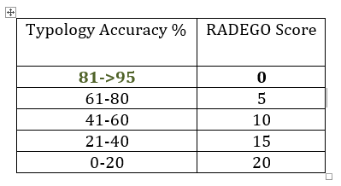
Typological Accuracy
Accuracy of categorical attributes
(i.e. geology, vegetation, flood plain values, etc)
Sample tested against a known dataset of field values
These values will affect the Y or impact axis of the risk matrix.

Slide 9
Metadata Compliancy
Operationally critical to prevent or avoid risk
Metadata assessment is binary
Is a dataset’s metadata complete?
Is it compliant with SanGIS regional metadata standard?
These values will affect the Y or impact axis of the risk matrix.

Slide 10
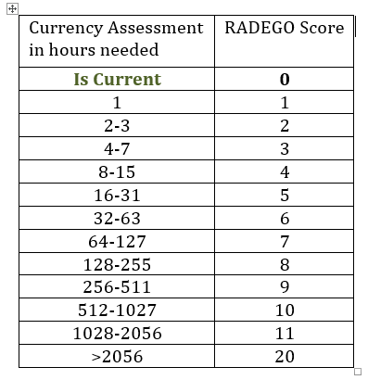
Maintenance: One-Time
Effort required raise a dataset up-to-date or current
Expressed in hours of labor
Can involve any level of effort or difficulty to accomplish
These values will affect the X or impact axis of the risk matrix.

Slide 11
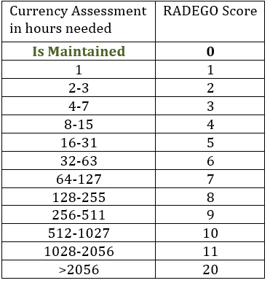
Maintenance: Routine
Effort required keep a dataset up-to-date or current
Expressed in hours of labor per year
Can involve any level of effort or difficulty to accomplish
These values will affect the X or impact axis of the risk matrix.

Slide 12
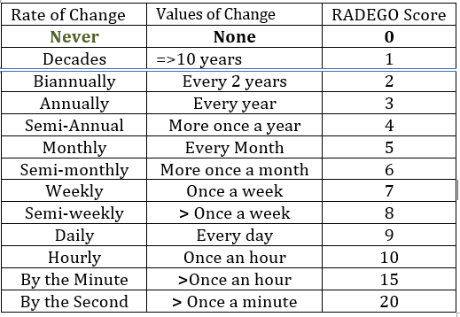
Frequency / Rate of Change
Rate of change in a dataset
Expressed in time periods: Hours - Months - Years - Never
Datasets that represent a unique event in Space or Time:
RADEGO Score = 0 (No maintenance / Always Up-to-Date)
These values will affect the X or impact axis of the risk matrix.

Slide 13
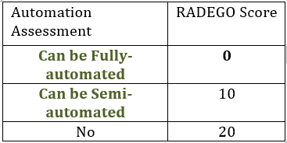
Automation
Automation matters greatly when determining risk
Ideal systems are automated in their maintenance
Automation = Reduction in Human Error & Ensures Maintenance
These values will affect the X and Y
(impact & frequency axis of the risk matrix)

Slide 14
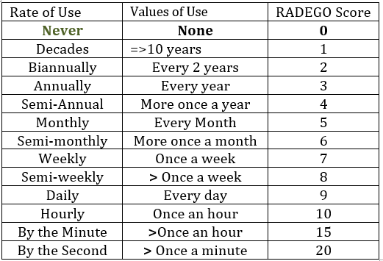
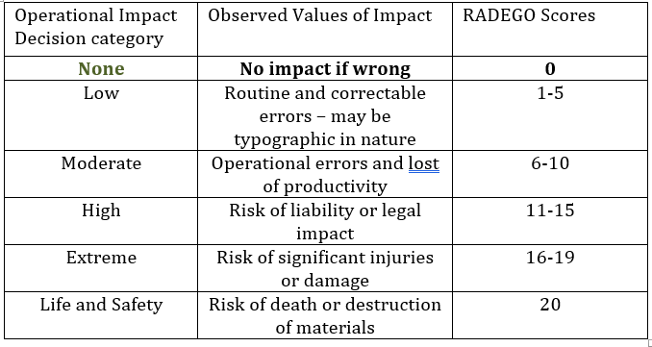
Combined Impact Score
Frequency of Use (rate) & Impact Level of Decision (risk)
Shows level of reliance on a dataset by an Organization
High impact reflects how critical a dataset is to Dept.
Impact Level of Decision affect the (Y) impact axis
Rate of Use scores affect the (X) frequency axis
Rate of Use (X)
Impact Level of Decision (Y)

Slide 15
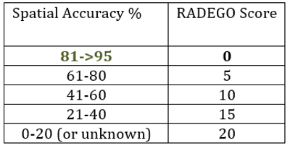
Approach – Geodatabase Domains

Slide 16
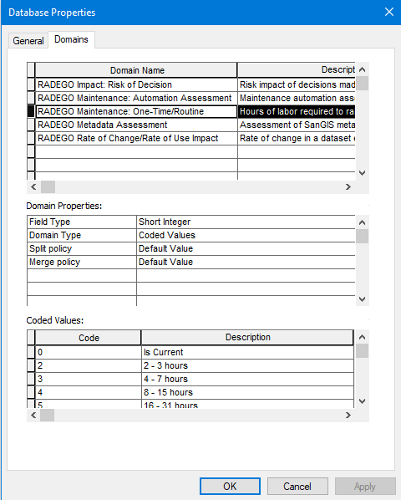
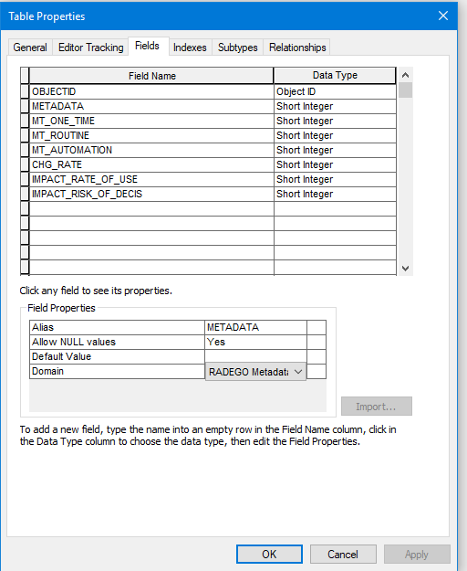
Domains – Coded Values
ESRI Geodatabase Domains created with coded integer values reflecting RADEGO Scores for each Assessment
Table Schema created with field for each RADEGO Assessment Value and Domains applied to each field Accordingly

Slide 17
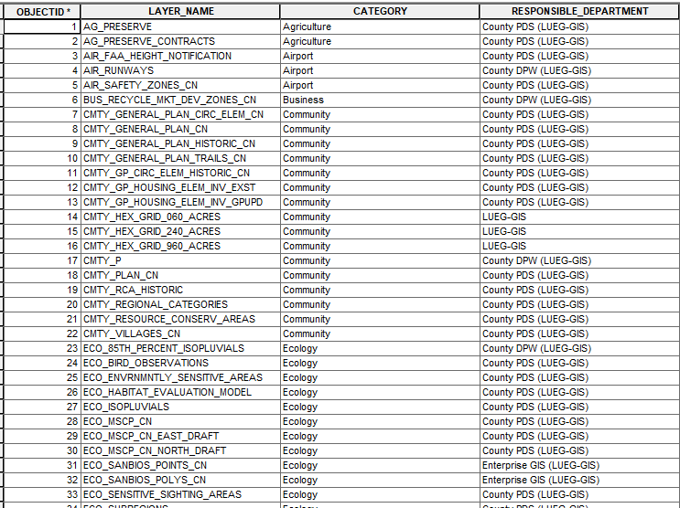
LUEG–GIS /SanGIS Layers
Table of 70 LUEG-GIS SanGIS Responsible layers Merged with RADEGO table schema
Assessed by LUEG-GIS Staff based on their specific knowledge
Initial Assessment: Does Not include Positional or Typological Accuracy
Prioritizes, based on RADEGO Score, which layers should be assessed for:
→ Accuracy (Positional / Typological)

Slide 18
LUEG–GIS /SanGIS Layers

Slide 19
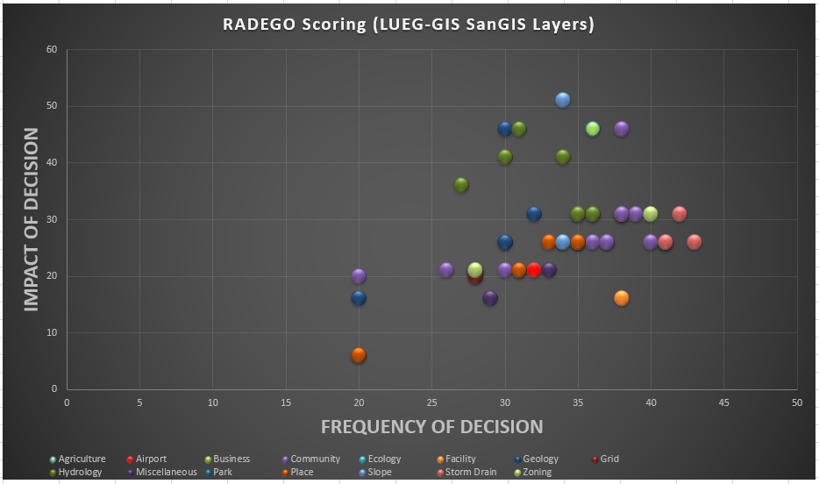
LUEG–GIS /SanGIS Layers

Slide 20
RADEGO
RADEGO Methodologies Evaluate
Currency – Accuracy – Risk – Effort – Precision
Method Assumptions:
Establish Impact of Risk and Frequency of Risk Impact
Help departments prioritize layer maintenance scheduling
Net effect: determination of staffing required to keep GIS data layers in an Enterprise GIS Data Warehouse up-to-date
Scoring of GIS Data simplifies the Risk and Impact of Use and Ownership of a GIS dataset to a 9 point data test.

