Slide 1
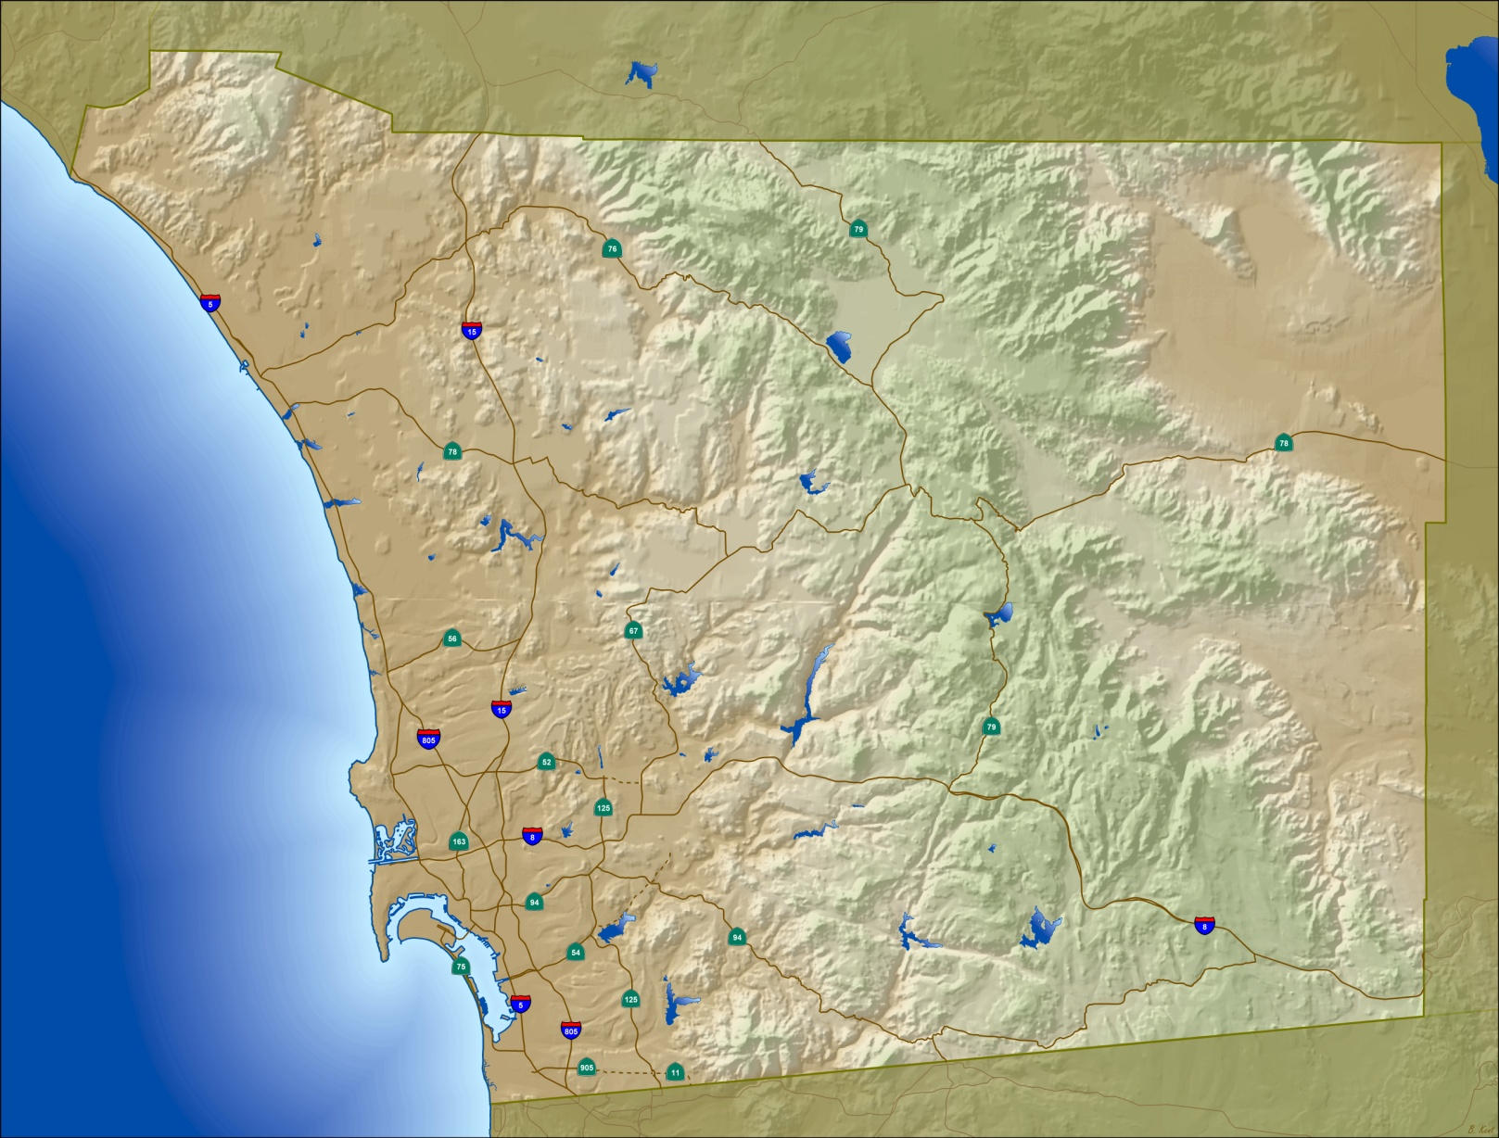
San Diego Regional GIS Council 2011 GIS Survey – Preliminary Results
Presented to SDRGC
April 13, 2011

Slide 2
2011 GIS Survey - Overview
Survey Focus
Agency GIS Staffing & Budgets
Current Data Usage – Regional vs. Agency Specific
Data Updates : Local-to-Regional Workflows
Software and Technology Usage
Survey Structure and Timeline
9 Sections
38 Questions
Survey Open March 7 - 25
53 Respondents
Current Status
Preliminary Results
Some “Holes” in Data – Some Follow Up Needed
Next Steps – Develop Final Survey Report
Identify Key “Action” Items

Slide 3
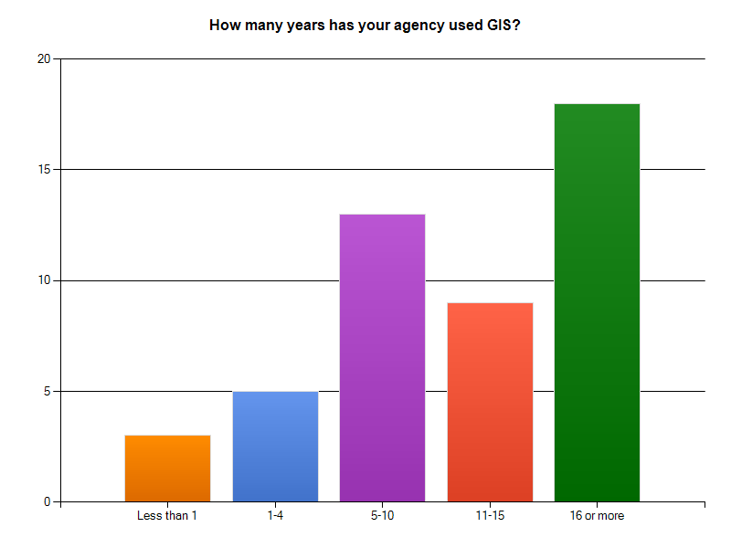
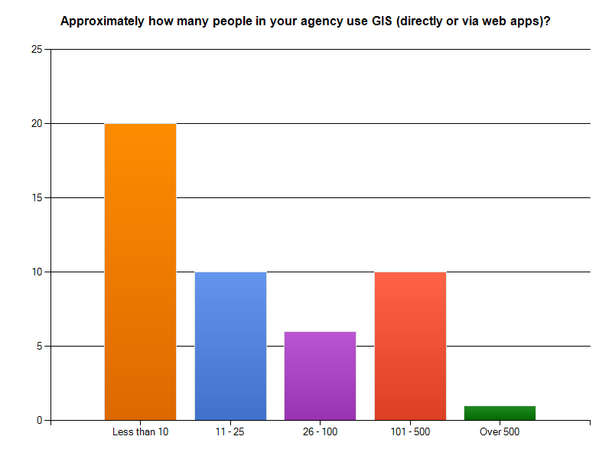
Key Findings
Mature GIS Community
Many Agencies with Low Number of GIS Users

Slide 4
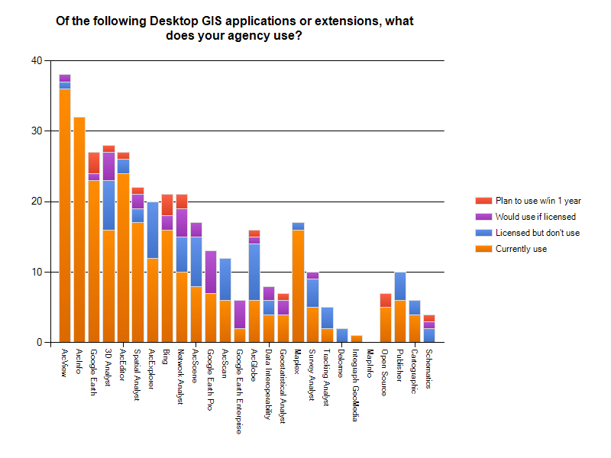
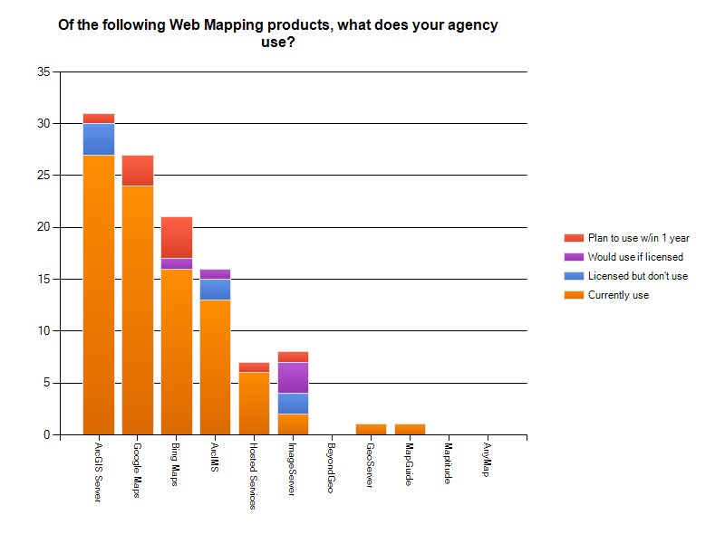
Software Use
Desktop Product Use
Web Map Server Software Use

Slide 5
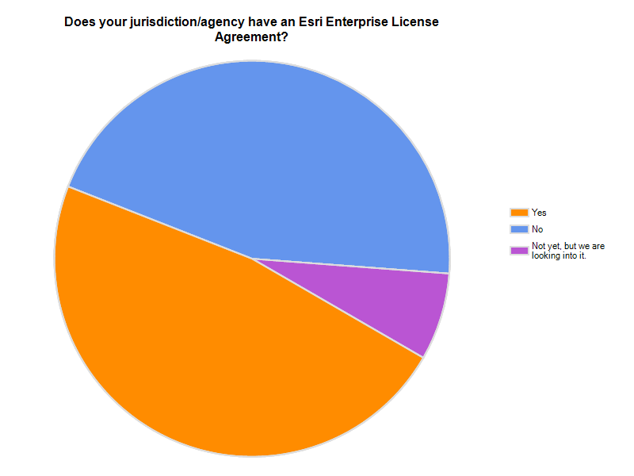
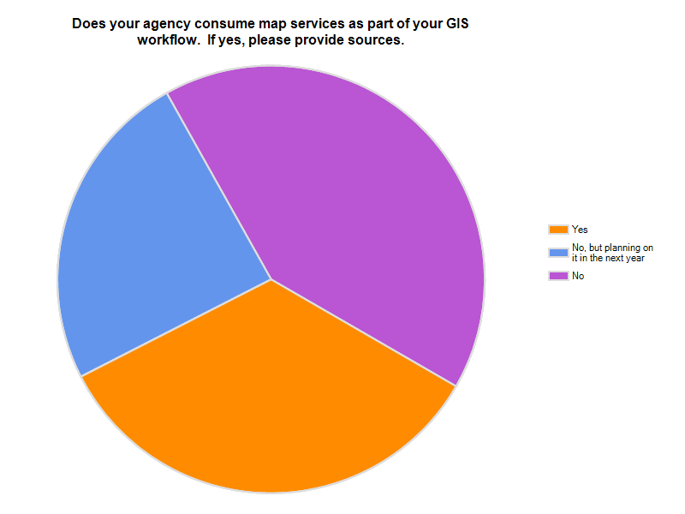
Software Use
Enterprise License Agreements
Web Map Services - Consumption

Slide 6
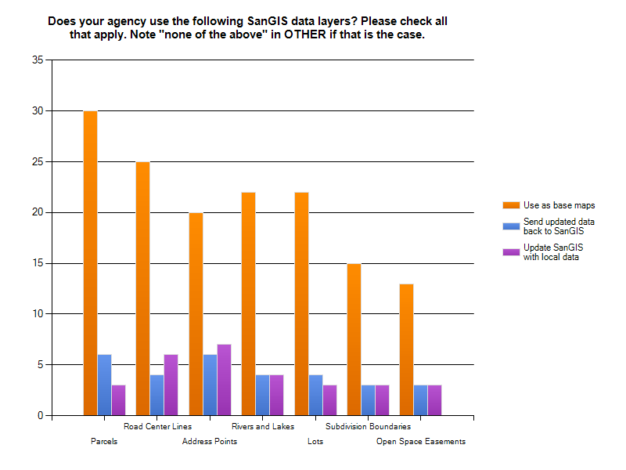
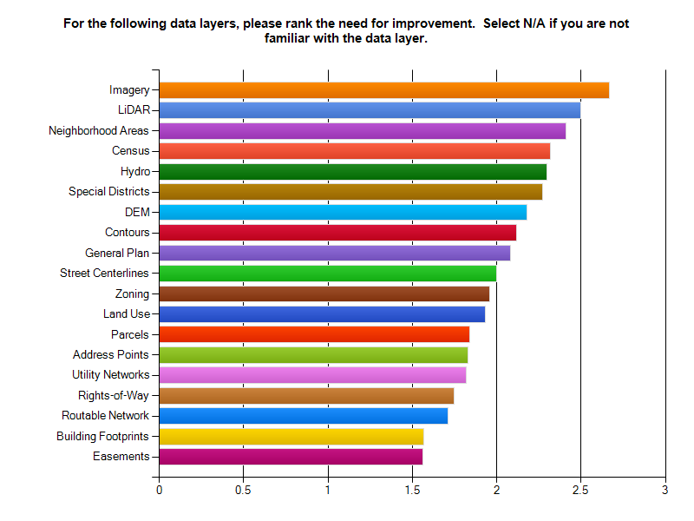
Regional GIS Data
SanGIS Data Usage & Updates
Data Improvement Needs

Slide 7
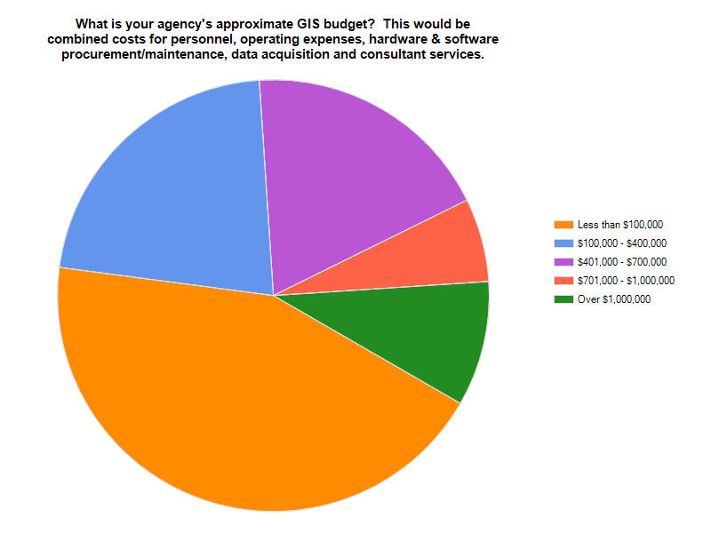
Agency GIS Budgets
Budget Ranges
Budget Wish Lists
$10k = Hardware, Software, Extensions, GPS Improvements
$100k = Above + Licensing, Analysts/Developers, GIS Program Development and Business Process Improvements
$500k = Above + Interest Staffing, ELA and Enterprise System Integration

Slide 8
2011 GIS Survey – Next Steps
Follow up with Specific Agencies
Compile Survey Results
Generate Survey Report
Publish to SDRGC Website
Define Key Action Items

Slide 9
Questions?
Notes:
9

