Slide 1
GIS Utilization at Padre Dam Municipal Water District
Colleen Larsen – GIS Coordinator
Yelena Granovskaya – GIS/CAD Specialist

Slide 2
About Padre Dam Municipal Water District
Service Area
Padre Dam provides water, wastewater, recycled water and recreation services to 100,000 residents in the San Diego suburbs of Santee, El Cajon, Lakeside, Flinn Springs, Harbison Canyon, Blossom Valley, Alpine, Dehesa and Crest
History
1955-formed by San Diego County Board of Supervisors to import water from the Colorado River. Originally named Rio San Diego Municipal Water District
1976-Renamed Padre Dam and merged with the Santee County Water District.
1980s-Acquired Alpine Highlands Water District and Crest Public Utility District.
The District is named for the Old Mission Dam in Mission Trails Regional Park, built by Spanish missionaries circa 1807.

Slide 3
Padre Dam MWD Statistics
Total Service Connections ~25,125
Potable & Sewer~13,600 Potable Only~9,700 Sewer Only~1,600 Recycled~225
Miles of Pipe
Water: 389 Sewer: 165 Recycled: 26
Santee Lakes
190 acres, 7 lakes, 300 campground sites, 10 cabins
GIS Staff
One GIS Coordinator
One GIS/CAD Specialists
Split time between Engineering & Enterprise GIS
What we work on…

Slide 4
CAD Mapping to GIS
Timeline
1985 – Board approves equipment to begin Engineering Computerization
1995/96 – Base & Utility Mapping begins
2002 – Moved from Integraph to ESRI
2013 – Upgraded to the Small Utility Enterprise License Agreement
2015 – ESRI Enterprise Advantage Program

Slide 5
The Dissemination of GIS Data to all Padre Dam Employees
Small Utility Enterprise License Agreement
Meter counts: 10,001-50,000
Unlimited licensing for most ESRI software (Step 1)
ArcGIS Desktop installed on Operations, Engineering, Customer Service and Public Information PC’s.
Most staff have been trained to pan, use the address locator, zoom to XY coordinates, find, query, ID in order to either get information needed for their jobs and/or to print maps.
Access to web based virtual campus/Instructor led training.
ArcGIS Online (Step 2 – Mobile)
Create organizational web maps
Accessed by Duty Tablets , Manager iPads, Smart Phones
Create public facing web maps

Slide 8
Desktop Application

Slide 9
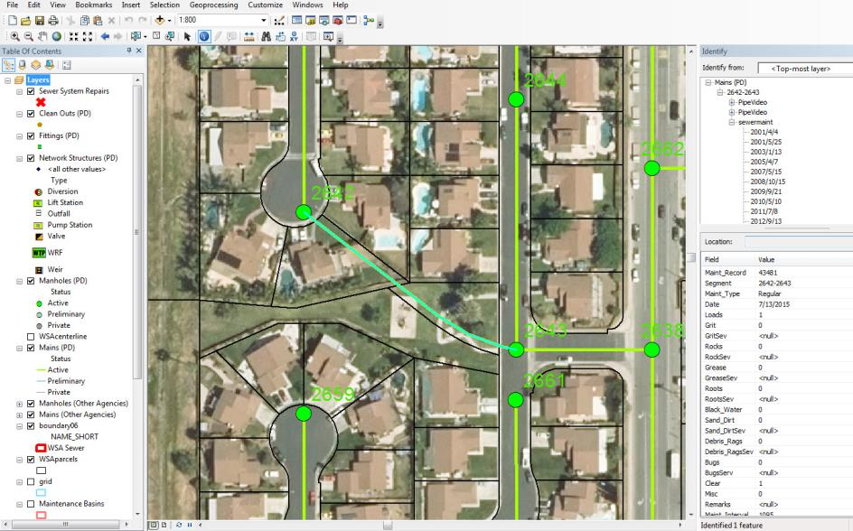
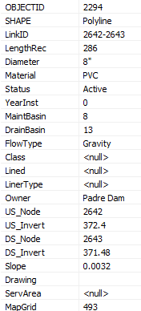

Slide 12
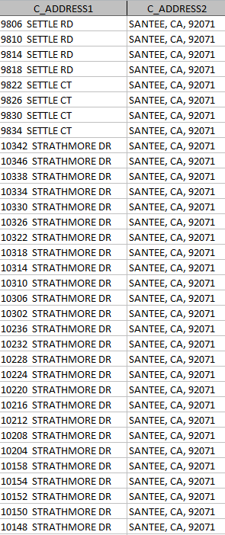

Slide 14
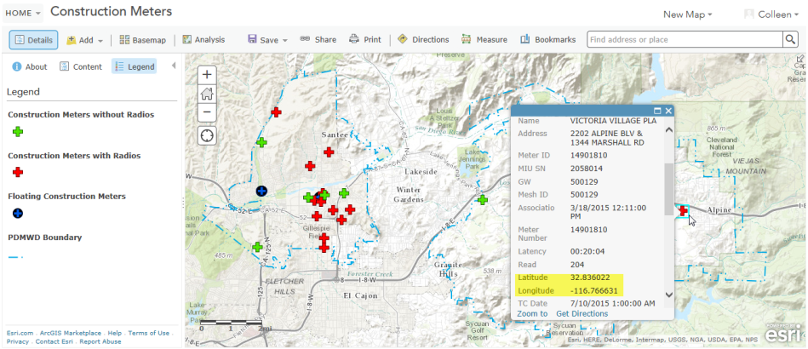

Slide 16
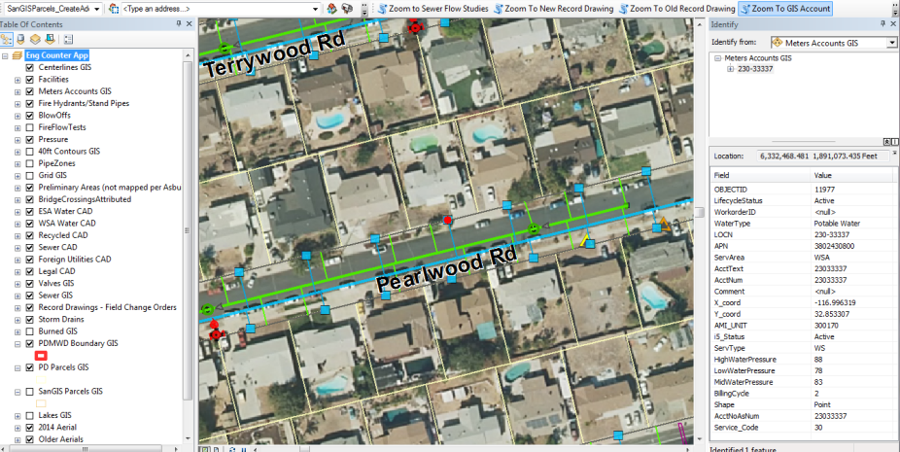

Slide 18
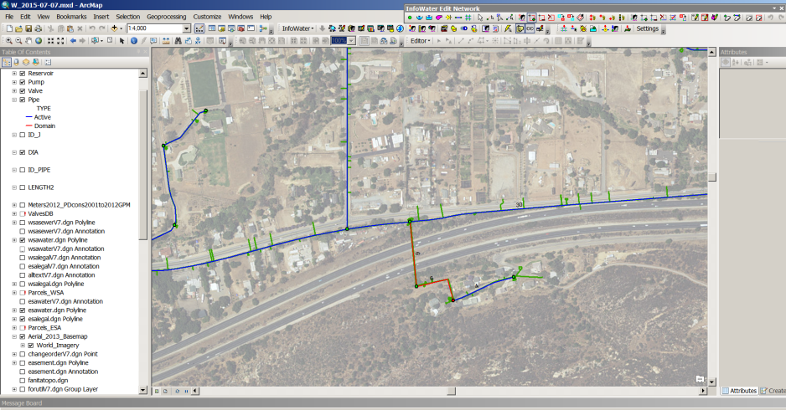
Modeling Software

Slide 19
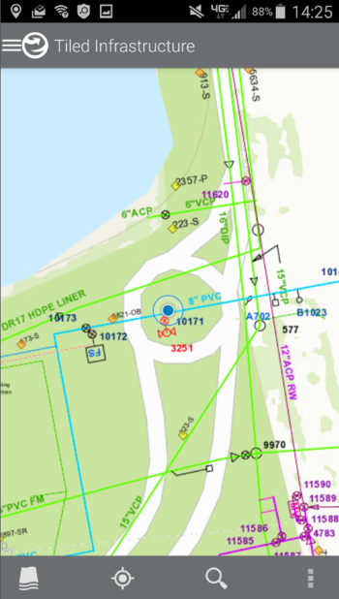
Finding Assets in the Field

Slide 22
ArcGIS Online Applications
Organizational applications
Tiled Infrastructure
Emulates 200’ scale map books (cached tile layers)
Open As-builts and field change orders
With location services turned on via tablets or smart phones, easy to find assets in the field.
Construction Meters
Helps meter readers find construction meters out in the field
Assists Development Services and Customer Service in the decision making process during the application process.
Status of Development Services Projects Story Map
Used Map Series Accordion Layout
Shared within organization for managers to know status of Development Projects.
Operations Yard Improvement Project Story Map (PDF)
Used Map Tour and Map Journal
Updated weekly to show progress

Slide 23
ArcGIS Online Applications
Public Facing applications
Padre Dam MWD Division Locator
Used parcel template
User can search by address or zoom to location to see their Board of Director and Division area.
Development Services Current Projects Story Map
Used the Map Tour and Map Journal templates
Displays current project locations, summary of project and photos
Potable Construction Meter Request
Embedded Web Map
User zooms into map to find nearest Fire Hydrant Asset ID
Water Efficient Landscapes
Used the Map Tour template
Highlights water efficient landscaping throughout our District

Slide 25
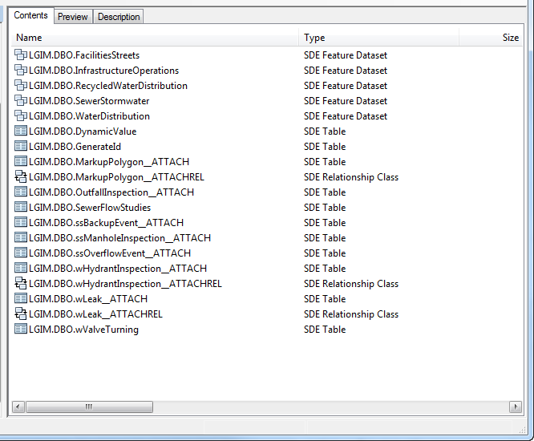

Slide 26
Future Goals
Leveraging the EEAP to help us reach these goals faster to create efficiencies.
Informational dashboards
Operational and Executive
More integration with our other databases
Financial Information System (FIS)
Customer Information System (CIS)
Supervisory Control and Data Acquisition (SCADA)
Electronic Document Management System (EDMS)
Enterprise Asset Management (EAM)
Completion of geometric network for tracing
Editing and capturing data in the field
Streamline Fireflow Requests
CIP Story Map

Slide 27
Questions?

