Slide 2
City of San Marcos Enterprise GIS
Upgrade and Deployment| January 10, 2018

Slide 3
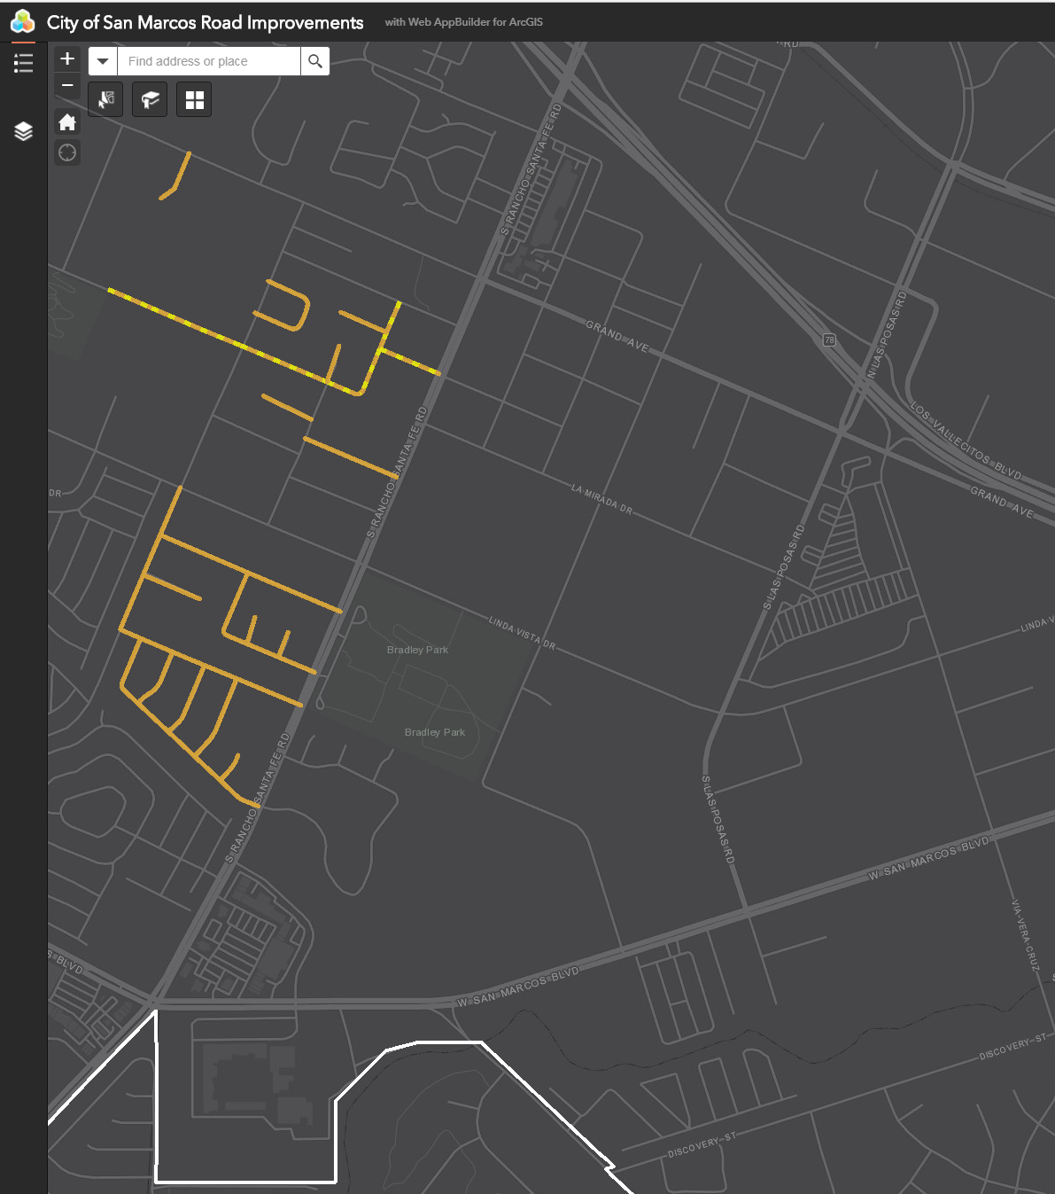
Phase 1: Upgrade and Migration
ESRI Professional Services, Upgrade Major Components, Migrate Data

Slide 4
Personnel Resources
City of San Marcos GIS Staff: 1 FTE + 1 PTE
Solution: Esri Professional Services
Augment existing GIS/IT capabilities and staffing during on-site “Jumpstart” period
Substantial preparation required by San Marcos GIS/IT
Notes:
1 FTE – limited resources
ESRI Professional services to provide assistance and knowledge transfer as part of Enterprise Jumpstart package.

Slide 5
Major Components
ArcGIS Desktop: Upgrade to v10.5.1
ArcGIS Server: Upgrade to v10.5.1
SQL Server: Upgrade to 2014 Standard
Migrate all components to Virtual Servers (running VMWare)
ArcGIS Server Site
Database Server (SQL)
GIS project files, data
Enable SSL on map services
SSL Certificate setup by Network Admin
Notes:
ArcGIS Desktop: various versions previously running to maintain 10.1 GDB
ArcGIS Server: previously 10.3.1
SQL Server: previously 2008R2 Express
Virtual Environment: modernized network architecture rolled out during Phase 1 and 2 of IT Strategic Vision
Applications: Upgrade and build on latest versions running on new IT architecture
SSL: Security advantages are clear. Enhanced capability also presents new challenges. SSL certificate acquired/configured by IT
Enterprise Applications: Asset Management, Land Management
Custom Applications: GeoScene (WebGIS Solutions) – particularly challenging with SSL-enabled services

Slide 6
Migrate ArcGIS Server Site
Map Services: re-source and re-publish map services
Best practices from ESRI Professional Services
Security: Roles and permissions, configure site security
Migrate caches and source data for imagery services
200+GB source data, data transfer run overnight
76GB cache tiles
Notes:
Map Services: re-source all MXD’s to point to new geodatabase
ArcGIS Server site security updates: Cleanup Windows AD users and roles, PSA account not tied to Windows AD user, update IP address of domain controller to work with updated Identity Store (Windows AD)

Slide 7
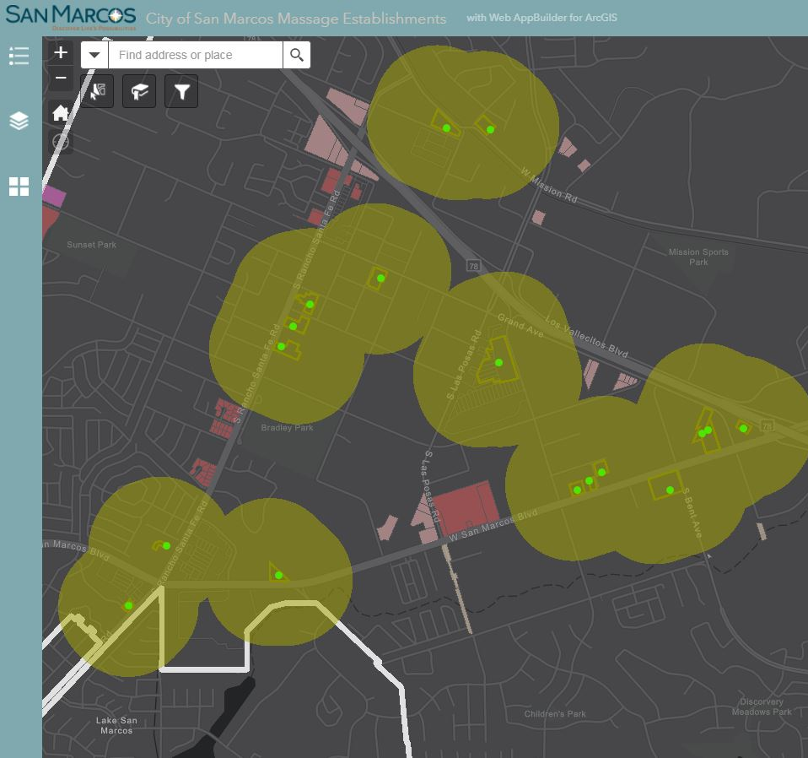
Phase 2: Maps and Applications
Configure and deploy updates on updated network infrastructure
Notes:
Migration complete with assistance from ESRI Professional Services.
Link Enterprise GIS to existing enterprise applications to maximize benefits and prepare users for future updates.
All network and application updates fit into the Business Continuity Plan formulated by the San Marcos IT Team.
Directions for updating Sample image – Communications Dept.
This image can be replaced by another .jpg image
keep file size under 1mb once you place in page,
Right click on the image and “Arrange” > “Send to Back”

Slide 8
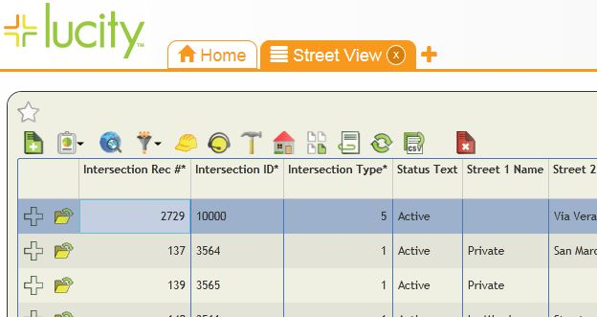
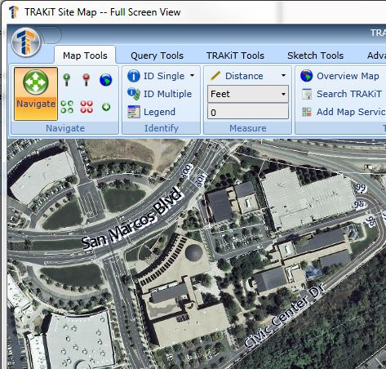
Enterprise Application Configurations
Lucity
Asset Management (Public Works)
TRAKiT
Land Management
TRAKiT (CRW/Fios/Sungard/Superion)
Notes:
Lucity: map services for Lucity Web/Mobile
TRAKiT: Vendor to update custom script for LandTRAK updates (import from GIS). Support is not easily reachable.
Updated configurations in progress as of 10Jan2018

Slide 9
San Marcos GeoScene
Custom web mapping application by WebGIS Solutions
Application updates required to consume secured services
Configuration updates in progress to preserve functionality (Street View, Print, etc)
Planned functionality and user experience enhancements
Notes:
GeoScene web map: JS/HTML5
Security updates required to preserve functionality such as Google Street View (Google account, API Key required in application code)
Internal and public-facing versions of web map to leverage security benefits of SSL environment.
SSL environment will require additional customization for necessary changes to internal and public-facing application.

Slide 10
Phase 3: Future Vision
Maximize investment in Enterprise GIS technology
Notes:
Future vision for application of new technology to organizational business practices.
Directions for updating Sample image – Communications Dept.
This image can be replaced by another .jpg image
keep file size under 1mb once you place in page,
Right click on the image and “Arrange” > “Send to Back”

Slide 11
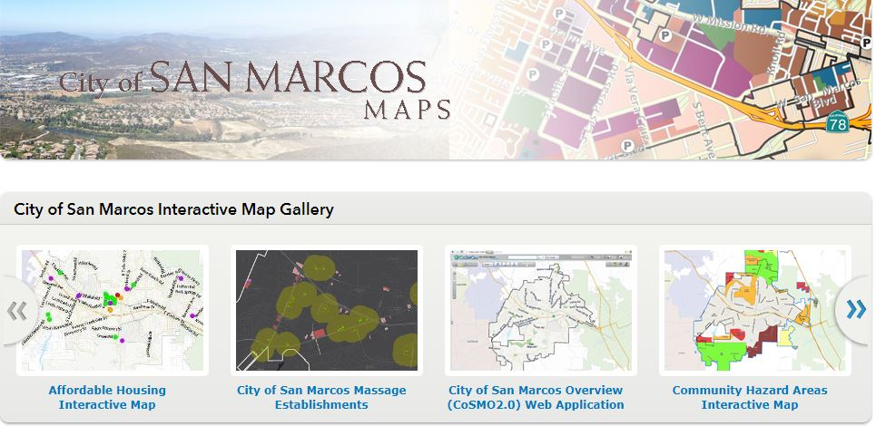
GIS Modernization: Web, Mobile, Desktop
Web: ArcGIS Online, GeoScene, web maps
Mobile: Collector for ArcGIS, Survey 123
ArcGIS Pro: next-generation desktop
Notes:
ArcGIS Online: EOC, maps for public consumption, story maps, web mapping applications for city projects
Mobile: Enable users to collect and edit data in the field
ArcGIS Pro: In-depth training for GIS professionals to achieve proficiency in new technology.

Slide 12
ArcGIS Enterprise in the Organization
DATA, DATA, DATA!
Training for GIS staff (ArcGIS Enterprise, Online, Pro), end users
Leverage technology to modernize business processes
Explore new technology capabilities (such as UAS)
Notes:
Training has already begun for ArcGIS Pro. Admittedly, this process will take some time – move as fast as possible for a local government agency.
As proficiency of GIS professionals increases, seize opportunities to incorporate into enterprise applications and enhance workflows.

Slide 13
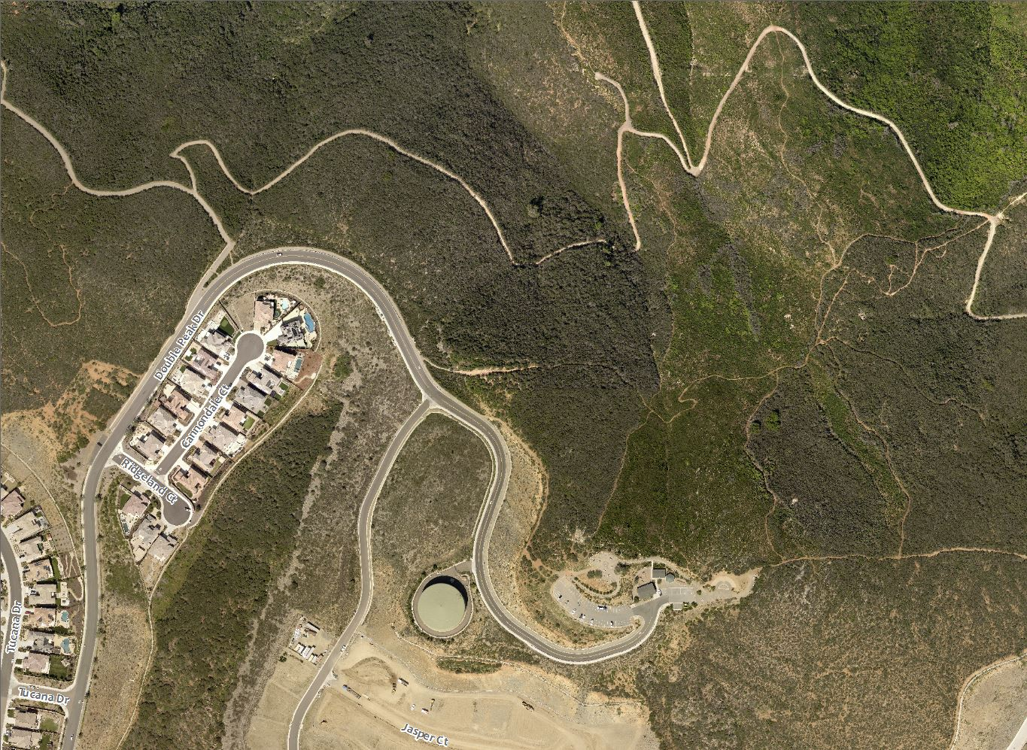
Questions?
Notes:
UAS Partnership?
ESRI Enterprise?
Migration plan for ArcGIS Pro?
ESRI Professional Services?

