Slide 1
ArcGIS PRO
MIGRATION, SUCCESSES, AND LESSONS LEARNED

Slide 2
Introduction
Current
Geospatial Information Database Administrator/ Environmental Planner with San Elijo Lagoon Conservancy
Background
Lecturer and Researcher at the University of Florida, College of Design Construction and Planning
Have been using ArcGIS Pro since 2014
Notes:
San Elijo Lagoon Conservancy: Who we are:
Our three-pronged business model is the foundation of everything we do. Through our clearly defined elements, we’ve created an organization committed to driving a passion for nature, for all.
Experiences
Conservation
Consultancy
We deliver experiences to drive a passion for nature, we build conservation projects that people can get behind to protect nature, and we are taking our 20 years of land management and watershed restoration to begin consulting with local government organizations and others.

Slide 3
Today’s Discussion
Not how to make maps in Pro
Why we made the transition
QAQC Process used to migrate
Successes
Lessons Learned (Top 7)
Notes:
Key points include why the organization made the transition to Pro, QAQC processes utilized during the migration, successes after the transition and key lessons learned during the process.

Slide 4
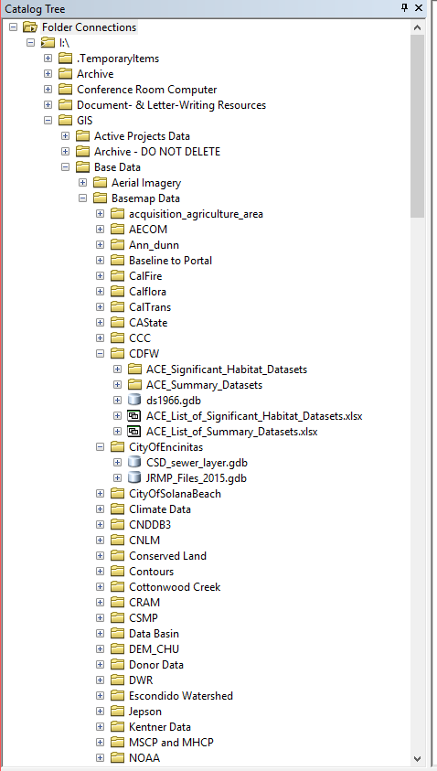
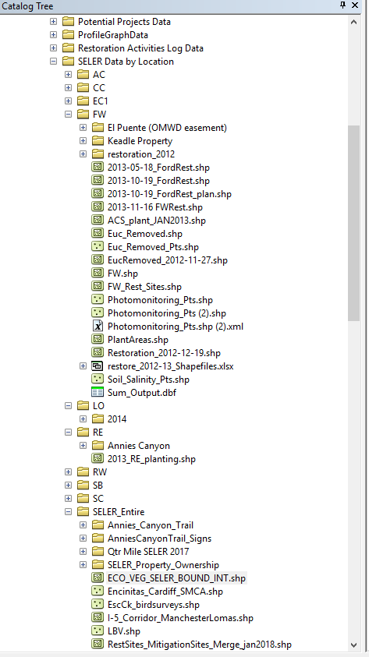
Why we made the transition
SELC’s Information Systems Overview
Abysmal database management structure
Notes:
No Metadata
No Project Management (active projects and archiving)

Slide 5
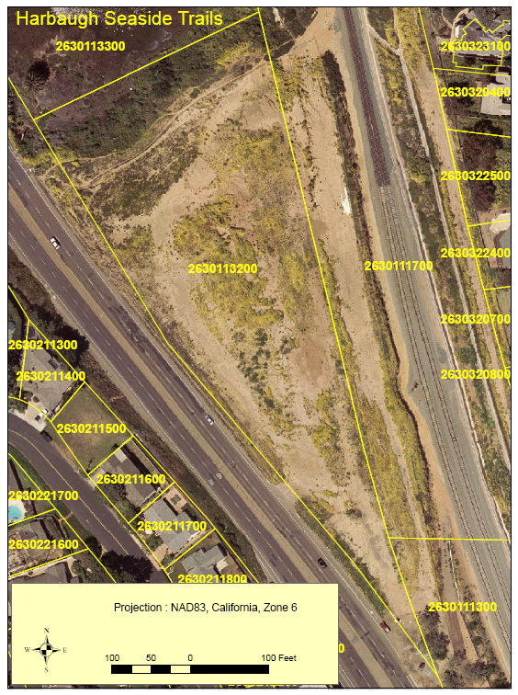
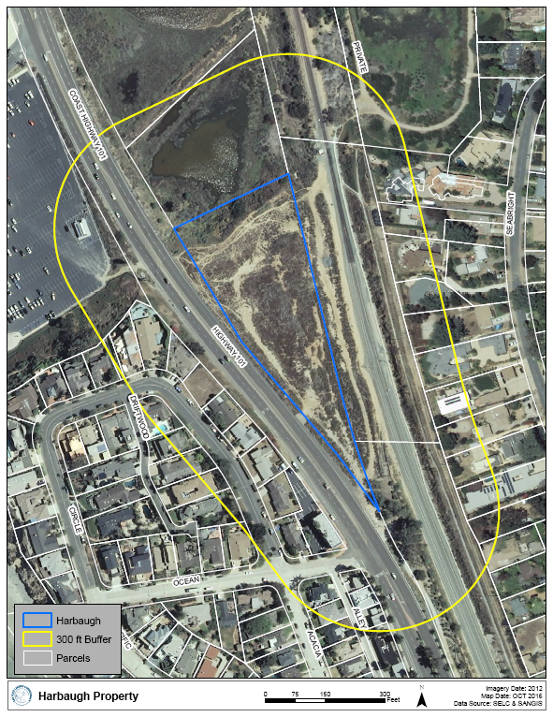
Why we made the transition
SELC’s Information Systems Overview
Abysmal database management structure
No cartographic consistency between map products
Opportunity
ESRI non-profit incentives
My familiarity with Pro
Notes:
Breakdown of the ArcGIS Online offerings within the ESRI Nonprofit Program:
• ArcGIS Desktop Nonprofit Bundle: (ArcGIS Pro & ArcMap advanced, single-use, 10 most popular extensions, and 1 ArcGIS Online named user + 100 service credits): $100/bundle
• ArcGIS Online Nonprofit Named Users:
• Level 2 named user (contributor) + 1,000 service credits: $100/user
• Level 1 named user (viewer): $50/user

Slide 6
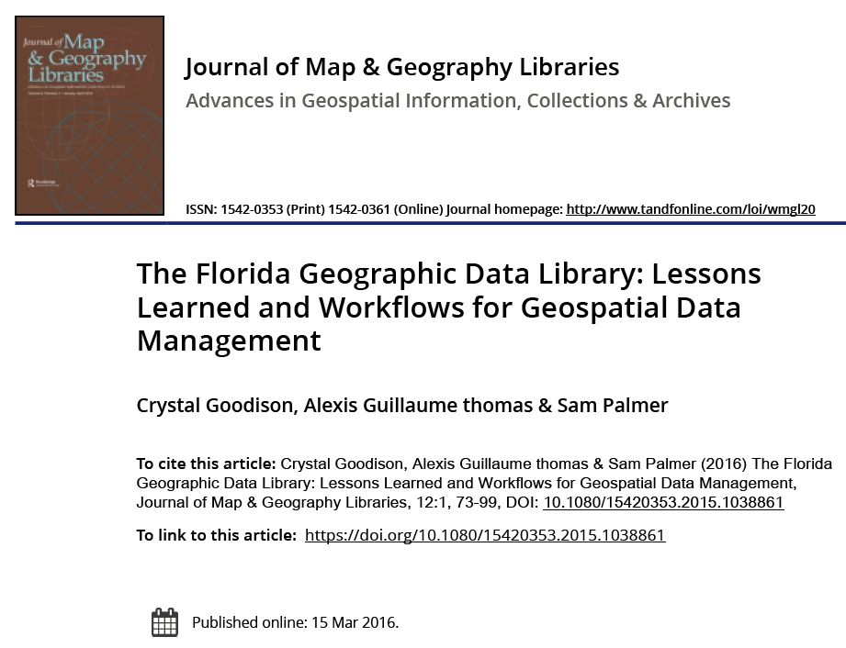
SELC QAQC Process (Adapted from FGDL Workflow)
Examine
Independent Review of layer:
Check data consistency
Check attribute information
Check metadata
Load
Export and Load data to appropriate file geodatabases
Change file name to standard format
Check for geometry errors
Optimize data for display and analysis (create indexes, confirm symbology, create representation and/or style)
Set database privileges
Enter
Make data available for download via a portal or metadata explorer
Set database privileges
Independent confirmation of layer in Portal
Create backups
Maintain
Periodic Updates
Check data consistency
Change file name and update citation
QAQC Process used to migrate
Timeline
Updated the Server Structure and Reconstructed Data using QAQC Process
Setup a system of tags for quick searches (Tag dictionary)
Designed standard symbology
Migrated all files to ArcGIS Online
Set up personalized templates and layouts for projects
Notes:
In 2001, the GeoPlan Center was awarded an NSDI Grant to convert FGDL format metadata to the FGDC’s Content Standard for Digital Geospatial Metadata, which was the then-current national standard for documenting geographic data.
The process has created a more efficient workflow that saves time and reduces confusion, while improving data organization, management, currency, and confidence in data quality.
“Versioning” methodology was crucial to our work

Slide 7
QAQC Process used to migrate
Timeline
Updated the Server Structure and Reconstructed Data using QAQC Process
Setup a system of tags for quick searches (Tag dictionary)
Designed standard symbology
Migrated all files to ArcGIS Online
Set up personalized templates and layouts for projects
Notes:
Build File Structure and Hierarchy (name: theme_yyyymmm)
File name: “What_(Where_)_When”
What = interpretable description of what the file contains
When = Timestamp of when the file was most recently updated, written in ‘mmmyyyy’
(Where_) = only include this if it is necessary to distinguish where the data is from or to further refine the description to distinguish it from another file with a similar name
Example 1: Boundaries for All Cities in San Diego County
“cityboundary_all_jul2011”
Example 2: City Boundary for Encinitas
“cityboundary_encinitas_feb2012”
4. All file names are lower case
Benefit
1. Improves wayfinding and descriptions in arcCatalog
2. Creates a standard for file interpretation and updating
“Reference Layers” commonly used layers receive standard symbology before being uploading to ArcGIS Online
ArcGIS is ready for “project-based” workflows; not yet up to speed for the enterprise environment

Slide 8
Successes
217 reconstructed layers
2 Geodatabases
Versioning capabilities
Drag-and-use mapping through Portal
5 Layout Templates

Slide 9
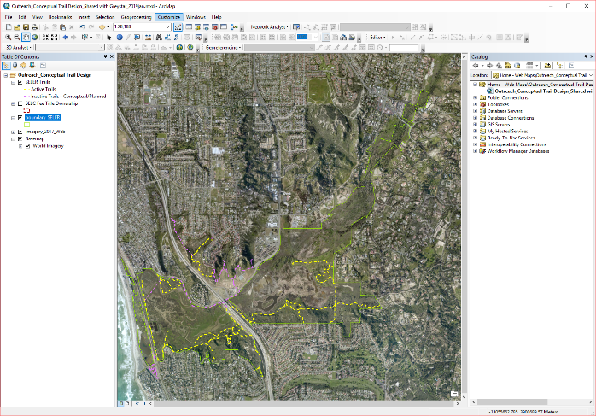
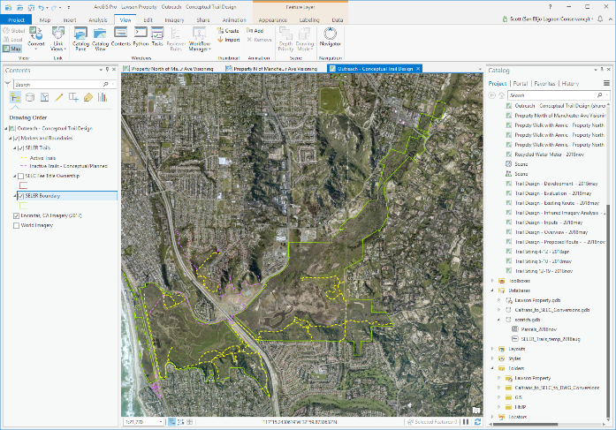
ArcMap to ArcGIS Pro:
Top 7 Thing to know
Old vs. New Layouts
View-based Tabs and Toolbars
Accessing the Portal
ArcCatalog is Still a Mainstay
Sharing Maps and Data
Educate Your Personnel
Notes:
Old vs. New Layouts
New Contents and Catalog Pane
Multiple Maps and Layouts within a single Project
Tasks appear in Catalog as they are created
“Create a project folder and file geodatabase just to use it” (solved)
View-based Tabs and Toolbars
One of the biggest challenges is transitioning to view-based tabs. ESRI often describes this as an issue of finding familiar commands and following familiar workflows. In Pro, as you switch between the Edit, View, Layout, Design tabs- the toolbars change. This can make your work smoother, but for many getting familiar with the on-the-fly toolbar change can be a headache.
Cartography in Pro is infinitely better than ArcMap. But, with so many options available to fine tune your map the learning curve is very high. It can take a long time to learn to browse through different options, utilize the hamburgers, and manage things like the legend and label properties.
Accessing the Portal
In ArcGIS Pro, the Portal really is the medium between a project’s content and ArcGIS Online.
In ArcMap, ArcGIS Online content has been accessible through an outdated popup widget. In Pro, the portal appears and functions as a secondary catalog pane.
ArcCatalog is Still a Mainstay
Catalog functionality isn’t fully supported in Pro yet.
Ability to manage your server and individual file metadata is far simpler in Catalog; it is the single action that requires use of our desktop software.
Sharing Maps and Data
Sharing maps and data is very complicated due to restrictions with backwards compatibility. There are work-arounds, but they take getting used to.
Educate Your Personnel
ArcMap Retirement 2025 and counting…
Bugs, Inconveniences, and Missing Capabilities - You’ll often find that that ESRI support defaults to “look forward to that capability in Pro 2.X.” Great, but that doesn’t help me now
Encourage education of your personnel, whether at UC sessions or through ESRI’s online learning
To GIS Managers, I would recommend leading this process. If you think transitioning workflows to Pro will be hard, think how much harder it will be if each of your technicians has their own approach to using Pro. Educating your staff will help ensure you maintain communication about workflows.

Slide 10
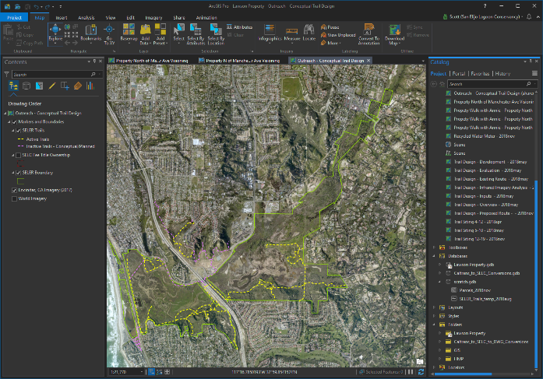
ArcMap to ArcGIS Pro:
Top 7 Thing to know
Old vs. New Layouts
View-based Tabs and Toolbars
Accessing the Portal
ArcCatalog is Still a Mainstay
Sharing Maps and Data
Educate Your Personnel
Notes:
Old vs. New Layouts
New Contents and Catalog Pane
Multiple Maps and Layouts within a single Project
Tasks appear in Catalog as they are created
“Create a project folder and file geodatabase just to use it” (solved)
View-based Tabs and Toolbars
One of the biggest challenges is transitioning to view-based tabs. ESRI often describes this as an issue of finding familiar commands and following familiar workflows. In Pro, as you switch between the Edit, View, Layout, Design tabs- the toolbars change. This can make your work smoother, but for many getting familiar with the on-the-fly toolbar change can be a headache.
Cartography in Pro is infinitely better than ArcMap. But, with so many options available to fine tune your map the learning curve is very high. It can take a long time to learn to browse through different options, utilize the hamburgers, and manage things like the legend and label properties.
Accessing the Portal
In ArcGIS Pro, the Portal really is the medium between a project’s content and ArcGIS Online.
In ArcMap, ArcGIS Online content has been accessible through an outdated popup widget. In Pro, the portal appears and functions as a secondary catalog pane.
ArcCatalog is Still a Mainstay
Catalog functionality isn’t fully supported in Pro yet.
Ability to manage your server and individual file metadata is far simpler in Catalog; it is the single action that requires use of our desktop software.
Sharing Maps and Data
Sharing maps and data is very complicated due to restrictions with backwards compatibility. There are work-arounds, but they take getting used to.
Educate Your Personnel
ArcMap Retirement 2025 and counting…
Bugs, Inconveniences, and Missing Capabilities - You’ll often find that that ESRI support defaults to “look forward to that capability in Pro 2.X.” Great, but that doesn’t help me now
Encourage education of your personnel, whether at UC sessions or through ESRI’s online learning
To GIS Managers, I would recommend leading this process. If you think transitioning workflows to Pro will be hard, think how much harder it will be if each of your technicians has their own approach to using Pro. Educating your staff will help ensure you maintain communication about workflows.

Slide 11
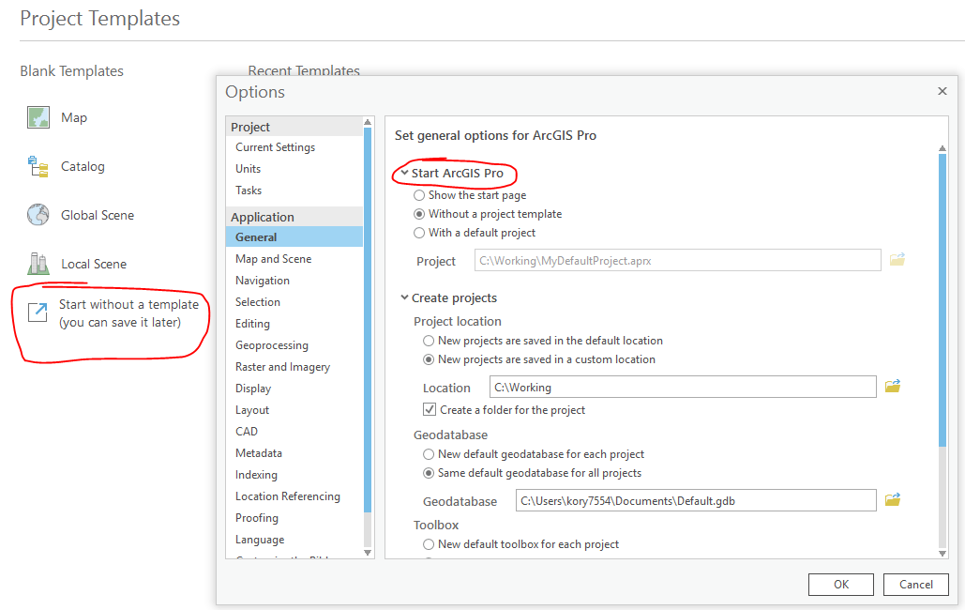
ArcMap to ArcGIS Pro:
Top 7 Thing to know
Old vs. New Layouts
View-based Tabs and Toolbars
Accessing the Portal
ArcCatalog is Still a Mainstay
Sharing Maps and Data
Educate Your Personnel
Notes:
Old vs. New Layouts
New Contents and Catalog Pane
Multiple Maps and Layouts within a single Project
Tasks appear in Catalog as they are created
“Create a project folder and file geodatabase just to use it” (solved)
View-based Tabs and Toolbars
One of the biggest challenges is transitioning to view-based tabs. ESRI often describes this as an issue of finding familiar commands and following familiar workflows. In Pro, as you switch between the Edit, View, Layout, Design tabs- the toolbars change. This can make your work smoother, but for many getting familiar with the on-the-fly toolbar change can be a headache.
Cartography in Pro is infinitely better than ArcMap. But, with so many options available to fine tune your map the learning curve is very high. It can take a long time to learn to browse through different options, utilize the hamburgers, and manage things like the legend and label properties.
Accessing the Portal
In ArcGIS Pro, the Portal really is the medium between a project’s content and ArcGIS Online.
In ArcMap, ArcGIS Online content has been accessible through an outdated popup widget. In Pro, the portal appears and functions as a secondary catalog pane.
ArcCatalog is Still a Mainstay
Catalog functionality isn’t fully supported in Pro yet.
Ability to manage your server and individual file metadata is far simpler in Catalog; it is the single action that requires use of our desktop software.
Sharing Maps and Data
Sharing maps and data is very complicated due to restrictions with backwards compatibility. There are work-arounds, but they take getting used to.
Educate Your Personnel
ArcMap Retirement 2025 and counting…
Bugs, Inconveniences, and Missing Capabilities - You’ll often find that that ESRI support defaults to “look forward to that capability in Pro 2.X.” Great, but that doesn’t help me now
Encourage education of your personnel, whether at UC sessions or through ESRI’s online learning
To GIS Managers, I would recommend leading this process. If you think transitioning workflows to Pro will be hard, think how much harder it will be if each of your technicians has their own approach to using Pro. Educating your staff will help ensure you maintain communication about workflows.

Slide 12
Thanks for listening!
Questions?

